Slide 1
Informatics 121 Software Design I
Lecture 14
Duplication of course material for any commercial purpose without the explicit written permission of the professor is prohibited.

Slide 2
Announcement
There will be discussion Friday!

Slide 3
Today’s lecture
Expert behaviors
Design methods
Design studio 3

Slide 4
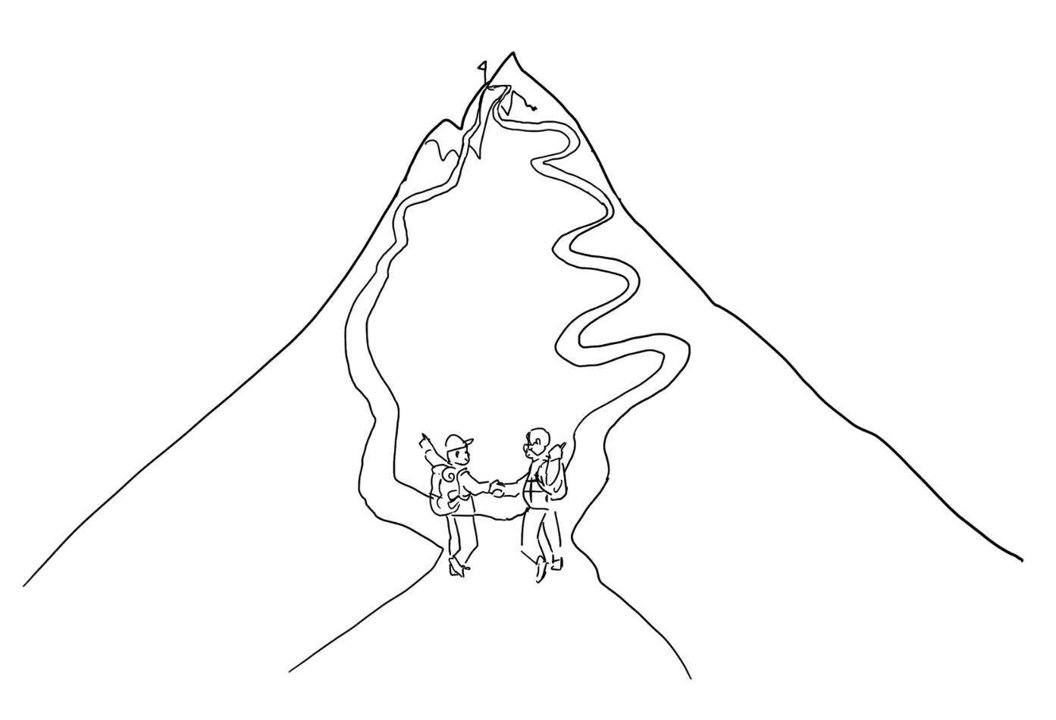
Experts agree to disagree

Slide 5
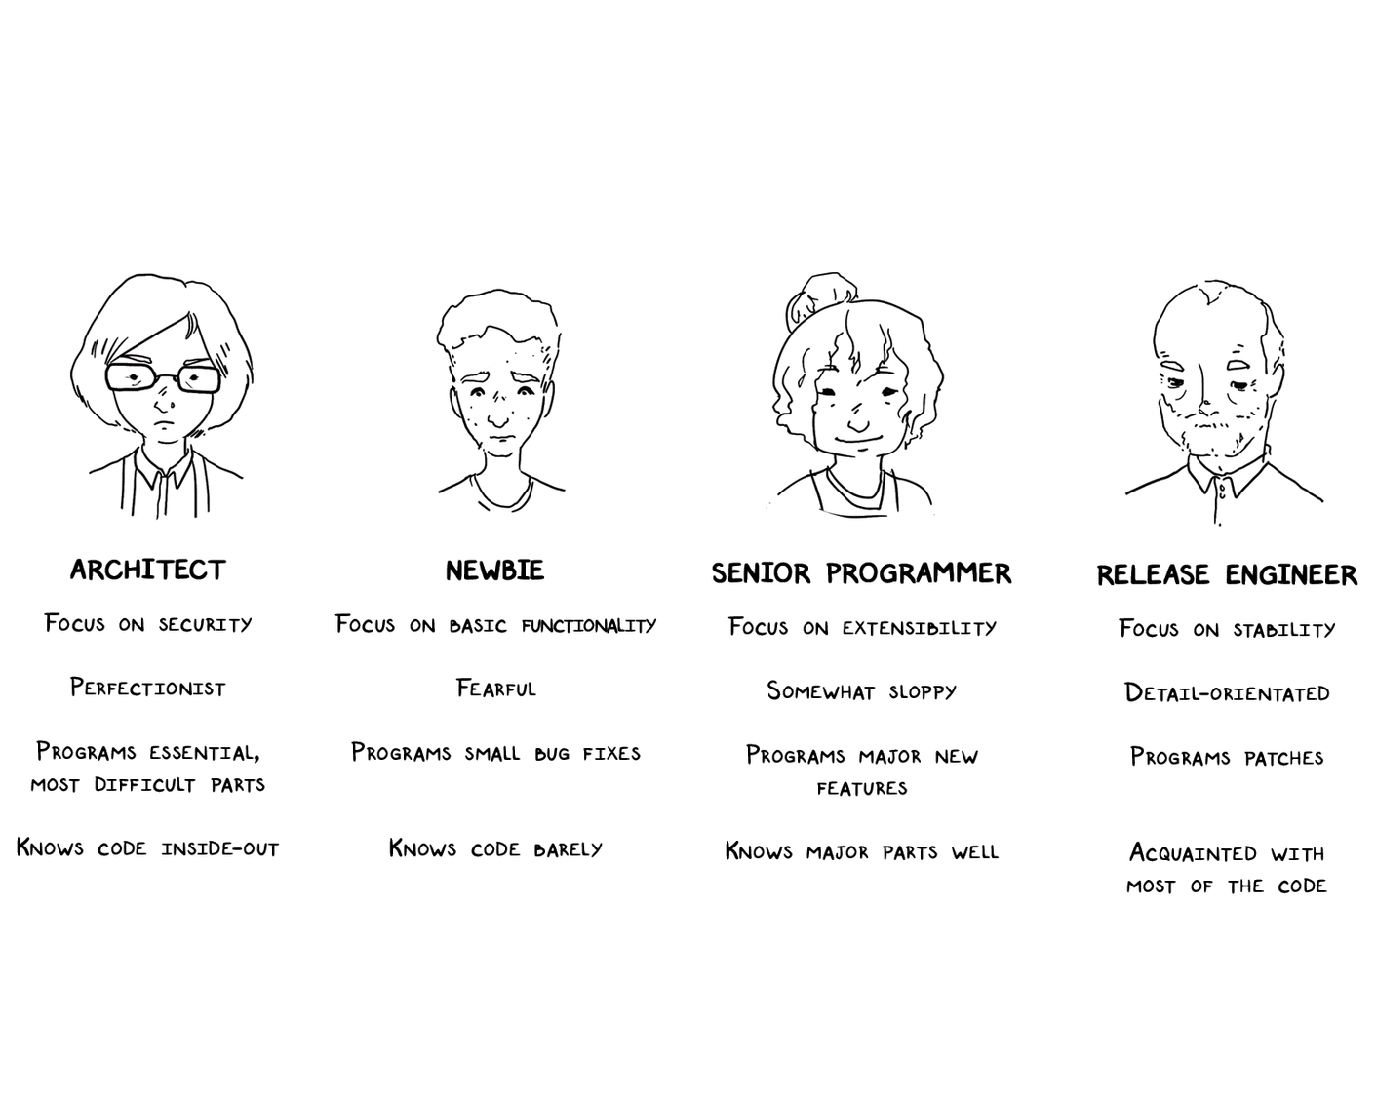
Experts use design methods (selectively)

Slide 6
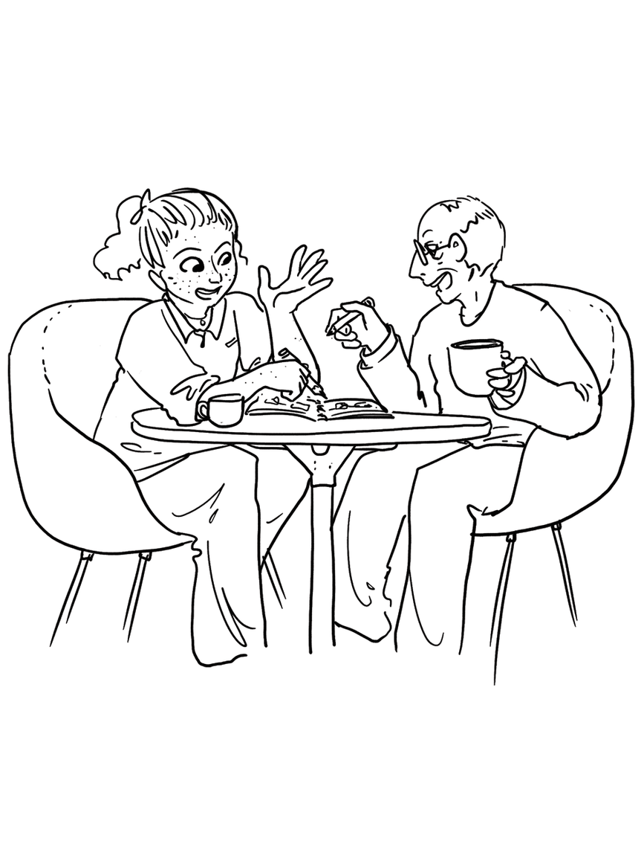
Experts externalize their thoughts

Slide 7
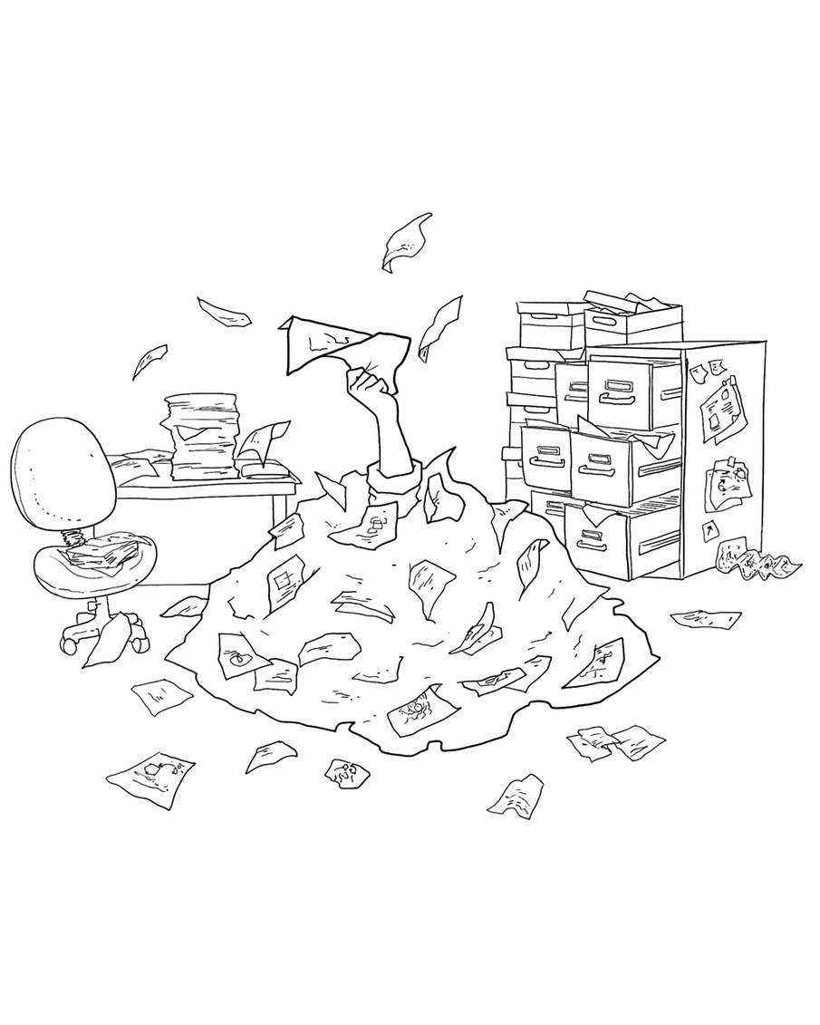
Experts keep sketches

Slide 8
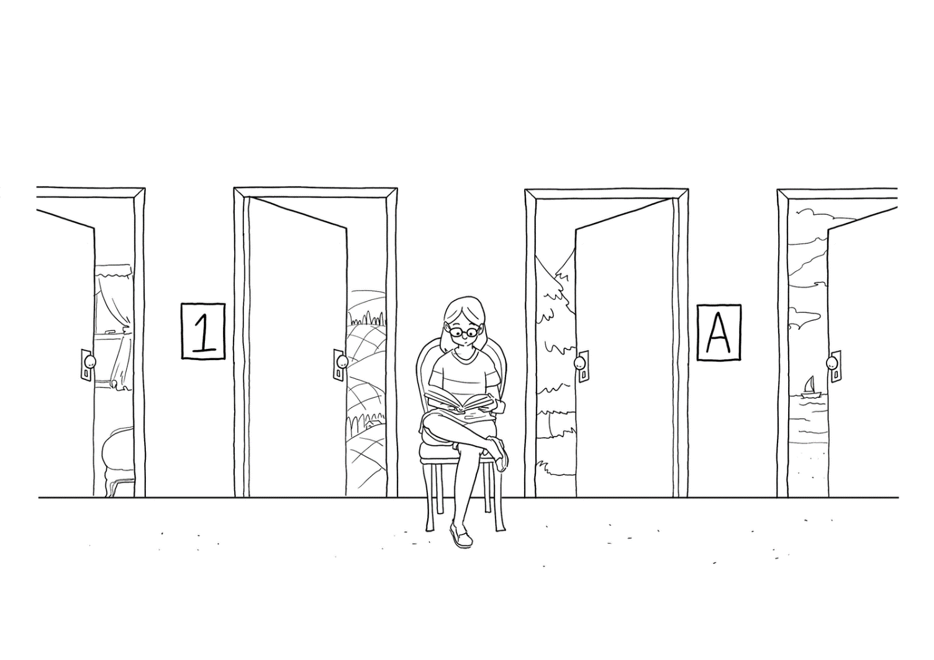
Experts keep options open

Slide 9
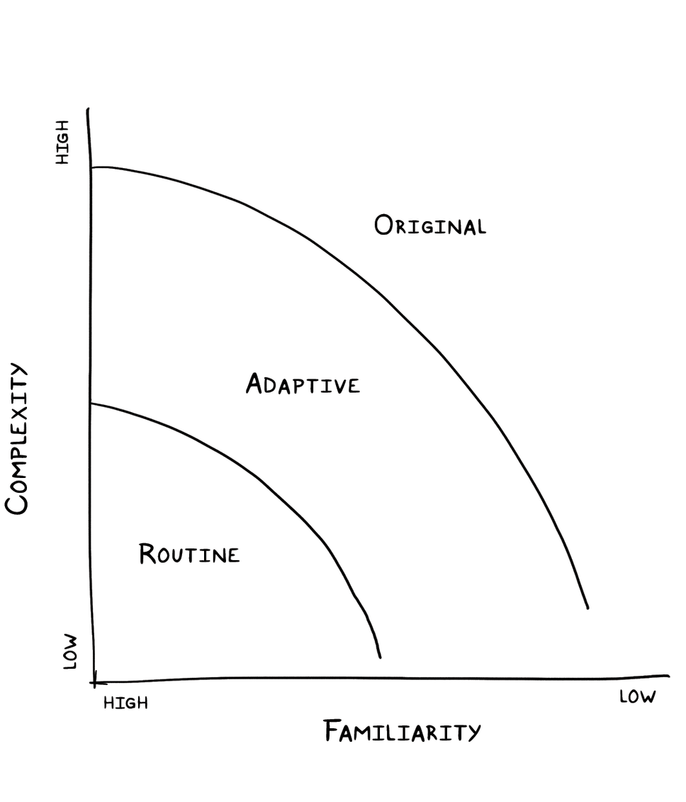
Experts adjust to the degree of uncertainty present

Slide 10
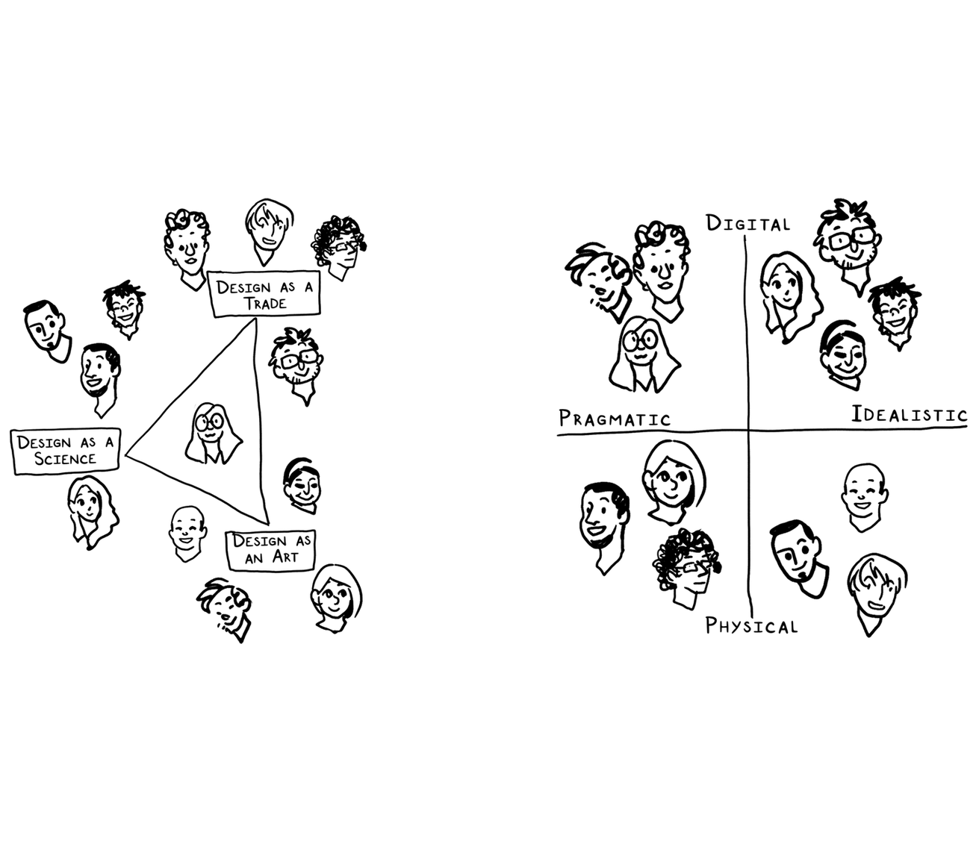
Experts explore different perspectives

Slide 11
Experts play the fool

Slide 12
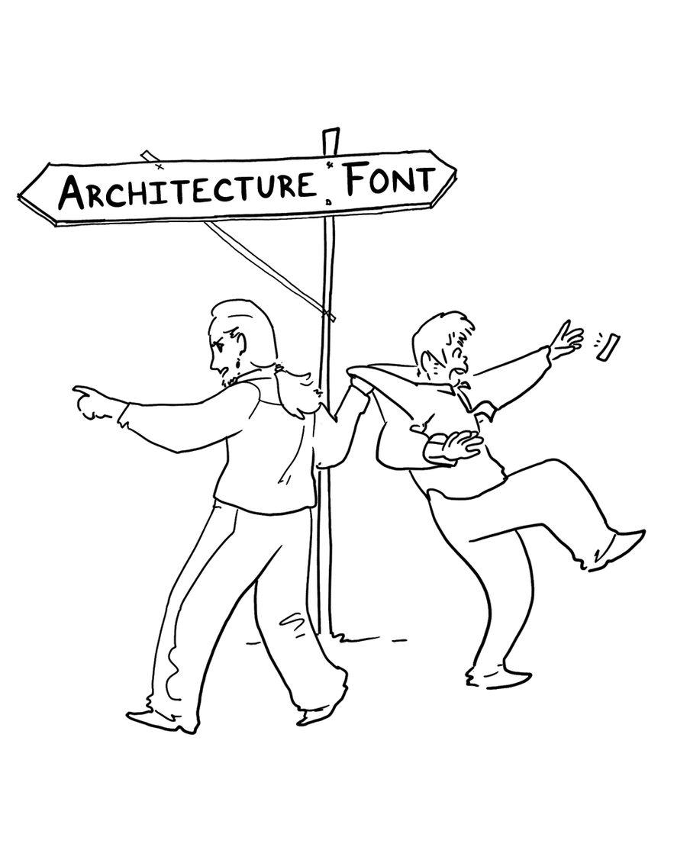
Experts curtail digressions

Slide 13
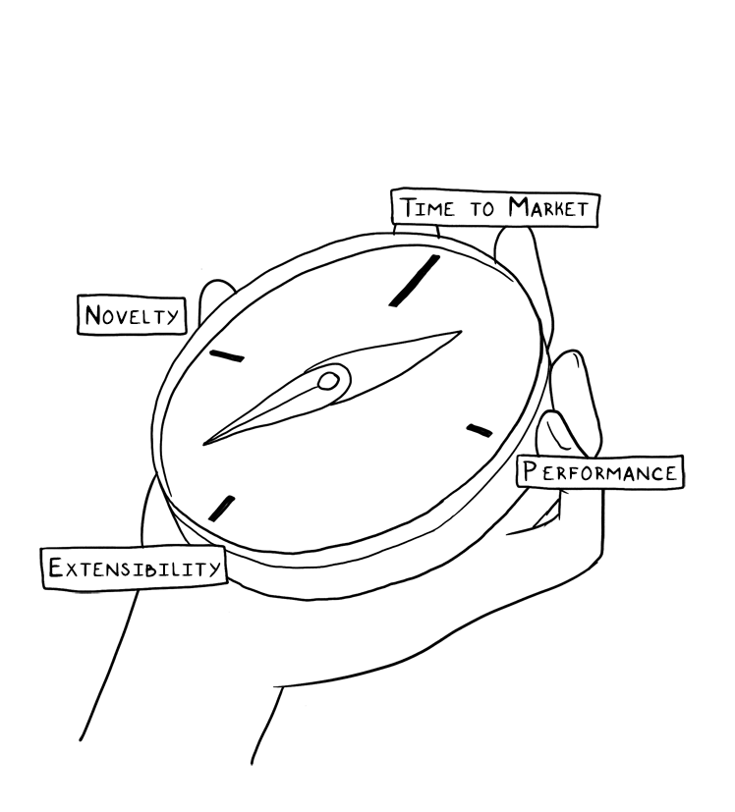
Experts retain their orientation

Slide 14
Software design methods
 | Application design | Interaction design | Architecture design | Implementation design
Analysis | competitive testing contextual inquiry feature comparison stakeholder analysis task analysis | critical incident technique interaction logging personas scenarios | framework assessment model-driven engineering quality-function-deployment reverse engineering world modeling | release planning summarization test-driven design visualization
Synthesis | affinity diagramming concept mapping mind mapping morphological chart | design/making participatory design prototyping storyboarding | architectural styles generative programming component reuse decomposition | pair programming refactoring search software patterns
Evaluation | requirements review role playing wizard of oz | cognitive walkthrough evaluative research heuristic evaluation think-aloud protocol | formal verification simulation weighted objectives | correctness proofs inspections/reviews parallel deployment testing

Slide 15
Software design methods
 | Application design | Interaction design | Architecture design | Implementation design
Analysis | competitive testing contextual inquiry feature comparison stakeholder analysis task analysis | critical incident technique interaction logging personas scenarios | framework assessment model-driven engineering quality-function-deployment reverse engineering world modeling | release planning summarization test-driven design visualization
Synthesis | affinity diagramming concept mapping mind mapping morphological chart | design/making participatory design prototyping storyboarding | architectural styles generative programming component reuse decomposition | pair programming refactoring search software patterns
Evaluation | requirements review role playing wizard of oz | cognitive walkthrough evaluative research heuristic evaluation think-aloud protocol | formal verification simulation weighted objectives | correctness proofs inspections/reviews parallel deployment testing

Slide 16
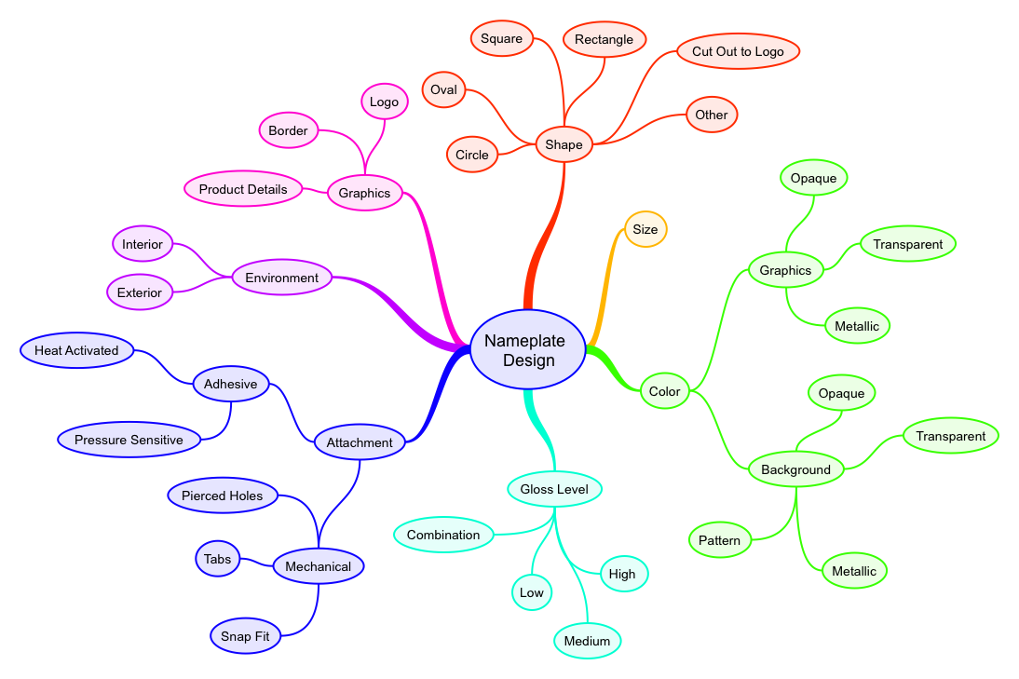
Mind mapping
Mind mapping is the process of generating ideas and developing concepts when the underlying relationships are unclear

Slide 17
Procedure
Identify the focus word or question
Free associate outward from the focus
Reorganize as needed
Annotate

Slide 18
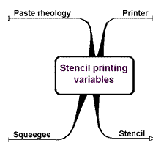
Example: identify the focus word or question

Slide 19
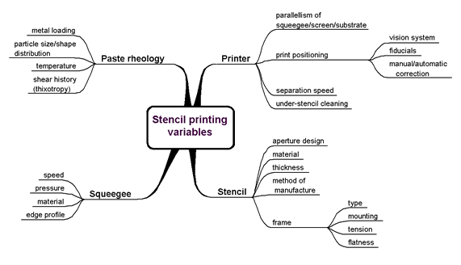
Example: free associate outward from the focus

Slide 20
Example: reorganize as needed

Slide 21
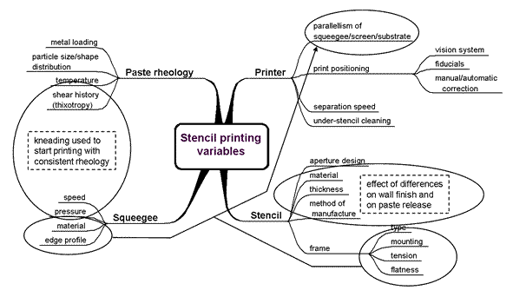
Example: annotate

Slide 22
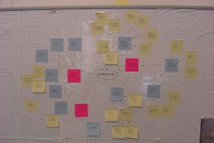
Typical notation: mind map

Slide 23
Criteria for successful use
The designer must possess, or have access to people with, strong domain knowledge
Relies on early insight into the design problem, and what dimensions might matter
One should not dismiss ideas (generate first, consolidate later)
Collaborate

Slide 24
Strengths and weaknesses
Strengths
Weaknesses
Can be used for many different purposes
Fluid representation suitable for tool use
Builds common understanding and language
Encourages idea generation
Can uncover ‘hidden’ relationships
Lightweight
May become too disconnected from reality
May become too unwieldy in size and complexity
Generation of ideas is restricted by the hierarchical form of representation
Requires a well-trained moderator

Slide 25
Variants
Concept mapping

Slide 26
Practice
Disney electronic queue management system

Slide 27
Software design methods
 | Application design | Interaction design | Architecture design | Implementation design
Analysis | competitive testing contextual inquiry feature comparison stakeholder analysis task analysis | critical incident technique interaction logging personas scenarios | framework assessment model-driven engineering quality-function-deployment reverse engineering world modeling | release planning summarization test-driven design visualization
Synthesis | affinity diagramming concept mapping mind mapping morphological chart | design/making participatory design prototyping storyboarding | architectural styles generative programming component reuse decomposition | pair programming refactoring search software patterns
Evaluation | requirements review role playing wizard of oz | cognitive walkthrough evaluative research heuristic evaluation think-aloud protocol | formal verification simulation weighted objectives | correctness proofs inspections/reviews parallel deployment testing

Slide 28
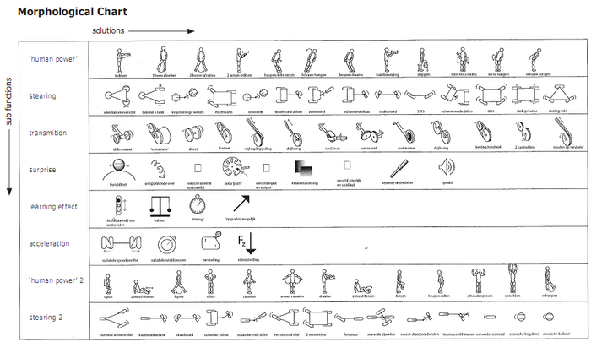
Morphological chart
Morphological chart is the process of generating ideas in an analytical and systematic manner

Slide 29
Procedure
List the features or functions that are essential to the product
For each feature or function, list the means by which it might be achieved
derive these systematically
Identify feasible combinations

Slide 30
Example: list the features or functions…
Engine
Shifting
Drive
Brakes
Steering
…

Slide 31
Example: list the means by which…
Engine | Fully electric | Hybrid | Gasoline | Diesel
Shifting | Automatic | Semi-automatic | Manual
Drive | Front-wheel | Rear-wheel | All-wheel
Brakes | Standard | Anti-lock
Steering | Regular | Power
… | … | … | …

Slide 32
Example: identify feasible combinations
Engine | Fully electric | Hybrid | Gasoline | Diesel
Shifting | Automatic | Semi-automatic | Manual
Drive | Front-wheel | Rear-wheel | All-wheel
Brakes | Standard | Anti-lock
Steering | Regular | Power
… | … | … | …

Slide 33
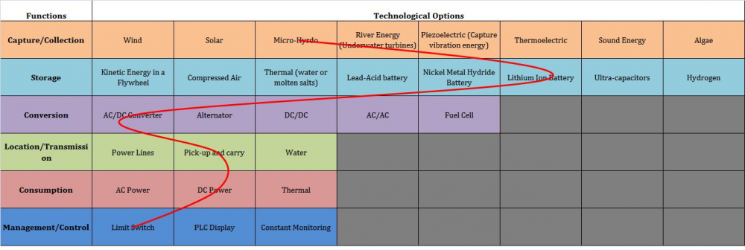
Typical notation: morphological chart

Slide 34
Criteria for successful use
The various features or functions of the eventual design solution must be well understood
The various features or functions of the eventual design solution must be relatively independent
The various means per feature or function must not be infinite, and principally relate to one another so a systematic articulation can uncover all of them

Slide 35
Strengths and weaknesses
Strengths
Weaknesses
Helps break down the design problem into features or functions
Systematic manner of deriving possible means
Avoids possible bias toward certain means
Helps identify and consider novel/unusual combinations
Applicable only to design problems where the features or functions of the design solution are well understood
Quickly leads to too many possible combinations
No valuation attached to individual means

Slide 36
Practice
Disney electronic queue management system

Slide 37
Design studio 3
Hand out

Slide 38
Design studio 3
Questions?

