Slide 1
Informatics 121 Software Design I
Lecture 3
Duplication of course material for any commercial purpose without the explicit written permission of the professor is prohibited.

Slide 2
Today
French fries and mayonnaise
French fries and mayonnaise (redux)
Software designers
Design studio 1, part 1

Slide 3
French fries and mayonnaise

Slide 4
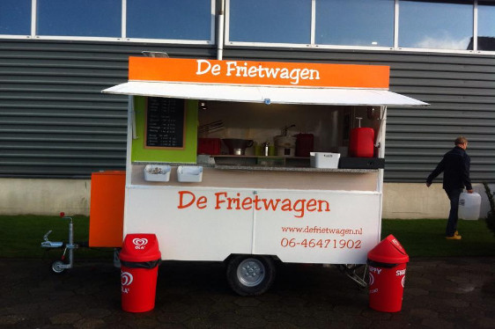
French fries and mayonnaise

Slide 5
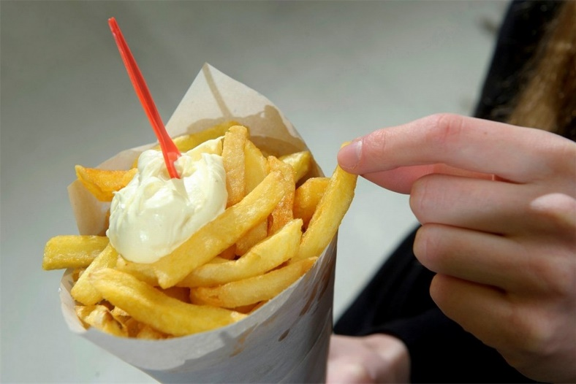
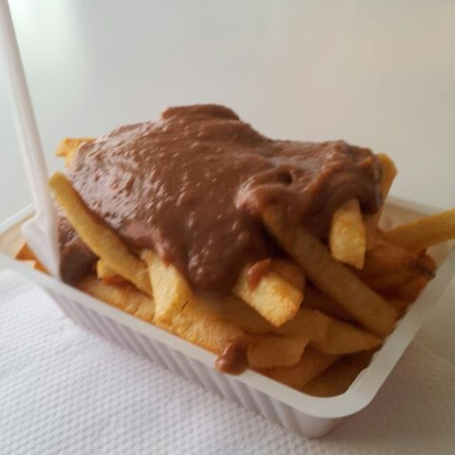
French fries and mayonnaise

Slide 6
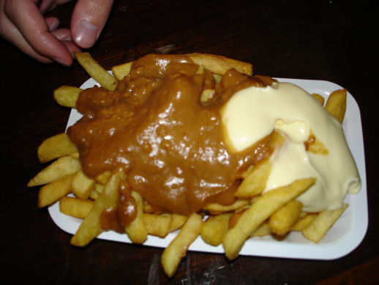
French fries and mayonnaise

Slide 7
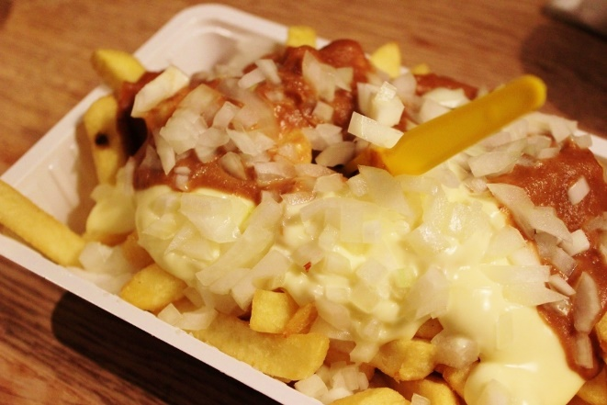
French fries and mayonnaise

Slide 8
Reflection
What went well?
What did not go well?
What are you most worried about in terms of progress at this time?
What would you like to do different?
What might we be mixing up?

Slide 9
Reflection
designer
plan
maker
change in the world
other stakeholders
audience
experiences

Slide 10
French fries and mayonnaise

Slide 11
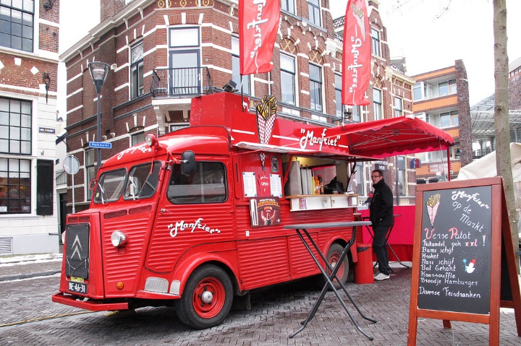
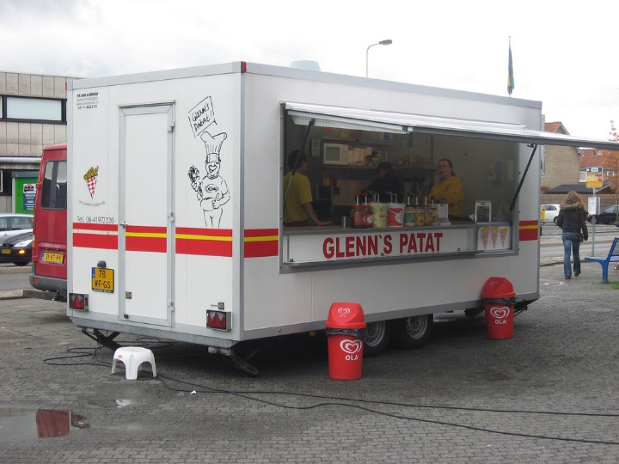
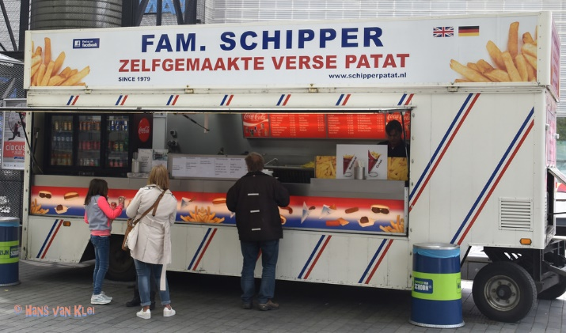
French fries and mayonnaise

Slide 12
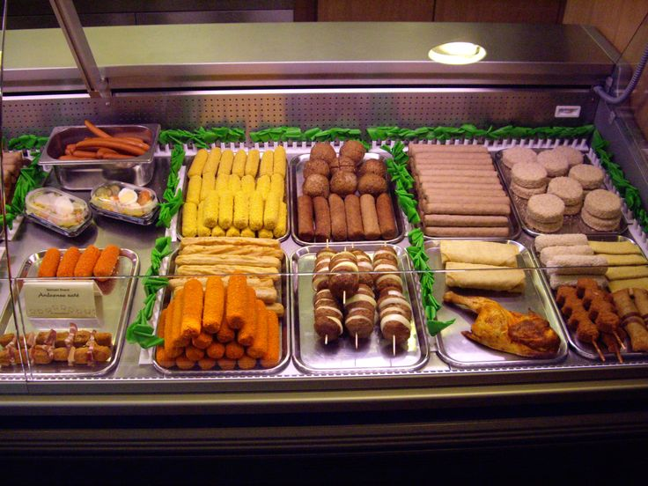
French fries and mayonnaise

Slide 13
Reflection
What went well?
What did not go well?
What did you learn about the problem?
What did you not learn about the problem?
What did you learn about the solution?
What did you not learn about the solution?

Slide 14
Reflection
Were you a problem solver, creative, skeptic, maker, collaborator, or pragmatist?
What are you most worried in terms of this design challenge?
What was different the second time?

Slide 15
Roles of the Software designer
Problem solver
Creative
Scavenger
Maker
Skeptic
Collaborator
Pragmatist
Harmonious polymorph

Slide 16
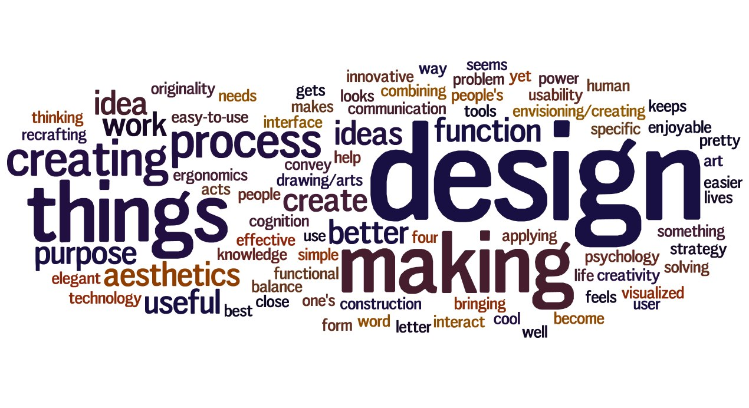
A design mindset

Slide 17
Design studio 1
Your client is RealPlay, a new company that recognizes the importance of children not only playing on some form of laptop, phone, or tablet, but also playing with friends in the real world.
RealPlay is particularly looking to break the increasing screen-oriented world of children by finding them opportunities to play with other children. It’s looking to borrow ideas from Facebook, Doodle, and so on, but really wants to ‘blow this out of the water’ and be the next unicorn ($1B startup). Additional functionality, then, is something it wants thought about.
The company has sought you out, because you are an excellent designer. All of the software design is in your hands. PlayTime has the idea protected (meaning no competition), but has no idea how to actually design the software.

Slide 18
Design studio 1 (part 1)
Identify possible audiences and other stakeholders
Identify possible goals, constraints, and assumptions
Bring two printed copies to discussion, this Friday
one for the TAs
one for your group
Your group will be announced at the start of your discussion

Slide 19
Design studio 1 (part 1)
This assignment will be worth 5 points

