Slide 1
Informatics 121 Software Design I
Lecture 6
Duplication of course material for any commercial purpose without the explicit written permission of the professor is prohibited.

Slide 2
Discussion
There will be discussion this upcoming Friday
Please join your designated discussion

Slide 3
Today
French fries and mayonnaise

Slide 4
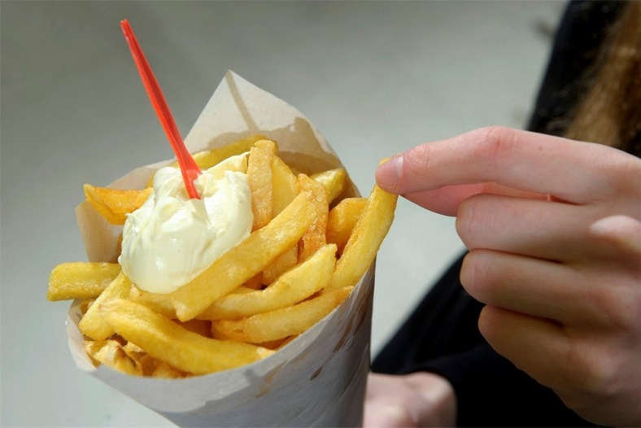
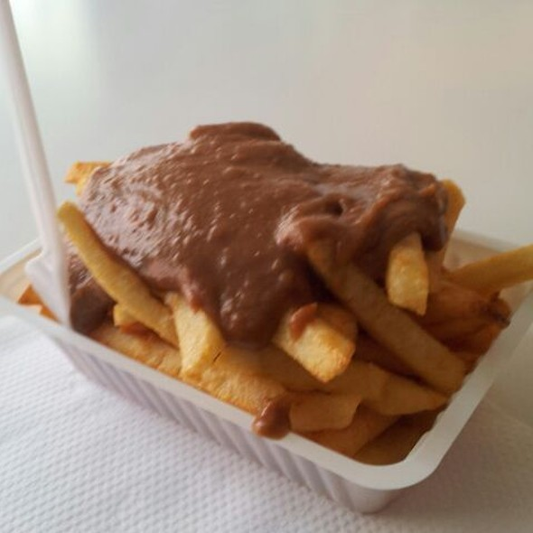
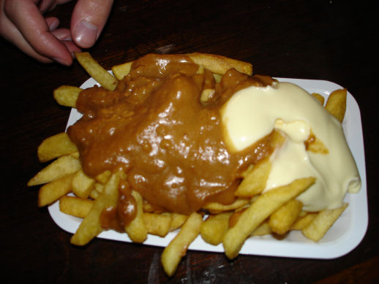
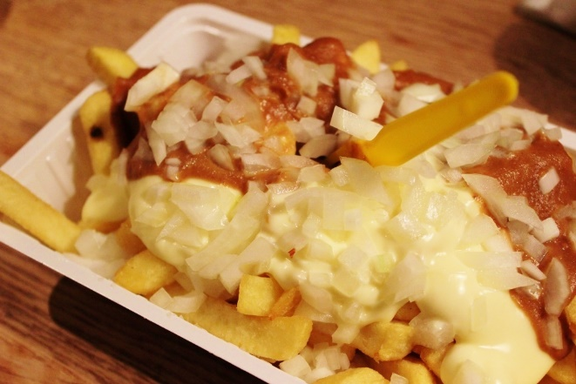
French fries and mayonnaise

Slide 5
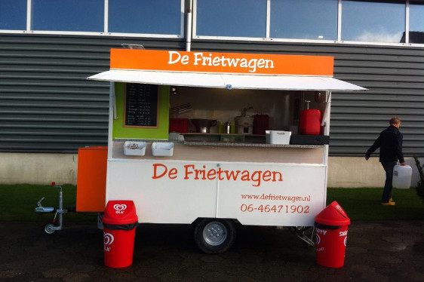
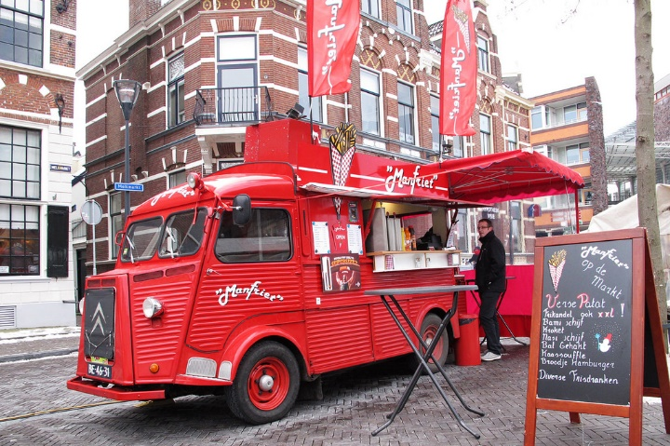
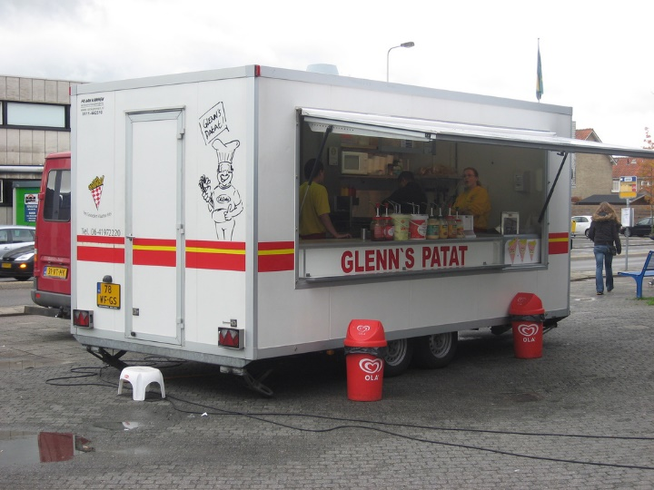
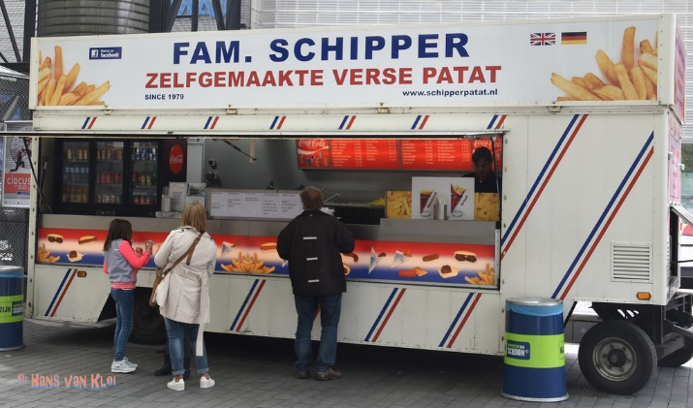
French fries and mayonnaise

Slide 6
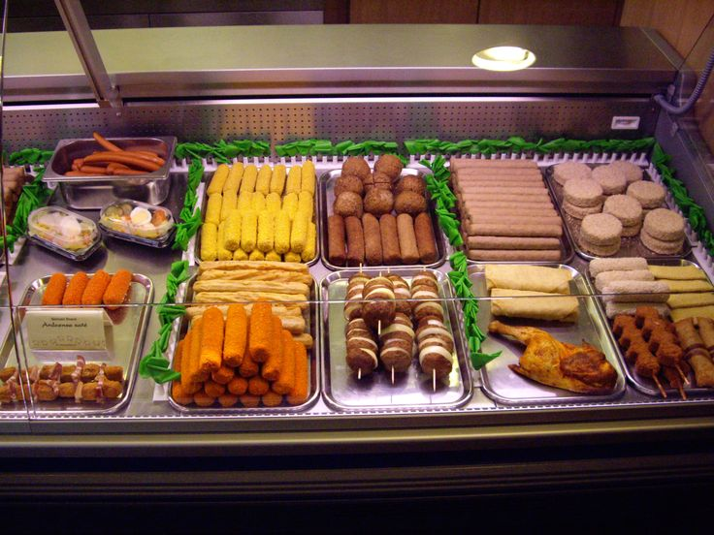
French fries and mayonnaise

Slide 7
Experts...
...focus on the essence
...prefer solutions that they know work
...address knowledge deficiencies
...generate alternatives
...are skeptical

Slide 8
Reflection
What went well?
What did not go well?
What did you learn about the problem?
What did you not learn about the problem?
What did you learn about the solution?
What did you not learn about the solution?

Slide 9
Reflection
What were key steps forward?
Did it help to consider goals, constraints, assumptions, ideas, and decisions separately?
Did it help to explicitly step through analysis, synthesis, evaluation?
How will you make sure to continue to do this?

