Slide 1
Informatics 121
Software Design I
Department of Informatics, UC Irvine sdcl.ics.uci.edu
Adriana Meza Soria
Lecture 7
Duplication of course material for any commercial purpose without the explicit written permission of the professor is prohibited.

Slide 2
Discussion
There will be discussion this upcoming Friday
Design Studio 1 (Part B) due on Tuesday 5th

Slide 3
Today
Expert behaviors (quick recap)
Generating alternatives
Fries and mayonnaise
Design studio 1 (Part B)

Slide 4
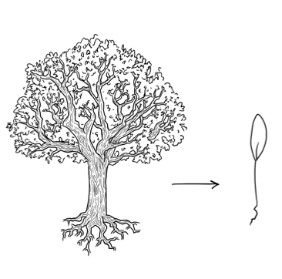
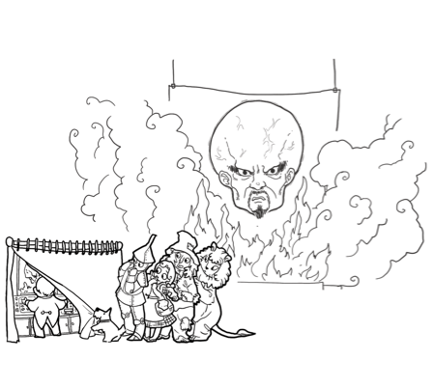
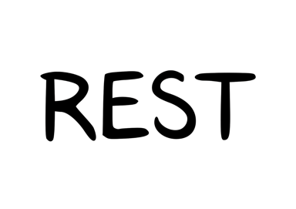
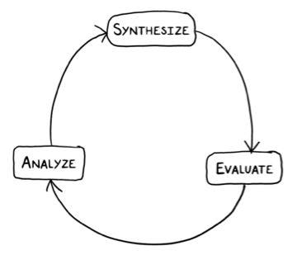
Expert behaviors
1
2
Focus on the essence
Address knowledge deficiencies
3
4
Explore solutions that work
Are skeptical

Slide 5
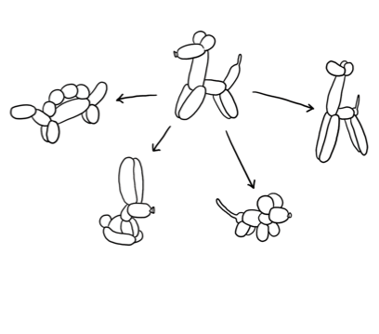
Experts generate alternatives

Slide 6
Developers taking notes at design meetings

Slide 7
Thinking about alternatives
Micro
Macro

Slide 8
Alternatives at the macro
Different options of shaping a piece of software in a significantly different way.
Alternatives can exist at:
Application
Interaction
Architecture
Alternatives are connected

Slide 9
Example of alternatives at the macro
Fully featured
Bare bones
Something in the middle

Slide 10
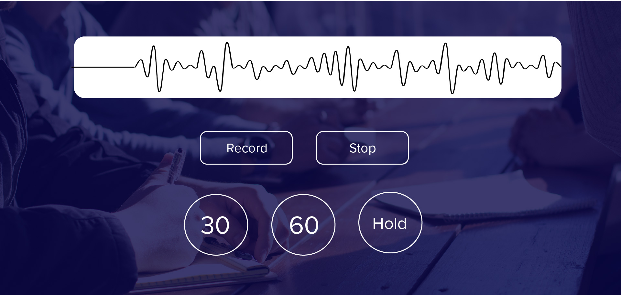
“Capturing voice notes in a natural way, through a lightweight interaction”

Slide 11
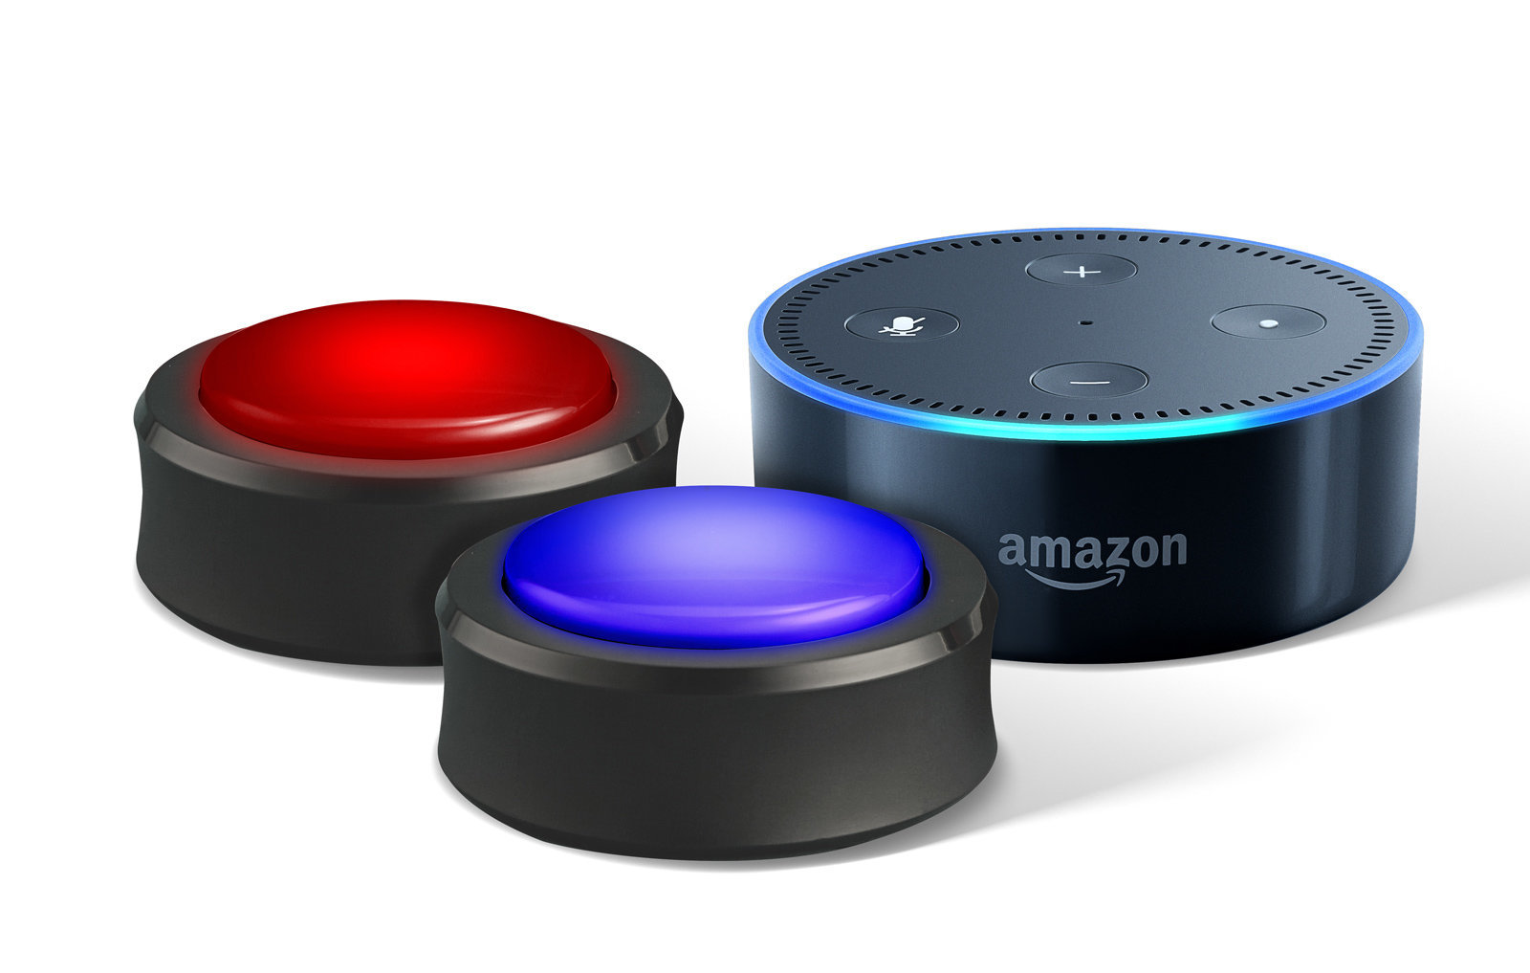
Another alternative

Slide 12
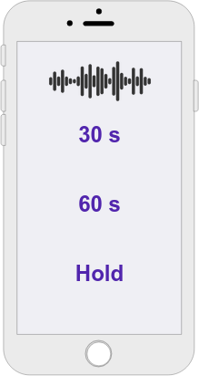
An additional alternative

Slide 13
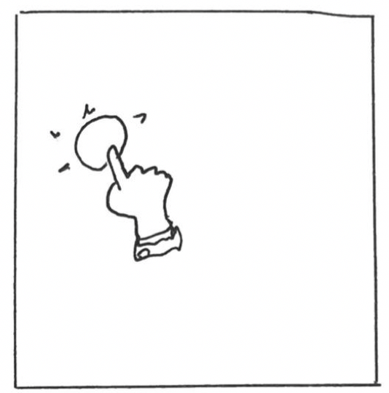
1
2
After 20 seconds

Slide 14
Practice: designing alternatives at the macro level

Slide 15
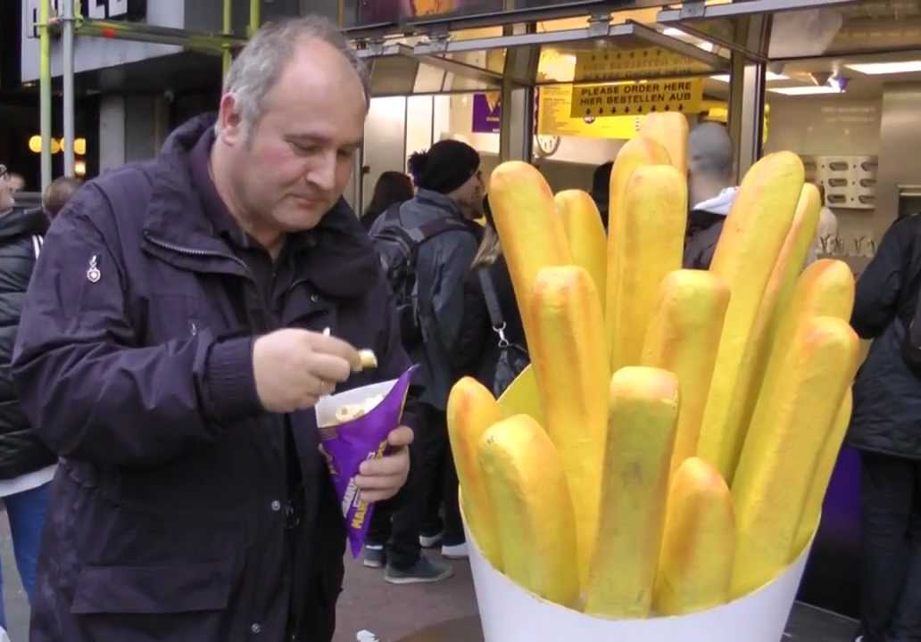
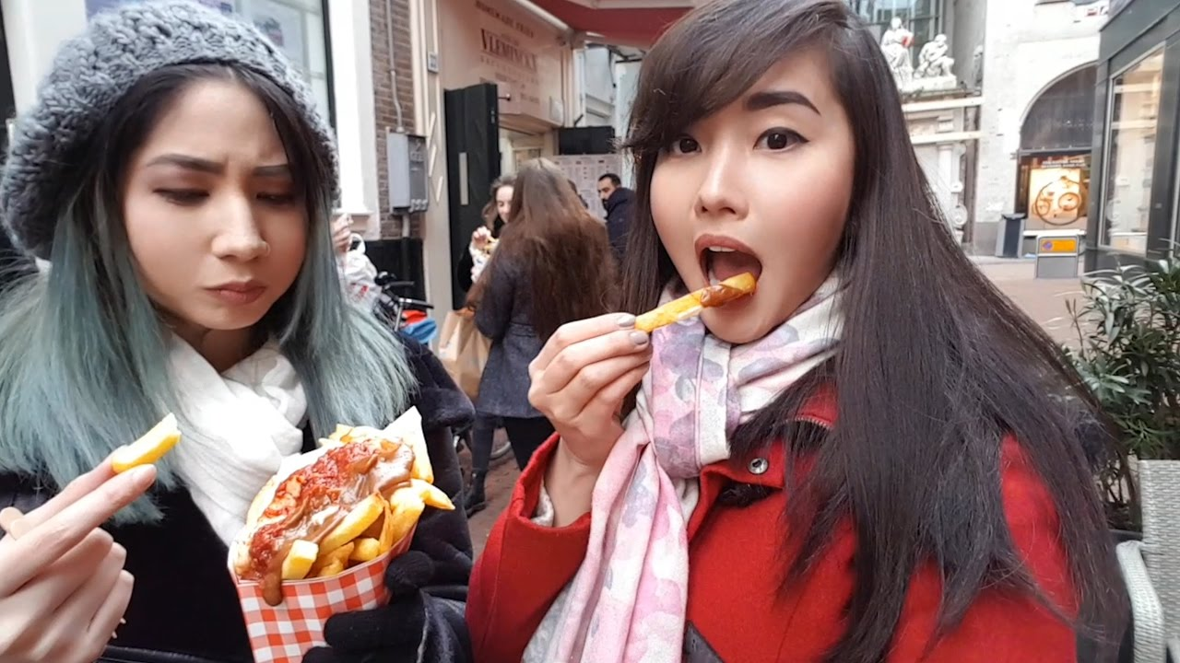
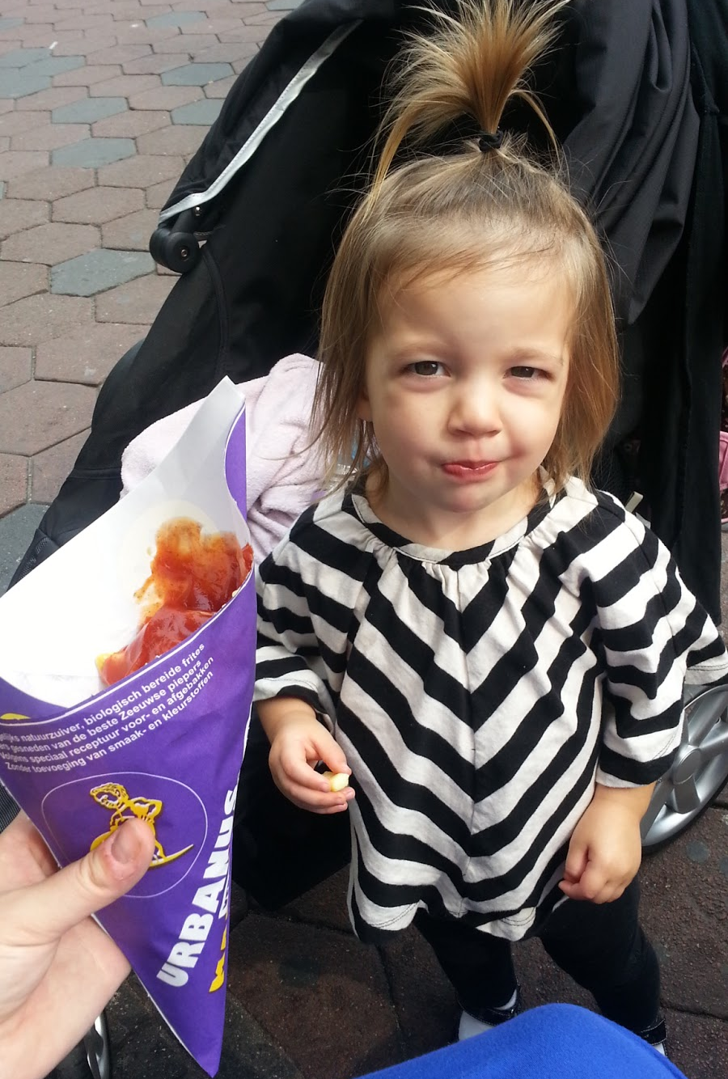
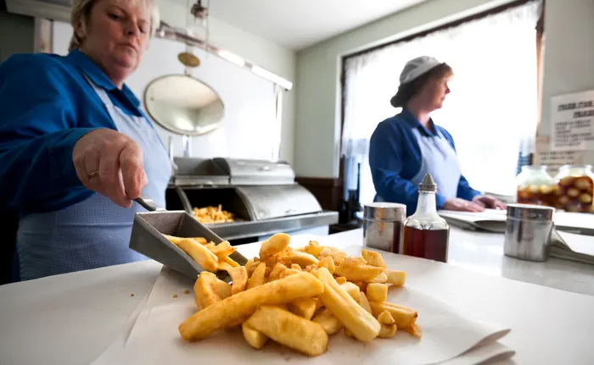
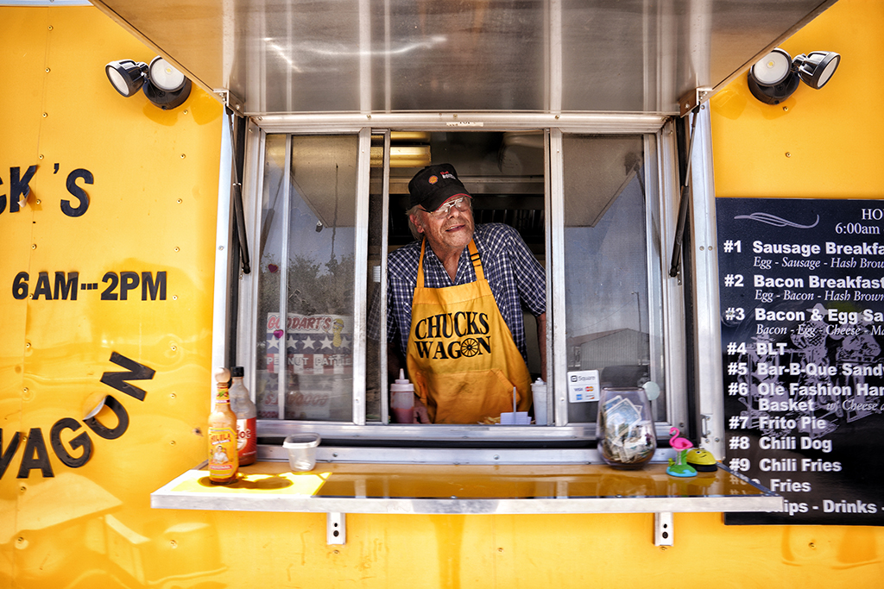
Who is our audience?

Slide 16
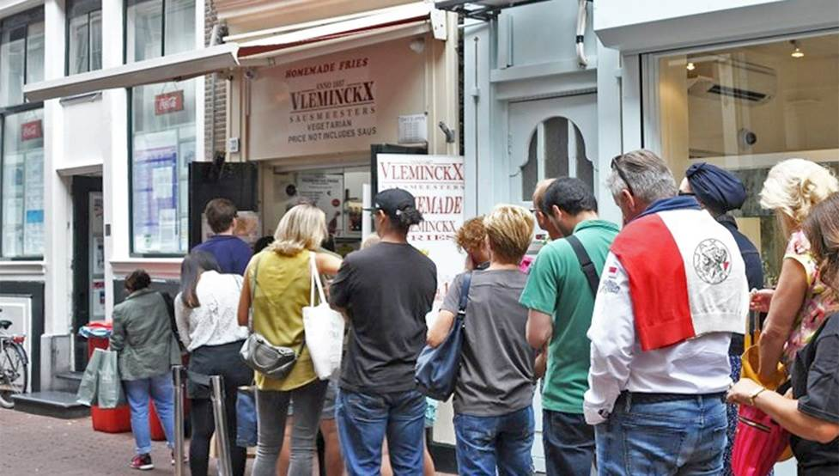
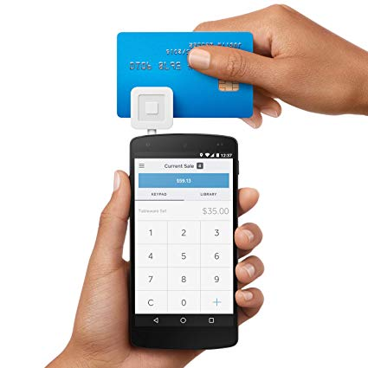
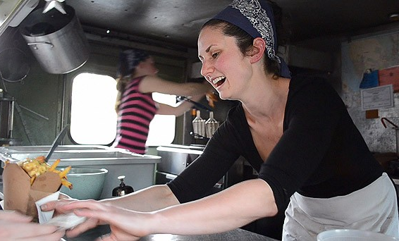
Customers goals
Customers want a smooth experience
The overall service
The order

Slide 17
Employees
Employees want a smooth experience
Cashiers take orders easily
Fries makers want to know what orders are coming

Slide 18
The Owner Goals
The owner wants to maximize profit
Arjen wants to prevent money drains (from sales and supplies)
Arjen wants to control inventory
Arjen wants to keep flexible prices
Arjen wants to keep the customers traditional experience.

Slide 19
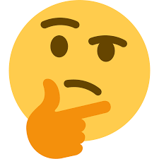
How can we come up with approaches?

Slide 20
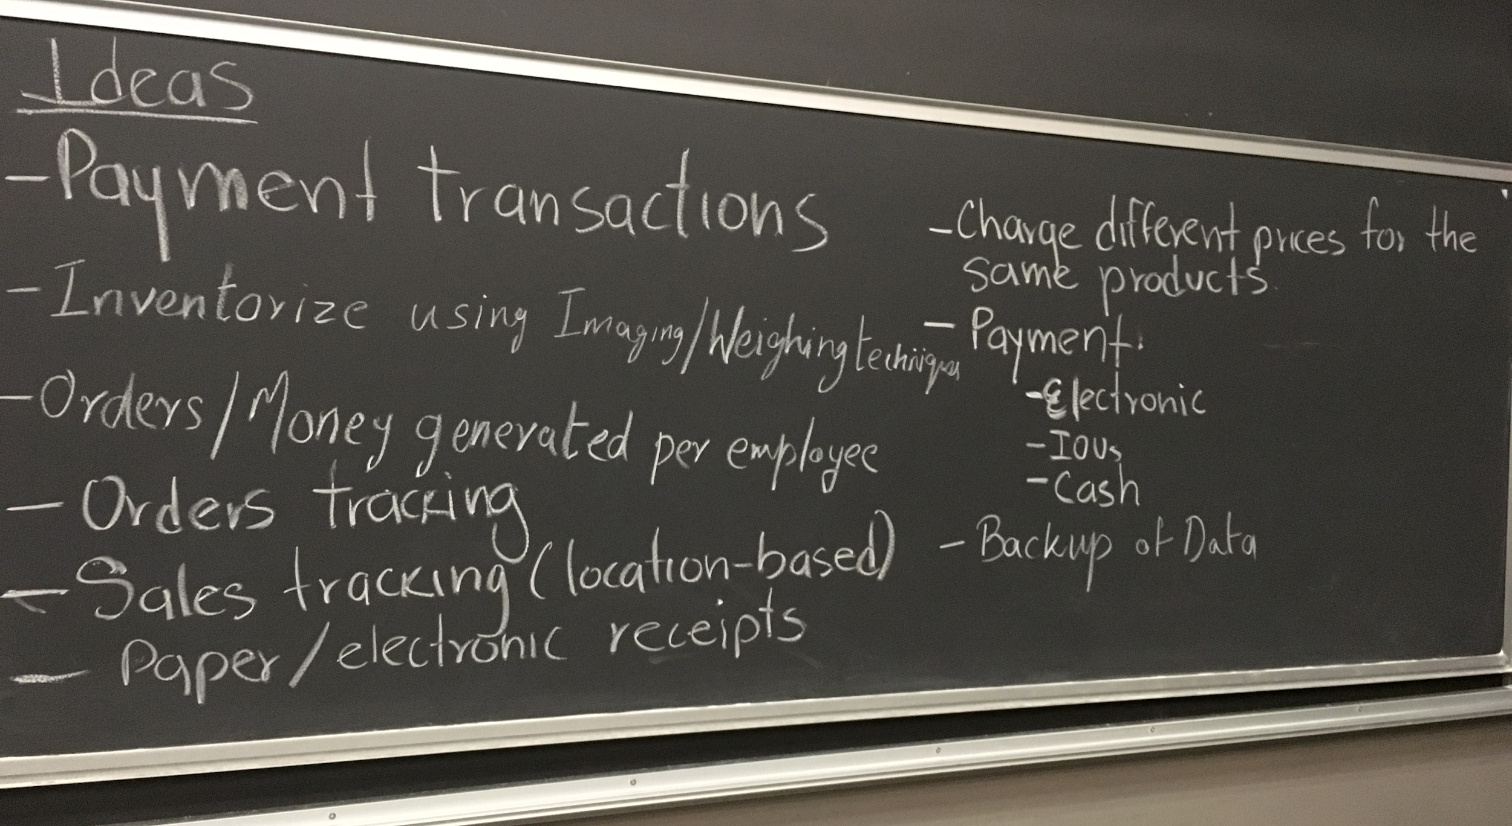

Slide 21
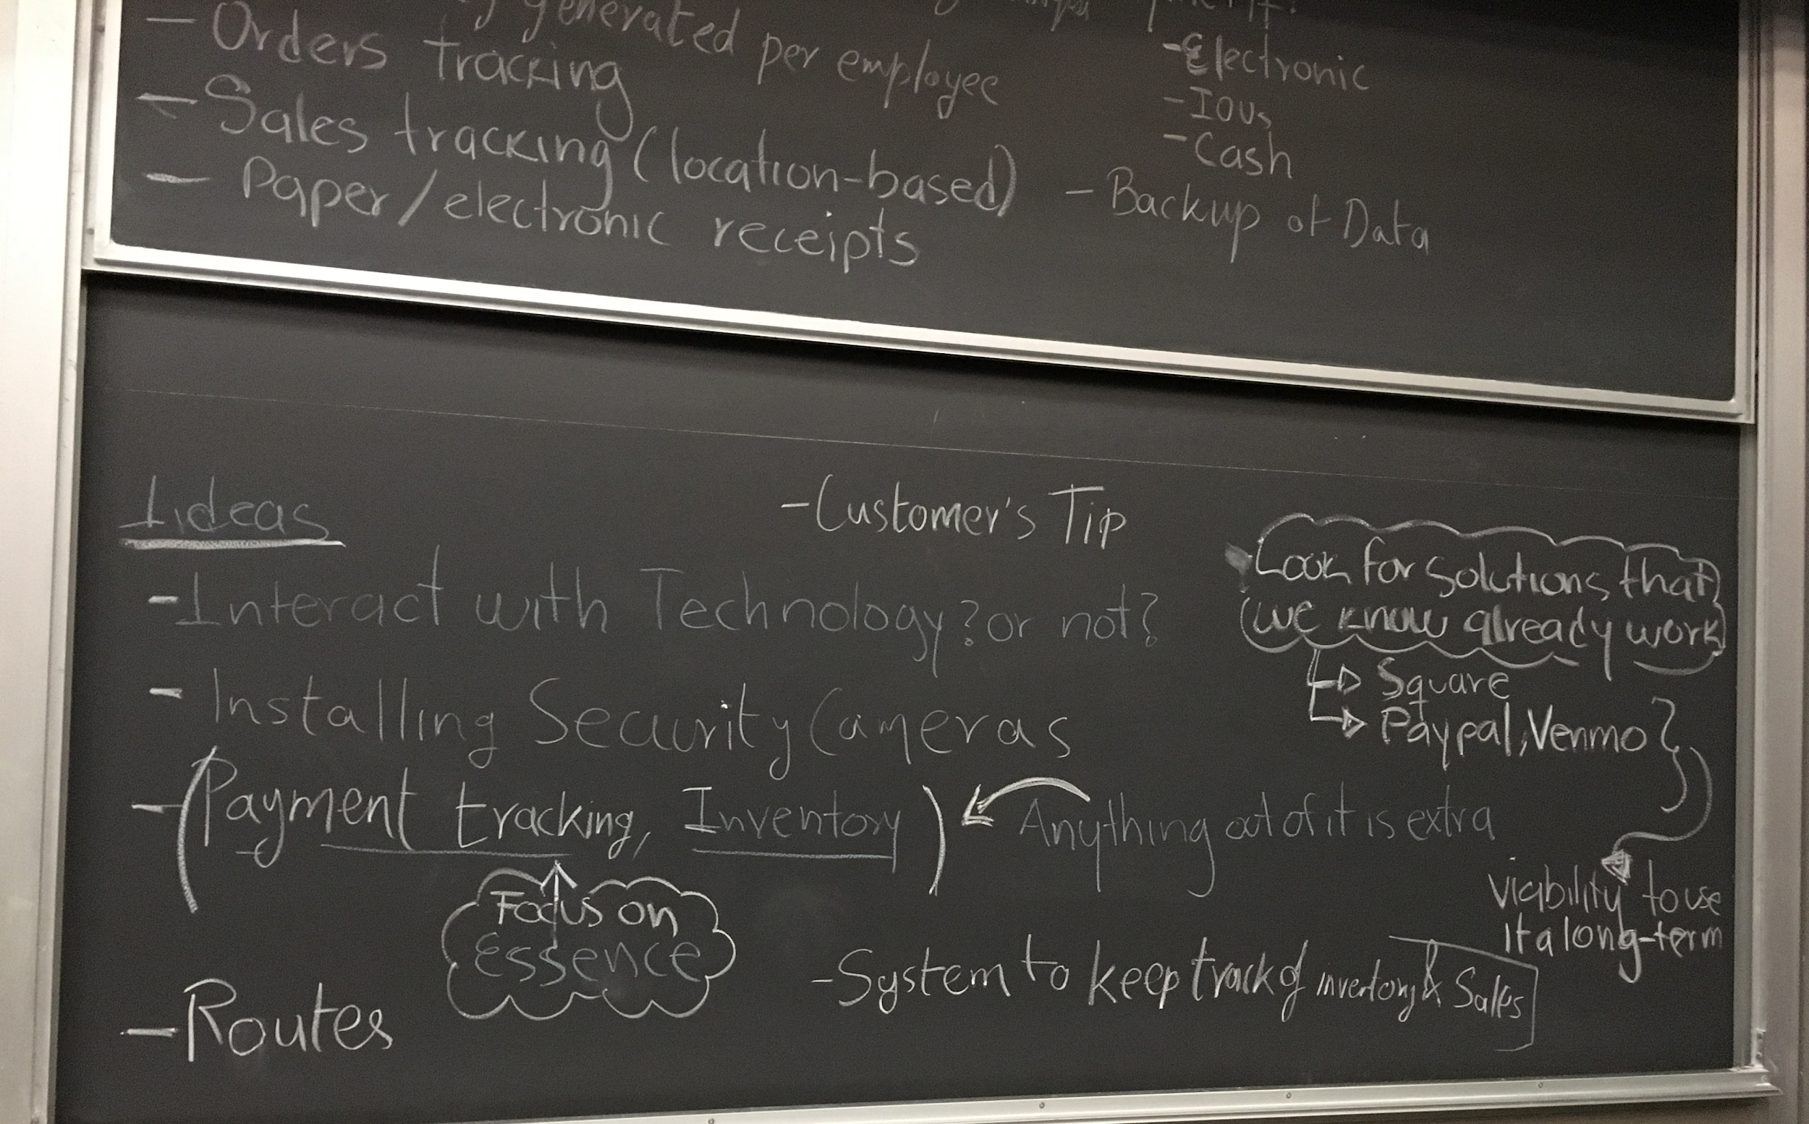

Slide 22
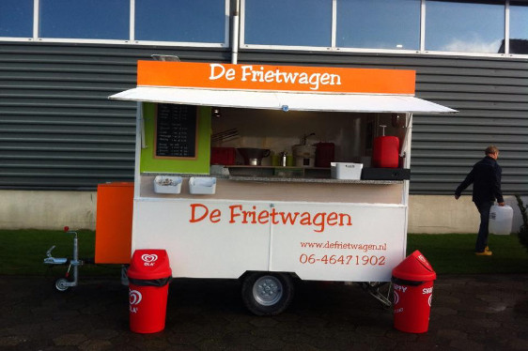
Order
Employee scans his/her employee id
Employee takes the order at the wagon window/in-line
Product selection, order details, and discounts
Employee tells customer final price
Employee places the order
Employee gives [paper] ticket to the customer
Employee gives a ticket copy to the fries maker
The owner wants to maximize profit
Customers want a smooth experience
Employees want a smooth experience

Slide 23
Payment requirements
The owner wants to maximize profit
Customers want a smooth experience
Systems should be able to charge orders to customer’s credit/debit card
System should be able to register cash entries

Slide 24
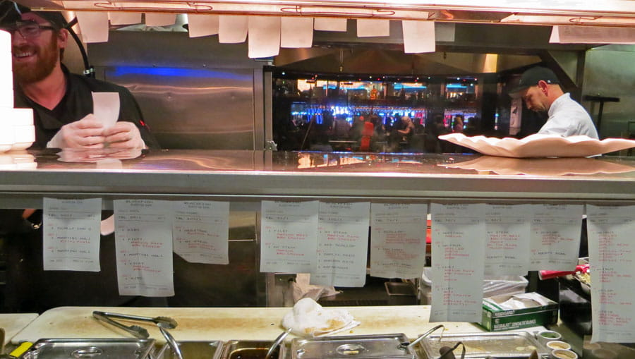
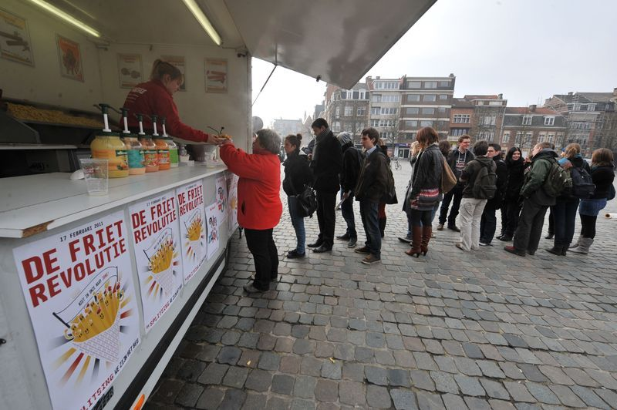
Order tracking
Employees that make the fries want to know what orders are coming.
Printed ticket for fries maker
Customers want a smooth experience.
Customers get their order presenting their ticket when the order is ready

Slide 25
Inventory tracking
The owner wants to maximize profit
Catalog of Ingredients and supplies for each menu option.
Minimum stock
When an employee charges an order
Ingredients are discounted from the wagon stock.
Low stock alerts

Slide 26
Centralized control
The owner wants to maximize profit
Modification of: menu, prices, etc.
Sales data per: wagon, schedule, stop, employee
Shopping
Low stock alerts
Profit reports

Slide 27
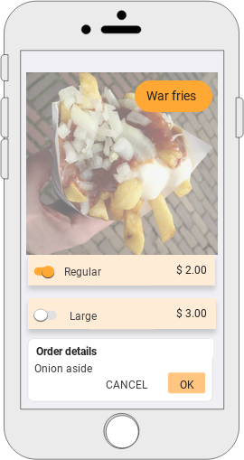
Interaction Design
Ordering GUI
Order selection
Accommodate special instructions
Accommodate discounts
Payment

Slide 28
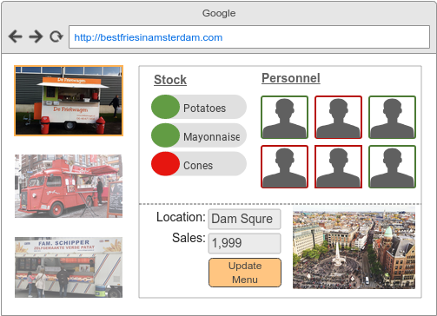
Interaction Design
Manager GUI
Daily operation
Each wagon stock data
Personnel on duty
Sales statistics for the day
Actual spot
Menu catalog
Aggregated reports
Filters: wagon, schedule, stop, employees
Sales, shopping, revenue

Slide 29
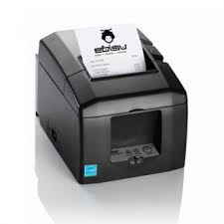
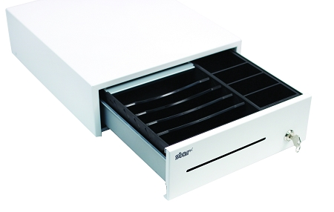
Interaction Design

Slide 30
Are we done with the ‘bare bones’ approach?
Architecture Design
Wagons’ operation is independant, but data should be synchronized with a centralized control system at some point.
What about other scenarios?
Canceling an order
Remaking an order

Slide 31
Let’s design another approach together...

Slide 32
Opportunities of improvement
Order tracking
Vendor managed inventory
Marketing

Slide 33
Design studio 1 (part B)
Must cover application design and the essence of Interaction design.
There is not format
Other questions?

