Slide 1
Informatics 121 Software Design I
Lecture 8
Duplication of course material for any commercial purpose without the explicit written permission of the professor is prohibited.

Slide 2
Discussion
There will be discussion this upcoming Friday
Please join your designated discussion
Design studio 1 part 2 is due Tuesday at noon
Gradescope
Team evaluations are forthcoming

Slide 3
Today’s lecture
Midterm
Design artifacts
Design notations
Expert behaviors
Design studio 1 part 2

Slide 4
Midterm
February 14
All material up to and including the lecture on February 12
Closed book; bring pen/pencil/eraser
Theory and practice

Slide 5
Sample question
The definition of design used in Informatics 121 is:

Slide 6
Sample question
Name the four types of design that must be addressed in software design:

Slide 7
Sample question
Why do experts prefer to work with others?

Slide 8
Sample question
Name the four types of design that must be addressed in software design:

Slide 9
Sample question
Suppose you are to design a new web app that allows anyone to track any flight, its departure and destination airport, where it currently is in route, and its anticipated arrival time. List a possible goal, constraint, assumption, decision, and idea for the web app as related to application design:

Slide 10
Sample question
Suppose you are asked to design a new software system through which it is possible for interested parties to adopt pets (e.g., dogs, cats, hamsters, …). What features would you foresee this software system to have (it is not necessary to be exhaustive):

Slide 11
Sample question
Continuing the previous question, draw a few mock-ups of how you envision the system to work:

Slide 12
Sample question
Continuing the previous question, draw a UML class diagram capturing the essence of the system:

Slide 13
Questions?

Slide 14
Design
designer
plan
maker
change in the world
other stakeholders
audience
experiences

Slide 15
A design artifact
An externalized representation used to further a design project
goals, constraints, assumptions, ideas, decisions
design problem, design solution, or both
partial or complete
fluid or frozen

Slide 16
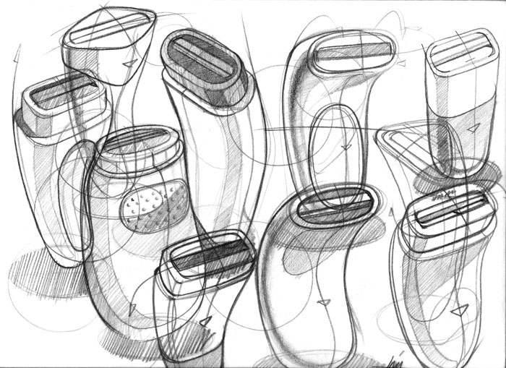
Example

Slide 17
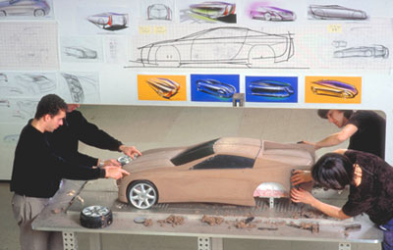
Example

Slide 18
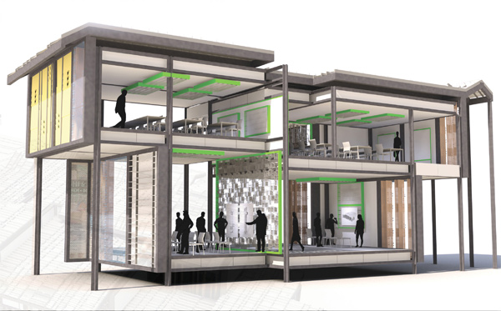
Example

Slide 19
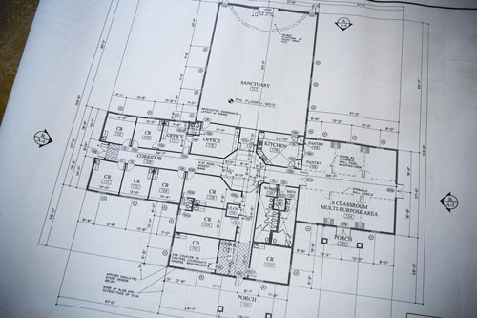
Example

Slide 20
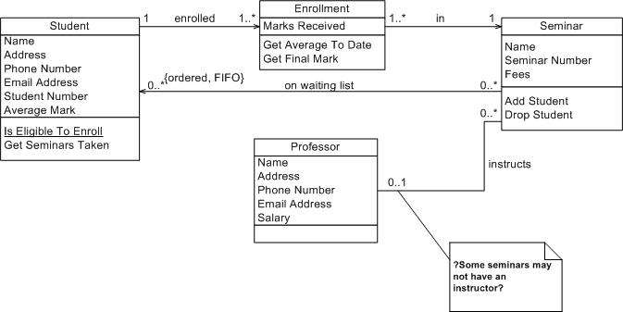
Example

Slide 21
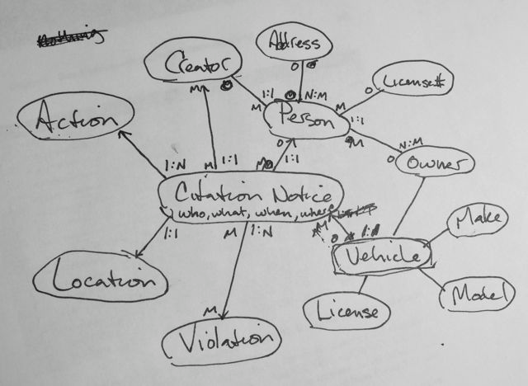
Example

Slide 22
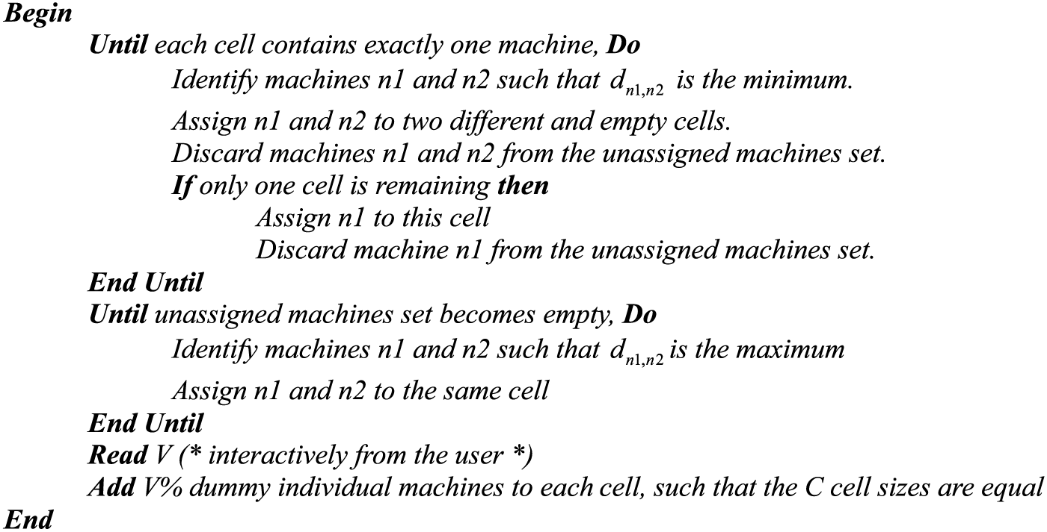
Example

Slide 23
Purpose of design artifacts
Design artifacts to think
Design artifacts to talk
Design artifacts to prescribe

Slide 24
Thinking design artifact

Slide 25
Thinking design artifact

Slide 26
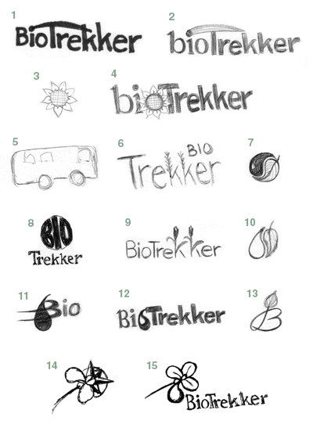
Thinking design artifact

Slide 27
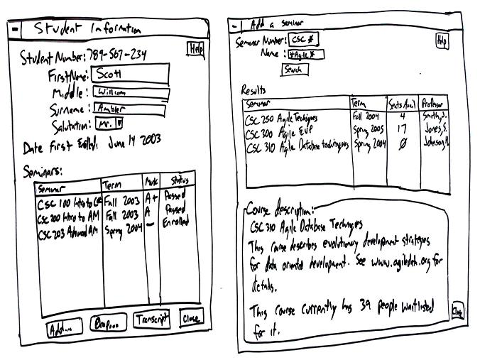
Thinking design artifact

Slide 28
Talking design artifact

Slide 29
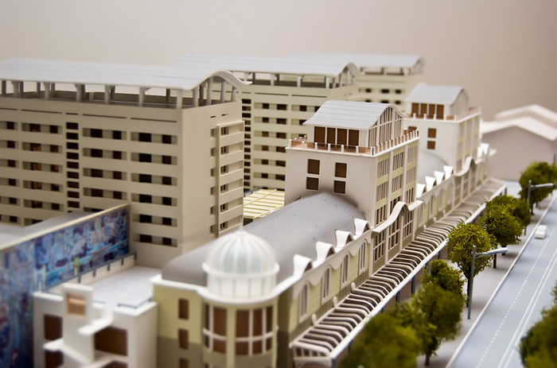
Talking design artifact

Slide 30
Talking design artifact

Slide 31
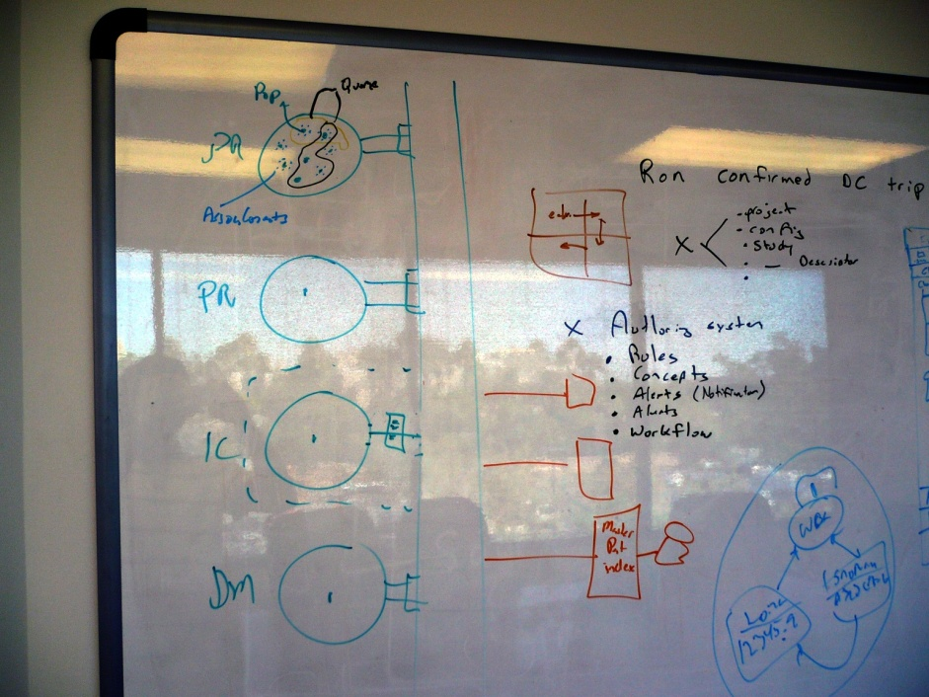
Talking design artifact

Slide 32
Prescribing design artifact

Slide 33
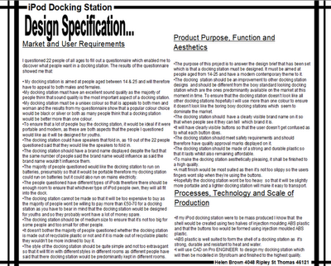
Prescribing design artifact

Slide 34
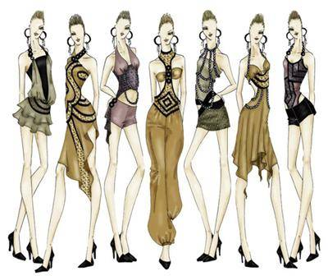
Prescribing design artifact

Slide 35
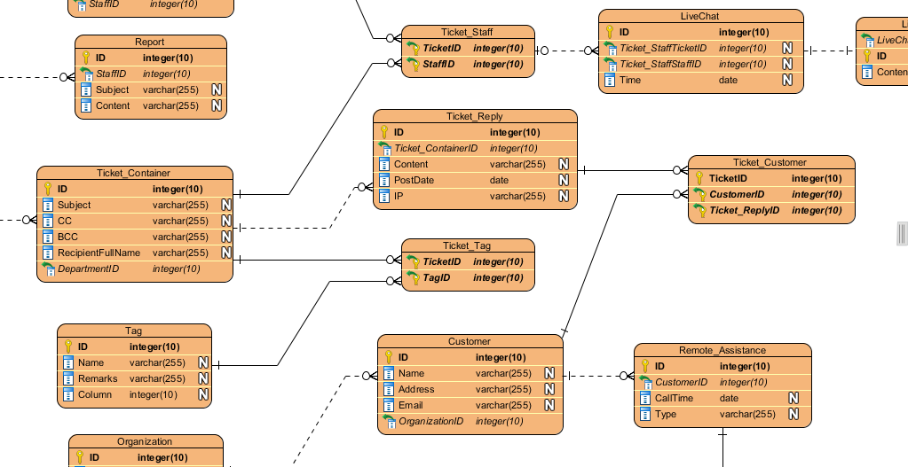
Prescribing design artifact

Slide 36
Abstraction
An abstraction is formed by reducing the information content of a concept or an observable phenomenon, typically to retain only information which is relevant for a particular purpose
choice of what to include
choice of what not to include
Each abstraction makes some information readily available at the expense of obscuring or removing other information

Slide 37
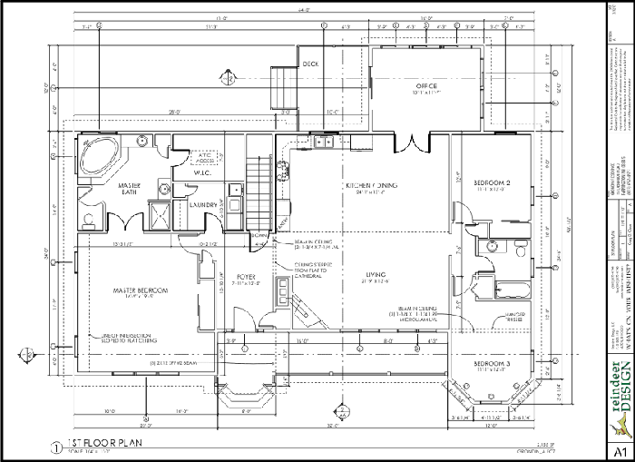
Floor plan

Slide 38
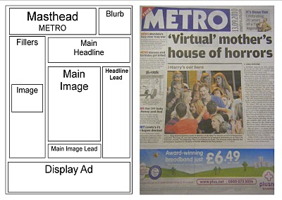
Page layout

Slide 39
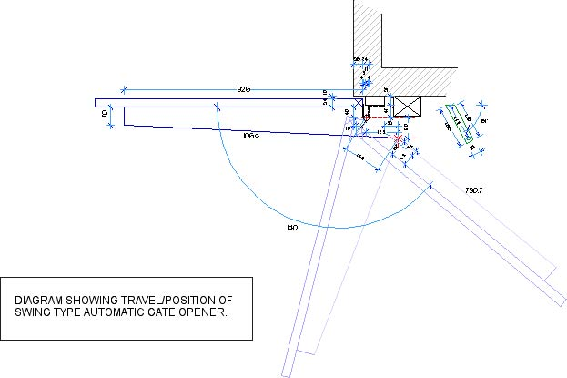
Mechanical engineering diagram

Slide 40
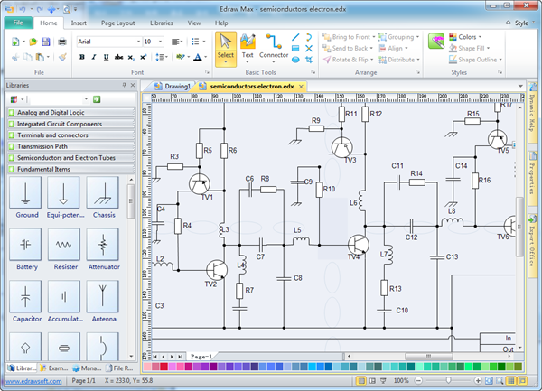
Schematic

Slide 41
Product sketch

Slide 42
Model

Slide 43
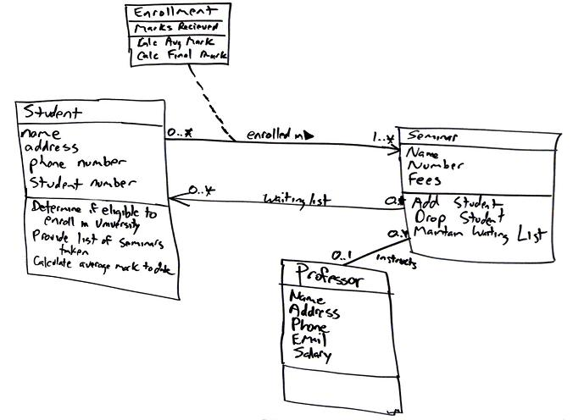
Class diagram

Slide 44
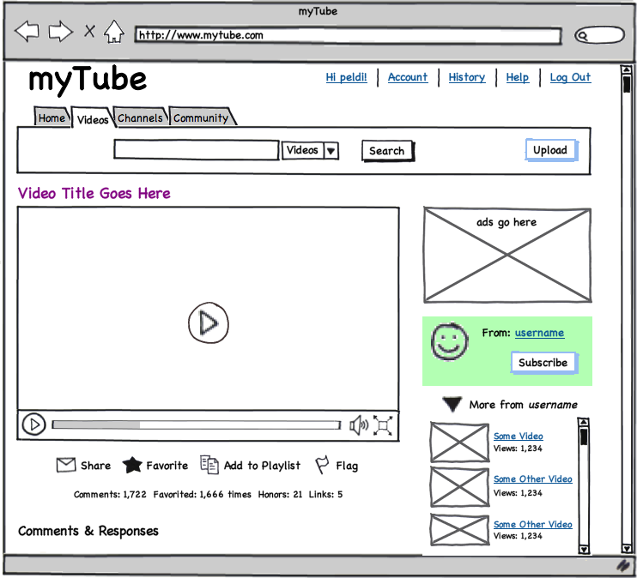
User interface mock-up
[balsamiq]

Slide 45
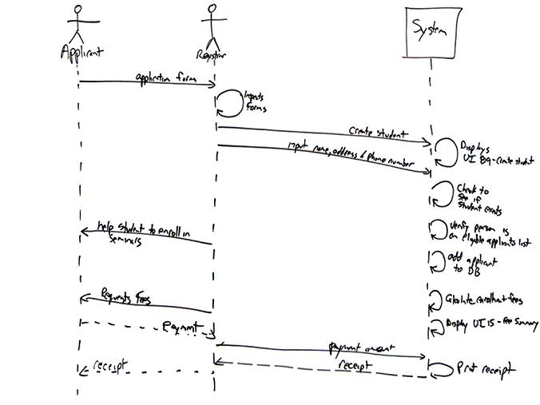
Sequence diagram

Slide 46
Design notation
A design notation offers a language for specifying certain aspects of a design artifact
textual and/or graphical vocabulary for specifying individual and composite elements
rules governing how individual elements can be combined into composite elements
implicit and/or explicit semantics for giving meaning
Each design notation is typically suited for a particular domain and a particular purpose
Every design notation invariably introduces abstraction

Slide 47
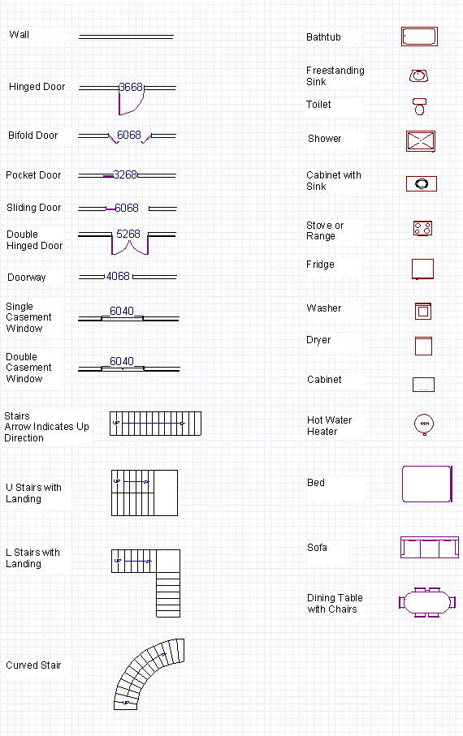
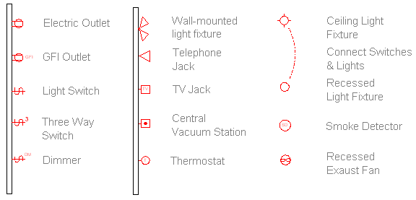
Example notation

Slide 48
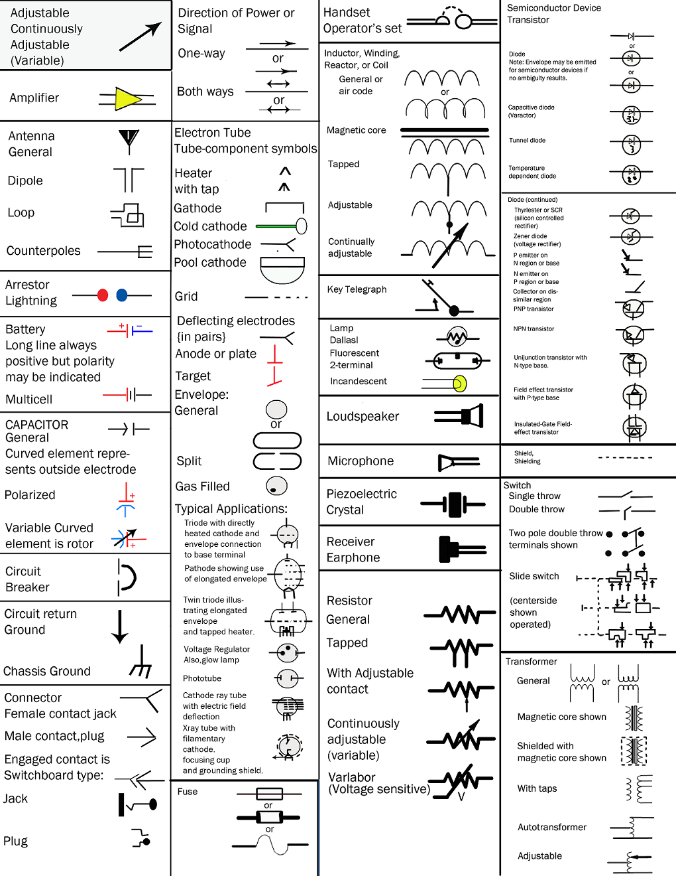
Example notation

Slide 49
Example notation

Slide 50
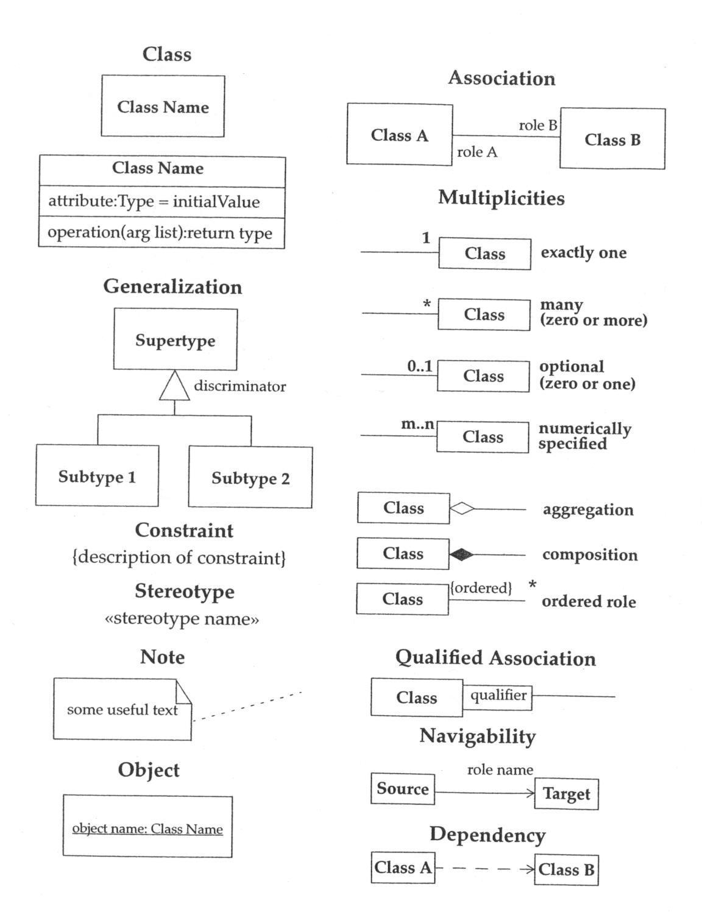
Example notation

Slide 51
Example notation

Slide 52
Considerations in choosing a design notation
Who is the audience?
What is the objective?
What is the timeframe?

Slide 53
Design studio 1 part 2
Questions?

