Slide 1
Informatics 121 Software Design I
Lecture 9
Duplication of course material for any commercial purpose without the explicit written permission of the professor is prohibited.

Slide 2
Today’s lecture
Design studio 1 debrief
Expert behaviors
Design studio 2

Slide 3
Design studio 1
Your client is RealPlay, a new company that recognizes the importance of children not only playing on some form of laptop, phone, or tablet, but also playing with friends in the real world.
RealPlay is particularly looking to break the increasing screen-oriented world of children by finding them opportunities to play with other children. It’s looking to borrow ideas from Facebook, Doodle, and so on, but really wants to ‘blow this out of the water’ and be the next unicorn ($1B startup). Additional functionality, then, is something it wants thought about.
The company has sought you out, because you are an excellent designer. All of the software design is in your hands. RealPlay has the idea protected (meaning no competition), but has no idea how to actually design the software.

Slide 4
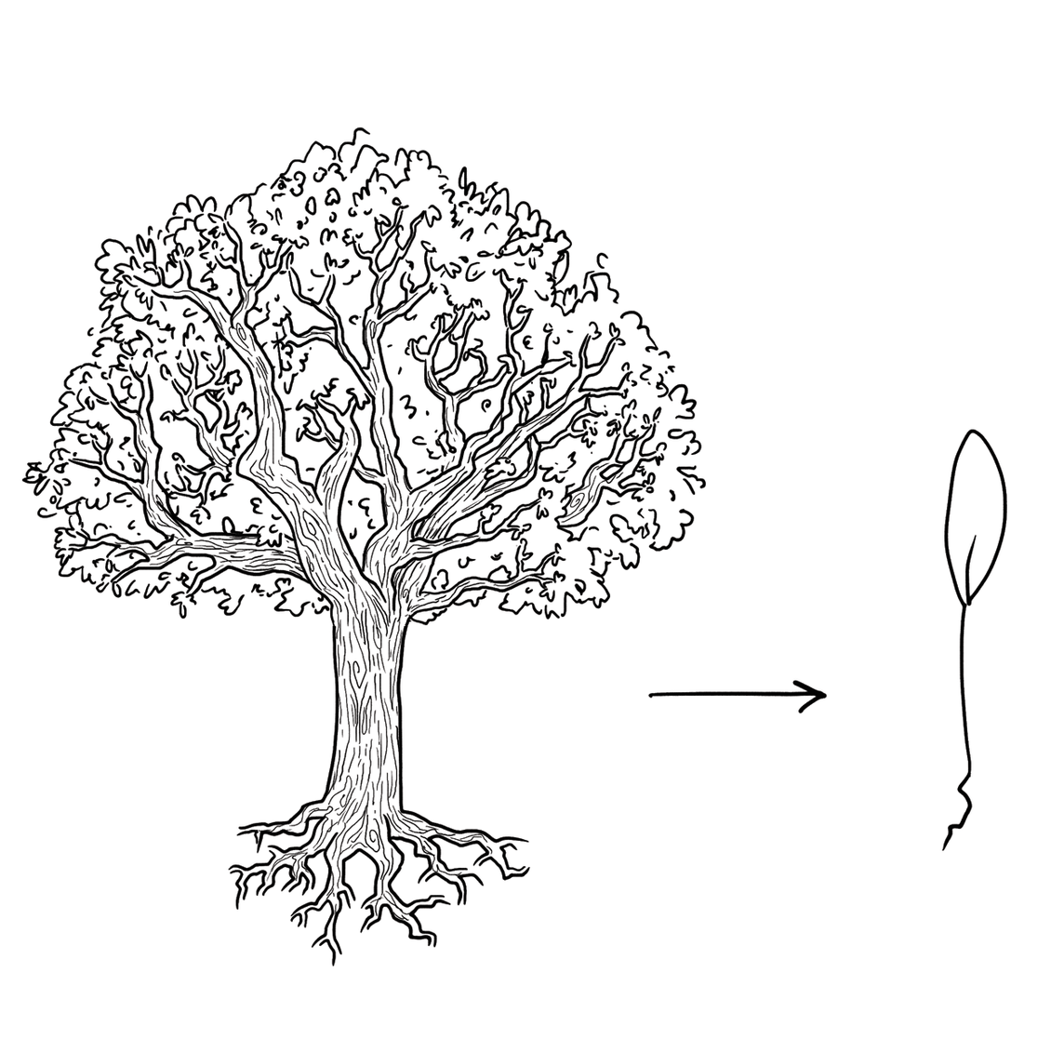
Where lies the essence of this design problem?

Slide 5
What past solutions that work did you prefer?

Slide 6
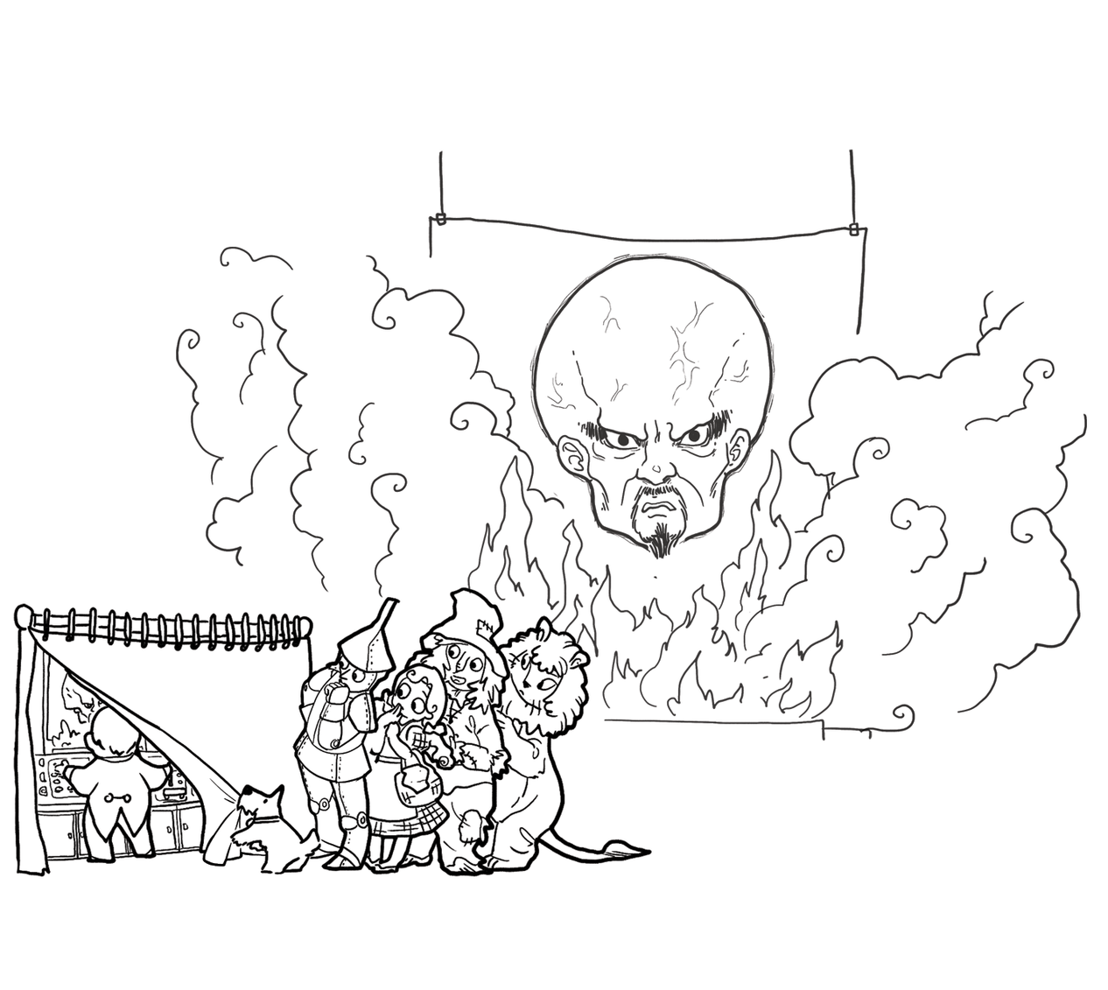
What knowledge deficiencies did you address?

Slide 7
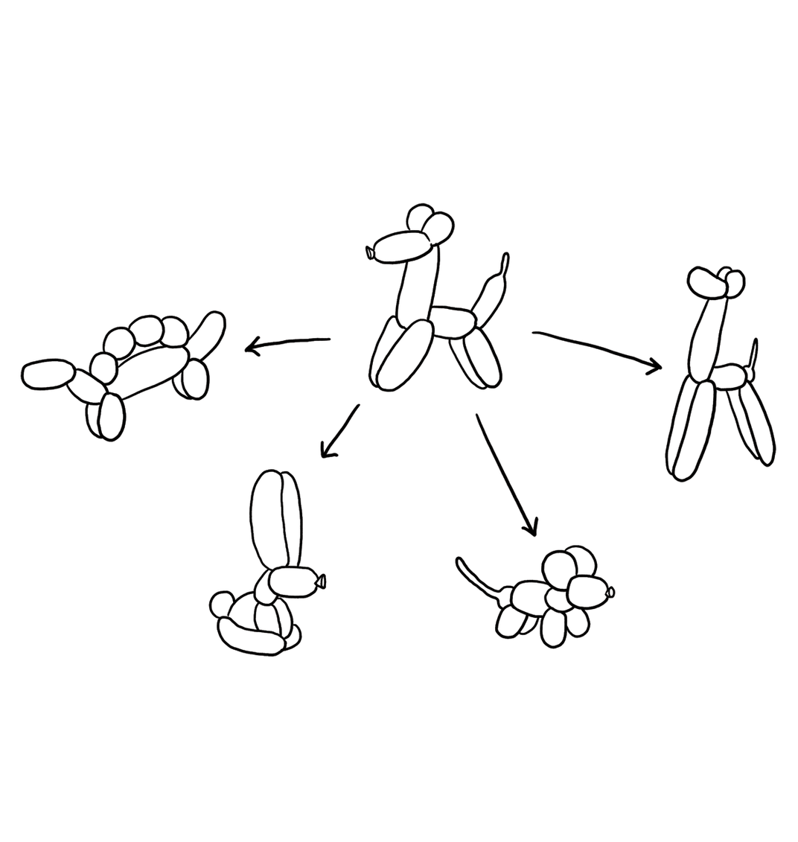
What alternatives did you generate?

Slide 8
How were you skeptical?

Slide 9
What was difficult about this design studio?
Why?

Slide 10
If you had more time, what would you have done?
Why?

Slide 11
How much did you feel you were engaging in...
...predicting the future, with incomplete information and thus uncertainty?
...making tradeoffs, across the different needs and anticipated experiences of the audience and other stakeholders?
...marrying technical and social perspectives, in engineering software to engender new people behavior?

Slide 12
How much did you feel you were engaging in...
...facing unique problems, even if you have seen them before?
...knowing when to stop, for no design is ever perfect?
...accommodating change, as everything you know now may be different sooner or later?

Slide 13
How much did you feel you were engaging in...
…it’s work!

Slide 14
Did you keep this in mind?
designer
plan
maker
change in the world
other stakeholders
audience
experiences

Slide 15
Did you keep this in mind?
synthesize
goals
constraints
assumptions
decisions
ideas
analyze
evaluate

Slide 16
How would you have structured the studio?

Slide 17
Final note on design studio 1
Much of what you just experienced was intentional on my part

Slide 18
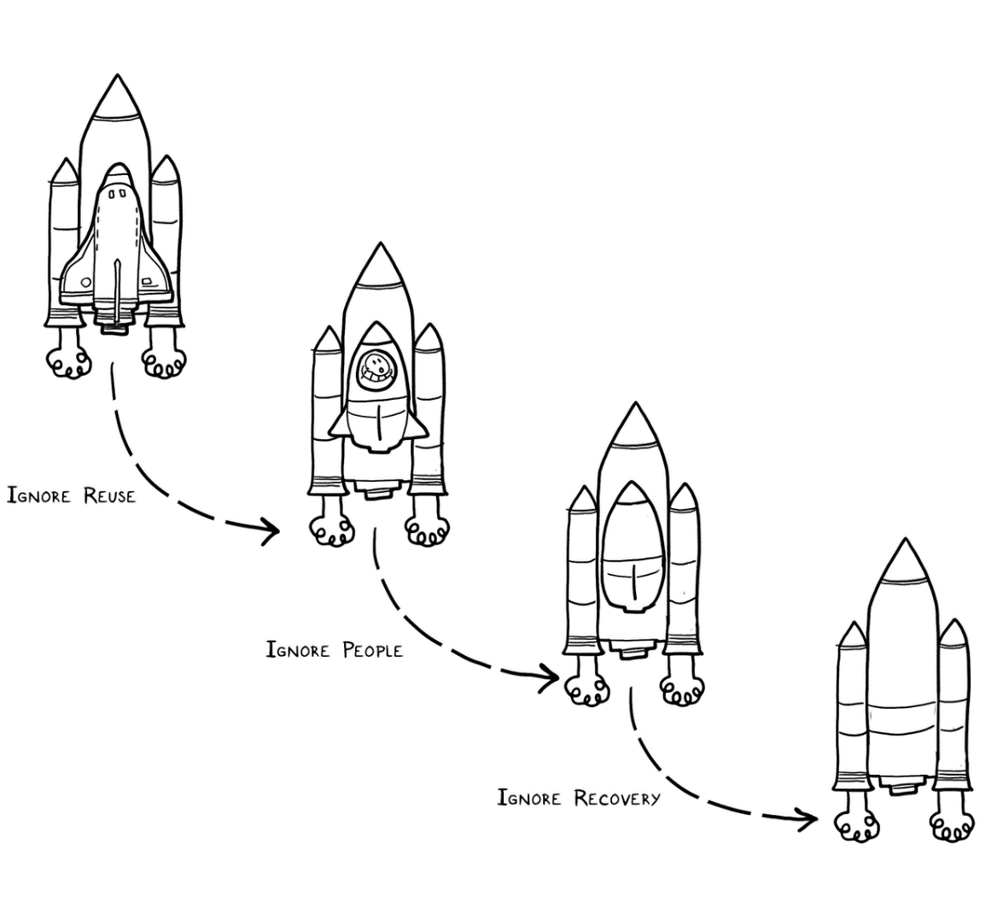
Experts solve simpler problems first

Slide 19
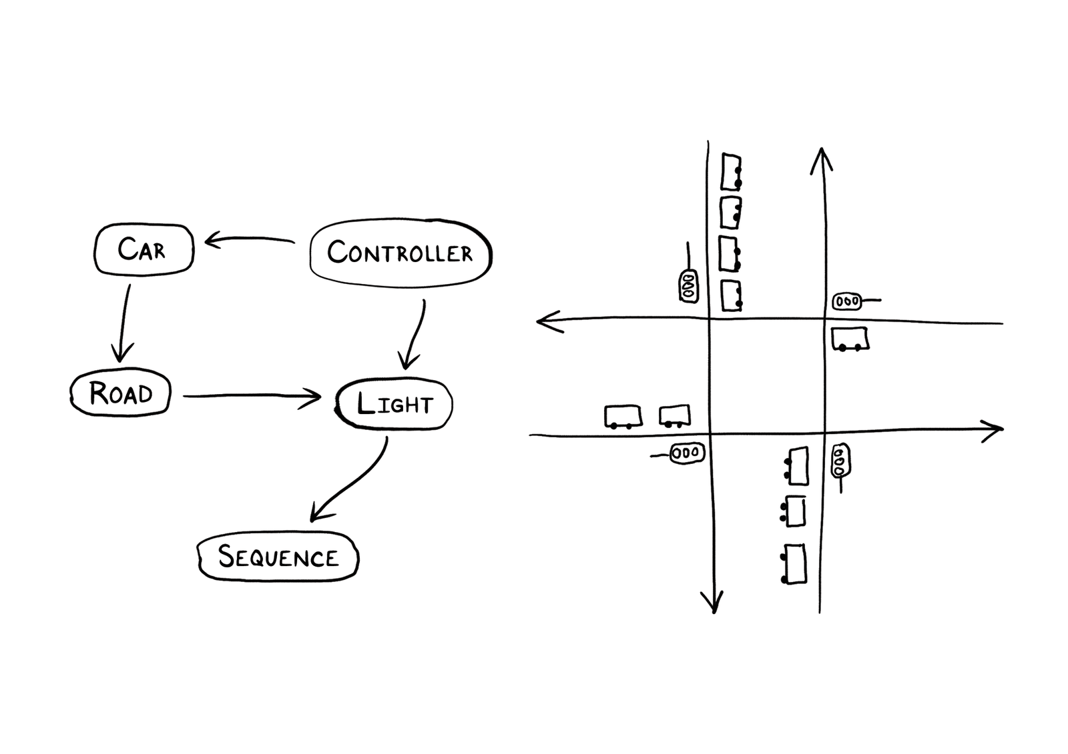
Experts draw the problem as much as they draw the solution

Slide 20
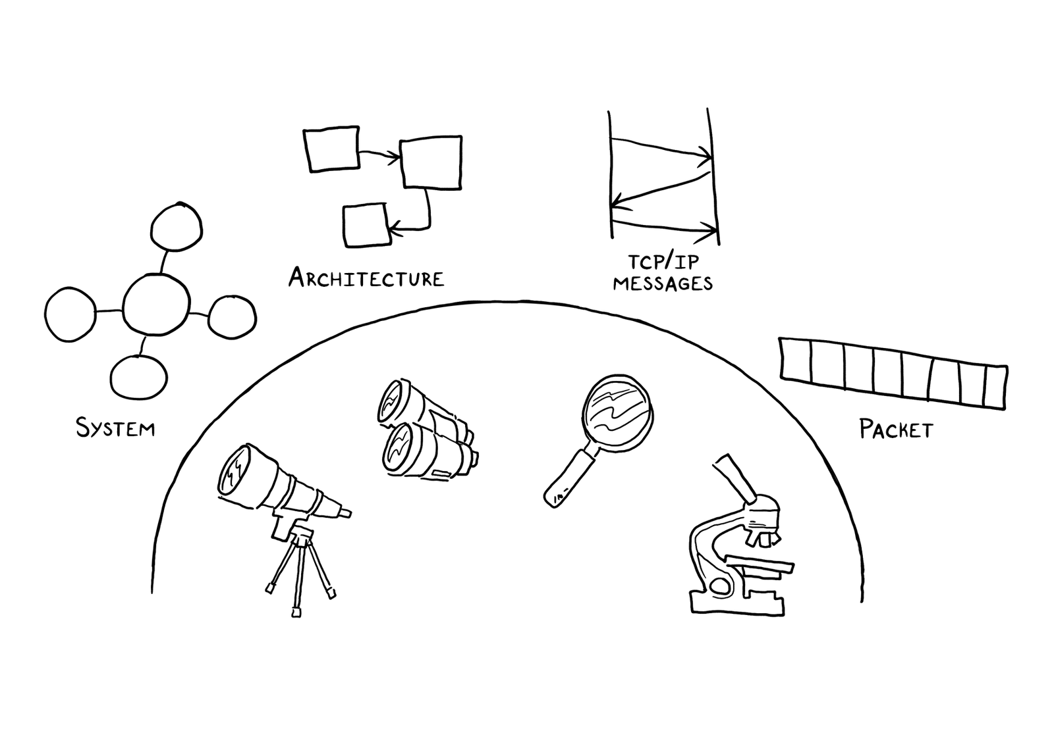
Experts move among levels of abstraction

Slide 21
Experts go as deep as needed

Slide 22
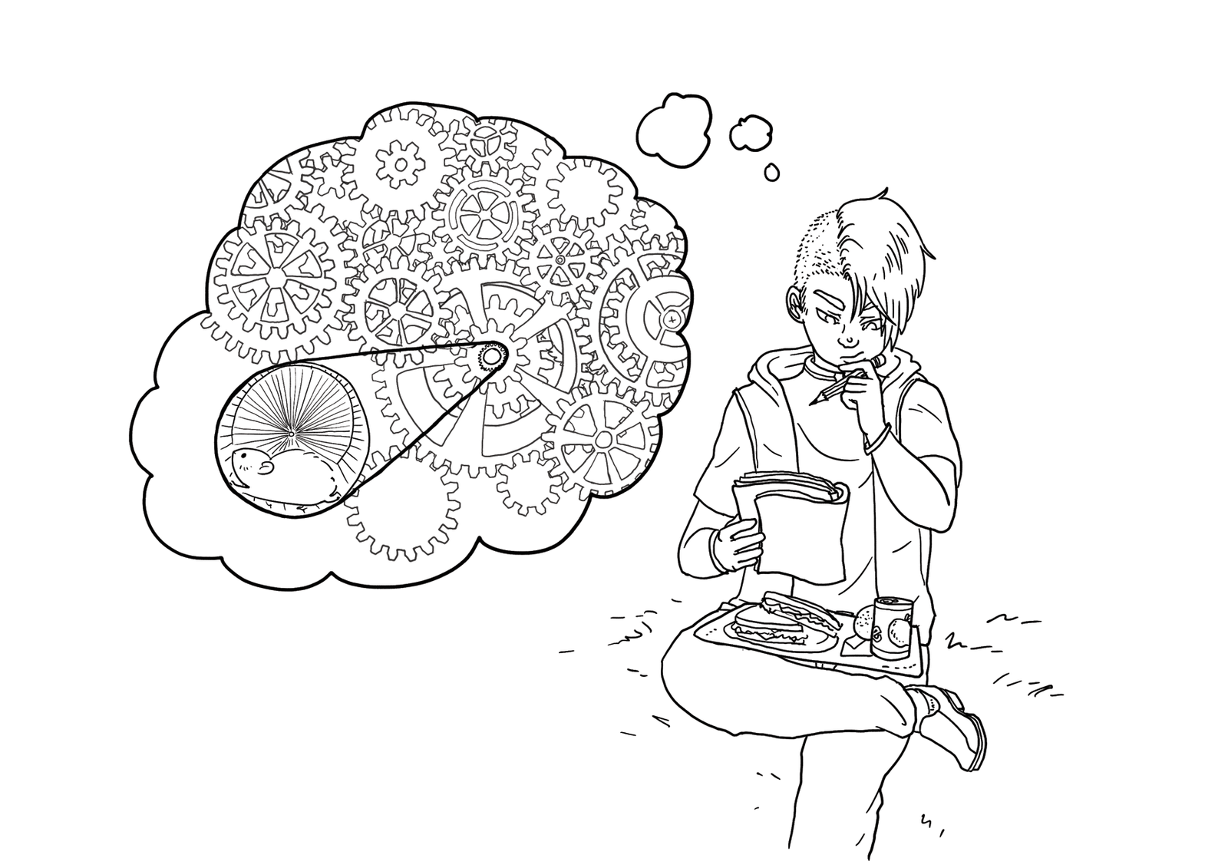
Experts simulate continually

Slide 23
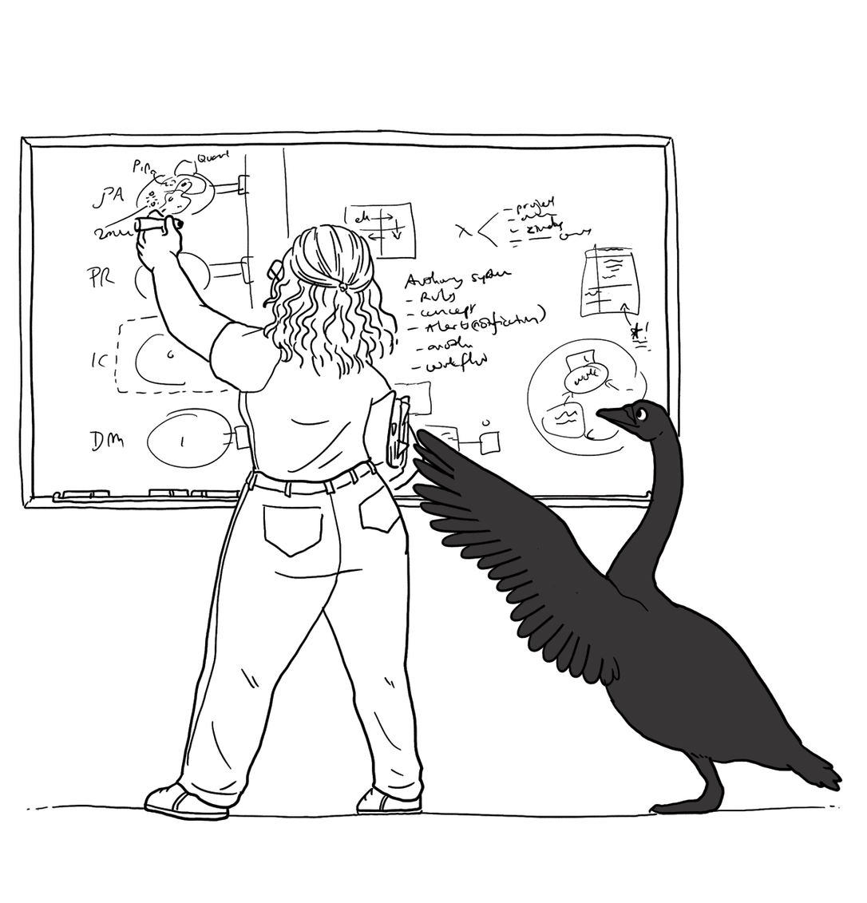
Experts are alert to evidence that challenges their theory

Slide 24
Experts think about what they are not designing

Slide 25
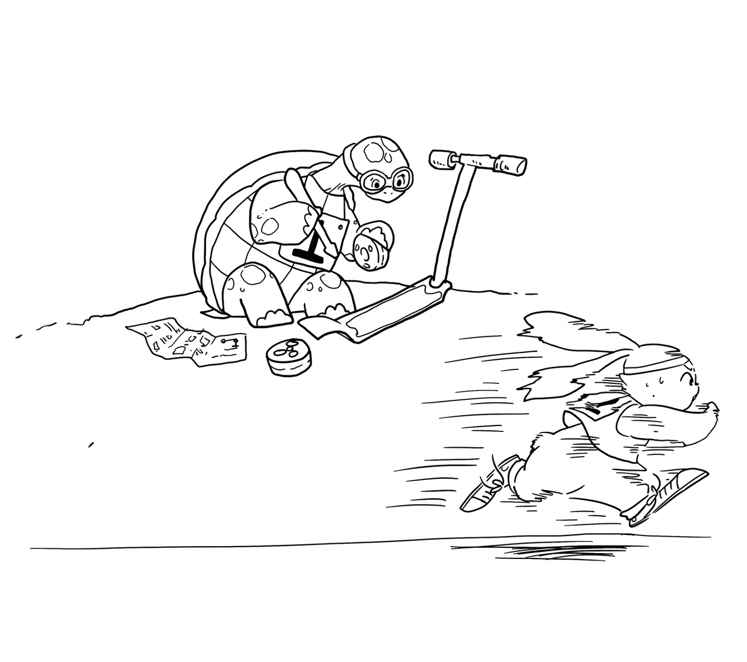
Experts invest now to save time later

Slide 26
Design studio 2 (part 1)
As a team, design an educational traffic simulator based on the design prompt we handed out in class
Make sure to consider at least three different approaches, highlight tradeoffs among the approaches, and discuss why you chose the approach you took
briefly document the approaches you considered but did not adopt
Your group will be announced at the start of your discussion

Slide 27
Design studio 2 (part 1)
Focus
predicting the future
making tradeoffs
marrying technical and social perspectives
facing unique problems
knowing when to stop
accommodating change

Slide 28
Design studio 2 (part 1)
Practice what you have learned about experts:
solve simpler problems first
draw the problem as much as they draw the solution
move among levels of abstraction
go as deep as needed
simulate continually
are alert to evidence that challenges their theory
think about what they are not designing
invest now to save time later

Slide 29
Design studio 2 (part 1)
Practice what you have learned about experts:
focus on the essence
prefer solutions that they know work
address knowledge deficiencies
generate alternatives
are skeptical

Slide 30
Design studio 2 (part 1)
Due through GradeScope, Tuesday February 19, at noon
make sure to identify all group members
make sure to identify your discussion time
No extensions, not even for reduced points

Slide 31
Design studio 2 (part 1)
Team members will assess other team members
in terms of the contributions they make
in terms of enabling others to make contributions

