Slide 1
Intelligent Transportation Systems:
A Vehicular Perspective
S. Ramesh
India Science Lab, GM R&D
Bangalore

Slide 2
OEM Challenges
Car owners are increasing along with the population increase
  Population: 6B (now) – 7.5B (2020) – 9B (2050)
  From 12% (now) - 15% (2020) - 20% (2050)
  Cars: 700M (now) – 1B (2020) – 1.5B (2050)
1B to 1.5B vehicles is not sustainable!
  Environment
  Energy
  Safety
  Congestion
  Affordability

Slide 3
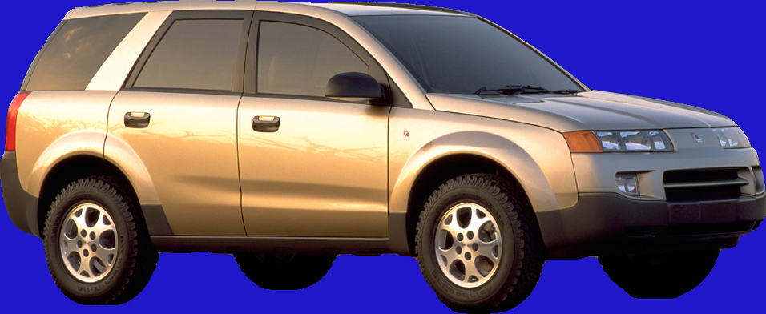
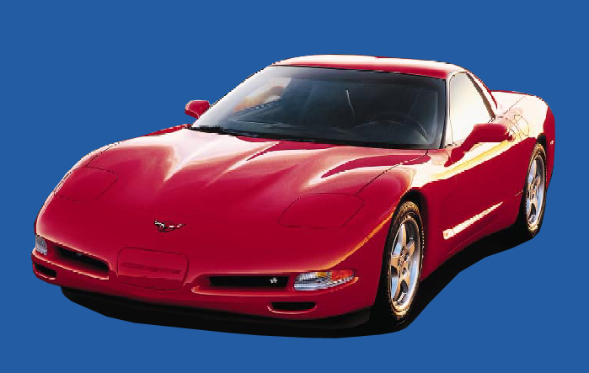
Customer Requirements
Energy efficient
Environmentally
friendly
Safe
Reliable
Functional
Fun to drive
Affordable
Stylish
Notes:
These stretch goals also are in line with customer demand
Our customers tell us they require vehicles that are energy-efficient, environmentally friendly, safe, reliable, functional, and fun to drive -- at an price they can afford --
-- and, because people are passionate about their vehicles, with some style
As I noted, none of these societal challenges and customer requirements can be met independently -- they are interrelated

Slide 4
Auto Industry Challenges
Challenges Stretch Goals
Energy Low-cost renewable energy
Emissions No tailpipe environmental impact
Safety Vehicles that never crash
Congestion Congestion-free routing
Personalization Customize without complexity
Affordability All of above with price constrained
Notes:
TISL12

Slide 5
Goal – Vehicles That Drive Themselves
Where am I – GPS + digital maps
What’s around me – 360° sensing (sensors + “V2V”)
Take me where I want to go –
Software algorithms + electronic
controls and actuators
Notes:
So how do you get to vehicles that drive themselves?
First, I need to know where I am – so I need GPS with digital maps.
Then, I need to know what’s around me – which means sensors and can also include vehicle-to-vehicle and vehicle-to-infrastructure communications.
And then, I need my vehicle to take me where I want to go – using software algorithms and electronic controls and actuators.
All of these technologies exist today … so GM sees vehicles that drive themselves without human input as possible in the next decade.
Imagine being able to catch up on your emails … or write and file your next story … while your vehicle drives you home or to your next assignment.
Imagine feeling completely safe in your vehicle because it can avoid crashes.
Imagine being able to eliminate the situations that today cause road rage!
DARPA09

Slide 6
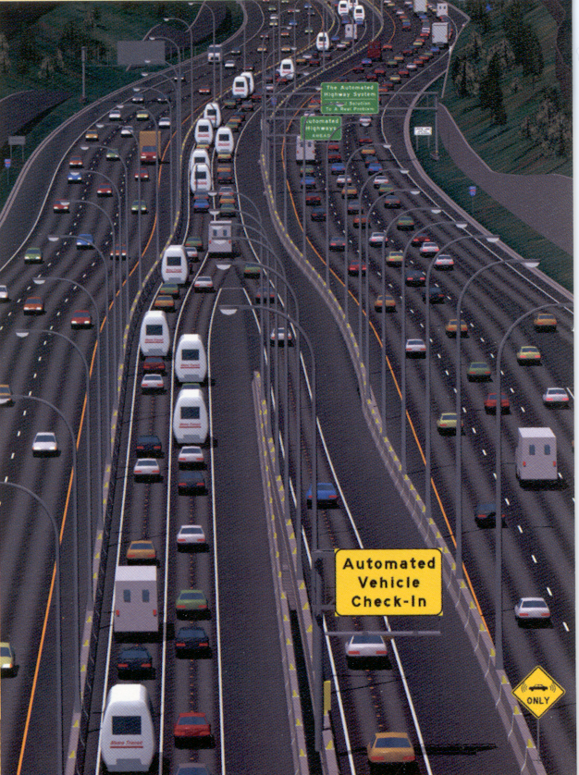
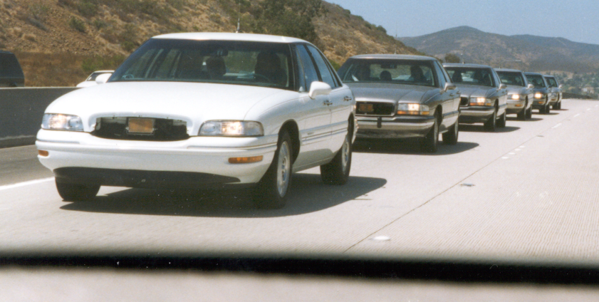
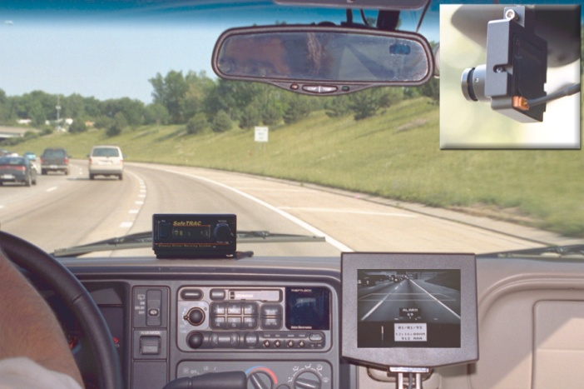
Intelligent Vehicles and Highways
Notes:
… intelligent highway systems will also be part of the safety equation
Vehicles will be capable of driving themselves on specially designated, limited-access “automated highways”
Traffic, and the movements of individual vehicles, will be coordinated region-wide through metropolitan traffic control centers
Since vehicles will be able to travel at high speed and platoon in close proximity, rush hour stop-and-go traffic will be eliminated
As a result, vehicle mileage ratings will move from the low end of the city driving schedule to the high end of the highway driving schedule
Making more productive use of infrastructure will decrease energy use – e.g., fewer roads are needed to provide adequate capacity

Slide 7
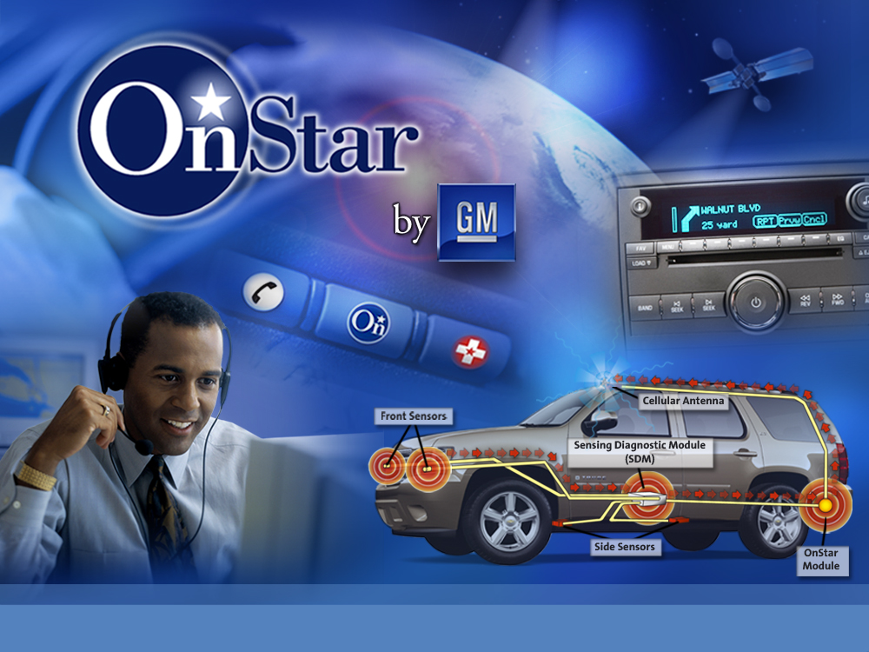
Notes:
GM is also a leader in vehicle telematics, with our OnStar safety, security, and communications service.
OnStar currently has more than 4 million subscribers and will be standard on most GM retail vehicles in the United States and Canada by the end of this year.
For 2007, OnStar introduced Turn-by-Turn Navigation, the first factory-installed, fully-integrated GPS navigation system. This system fundamentally changes how drivers access navigation, with audio directions automatically played through the vehicle’s stereo as needed, triggered by OnStar’s GPS capabilities.
By the way, did you know that OnStar makes GM the largest civilian purchaser of GPS units in the world?
Today, the precision of GPS is making it possible to connect everything to everything else, precisely and affordably – and this is another key piece in the automated driving puzzle.
DARPA12

Slide 8
Notes:
Today, 360-degree sensing for advanced vehicle safety systems involves the use of expensive radars, cameras, and other state-of-the-art technologies to provide capabilities such as adaptive cruise control, forward collision warning, parking assist, blind-spot detection, and driver alerts.
DARPA13

Slide 9
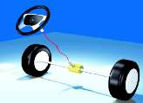

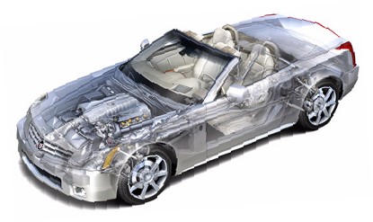
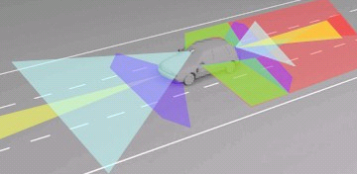


Active Safety to Autonomy
System Integration
EPS+AFS
(Partial Steer-by-wire)
Wheel Motor
By-wire applications
Partial and Fully
Autonomous
Federated to
Integrated functions
Brake by Wire
Hybrid Power
Train
V2I
V2V
CAN
360º Sensing

Slide 10

Roadmap to Autonomous Driving
Functionality
Autonomous Driving
On-Demand Autonomous Driving
Vehicle drives itself for an entire travel journey
• Vehicle as Chauffeur
Vehicle performs autonomously
“on-demand” for limited travel
• Highway-Only Autonomous Driving
Semi-Autonomous Driving
Driver Assist/
Warning
Distributed control between vehicle and driver
• Lane Centering
Lane Departure Warning
Side Blind-Zone Alert
Today
Future
Notes:
Here’s how GM sees the progression to vehicles that drive themselves.
DARPA16

Slide 11
Middleware Challenges
Distributed Autonomous Agents
Mobility
Context Awareness
Real-Time Response
Safety-Criticality
Quality of Service
  Fault-Tolerance
  Security
Evolution of Changes

Slide 12
Thank You

