Slide 1
SUSTAIN: An Adaptive Fault Tolerance Service for Geographically Overlapping Wireless Cyber-Physical Systems
Gholam Abbas Angouti Kolucheh, Qi Han
{gangouti,qhan}@mines.edu

Slide 2
Geographically Overlapping CPSs
More than one wireless sensor network (WSN) may be deployed in the same geographical area
Each WSN is isolated from the other

Slide 3
WSNs are Failure Prone
Existing fault management techniques do not exploit resources in neighbor WSN
A network may be partitioned

Slide 4
Problem Definition
Objective:
To design SUSTAIN that resumes the communication between the sink and the disconnected parts using nodes in neighbor WSNs.
Assumptions
Some nodes in neighbor WSNs are in the transmission range of each other.
All nodes in a network need to send their data to the sink.
WSNs are initially connected.
The full topology of each WSN is available at its sink.

Slide 5
Flow of SUSTAIN

Slide 6
Terms Used
FT: a node that is in the transmission range of at least one node in neighbor WSNs.
FT_peer: one of the nodes in the neighbor WSN within the transmission range of an FT_node
sink-included part: the part of network including the sink
no-sink parts: The parts not including the sink
FT_ selected: the FT node which serves as the access point of all nodes in a partition

Slide 7
Identifying Network Partitions
Failures are reported to the sink node
SUSTAIN identifies all the partitions and nodes belong to those partitions
Using the concept of articulation sets
FT nodes and their correspondent FT_peer nodes are identified for each part

Slide 8
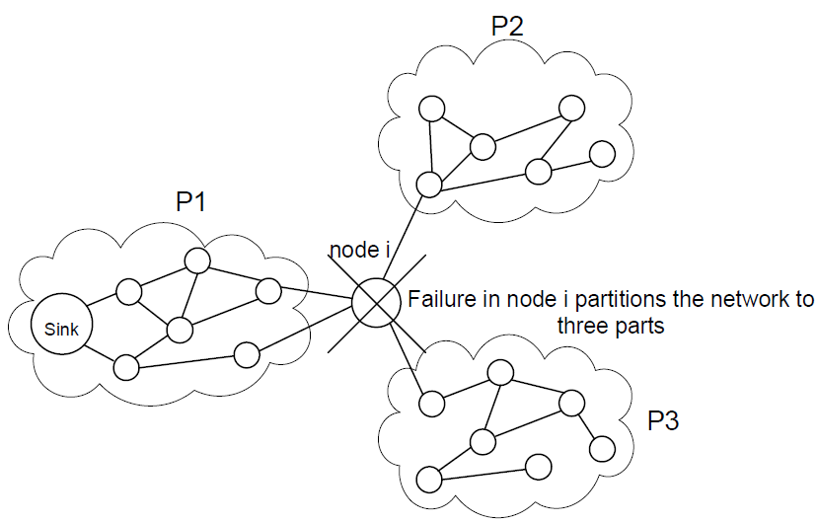
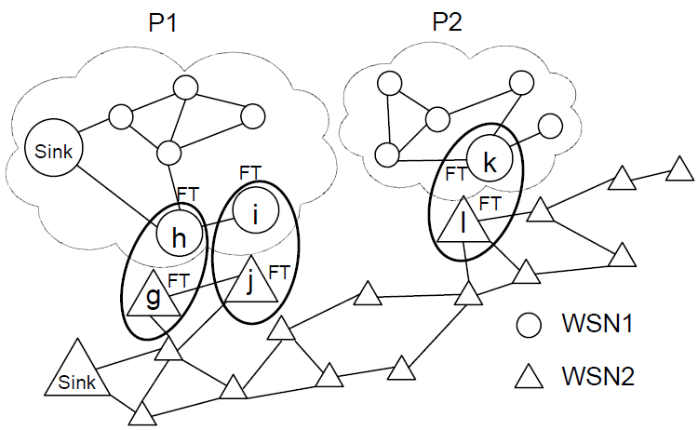
An Example of Network Partitions

Slide 9
Connecting Sink-included and No-sink Parts
Select an FT_selected node in sink-included part
Construct a path between this FT_selected node and an FT node in a no-sink part using nodes in a neighbor WSN
Select the FT node that belongs to the created path as the FT_selected node in no-sink parts.

Slide 10
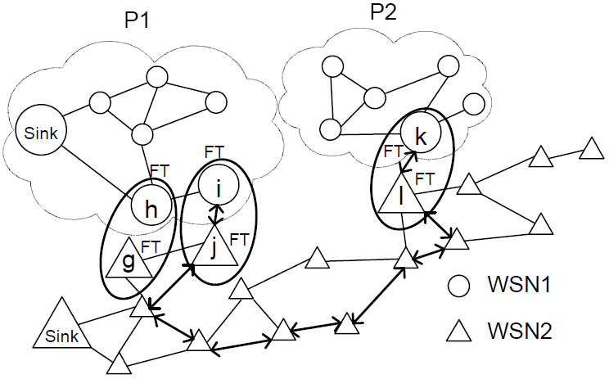
An Example

Slide 11
Managing Partitioning in No-sink Parts
Possible situation: the exact number of partitions is not known at the sink.
no-sink parts are further partitioned.
Solution:
the topology of this part is then transmitted to the sink along with any faults reported to the FT_selected node.

Slide 12
Performance Evaluation
Baseline methods:
CTP-without-faults:
no network partitioning
upper bound of the performance
CTP-with-faults:
network is partitioned
CTP does not deal with faults
Performance metrics:
packet delivery ratio (PDR), cost, and delay
Evaluation scenarios
Impact of network size
Impact of fault severity

Slide 13
Simulation Environment
Implemented in nesC
Two geographically overlapping WSNs.
All nodes send data to the sink every 8 seconds.

Slide 14
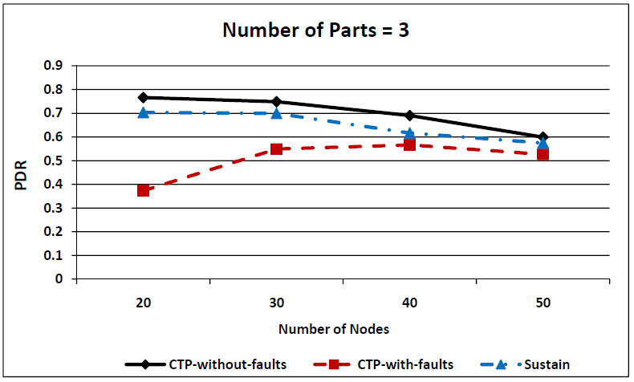
Impact of Network Size- PDR

Slide 15
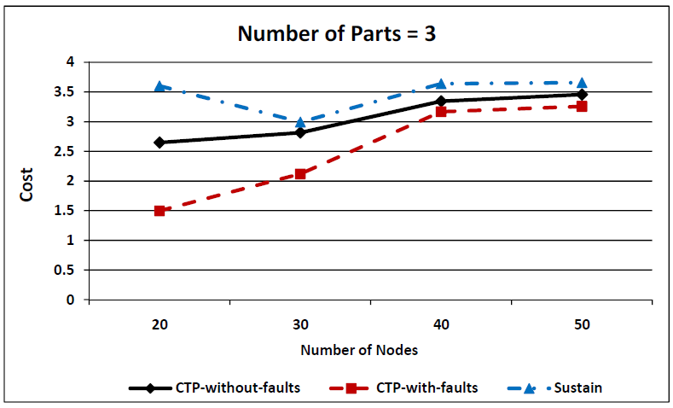
Impact of Network Size- Cost

Slide 16
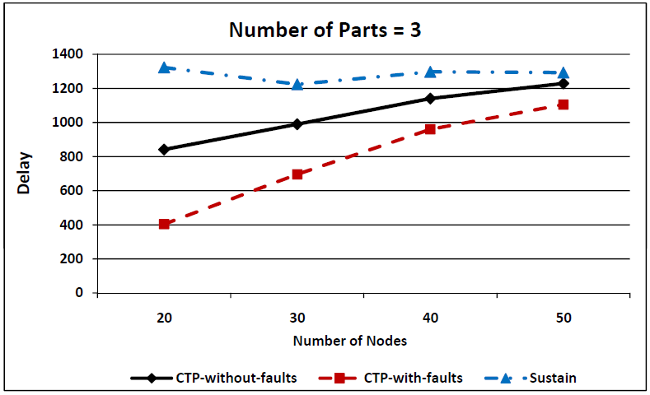
Impact of Network Size- Delay

Slide 17
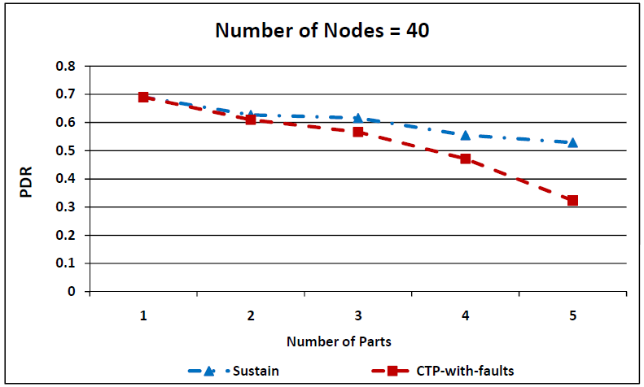
Impact of Fault Severity- PDR

Slide 18
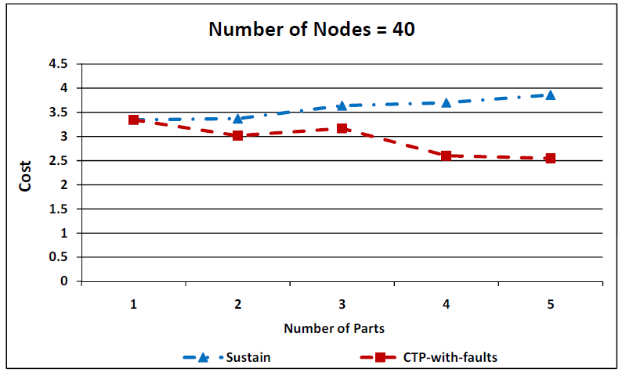
Impact of Fault Severity- Cost

Slide 19
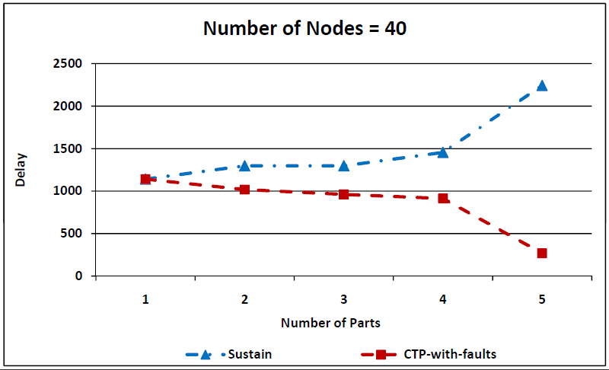
Impact of Fault Severity- Delay

Slide 20
Conclusion
SUSTAIN supports fault tolerance in geographically overlapping WSNs.
SUSTAIN increases the average PDR with an affordable overhead.
SUSTAIN is beneficial to cyber-physical applications where the PDR is more important than slightly increased latency and number of hops for packets.

