Slide 1


Supporting Analytics on Big Geospatial Data Using ASTERIX
Chen Li
Information Systems Group (ISG)
University of California, Irvine
BigSpatial Workshop, Nov. 6, 2012
Redondo Beach, CA, USA

Slide 2

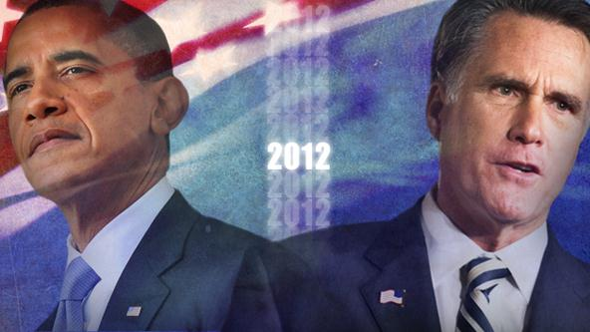
Today is a special day!
Notes:
2

Slide 3

If I Could Turn Back Time…
Notes:
3

Slide 4
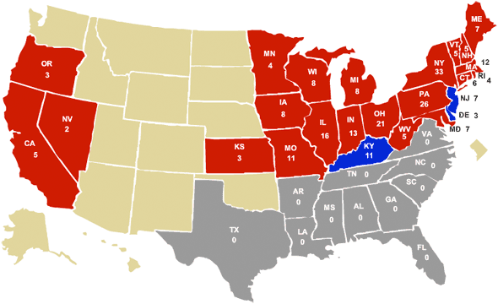
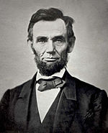
Election results: 1864
Abraham Lincoln
Notes:
4

Slide 5
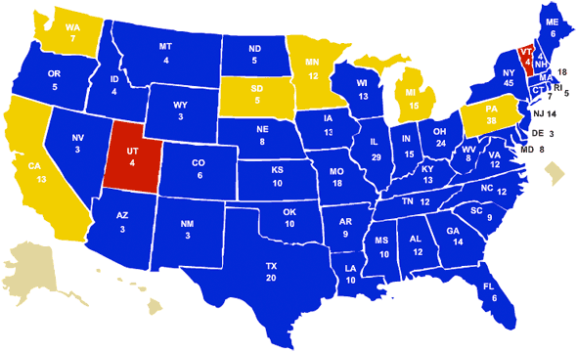
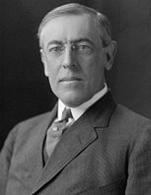
Election results: 1912
Woodrow Wilson
Notes:
5

Slide 6
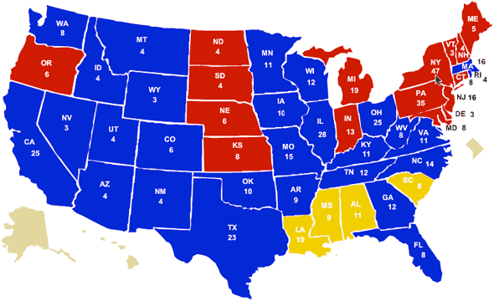

Election results: 1948
Harry S. Truman
Notes:
6

Slide 7
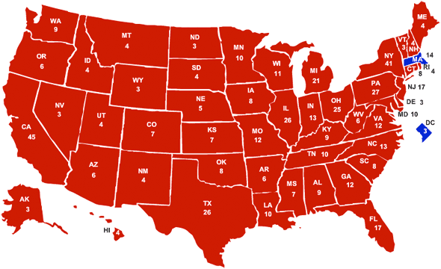

Election results: 1972
Richard Nixon
Notes:
7

Slide 8
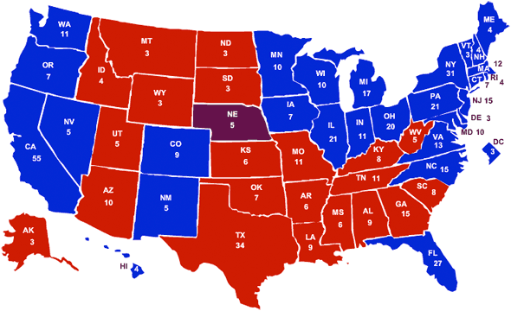
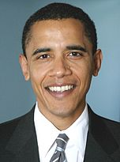
Election results: 2008
Barack Obama
Notes:
8

Slide 9

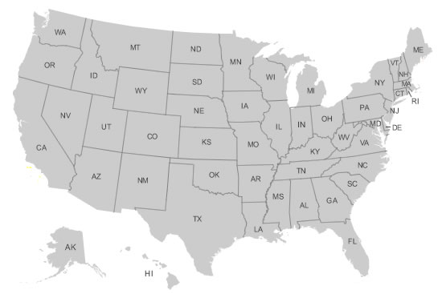

Election results: 2012
Notes:
9

Slide 10




Huge Costs
Notes:
10

Slide 11
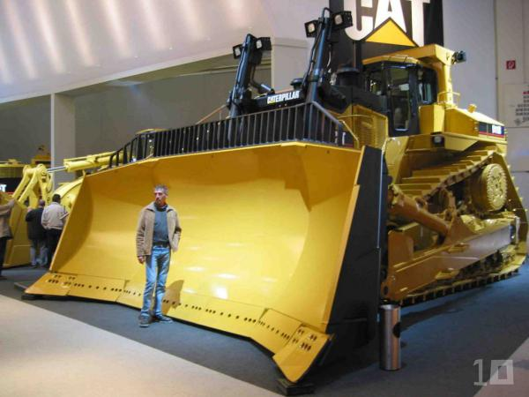


Powerful tools in 2012: Social Media
Notes:
11

Slide 12
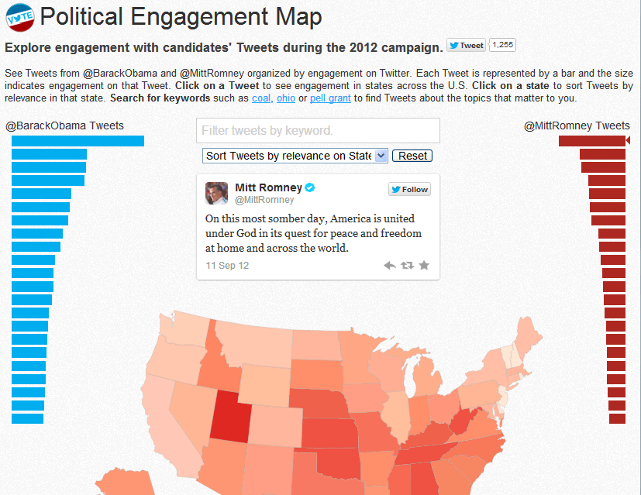
Example: Twitter Political Engagement Map
Notes:
12

Slide 13
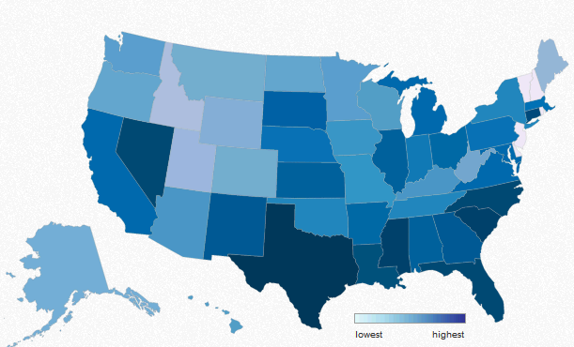


Other applications: Business Competition
Query: “Spatial distribution of tweets mentioning iphone sales during the Christmas week.”
Notes:
13

Slide 14

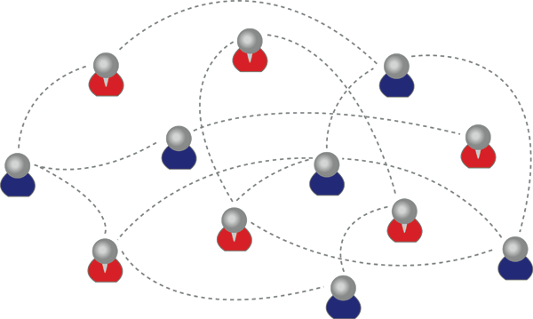
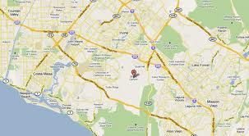
Other applications: Social Networks
A user wants to find a good jazz club in a neighborhood that starts in the next two hours, and find friends in the same area to go.
Notes:
14

Slide 15


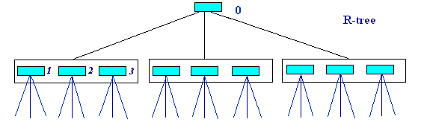
Challenge: Spatial as 1st-class citizen
Notes:
15

Slide 16
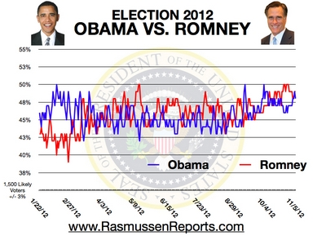
Challenge: Temporal Info
Notes:
16

Slide 17

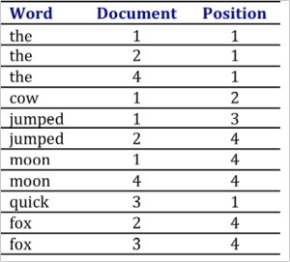
Challenge: Textual Info
Tools for
Text search
Text aggregation
Text mining
Inverted index
Notes:
17

Slide 18


Challenge: Large and Dynamic
Tweets per second (TPS): 25,088
Notes:
18

Slide 19
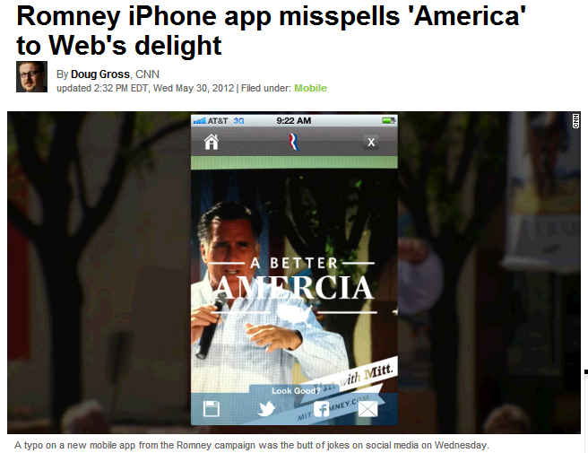
Challenge: Noisy data
Notes:
19
Selection query: Find all tweets mentioning “Rick Santorum”
Should “Rick Sanitarium” match? Probably yes!
Fuzzy selection query can find similar matches
ASTERIX will support indexed fuzzy selection queries

Slide 20





Existing solutions
Notes:
20

Slide 21

The ASTERIX Approach
Semistructured
Data Management
Parallel Database Systems
Data-Intensive
Computing
Big Data Management System (BDMS)
Notes:
21
Semistructured data management
Core work exists
XML & XQuery, JSON, …
Time to parallelize and scale out
Parallel database systems
Research quiesced in mid-1990’s
Renewed industrial interest
Time to scale up & de-schema-tize
Data-intensive computing
MapReduce and Hadoop quite popular
Language efforts even more popular (Pig, Hive, Jaql, …)
Ripe for parallel DB query processing ideas and support for stored, indexed data sets

Slide 22
The ASTERIX Architecture
Data loads and feeds from external sources
AQL Queries/Results
Data publishing
Hi-Speed Interconnect
Asterix Client Interface
Asterix Client Interface
Shared-Nothing
Architecture
AQL Compiler
Metadata Manager
AQL Compiler
Metadata Manager
…
Hyracks Dataflow Engine
Hyracks Dataflow Engine
Dataset Feed Storage
Dataset Feed Storage
LSM Tree Manager
LSM Tree Manager
ASTERIX Cluster
Notes:
22

Slide 23
The ASTERIX Stack

Slide 24

How ASTERIX Indexes Fast-Incoming Spatial Data?
How about using conventional indexes such as R trees?
Insert to the R-tree
Does not scale!
Can we do better?
Notes:
Not designed to ingest fast data
Disk arm is moving all around the place
As tree gets bigger, the insertion cost is even getting higher

Slide 25
LSM-based R-tree
Memory
Sequential write to disk
Disk
Periodically merge disk trees
Notes:
ASTERIX uses LSM-based R-tree (LSM: Log Structured Merge trees).
LSM-tree designed for high write throughput.
Basic Idea:
Batch inserts into in-memory R-tree
Flush R-tree sequentially to disk when memory budget is consumed.
Periodically merge disk R-trees
For efficient merges and even search performance, we use Hilbert curve to organize trees on disk

Slide 26
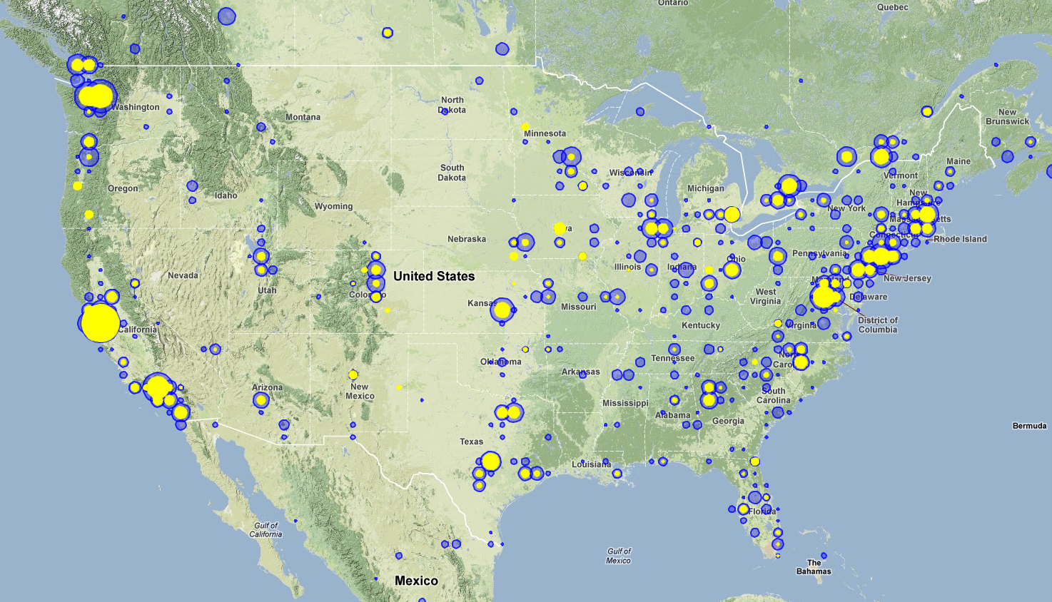
Spatial Aggregation Using ASTERIX

Slide 27
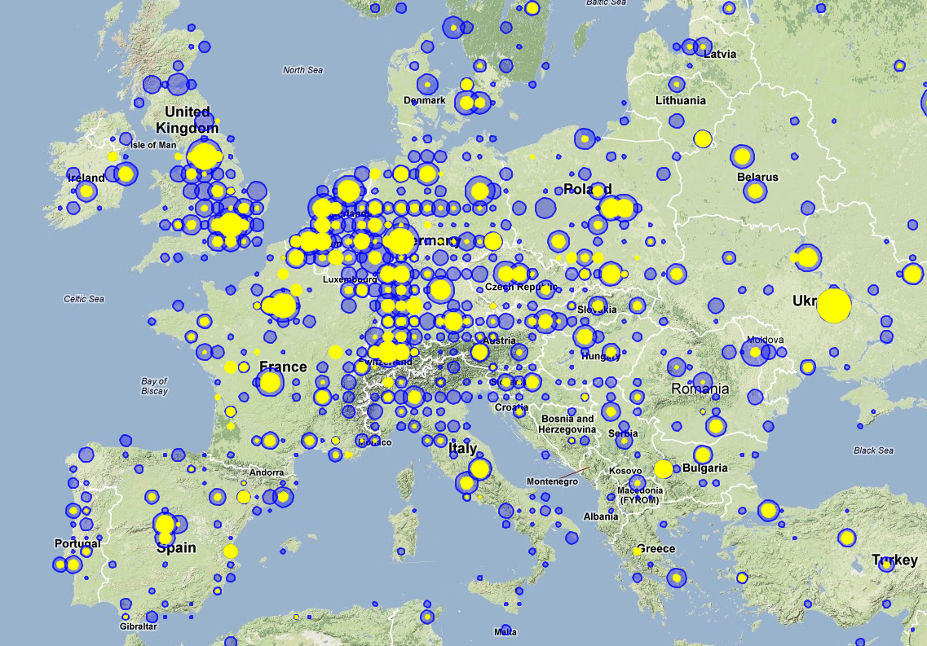
Spatial Aggregation Using ASTERIX

Slide 28
Data Loading
drop dataverse VLDBDemo if exists;
create dataverse VLDBDemo;
use dataverse VLDBDemo;
create type ProcessedWeblogType as
open {
id: int64,
gid: string?,
aid: string?,
version: string?,
location: point?,
year: int64?,
month: int64?,
day: int64?
};
create dataset ProcessedWeblog(ProcessedWeblogType) partitioned by key id;
create index location_index on ProcessedWeblog(location) type rtree;
load dataset ProcessedWeblog
using "edu.uci.ics.asterix.external.dataset.adapter.NCFileSystemAdapter"
(("path"="nc1:///data/demo/vldb-demo/processed_logs2.adm"),("format"="adm"));
Notes:
drop dataverse VLDBDemo if exists;
create dataverse VLDBDemo;
use dataverse VLDBDemo;
create type ProcessedWeblogType as open {
id: int64,
gid: string?,
aid: string?,
version: string?,
location: point?,
year: int64?,
month: int64?,
day: int64?
};
create dataset ProcessedWeblog(ProcessedWeblogType) partitioned by key id;
create index location_index on ProcessedWeblog(location) type rtree;
load dataset ProcessedWeblog
using "edu.uci.ics.asterix.external.dataset.adapter.NCFileSystemAdapter"
(("path"="nc1:///data/demo/vldb-demo/processed_logs2.adm"),("format"="adm"));

Slide 29
Spatial Aggregation Query
for $x in dataset('ProcessedWeblog')
where $x.version = ‘6-b14’
let $poly := create-polygon(create-point(47.94900708555258,-74.49965312500001),create-point(38.63779231230829,-74.49965312500001),create-point(38.63779231230829,-111.41371562500001),create-point(47.94900708555258,-111.41371562500001))
where spatial-intersect($x.location, $poly)
let $n := 1
group by $c := spatial-cell($x.location, create-point(0.000,0.000), 0.093, 0.369) with $n
return {'cell': $c, 'count': count($n)}

Slide 30


Asterix Data Model
create type TweetType as open {
id: string,
username: string,
location: point?
text: string,
hashtags: {{string}}?
}
create type NewsType as open {
id: string,
title: string,
description: string?
link: string,
topics: {{string}}?
}
Definition of a tweet in ADM
Definition of a news article in ADM
Notes:
30

Slide 31

Similarity Selection Queries
…
where keyword ∼= “america”
…
Notes:
31
Selection query: Find all tweets mentioning “Rick Santorum”
Should “Rick Sanitarium” match? Probably yes!
Fuzzy selection query can find similar matches
ASTERIX will support indexed fuzzy selection queries

Slide 32
Fuzzy Join in AQL
Fuzzy Join on Topics
topics ~= hashTags
set simfunction "jaccard"
set simthreshold "0.5f“
for $tweet in dataset(’Tweets’)
for $article in dataset(’News’)
where $tweet.hashTags ∼= $article.topics
group by $a := $article.id with $article
order by count($article) desc
limit 10
return {"article": $article, "popularity": count($article)}
Find top 10 popular news articles based on # of tweets about similar topics.
Notes:
32
~= operator means “similar to”
~= is qualified by “set simfunction” and “set simthreshold”
~= just syntactic sugar, other representations via jaccard function equivalent
For each article find count the number of tweets that are about similar topics, and return the top ten articles based on the number of tweets
ASTERIX will support parallel fuzzy joins (possibly using indexes)

Slide 33
Creating a Feed
create
feed
dataset Tweets(TweetType)
using TwitterAdapter (“interval”=“10”)
apply function addHashTagsToTweet
partitioned by key id;
create feed dataset News(NewsType)
using CNNFeedAdapter (“topic”=“politics”,”interval”=“600”)
apply function getTaggedNews
partitioned by key id;
create index location_index on Tweets(location) type rtree;
Notes:
33

Slide 34


Ingesting Data
Data Ingestion
begin feed Tweets;
Adapter
Hash Partition
Hash Partition
f(tweet)
Insert
Raw Tweets (json)
Asterix Node
Asterix Node
Asterix Node
f(tweet)
Insert
Asterix Node
Tweets in ADM format
Asterix Node
Asterix Node
Notes:
34

Slide 35

ASTERIX Project Status
3 years, large team, ~250K lines of Java code (LOC)
Various modules released (Hyracks, Pregelix…)
Collaborators: Facebook, Yahoo, Rice, UCSC, NTUA, T.U. Berlin, HPI, Humboldt U., Apache Software Foundation, HTC, ….
LSM-based storage and indexes ready
Transaction manager ready soon
ASTERIX ready to release in a few months
Looking for collaborators and customers!
http://asterix.ics.uci.edu

Slide 36

Conclusions
Tonight marks the end of 2012 election
Big Data research just started
http://asterix.ics.uci.edu
Notes:
36

Slide 37
References
Asterix code base: http://code.google.com/p/asterixdb/
Hyracks code: http://code.google.com/p/hyracks/
Pregelix: http://hyracks.org/projects/pregelix/
Inside “Big Data Management”: Ogres, Onions, or Parfaits? Vinayak R. Borkar, Michael J. Carey, Chen Li, EDBT 2012
ASTERIX: Scalable Warehouse-Style Web Data Integration, Alsubaiee et al., IIWeb 2012
ASTERIX: Towards a Scalable, Semistructured Data Platform for Evolving-World Models., Behm et al., Distributed Parallel Databases 29, 3 (June 2011)
Hyracks: A Flexible and Extensible Foundation for Data-Intensive Computing, Borkar et al., ICDE 2011.
Notes:
37

Slide 38
References
History of US presidential election results: http://www.deke.com/content/this-is-not-a-political-entry-this-is-an-historical-one
Twitter Political Engagement Map: election.twitter.com/map
The Top 15 Tweets-Per-Second Records: http://mashable.com/2012/02/06/tweets-per-second-records-twitter/
Romney iPhone app misspells 'America' to Web's delight: http://www.cnn.com/2012/05/30/tech/mobile/amercia-romney-iphone-app/index.html?hpt=hp_bn11
Notes:
38

