Slide 1


Improving Search for Emerging Applications
Chen Li
UC Irvine
* Some techniques current being licensed to Bimaple

Slide 2
Overview of my UC Irvine Research
Text research (main focus of this talk)
Data-intensive computing: ASTERIX project

Slide 3
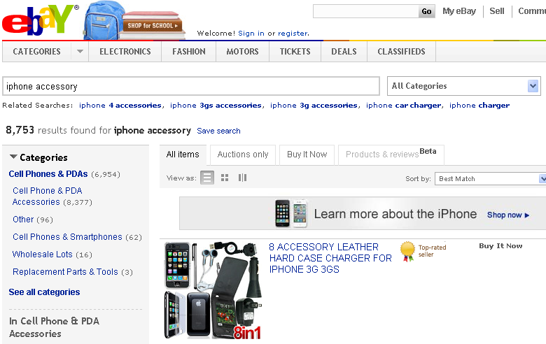
Vertical Search
Search on a specific segment of online content
Different from general Web search engine

Slide 4

Approach 1: Database built-in full-text search
Example (Oracle)
SELECT SCORE(1) score, id, name
FROM Products
WHERE CONTAINS(doc, ‘iphone', 1) > 0
ORDER BY SCORE(1) DESC;
Limitations
  Speed
  Ranking

Slide 5


Approach 2: Open-source packages

Slide 6
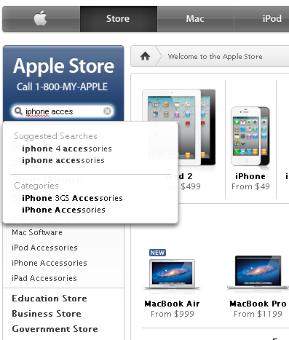
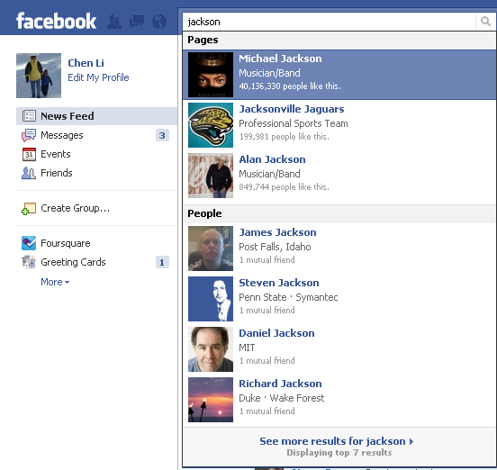
Approach 3: Home-grown search engines

Slide 7



Recent Trend1: More Mobile Applications
Fat fingers …

Slide 8





Recent Trend 2: More Location-Based Services

Slide 9
So: New requirements for Vertical Search
Find results faster → Instant search
Deal with errors → Fuzzy search
Be aware of the location → Location-based Search

Slide 10
Demos
http://psearch.ics.uci.edu: Search on UCI directory;
http://ipubmed.ics.uci.edu: Search on more than 21 million MEDLINE publications
http://www.omniplaces.com/: Location-based search on 17 million geospatial objects.

Slide 11
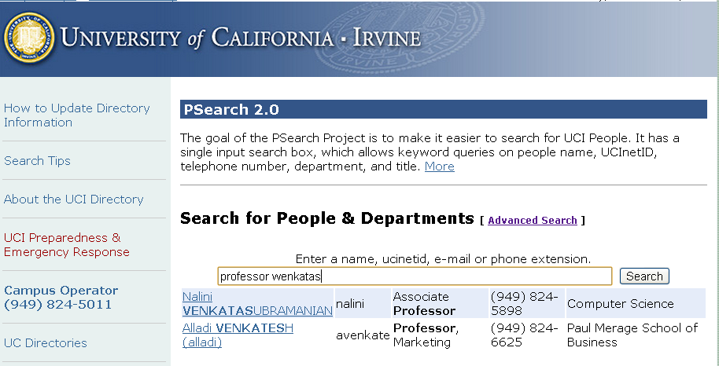
Search on People Directories
psearch.ics.uci.edu

Slide 12
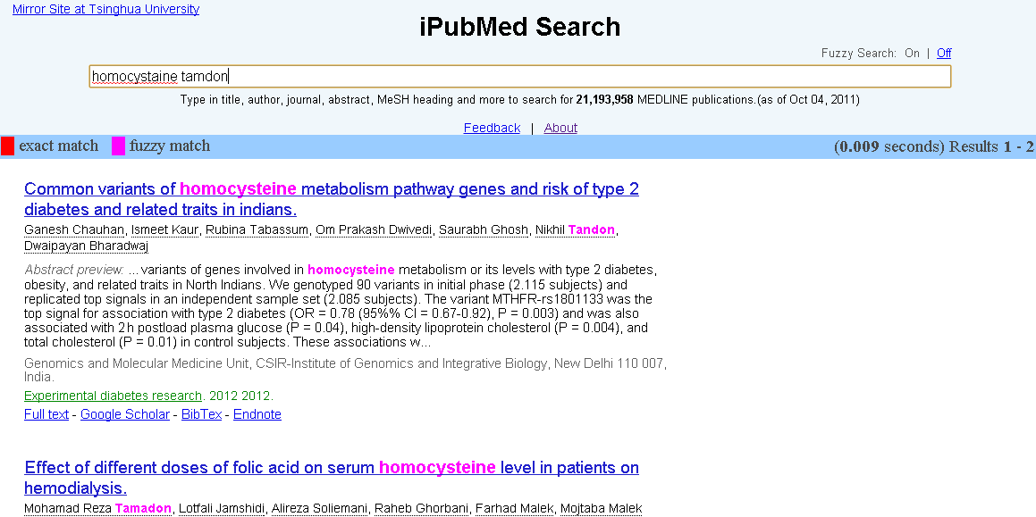
Search on Publications
ipubmed.ics.uci.edu

Slide 13
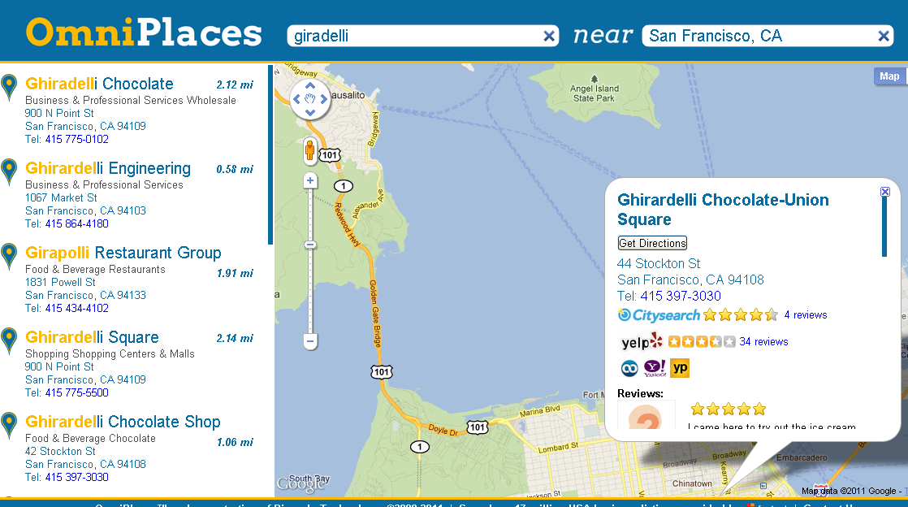
Search on Business Listings
www.omniplaces.com

Slide 14
Our Focus: Instant Search in Vertical Domains
Server applications (enterprises)
  E.g., e-commerce systems
Powerful features
  Efficient
  Full text
  Fuzzy search
  Location-based search
  …

Slide 15
“Instant Search”
Search as you type
Type-ahead search
Autocompletion
…
Benefits:
  Save user time
    Suggestions
    Save 2-3 seconds (Google Instant)
  Mobile devices

Slide 16
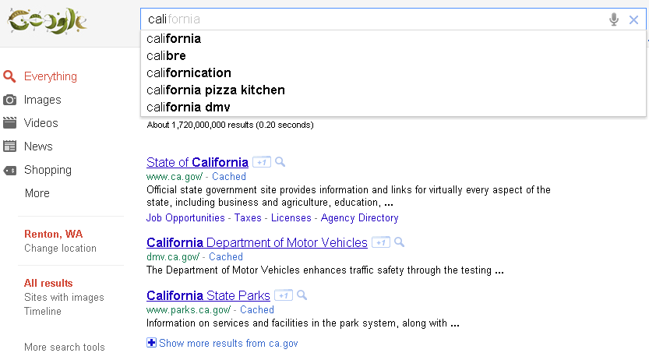
Google Instant

Slide 17
Instant Search Classification
Query Prediction
  Example: Google Instant
  Rely on query logs and user profiles
  “Fire” the most likely prediction
Searching directly on the data
  Example: PSearch@UCI
  Not relying on query logs

Slide 18
Challenges
Performance
  < 100 ms
  server processing, network, javascript, etc
Requirement for high query throughput
  20 queries per second (QPS) → 50ms/query (at most)
  100 QPS → 10ms/query
Other challenges:
  Ranking
  Space requirements
  …

Slide 19


Next: two features
Fuzzy Search: finding results with approximate keywords
Full-text: find results with query keywords (not necessarily adjacently)

Slide 20
Edit Distance
Ed(s1, s2) = minimum # of operations (insertion, deletion, substitution) to change s1 to s2
s1: v e n k a t s u b r a m a n i a n
s2: w e n k a t s u b r a m a n i a n
ed(s1, s2) = 1

Slide 21
Problem Setting
Data
  R: a set of records
  W: a set of distinct words
Query
  Q = {p₁, p₂, …, p_{l}}: a set of prefixes
  δ: Edit-distance threshold
Query result
  R_{Q}: a set of records such that each record has all query prefixes or their similar forms

Slide 22
Feature 1: Fuzzy Search

Slide 23
Formulation
Query:
wenkatsubra
Record Strings
carey
jain
nicolau
smith
venkatasubramanian
Find strings with a prefix similar to a query keyword
Do it incrementally!

Slide 24
Fuzzy search using grams
u n i v e r s a l
Merge
2-grams
Ascending
order
Find elements whose occurrences ≥ T

Slide 25
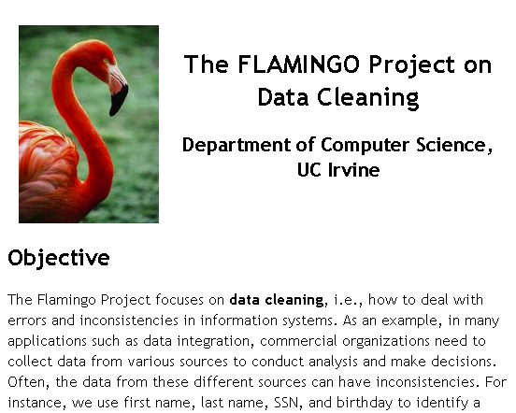
The Flamingo Package
http://flamingo.ics.uci.edu/

Slide 26
Observation
  Strings = {exam, example, exemplar, exempt, sample}
  Edit-distance threshold δ = 2
Q’ = exampl
Q = example
Prefix | Distance
exam | 2
examp | 1
exampl | 0
example | 1
exemp | 2
exempt | 2
exempl | 1
exempla | 2
sampl | 2
Prefix | Distance
examp | 2
exampl | 1
example | 0
exempl | 2
exempla | 2
sample | 2
delete e
delete e
match e
delete e
replace e with a
match e

Slide 27
Trie Indexing
Computing set of active nodes Φ_{Q}
  Initialization
  Incremental step
e
s
x
a
a
e
m
Active nodes for Q = example
m
m
p
Prefix | Distance
examp | 2
exampl | 1
example | 0
exempl | 2
exempla | 2
sample | 2
$
p
2
p
l
l
1
l
2
t
e
2
e
0
a
2
$
$
$
r
$

Slide 28
Initialization
Q = ε
0
Prefix | Distance
Prefix | Distance
 | 0
e | 1
ex | 2
s | 1
sa | 2
Prefix | Distance
ε | 0
e
1
s
1
x
2
a
2
a
e
m
m
m
p
$
p
p
l
l
l
t
e
Initializing Φ_{ε} with all nodes within a depth of δ
e
a
$
$
$
r
$

Slide 29
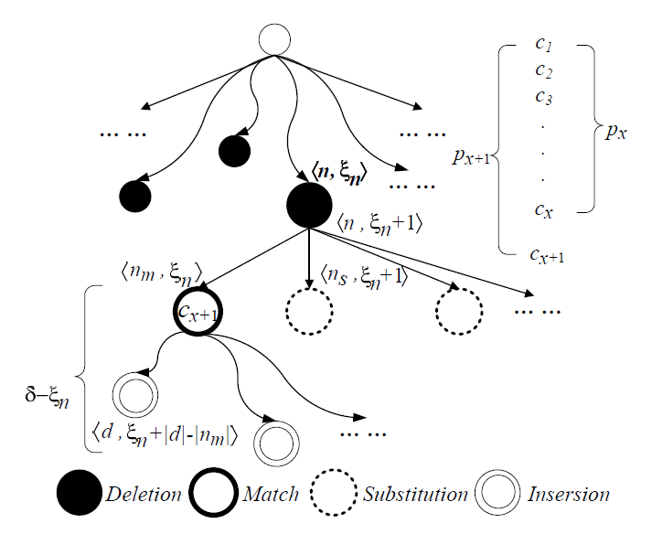
Incremental Algorithm: Overview
Access their leaf nodes as answers.

Slide 30
Feature 2: Full-text search
Find answers with query keywords
Not necessarily adjacently

Slide 31
Multi-Prefix Intersection
ID | Record
1 | Li data…
2 | data…
3 | data Lin…
4 | Lu Lin Luis…
5 | Liu…
6 | VLDB Lin data…
7 | VLDB…
8 | Li VLDB…
Q = vldb li
d
l
v
a
i
u
l
6 | VLDB Lin data…
t
$
n
u
$
i
d
8 | Li VLDB…
a
1
8
$
$
4
s
b
$
3
4
6
5
$
$
1
2
3
6
4
6
7
8

Slide 32
Multi-Prefix Intersection: Method 1
ID | Record
1 | Li data…
2 | data…
3 | data Lin…
4 | Lu Lin Luis…
5 | Liu…
6 | VLDB Lin data…
7 | VLDB…
8 | Li VLDB…
d
l
v
a
i
u
l
t
$
n
u
$
i
d
a
1
8
$
$
4
s
b
$
3
4
6
5
$
$
1
2
3
6
4
6
7
8
Space cost | Inverted index
Time cost | Union + intersection
Q = vldb li
li
1 3 4 5 6 8
vldb
6 8
6 7 8
More efficient intersection approaches…

Slide 33
Multi-Prefix Intersection: Method 2
ID | Record
1 | Li data…
2 | data…
3 | data Lin…
4 | Lu Lin Luis…
5 | Liu…
6 | VLDB Lin data…
7 | VLDB…
8 | Li VLDB…
Forward List
1 2
1
1 3
3 5 6
4
1 3 7
7
2 7
[1, 7]
d
[1, 1]
l
[2, 6]
v
[7, 7]
a
[1, 1]
i
[2, 4]
u
[5, 6]
l
[7, 7]
t
[1, 1]
$
2
n
[3, 3]
[4, 4]
[6, 6]
[7, 7]
u
$
5
i
d
6 | VLDB Lin data… | 1 3 7
[1, 1]
[6, 6]
[7, 7]
a
1
8
$
3
$
4
4
s
b
8 | Li VLDB… | 2 7
$
1
3
4
6
5
$
6
$
7
1
2
3
6
4
6
7
8
6
7
8
Read each
Verify/Probe
[2, 4]
Q = vldb li
Space cost | Inverted + forward index
Time cost | Probing forward lists

Slide 34
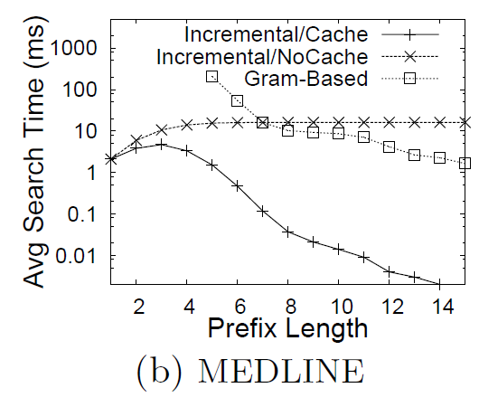
Experimental Results
Computing similar prefixes

Slide 35
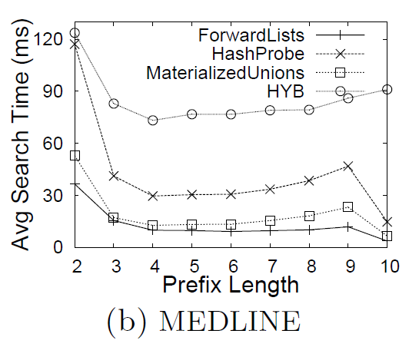
Multi-prefix intersection

Slide 36
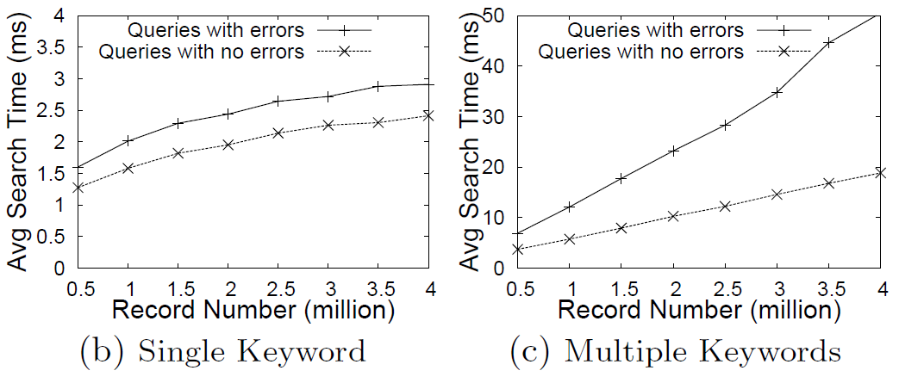
Time Scalability

Slide 37
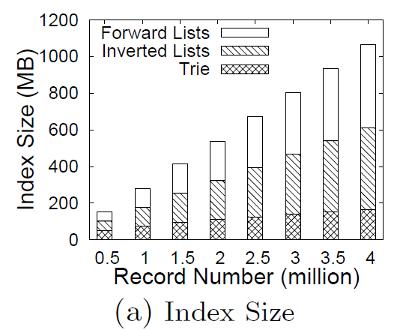
Index scalability

Slide 38
Research on data-intensive computing
http://asterix.ics.uci.edu
http://cherry.ics.uci.edu/

Slide 39

Thank you!

