Slide 1
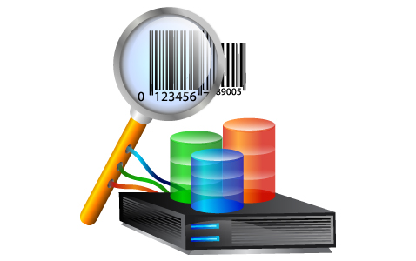
Search as You Type: From Research to Commercialization
Chen Li
UC Irvine
DBRank Workshop, August 27, 2012, Istanbul, Turkey

Slide 2
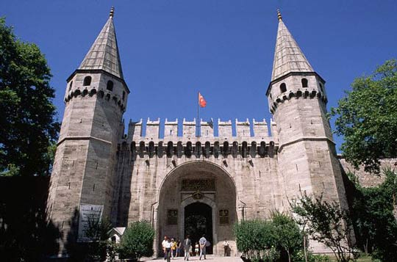
Q: Why is DBRank in Istanbul?
Topkapı Palace
Top-k api

Slide 3
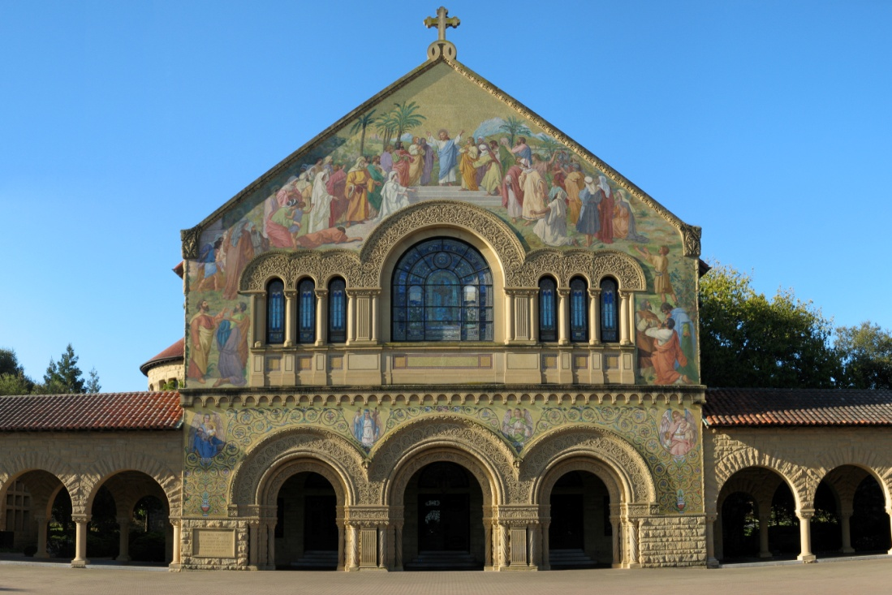
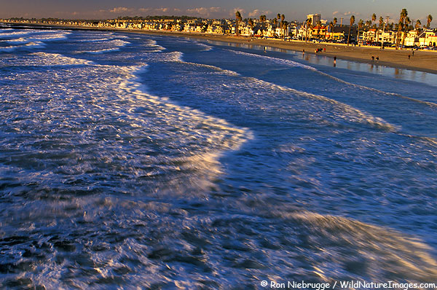
Personal Journey: 2001 …

Slide 4
Data Integration Problems?
Talking to medical doctors…

Slide 5
Example
Table R
Table S
Name | SSN | Addr
Jack Lemmon | 430-871-8294 | Maple St
Harrison Ford | 292-918-2913 | Culver Blvd
Tom Hanks | 234-762-1234 | Main St
… | … | …
Name | SSN | Addr
Ton Hanks | 234-162-1234 | Main Street
Kevin Spacey | 928-184-2813 | Frost Blvd
Jack Lemon | 430-817-8294 | Maple Street
… | … | …
Q: Find records from different datasets that could be the same entity

Slide 6
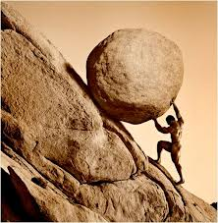
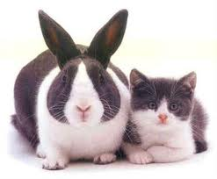
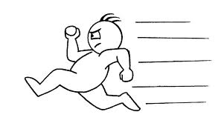
Challenges
How to define good similarity functions?
How to do matching efficiently?

Slide 7
The Flamingo Package
http://flamingo.ics.uci.edu/

Slide 8
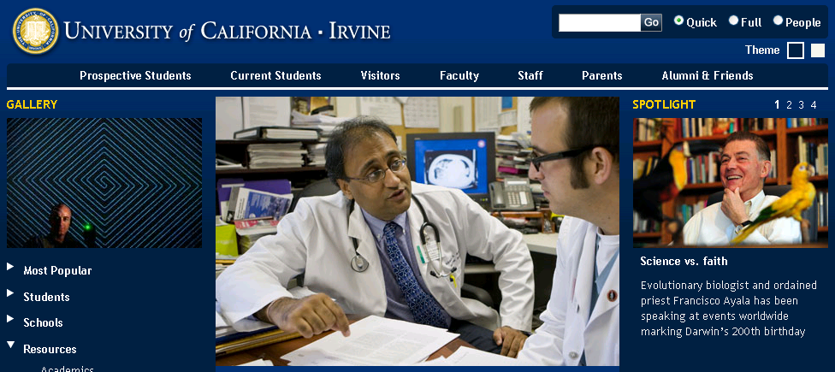
Make an impact?

Slide 9
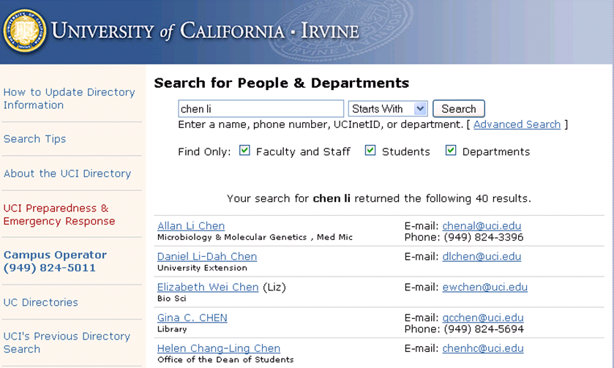
UCI People Search

Slide 10
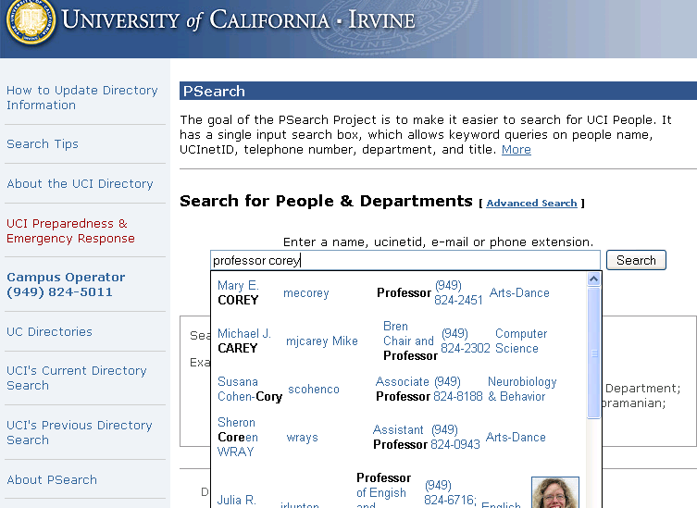
Psearch (2008) : 2 stories

Slide 11
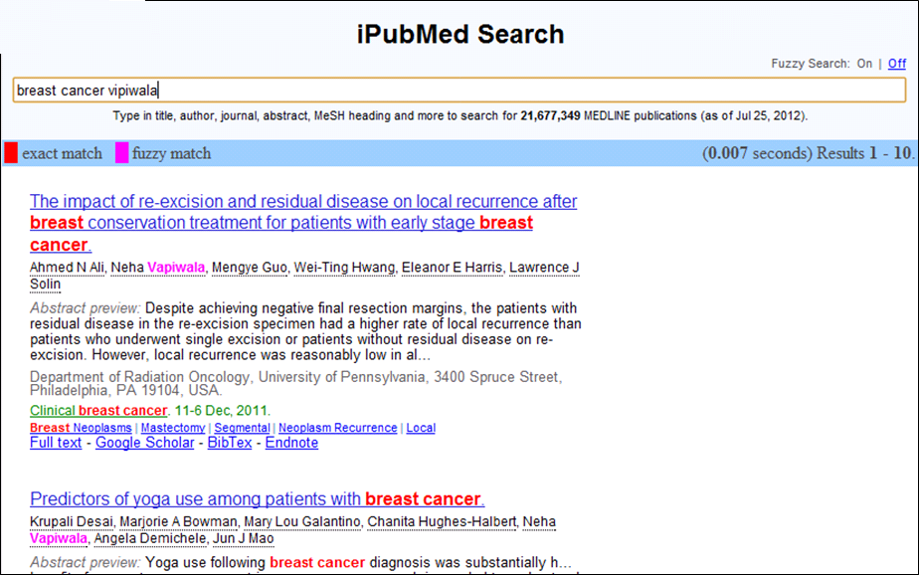
Fuzzy search

Slide 12
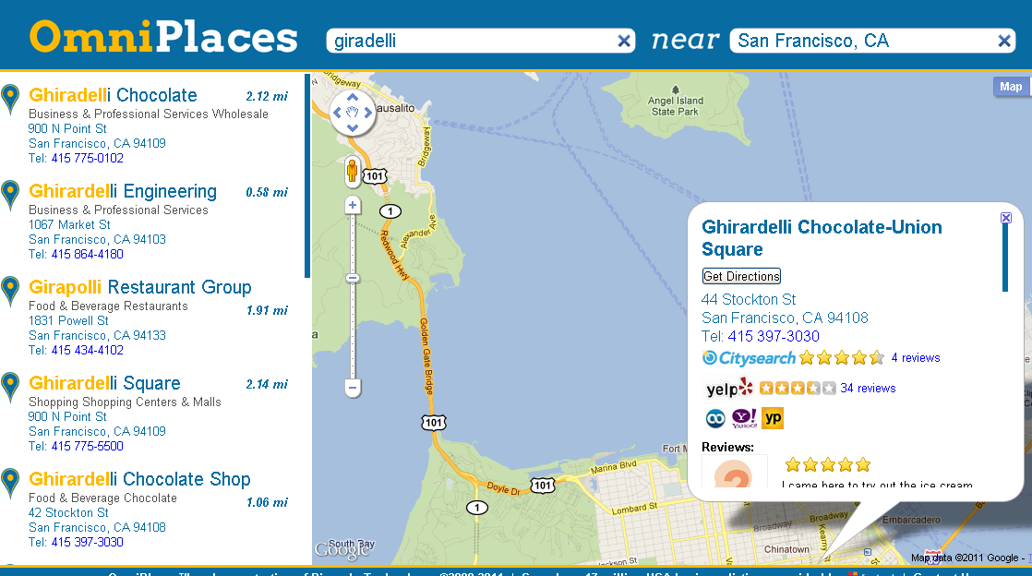
Location-based search
www.omniplaces.com

Slide 13
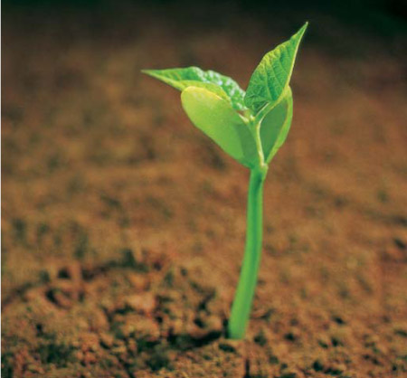
Bimaple Incorporated (2008)

Slide 14
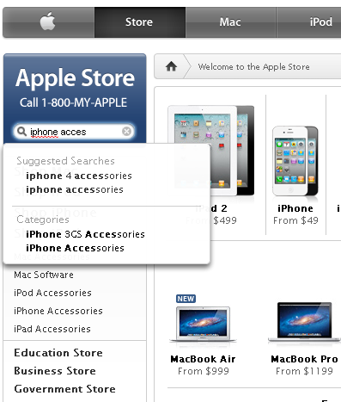
Query suggestions

Slide 15
Instant Search

Slide 16
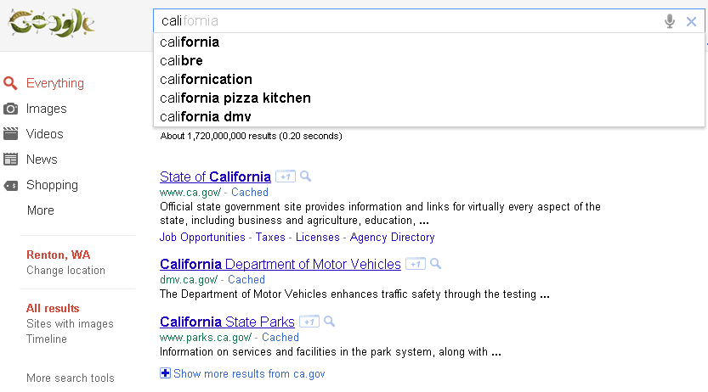
Different from Google Instant

Slide 17
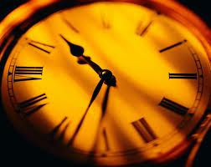
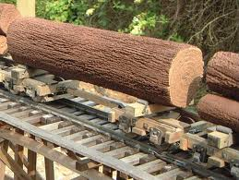
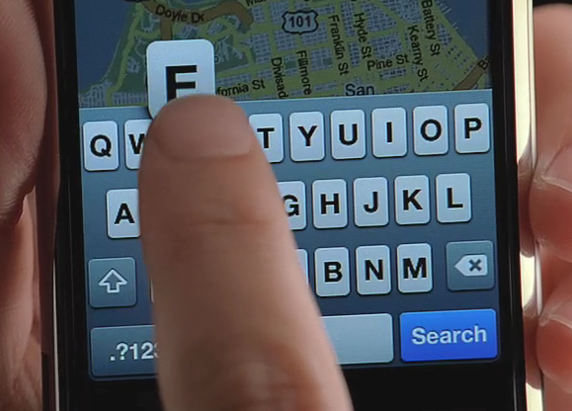
Advantages of instant fuzzy search
Save time
Correct errors
Mobile friendly
Fat fingers!

Slide 18
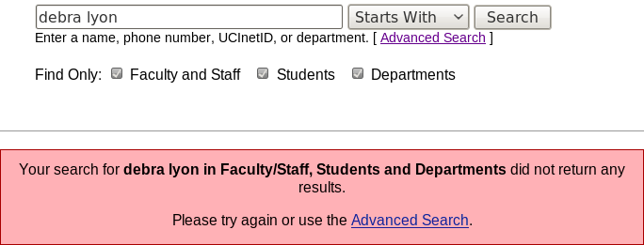
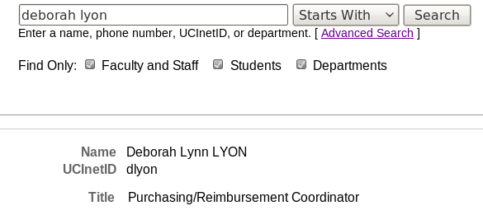
Comparing Two Search Systems
UCI Directory Search
Traditional Keyword Search on UCI People Directory
Frequently used by UCI community

Slide 19
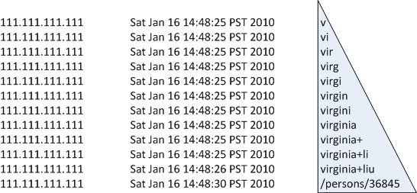
User Behavior Analysis
Log Structure
Log Record, Click Record, Query, Peak Query
Log Record
Peak Query
Click
IP
Timestamp
Queries

Slide 20
User Behavior Analysis
96% queries, 4% clicks
35% of sessions have click records
Median of session durations is 3 sec
Average peak query length is 8.89 chars
Average number of queries in a session is 9.16
61%
19.4%
12.2%
7.2%

Slide 21
Benefits of Instant Search
Median of Session Durations
PSearch | UCI Directory Search
3s | 5s

Slide 22
Challenges
Speed
“100ms rule”
Prefix matching
Fuzzy matching
Quality

Slide 23
Database built-in full-text search
Example (Oracle)
SELECT SCORE(1) score, id, name
FROM Products
WHERE CONTAINS(doc, ‘iphone', 1) > 0
ORDER BY SCORE(1) DESC;
Limitations
Speed
Ranking

Slide 24
Open-source packages
Limitations
Weak support of fuzzy search
Poor ranking in instant search

Slide 25
Results
Efficient indexing and searching (WWW09,SIGMOD09,Bioinformatics09, ICDE10,VLDBJ11)
Ranking (SIGIR12)
Log Analysis (WebDB12)
Map search (SSDBM11)

Slide 26
Index structures
Trie
ID | Record
r₀ | graph icdm
r₁ | graph group lui
r₂ | gray icde liu
r₃ | graph icde lin lui
r₄ | graph group icdm lin liu
r₅ | graph gray gross icdm lin liu
r₆ | gray group icdm lin liu
r₇ | gray gross group icde lin
r₈ | gross icde liu
r₉ | icdm liu
g
i
l
r
c
i
u
a
o
d
n
u
i
p
y
s
u
e
m
h
s
p
$$r_{0}$$
$$r_{1}$$
$$r_{3}$$
$$r_{4}$$
$$r_{5}$$
$$r_{2}$$
$$r_{5}$$
$$r_{6}$$
$$r_{7}$$
$$r_{5}$$
$$r_{7}$$
$$r_{8}$$
$$r_{1}$$
$$r_{4}$$
$$r_{6}$$
$$r_{7}$$
$$r_{2}$$
$$r_{3}$$
$$r_{7}$$
$$r_{8}$$
$$r_{4}$$
$$r_{5}$$
$$r_{6}$$
$$r_{9}$$
$$r_{0}$$
$$r_{3}$$
$$r_{4}$$
$$r_{5}$$
$$r_{6}$$
$$r_{7}$$
$$r_{2}$$
$$r_{4}$$
$$r_{5}$$
$$r_{6}$$
$$r_{8}$$
$$r_{9}$$
$$r_{1}$$
$$r_{3}$$
Inverted Index

Slide 27
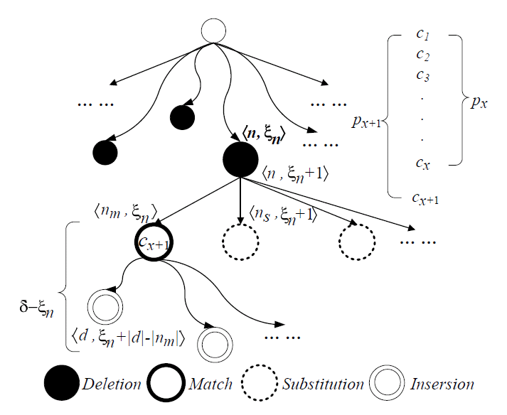
Fuzzy-search Algorithm: Overview

Slide 28
Multi-Prefix Intersection
ID | Record
1 | Li data…
2 | data…
3 | data Lin…
4 | Lu Lin Luis…
5 | Liu…
6 | VLDB Lin data…
7 | VLDB…
8 | Li VLDB…
Q = vldb li
d
l
v
a
i
u
l
6 | VLDB Lin data…
t
$
n
u
$
i
d
8 | Li VLDB…
a
1
8
$
$
4
s
b
$
3
4
6
5
$
$
1
2
3
6
4
6
7
8

Slide 29
Multi-Prefix Intersection: Method 1
ID | Record
1 | Li data…
2 | data…
3 | data Lin…
4 | Lu Lin Luis…
5 | Liu…
6 | VLDB Lin data…
7 | VLDB…
8 | Li VLDB…
d
l
v
a
i
u
l
t
$
n
u
$
i
d
a
1
8
$
$
4
s
b
$
3
4
6
5
$
$
1
2
3
6
4
6
7
8
Space cost | Inverted index
Time cost | Union + intersection
Q = vldb li
li
1 3 4 5 6 8
vldb
6 8
6 7 8
More efficient intersection approaches…

Slide 30
Multi-Prefix Intersection: Method 2
ID | Record
1 | Li data…
2 | data…
3 | data Lin…
4 | Lu Lin Luis…
5 | Liu…
6 | VLDB Lin data…
7 | VLDB…
8 | Li VLDB…
Forward List
1 2
1
1 3
3 5 6
4
1 3 7
7
2 7
[1, 7]
d
[1, 1]
l
[2, 6]
v
[7, 7]
a
[1, 1]
i
[2, 4]
u
[5, 6]
l
[7, 7]
t
[1, 1]
$
2
n
[3, 3]
[4, 4]
[6, 6]
[7, 7]
u
$
5
i
d
6 | VLDB Lin data… | 1 3 7
[1, 1]
[6, 6]
[7, 7]
a
1
8
$
3
$
4
4
s
b
8 | Li VLDB… | 2 7
$
1
3
4
6
5
$
6
$
7
1
2
3
6
4
6
7
8
6
7
8
Read each
Verify/Probe
[2, 4]
Q = vldb li
Space cost | Inverted + forward index
Time cost | Probing forward lists

Slide 31
Ranking
Aggregate
Query
graph
icde
li
Max
Score(graph)
Score(icde)
Score(lin)
Score(liu)
Record
graph, gray, gross, icde, lin, liu

Slide 32
Multi-Prefix Intersection
{graph, icde, li} k=1
Too many candidates
g
i
l
r
c
i
u
a
o
d
n
u
i
p
y
s
u
e
m
h
s
p
$$r_{0}$$
$$r_{1}$$
$$r_{3}$$
$$r_{4}$$
$$r_{5}$$
$$r_{2}$$
$$r_{5}$$
$$r_{6}$$
$$r_{7}$$
$$r_{5}$$
$$r_{7}$$
$$r_{8}$$
$$r_{1}$$
$$r_{4}$$
$$r_{6}$$
$$r_{7}$$
$$r_{2}$$
$$r_{3}$$
$$r_{7}$$
$$r_{8}$$
$$r_{4}$$
$$r_{5}$$
$$r_{6}$$
$$r_{9}$$
$$r_{0}$$
$$r_{3}$$
$$r_{4}$$
$$r_{5}$$
$$r_{6}$$
$$r_{7}$$
$$r_{2}$$
$$r_{4}$$
$$r_{5}$$
$$r_{6}$$
$$r_{8}$$
$$r_{9}$$
$$r_{1}$$
$$r_{3}$$
icde
graph
lin
liu

Slide 33
Optimization 1: Heap-based Method
Aggregate
$$r_{5},9$$
$$r_{4},7$$
$$r_{3},4$$
$$r_{1},3$$
$$r_{0},2$$
$$r_{7},4$$
$$r_{2},2$$
$$r_{3},2$$
$$r_{8},2$$
GetMax()
$$r,9$$
icde
graph
$$r_{5},8$$
Max Heap
$$r_{3},9$$
$$r_{7},8$$
$$r_{6},4$$
$$r_{5},3$$
$$r_{4},2$$
$$r_{5},8$$
$$r_{4},7$$
$$r_{6},5$$
$$r_{9},4$$
$$r_{2},3$$
$$r_{8},1$$
lin
liu

Slide 34
Optimization 2: Top-k List-Merging Algorithm
Example: Threshold algorithm
$$r_{5},9$$
$$r_{4},7$$
$$r_{7},4$$
$$r_{3},3$$
$$r_{1},2$$
$$r_{3},9$$
$$r_{7},8$$
$$r_{5},8$$
$$r_{4},7$$
$$r_{6},5$$
$$r_{9},4$$
T = 15
Sorted
Access
Sorted
Access
$r_{5}$ = 17
$r_{4}$= 14
$r_{3}$= 12
$r_{7}$= 12
Random
Access
Early termination

Slide 35
Random Access Using Forward Index
ID | “graph” | “icde” | “li”
$$\text{r}\text{4}$$ | 7 | 0
7
?
ID | Forward list
r₀ | <1, 2> <5, 3>
r₁ | <1, 3> <1, 9> <9, 6>
r₂ | <2, 9> <5, 2> <8, 3>
r₃ | <1, 4> <5, 2> <7, 9> <9, 4>
r₄ | <1, 7> <4, 3> <6, 9> <7, 2> <8, 7>
… | …
[1, 4]
[7, 9]
g
i
[5, 6]
[7, 8]
l
[9, 9]
[1, 4]
r
[3, 4]
c
[5, 6]
i
u
[1, 2]
a
[3,3]
o
[4, 4]
d
[5, 6]
n
u
i
[1, 1]
[2,2]
7
8
9
p
y
s
u
e
m
2
5
6
h
s
p
1
3
4

Slide 36
Ranking Framework (Fuzzy matching)
Aggregate
Query
graph
icde
li
Max
Sim(icde,icdm)
*Score(icdm)
Sim(li,i)
*Score(lin)
Score(graph)
Score(lin)
Score(liu)
Record
graph, gray, icdm, gross, lin, liu

Slide 37
Computing Similar Prefixes
{graph, icde, li}, similarity threshold τ=0.45
g
i
l
r
c
i
u
a
o
d
n
u
i
p
y
s
u
e
m
h
s
p
$$r_{5},9$$
$$r_{4},7$$
$$r_{3},4$$
$$r_{1},3$$
$$r_{0},2$$
$$r_{2},9$$
$$r_{5},8$$
$$r_{6},4$$
$$r_{7},3$$
$$r_{8},9$$
$$r_{7},8$$
$$r_{5},4$$
$$r_{1},9$$
$$r_{7},8$$
$$r_{6},4$$
$$r_{4},3$$
$$r_{7},4$$
$$r_{2},2$$
$$r_{3},2$$
$$r_{8},2$$
$$r_{4},9$$
$$r_{5},8$$
$$r_{6},5$$
$$r_{9},4$$
$$r_{0},3$$
$$r_{3},9$$
$$r_{7},8$$
$$r_{6},4$$
$$r_{5},3$$
$$r_{4},2$$
$$r_{5},8$$
$$r_{4},7$$
$$r_{6},5$$
$$r_{9},4$$
$$r_{2},3$$
$$r_{8},1$$
$$r_{1},6$$
$$r_{3},4$$

Slide 38
Top-k Algorithm
sum
GetMax()
GetMax()
GetMax()
li
graph
icde
$$r_{3},9$$
$$r_{5},8$$
$$r_{4},4.5$$
$$r_{4},4.5$$
$$r_{5},9$$
Max Heap
$r_{7},$4
$r_{1},$3
$r_{7},$2
Max Heap
Max Heap
×1
×1
×0.5
×0.5
×0.5
×1
×1
×0.5
$$r_{5},9$$
$$r_{4},7$$
$$r_{3},4$$
$$r_{1},3$$
$$r_{0},2$$
$$r_{7},4$$
$$r_{2},2$$
$$r_{3},2$$
$$r_{8},2$$
$$r_{4},9$$
$$r_{5},8$$
$$r_{6},5$$
$$r_{9},4$$
$$r_{0},3$$
$$r_{7},4$$
$$r_{2},2$$
$$r_{3},2$$
$$r_{8},2$$
$$r_{4},9$$
$$r_{5},8$$
$$r_{6},5$$
$$r_{9},4$$
$$r_{0},3$$
$$r_{3},9$$
$$r_{7},8$$
$$r_{6},4$$
$$r_{5},3$$
$$r_{4},2$$
$$r_{5},8$$
$$r_{4},7$$
$$r_{6},5$$
$$r_{9},4$$
$$r_{2},3$$
$$r_{8},1$$
$$r_{1},6$$
$$r_{3},4$$
similarity
lui
graph
icde
icde
icdm
icdm
lin
liu

Slide 39
Other interesting problems
www.omniplaces.com

Slide 40
Current status of Bimaple
Mainly focusing on product development (C++)
With angel investment
Has customers

Slide 42
1. Different challenges
Technology
Products
Business

Slide 43
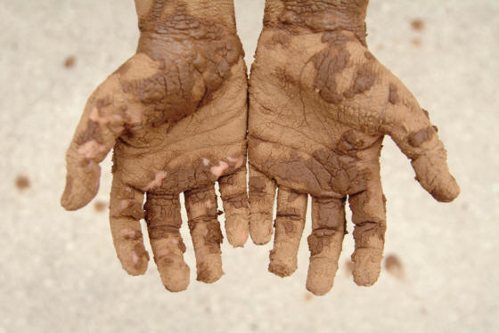
2: Hands-on experiences

Slide 44
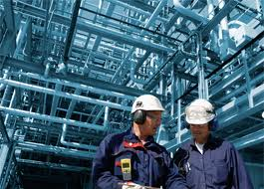
3: More systems challenges
E.g.: Updates; Multi-threading …

Slide 45
4: Balancing

Slide 46
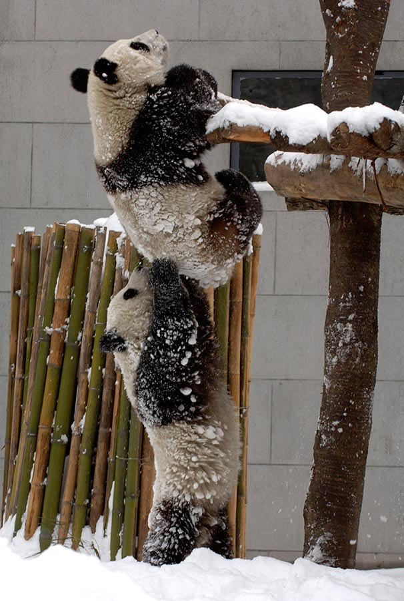
5: Getting support

Slide 47
6: Make a difference

Slide 48
Thank you
Supported by NSF (US), NIH (US), and NSF (China).

