Slide 1


Efficient Type-Ahead Search on Relational Data:
a TASTIER Approach
Guoliang Li¹, Shengyue Ji², Chen Li², Jianhua Feng¹
¹ Tsinghua University, Beijing, China
² University of California, Irvine, CA, USA

Slide 2
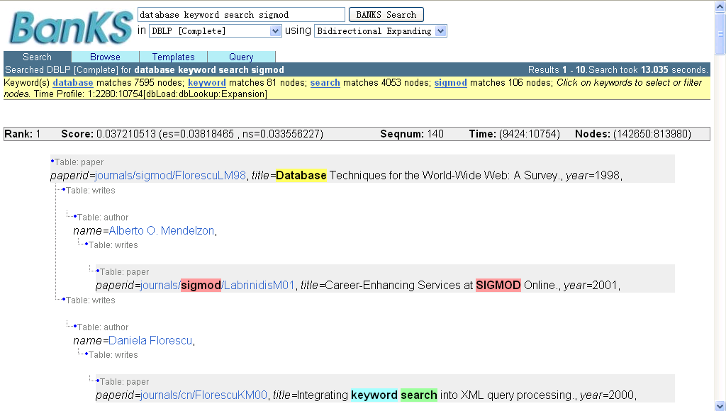
Traditional Keyword Search
MUST Type in Complete keywords

Slide 3
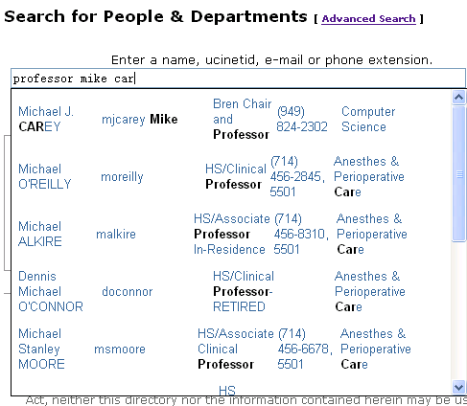
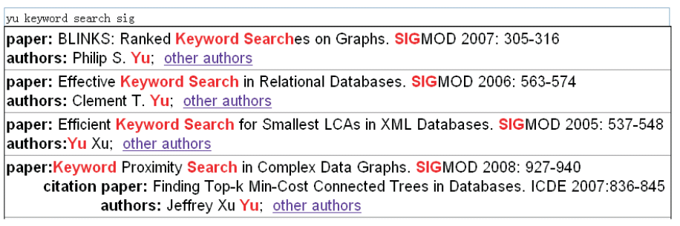
Type-Ahead Search
Advantages:
Interactive: data exploration in relational databases
Full-text search: full-text search on-the-fly

Slide 4
Challenges and Preliminaries
  Efficiency requirement (milliseconds vs. seconds)
  Client-side processing
  Network delay
  Server-side processing
Opportunities:
  Subsequent queries can be answered incrementally

Slide 5
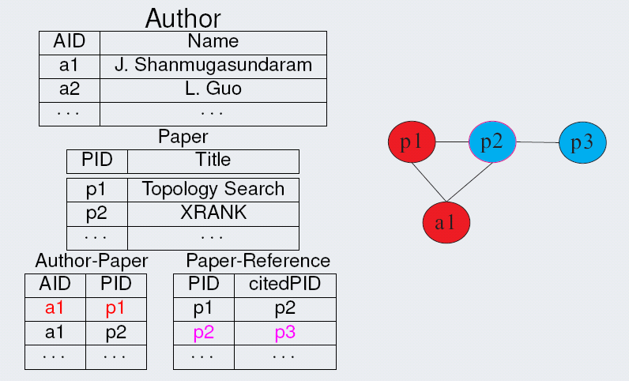
Fundamentals
Data
  R: a relational database with a set of tables
  D: a set of distinct words tokenized from the data in R

Slide 6
Fundamentals
Query
  Q = {p₁, p₂, …, p_{l}}: a set of prefixes
Query result
  R_{Q}: a set of subtrees (called Steiner trees) such that each subtree has all query prefixes, i.e., a set of relevant tuples connected through foreign keys such that each answer has all query prefixes (conjunctive)

Slide 7
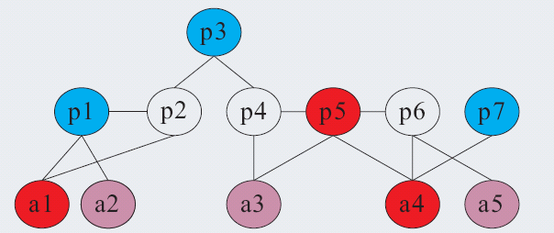


Traditional Keyword Search
Data Graph
  database
  search
  sigmod
  sigir
  signature
  Query: {database search sigmod}
  Answers:
  Steiner trees(radius ≤ r)
a2
a3
a5
a2
a3
a5

Slide 8
Type-Ahead Search
Data Graph
  database
  search
  sigmod
  sigir
  signature
  Query: {database search sig}
  Answer:
  Steiner trees(radius ≤ r)
a2
a3
a5
a2
a3
a5

Slide 9
Type-Ahead Search in Relational Data
Step 1
  Incremental prefix matching
Step 2
  Incrementally find relevant connected tuples that contain query prefixes
Contributions
  Efficiently Finding answers using δ-step forward index
  Improving search efficiency
    graph partition
    query prediction

Slide 10
Step 1: Incremental Prefix Matching
Example
  D = {sigmod, search, spark, yu, graph}
  Q = “graph s”
  W_{s}={sigmod, search, spark}
  Q’ = “graph sig”
  W_{sig}={sigmod}

Slide 11
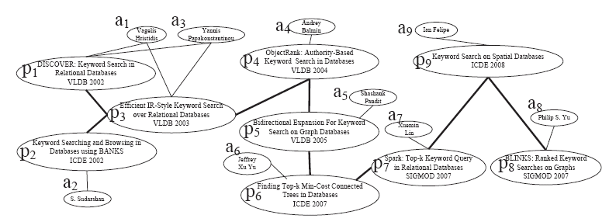
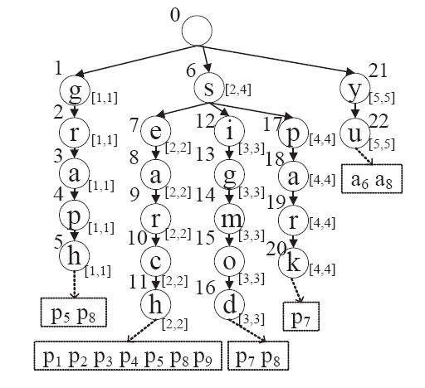
Tire Index
Graph
Graph

Slide 12
Incremental Prefix Matching
sigmod, search, spark, yu, graph
graph
s
search
sigmod
spark

Slide 13
Step 2: Finding answers
yu
graph
How to efficiently find answers?
Yu
Graph
Yu
Graph

Slide 14
Contributions
Step 1
  Incremental prefix matching
Step 2
  Efficiently Finding answers using δ-step forward index
  Improving search efficiency
    graph partition
    query prediction

Slide 15
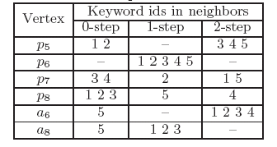
δ-step forward index
Graph
Search
Yu

Slide 16
Finding answers using δ-step forward index
Yu
s

Slide 17
Finding answers using δ-step forward index
p
Yu
s

Slide 18
Contributions
Step 1
  Incremental prefix matching
Step 2
  Efficiently Finding answers using δ-step forward index
  Improving search efficiency
    graph partition
    query prediction

Slide 19
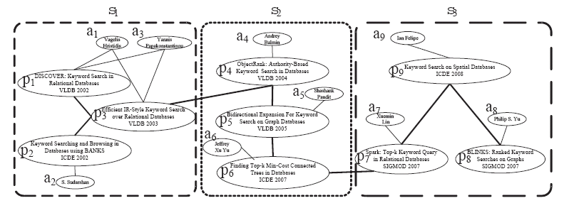
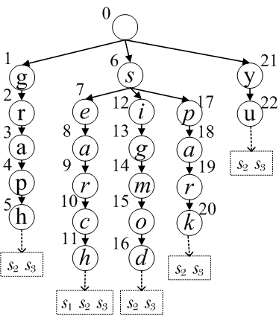
Graph Partition
Graph
Graph
Step 1
  Find subgraphs that contain query prefixes
Step 2
  Find answers within subgraphs

Slide 20
Graph Partition
Q= “Graph Yu”
  Step 1: find subgraphs S₂, S₃
  Step 2: find answers within S₂, S₃

Slide 21
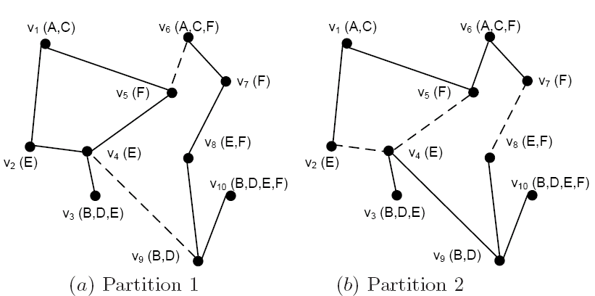
High-Quality Graph Partition
S₁
S₂
S₃
S₄
A: S₁,S₂
B: S₁,S₂
C: S₁,S₂
D: S₁,S₂
E: S₁,S₂
F: S₁,S₂
Advantages:
Shorten List
Subgraph Pruning
A: S₃
B: S₄
C: S₃
D: S₄
E: S₃,S₄
F: S₃,S₄

Slide 22
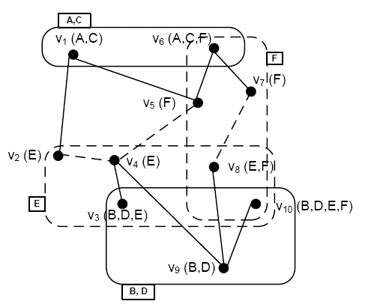
Keyword-Sensitive Partition
Graph → Hypergraph
  G(V, E) → G_{h}(V_{h},E_{h})
    V_{h}=V
    if (u,v) ∈ E, then (u,v) ∈ E_{h} ,
    if u₁, u₂, …, u_{n} contain a
    same keyword,
    then (u₁, u₂, …, u_{n} ) ∈ E_{h}
Hypergraph Partition
B

Slide 23
Contributions
Step 1
  Incremental prefix matching
Step 2
  Efficiently Finding answers using δ-step forward index
  improving search efficiency
    graph partition
    query prediction

Slide 24
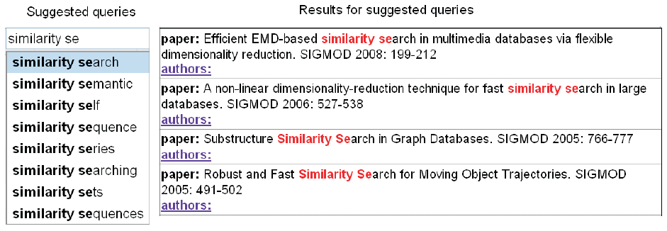
Query Prediction

Slide 25
Previous Method vs. Query Prediction
  Previous method
    Find all potential compute words of query prefixes and compute corresponding answers
    e.g., {sigmod, sigir, signature, …,} for sig
  Query prediction
    Predict the complete keywords with maximal probabilities and compute corresponding answers using the predicted keywords
    E.g., predict 2 best keyword {sigmod, sigir} for sig

Slide 26
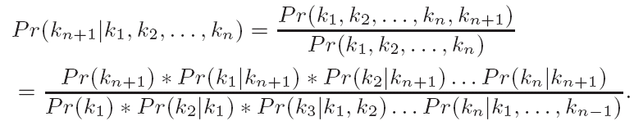
Query Prediction
Query-prediction model
  Bayesin network
  Pr(k_{i}) = #of occurrences of k_{i}/ # of nodes
  Pr(k_{i}|k_{j}, k_{n}) = Pr(k_{i}|k_{n})

Slide 27
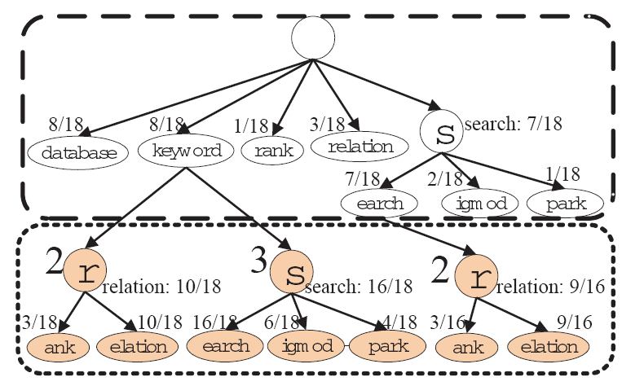
Query Prediction
Q=“keyword s”
keyword search
Q=“keyword search r”
keyword search relation

Slide 28
Experimental Results
Setting
  C++, Gnu compiler, FastCGI,
  Ubuntu, X5450 3.0GHz CPU, 3GB RAM
Datasets
  DBLP
  IMDB

Slide 29
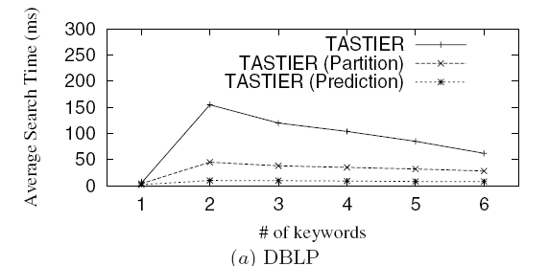
Search Efficiency

Slide 30
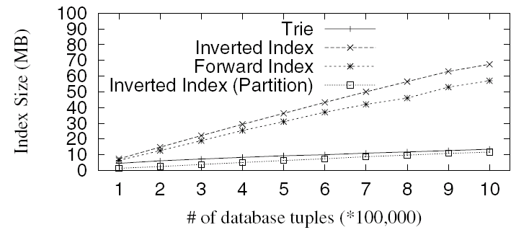
Scalability: Index Size

Slide 31
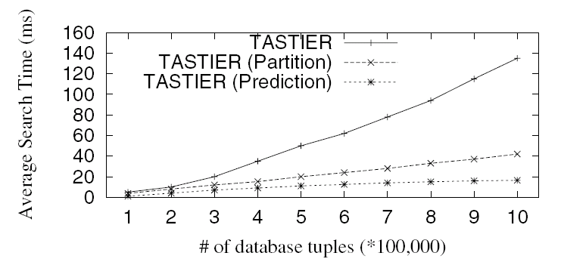
Scalability: Search Time

Slide 32
http://tastier.ics.uci.edu/ http://tastier.cs.tsinghua.edu.cn/
Search: tastier type-ahead search
Thank You!
Questions?
Questions?

