Slide 1
Dynamic Communities : “Samudaya”
CS 237 : Middleware For Distributed Systems
Team :
Abhishek Nancherla J ()
Ashwin Raman
Vaishakh Baragur Narasimhareddy

Slide 2
Motivation and Goal
1.In today's world, where there is an outburst in the number of notifications, relevance of messages to the users is important, failing which messages will be treated as spam or ignored.
2.Our application, which we like to call “Samudaya” aims to leverage a static ontology which allows a client to specify their interest;
based on the user’s interest, messages are delivered dynamically.

Slide 3
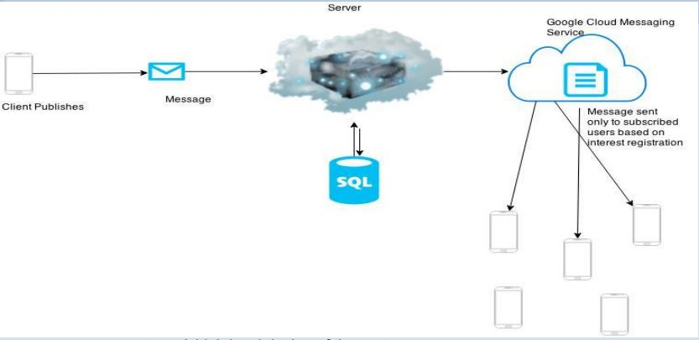
System Architecture

Slide 4
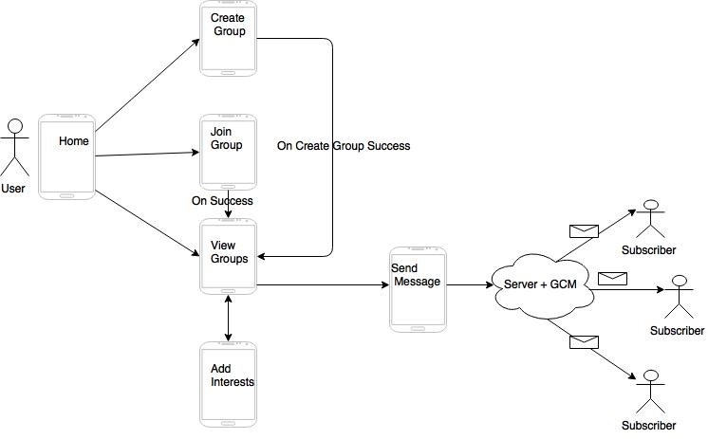
Application Flow

Slide 5
Use Case
The College Student Community With Varied Interests.

Slide 6
Tools/ Softwares
Client : Android Application
Server : Java (Container : Tomcat7)
Database
Client : SQLite
Server : MySQL
Notification Service : Google Cloud Messaging Service ( GCM)

Slide 7
Future Scope
Dynamic Ontologies:
Currently, we have written a service that parses an XML file containing interests and adds them to our Database. The client syncs itself to copy the interests from the server on start of the app.
An abstraction layer can be developed which extracts these interests from the Web.

Slide 8
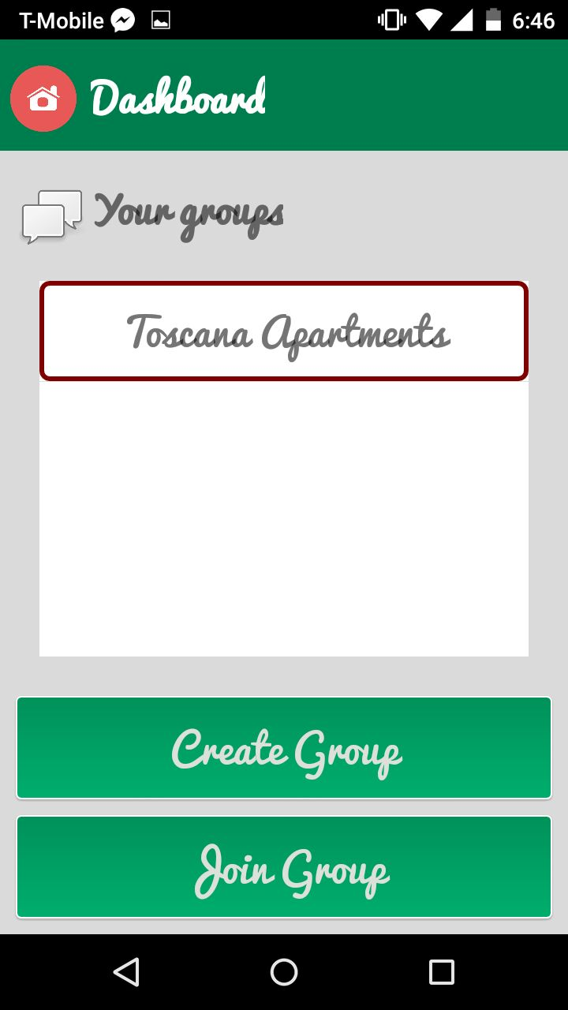
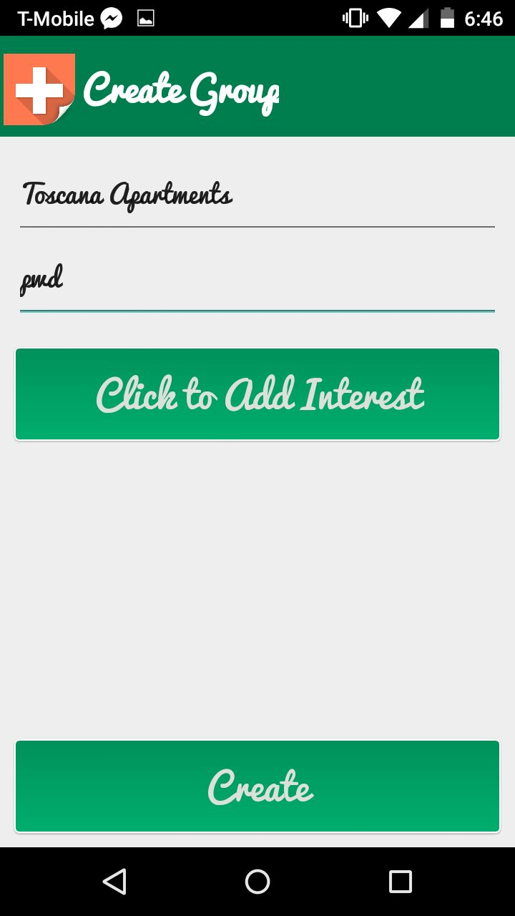
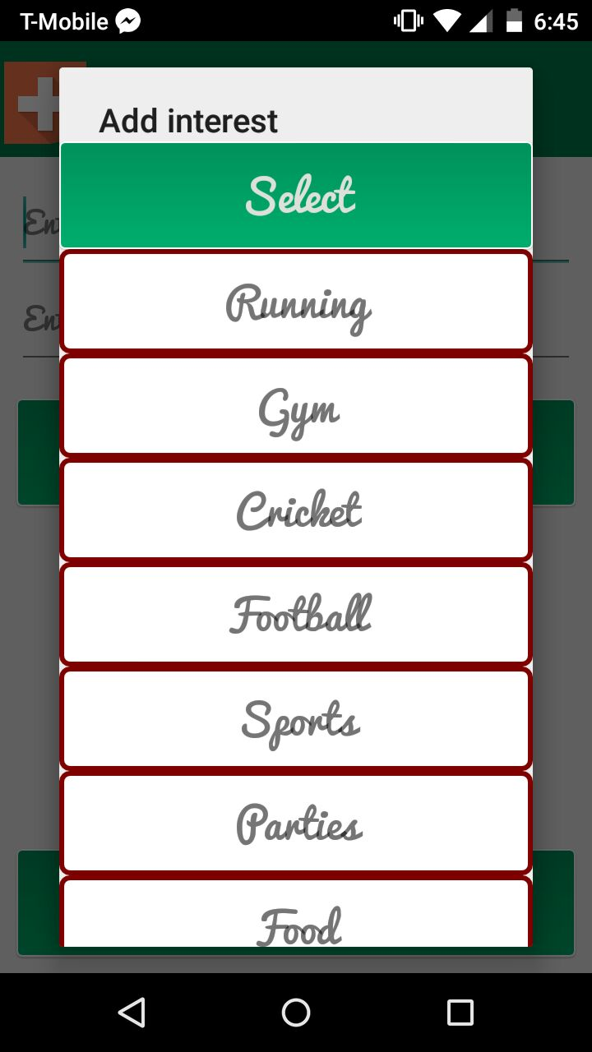
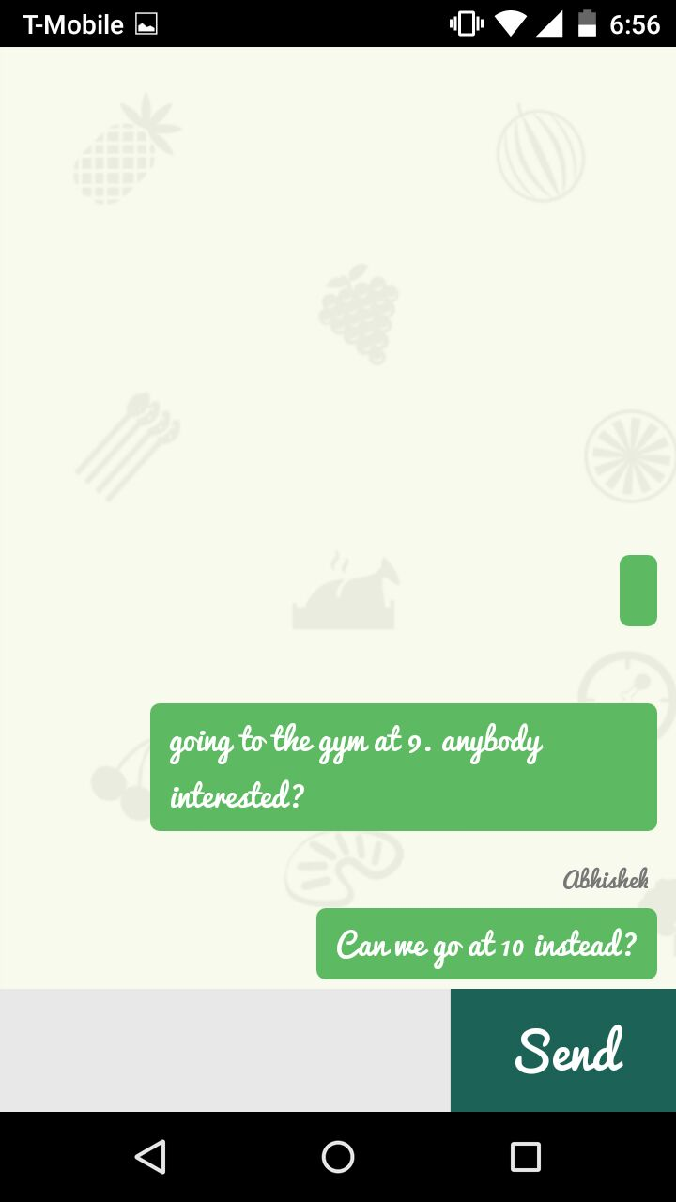
App In Action

