Slide 1
Feed –An android app
- Muroor Vikas Rao
- Ronit Shyam kadam
- Kamalpreet singh
- Sanket m. padwal

Slide 2
Motivation and Goal
Motivation:
The motivation behind making the Android Application is to provide ease of access to the user about the Trending Topics of the world.
Topics would be fetched from various social networking websites without explicitly visiting them.
Most current news feed applications involve certain degree of personalization thereby restricting the scope of topics.
Goal: The Application would serve as a real time “Interactive e-newspaper” which will provide an impersonalized and randomized news feed. These news feeds would be an amalgamation of the trends from Google, Yahoo, Twitter and 9gag APIs.
Notes:
Motivation is to provide a single platform that would provide all trends to the user.
There exists such services, however have certain degree of personalization. Eg. Facebook
Goal

Slide 3
Related Research
In the current market there are several personalized news aggregator applications like
Feedly It is personalized with the google reader account providing the content feed as chunks instead of a massive list.
Flipboard Integrates all personalized social media accounts and converts them into a stylish magazine like environment.
Zite Zite smart magazine tailors its content to user’s reader habits hence becoming increasingly personalized the more you use it.
The main observation that we made from our research was that, all the above stated applications involve certain degree of personalization and connection to an existing user account.
Our Feed application would use similar principle of news aggregation without any personalization.
Moreover, with the variety of APIs for retrieval of data, we came down to the selected lot for use in our application .

Slide 4
ANDROID STACK
The purpose of our application would require a single screen with a user interface which would guide the user to a particular link that he/she wishes to see. These links are the trending applications from the various APIs that we obtain from a HTML request.
The construction of our interface involves a ListView with an Adaptor which fetches and displays the data. These components are loosely coupled by the application manifest file AndroidManifest.xml that describes each component of the application and how they interact

Slide 5
YAHOO! API
GOOGLE API
TWITTER API
9GAG
API
links
links
links
links
HTML Parser
JSON Parser
trends
trends
RANKER
ListView
Array Adapter
ApplicationManifest.xml
RESULT
Intent
Web Browser

Slide 6
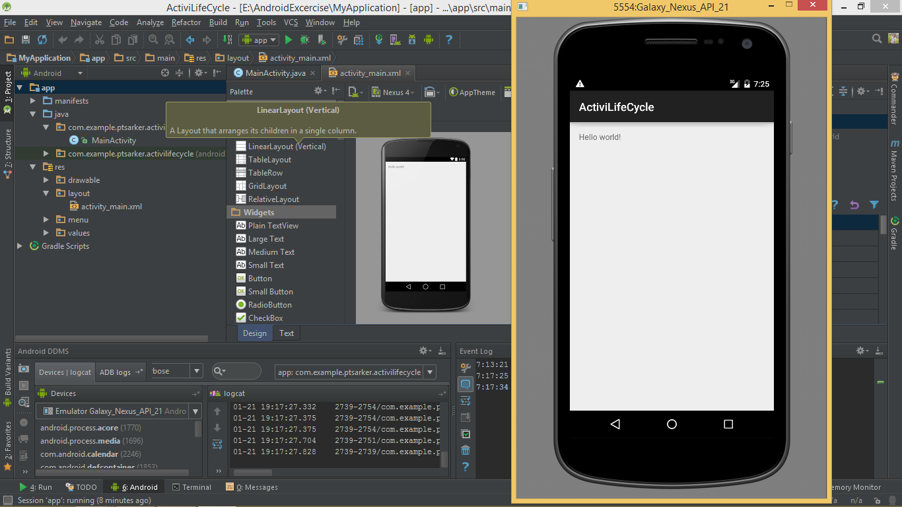
VALIDATION
Emulator Screen
The android.util.log library is imported for debugging statements (Log.d(“Testingpoint A”)). Testing is done in the Android DDMS (Logcat and ADB Logs) in the verbose mode.
USB Debugging
EVALUATION
Matching of crawled results with the actual results from respective sources to ensure correctness of libraries on the AVM
Number of downloads, User Rating and Feedback on Google Play Store

Slide 7
FUTURE SCOPE
result
Incorporation of location based trends using GPS
Usage of self made API that would simply computation

