Slide 1
Data Replication
Project Team:
Murtadha Al Hubail

Slide 2
Motivation & Goals
AsterixDB typical cluster consists of a master node (Cluster Controller) and multiple node controllers (NC).
Data is hashed partitioned across NCs based on primary key and stored only in one node.
In case of NC failure, all data stored on that node is permanently lost.
Goal:
Implement an efficient data replication protocol to prevent permanent data loss.
Cluster Controller
NC 1
NC2
NC3

Slide 3
Related Work
Synchronous Replication
All Replicas Identical
Two Phase Commit
Group Communication (Postgres-R)
Asynchronous Replication
Primary-Backups Model
Strong Consistency
Middleware Messaging Service
Publish/Subscribe (Yahoo’s PNUTS)
Distributed File System (Google’s Bigtable)
Using Paxos for consensus on failures (Google’s Spanner, Spinnaker)
Eventual Consistency
Amazon's Dynamo (Cassandra)

Slide 4
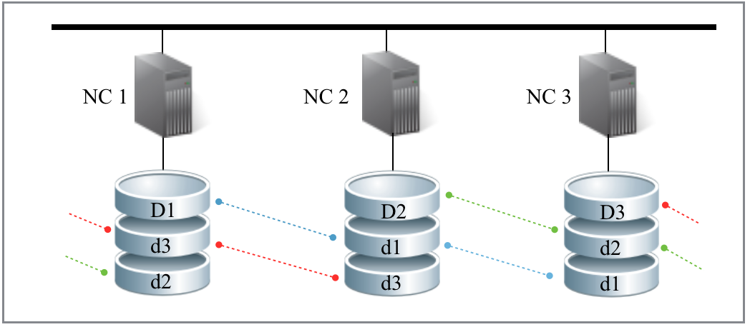
System Architecture
Each NC has a number of NCs designated as backup nodes based on a replication factor (# of copies).
Primary and backup NCs based on replication factor = 3

Slide 5
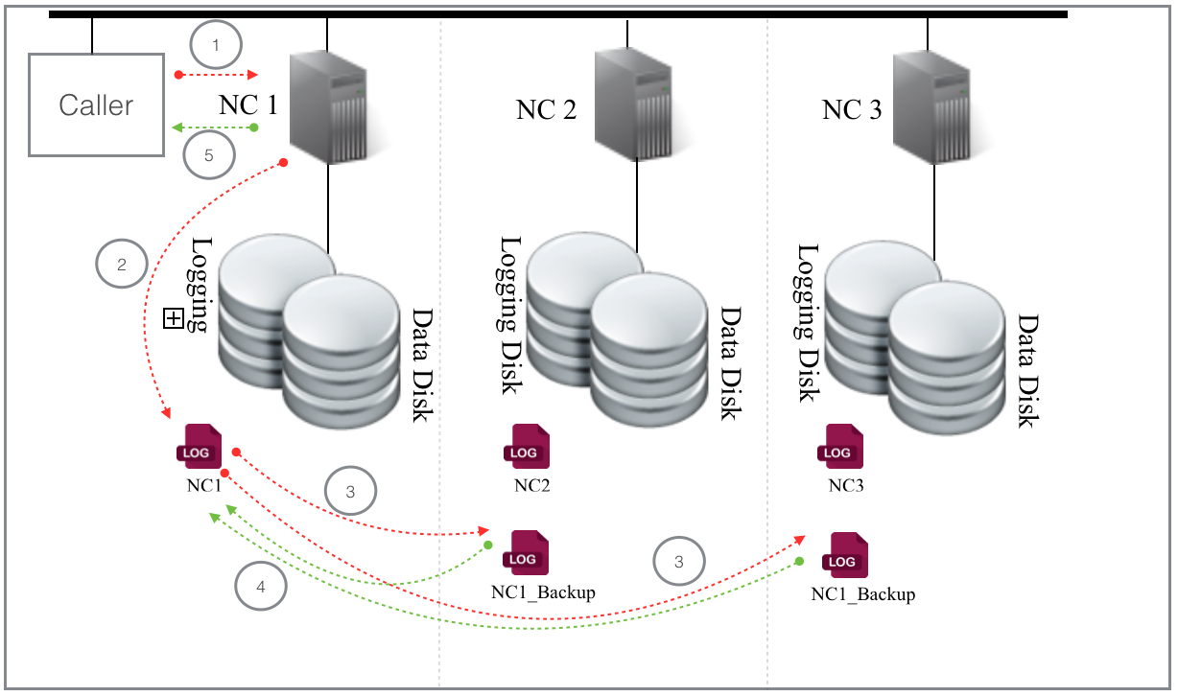
System Architecture
Implement data replication by sending transactions REDO logs, and LSM disk components to back NCs via Replication Channel over the network.
Transaction logs flow from NC1 to backups in NC2 and NC3

Slide 6
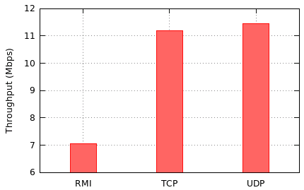
RMI vs. Socket Programming

Slide 7
Testing & Evaluation
1. Deploy AsterixDB on a cluster consisting for two or more nodes and enable data replication.
2. Evaluate data replication performance impact compared to no replication.
3. Disconnect a node from the cluster and erase all data to simulate hardware failure.
4. Reconnect the failed node.
5. Check that all data has been restored.

Slide 8
Testing Results
Environment
2 Nodes Cluster
Gigabit Ethernet
Replication Factor = 2
Results:
With an average of %12.97 throughput decrease, two copies of the data could be maintained.

