Slide 1
High Scalability IoT Messaging Architecture for Health Care
Wei-Han Chen, Cheng-Han Lee

Slide 2
Motivation
Currently, the IoT applications in many aspects of our daily life are prosperous, and there is also a growing trend in the applications of health care which can gather and upload biometrics data to cloud.
It’s crucial to support the correctness and completeness of biometrics for healthy care applications. So, there are demands for high-reliability messaging services.
However, with the growth of the IoT applications, the message traffic will grow up. It’s a big challenge for service providers to empower their services by scale up their existing equipment.

Slide 3
Goals
We try to propose a high scalability IoT messaging architecture with dynamic load balancing mechanism for health care, which can add and remove messaging agents without shutting down services.
This architecture will include these features:
Add/Remove Messaging Agents without shutting down services
Dynamic Load Balancing
Finally, we will do some benchmarks to evaluate the performance of the architecture.

Slide 4
Reference & Related Work
Managing Complexity: Middleware Explained Andrew T. Campbell, Geoff Coulson, and Michael E. Kounavis: Middleware can manage the complexity and heterogeneity of distributed computing environment.
V. Cardellini, M. Colajanni, “Dynamic Load Balancing on Web-server Systems” : Proposed a classification of existing solutions based on the entity that dispatches the client requests among the distributed Web-servers: client-based, DNS-based, dispatcher-based and server-based.
http://mqtt.org/: MQTT is a machine-to-machine (M2M)/"Internet of Things" connectivity protocol.
http://www.hivemq.com/building-a-high-availability-mqtt-cluster/: HiveMQ demonstrates how to build a MQTT high availability cluster environment using a TCP load balancer and the HiveMQ broker.

Slide 5
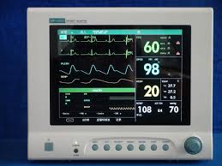
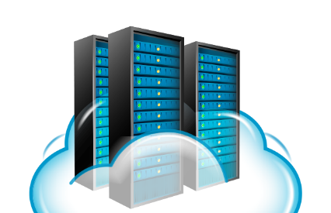
System Architecture
Broker
Request
Working Agents
Standby Agent Pool

Slide 6
Testing & Evaluation Plan
1. Generate a set of workload
2. Use simulators to perform stress test
3. Analyze the data from database to see:
loss rate of message packages
correctness of message packages
We want to observe that the number of working agents grow when message packages are sent at a higher frequency, and vice versa.

Slide 7
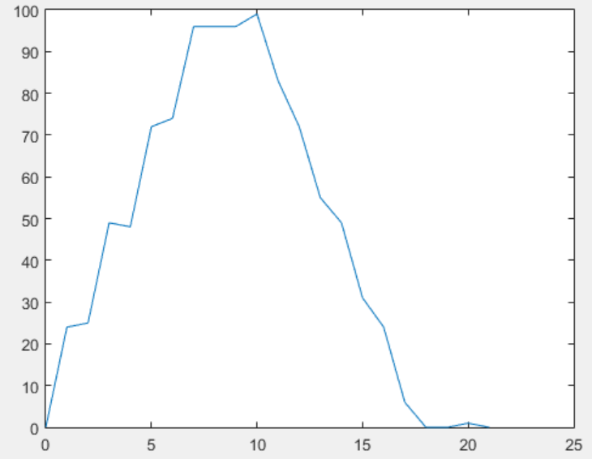
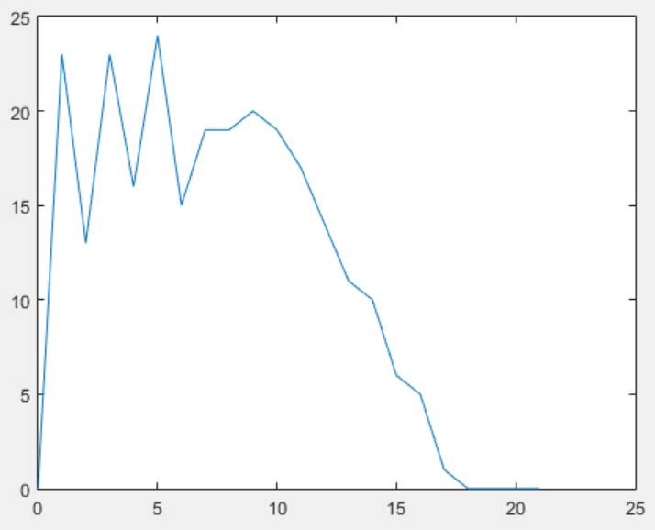
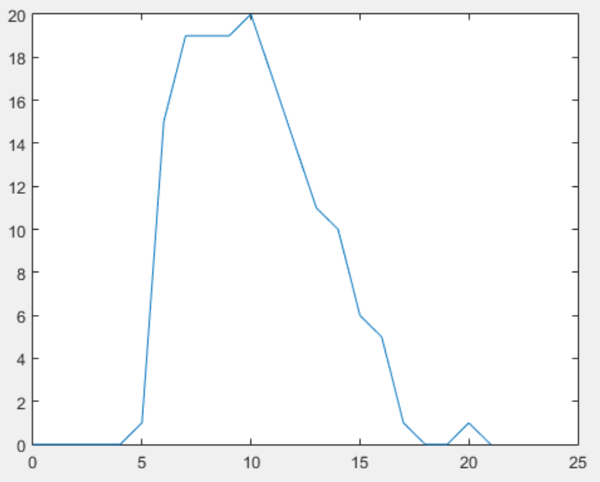
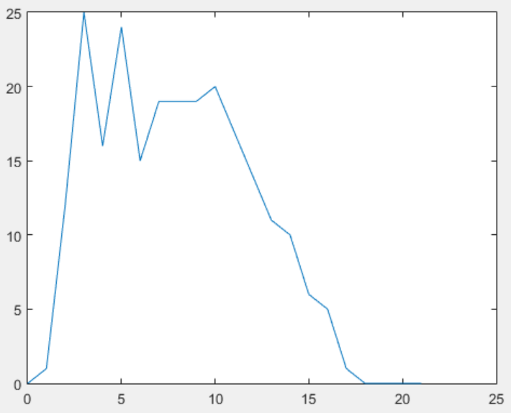
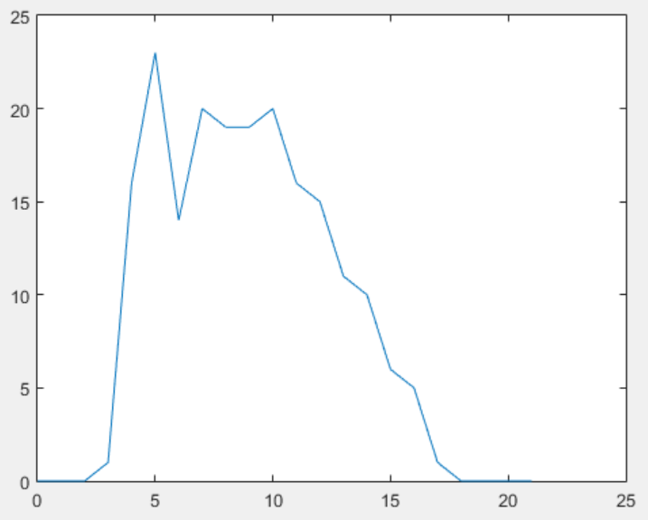
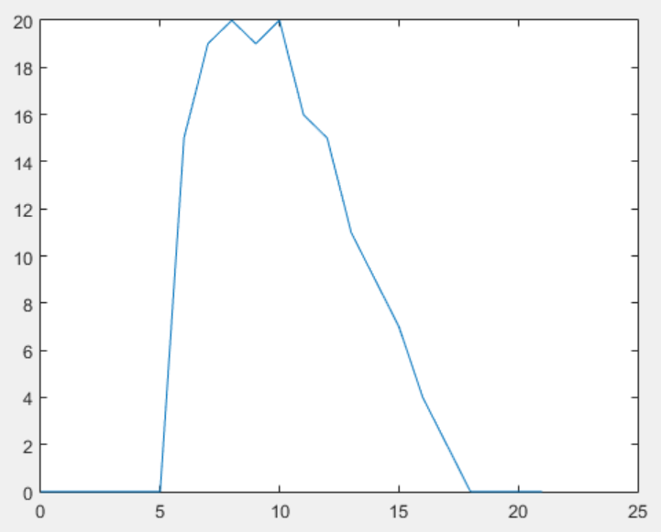
Results
Total messages
Messages for each agent

