Slide 1
eNanny: Child Tracking App
Andrew Manalo
Kevin White
CS237 – Spring 2015

Slide 2
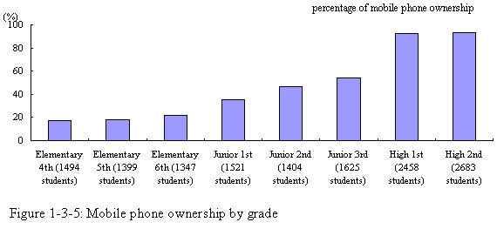
Motivation and Goals
Parent supervision is declining, while cell phone ownership among children is increasing.
Create an Android app that uses Google Cloud Messaging APIs to allow parents to keep track of their children.
Provide a open-source framework to allow for future improvements that don’t require the up-front price or subscription cost of existing apps.
Notes:
‹#›

Slide 3
Related Work
Existing Apps:
My Mobile Watchdog PhoneSheriff Net Nanny Qustodio
$45 $49.95 $13/year $45
Notes:
‹#›

Slide 4
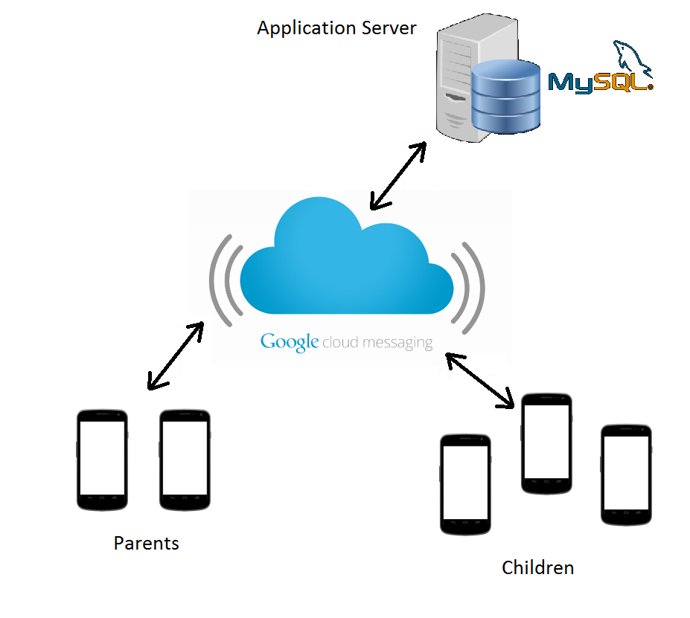
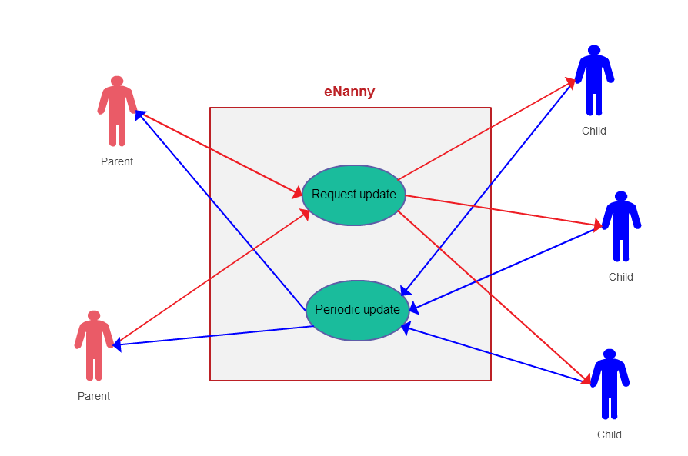
Architecture / Use Case
Periodic Updates
Child phones send updates periodically to the GCM
On-demand Updates
Parent phones can request updates from child phones above a threshold battery percentage
Notes:
‹#›

Slide 5
Challenges
Battery
Problem: Accessing GPS Location on Android drains battery fast
~.66% / min on Droid Turbo with 3900 mAh battery attempting to access GPS Location Provider once a second
Solution:
Adjust the periodic update rate on child phones based on remaining battery
Set a minimum battery amount for on-demand updates
Security
Problem: Limiting access to the location of children exclusively to authorized parent phones
Solution:
Append a child phone’s ID and passwords to GCM payload
Match device ID and password on parent phone when retrieving child phone location
Require parent and child phones to be local to each other during setup
Notes:
‹#›

Slide 6
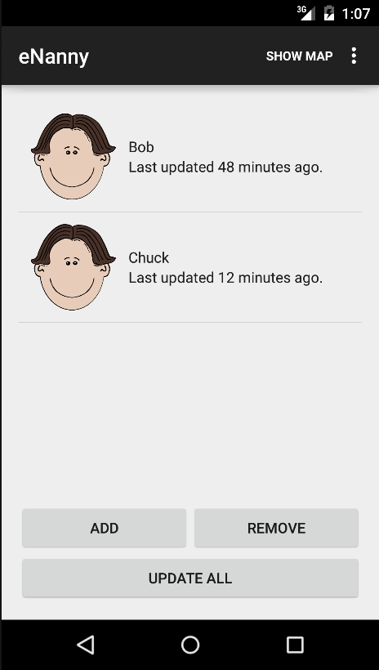
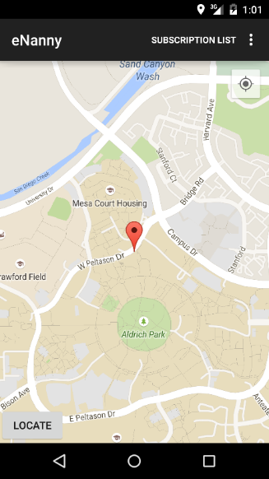
Results and Future Work
Future Work:
Move the security solution off client applications to prevent access child information in case the device is lost or stolen
Whitelist areas
Encryption of messages at source
Notes:
‹#›

