Slide 1
DDSP: A Transmission Protocol and its relative APIs in distributed systems
Yue Lin 52085582
Danna Wang 47764144
Yameng Qi 33561361

Slide 2
Motivation & Goals
In this project we design and implement Distributed Data Sharing Protocol (DDSP), a peer-to-peer protocol with a set of APIs that allow upper-layer application to share data among peers.
The goal of our design is to allow nodes in a local area network to decentralized share data with each other using a light weight protocol.

Slide 3
Related work and efforts
DHCP
ARP
Publisher/Subscriber
P2P

Slide 4
What was done
Protocol design, APIs implementation, application demo
IP address | File Identifier | TTL | status
x.x.x.x | MD5 | TTL | on_the_disk
y.y.y.y | MD5 | TTL | on_the_wrie
z.z.z.z | MD5 | TTL | on_remote
… | … | …
APIs
addContent, addContents, removeContent,removeContents,
requestContent, requestContents, getResourceTable

Slide 5
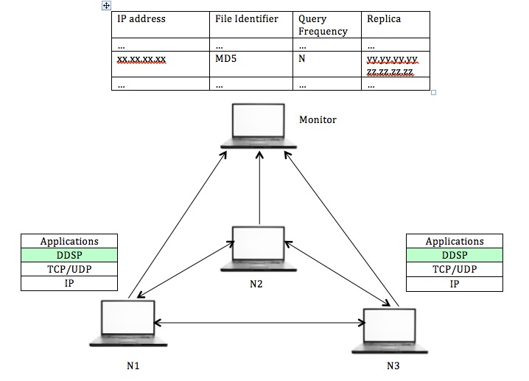
Use Cases

Slide 6
Results
Evaluation Environment
Local Area Network (2 nodes)
Virtualbox (3 nodes)
Mininet (10+ nodes)
Metrics
Throughput (first try success is 100% in 10 nodes in Mininet,
slightly drops in 20 nodes)
Future Works
Load Balancing (all queries come to same node)
Broadcast Storm
Integrate with SDN

