Slide 1
SDN Based IoT-Cloud Comm.
Presented By: Devendra K Lavaniya (26848236)
Bradley Quadros (38321094)
(Collaborating with Gouxi Wang )

Slide 2
Motivation / Goal:
Currently, IoT sensors directly connect to the Cloud and off-load all data in real time.
Consequence :
Link/device Failures leads to loss of sensor data.
No local control over what and how frequently to send data.
Solution :
Implement a robust policy framework for IOT-Cloud communication.
Using the concept of edge networking for transient storage & SDN for policy based forwarding.

Slide 3
Related Works
M2M + SDN based management framework
http://ieeexplore.ieee.org/xpl/articleDetails.jsp?arnumber=6912751
MINA ( Multinetwork INformation Architecture)
http://ieeexplore.ieee.org/xpl/login.jsp?tp=&arnumber=6838365&url=http%3A%2F%2Fieeexplore.ieee.org%2Fxpls%2Fabs_all.jsp%3Farnumber%3D6838365
Fog Networks/Edge Computing
http://ieeexplore.ieee.org/xpl/abstractAuthors.jsp?arnumber=7020884

Slide 4
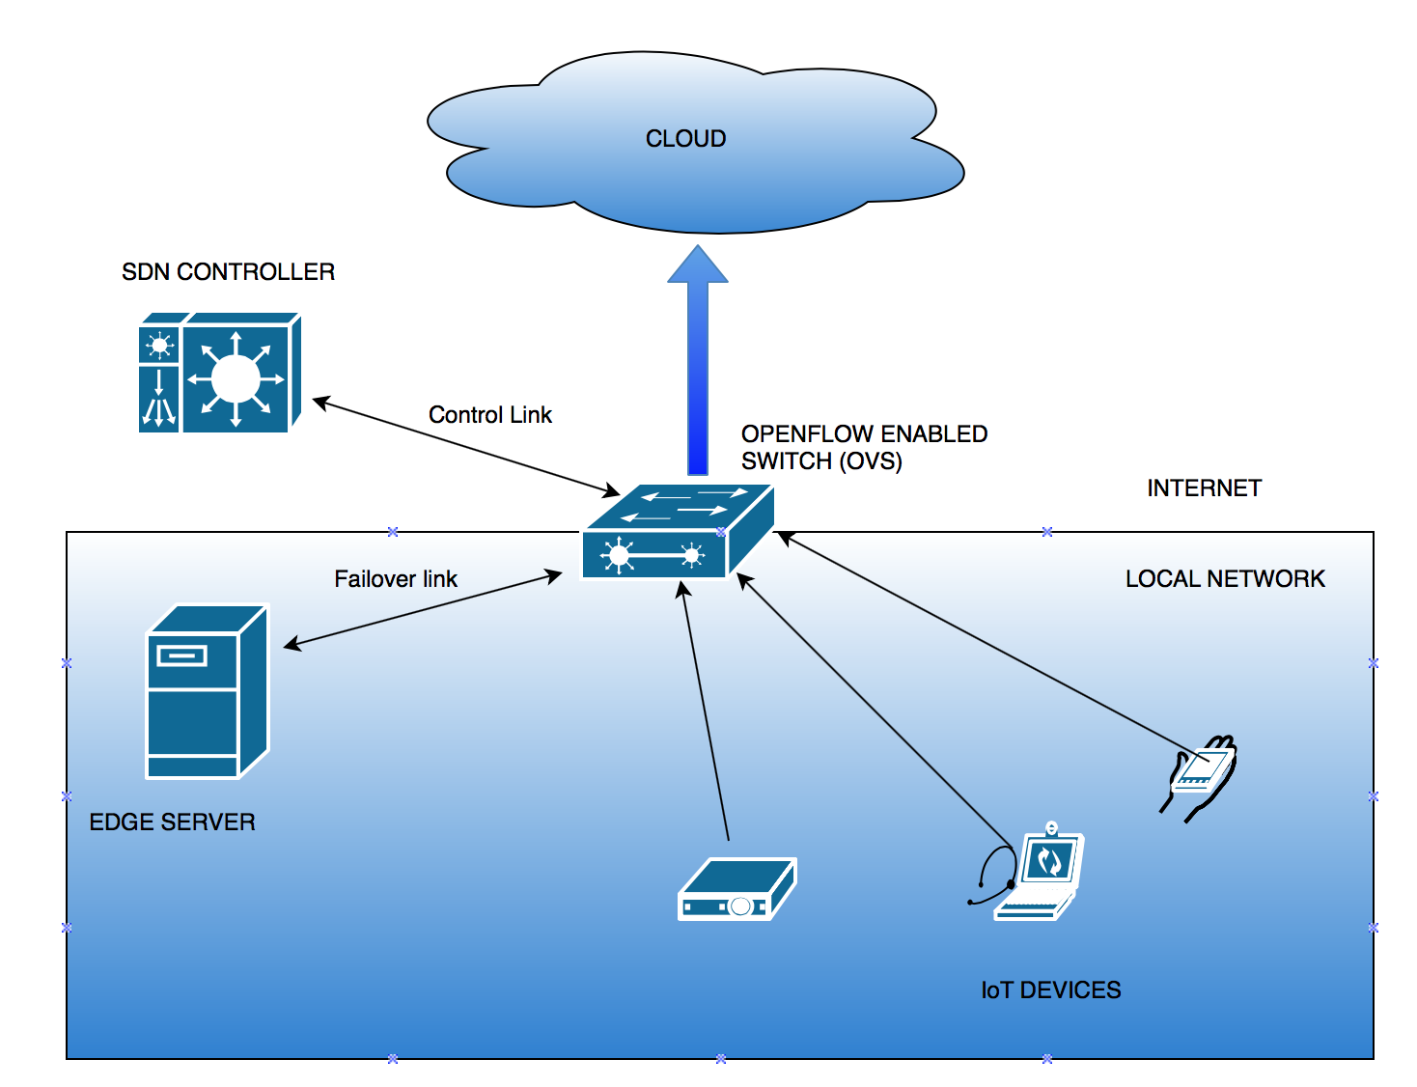
Architecture

Slide 5
Implementation
Different sensor devices connected to the cloud using a OpenFlow enabled switch. Switch communicate with a SDN controller and Edge servers (One or more).
SDN controller intercepts the data and creates flow to the cloud using OpenFlow protocol.
Switch-Cloud link status is continuously monitored using a control signal from edge servers (currently implemented using ping).
Link failure or congestion is detected by the switch using pre-defined condition (consecutive ping failures) . Flow is modified to divert traffic to local edge server if link failure/congestion detected as a auto failover mechanism.
As link comes back up, another flow-mod entry directs the back to the cloud.
Each packet is assigned a local sequence to make sensor data is stored in cloud in order.
Currently based on HTTP (TCP) traffic but can be implemented over UDP.

Slide 6
Softwares/Tools/Test-Bed
Test Environment :
OpenDayLight SDN Controller
Openflow Switch (OpenVSwitch)
Different IoT sensors (Simulated using simple nodes)
Edge Server and Cloud (Local HTTP server implementations)
Mininet (SDN applications testbed with basic flow forwarding)
Test Case/Results :
Link Failure : Successive N failed ping
Link Congestion : Total M failures in fixed time intervals.
Auto-Failover in both cases, duplicates discarded at switch.
Packet numbering at switch to ensure sensor data is stored at cloud in sequence.

Slide 7
Future Work
Adding more functionalities to the SDN based flows to implement a comprehensive policy framework for secure, flexible and robust communication.
More granular control over data forwarded to cloud (Pre-processing at Edge Servers)
Location aware edge-server placement for large scale deployment.

