Slide 1
CompSci 237 - Spring 2015: Distributed Systems Middleware
Find New Buddy (FNB) web service
Group ID: 3
Ankur Aggarwal (20009480)
Saurebh Raut (27481720)
Siddharth Kodwani (32445633)

Slide 2
Goals & Motivation:
New Location needs New Friends
Get Social
People unable to find other people with same interest
Scalable to more functionalities
Related Works: www.hobbybuddy.com, www.TennisPartner.com, www.livejournal.com

Slide 4
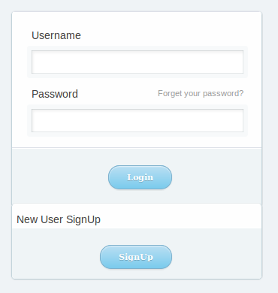
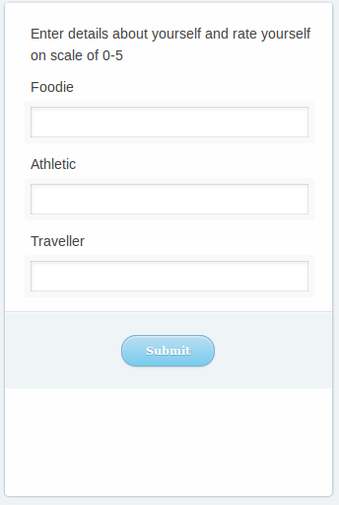
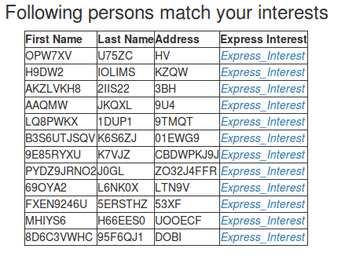
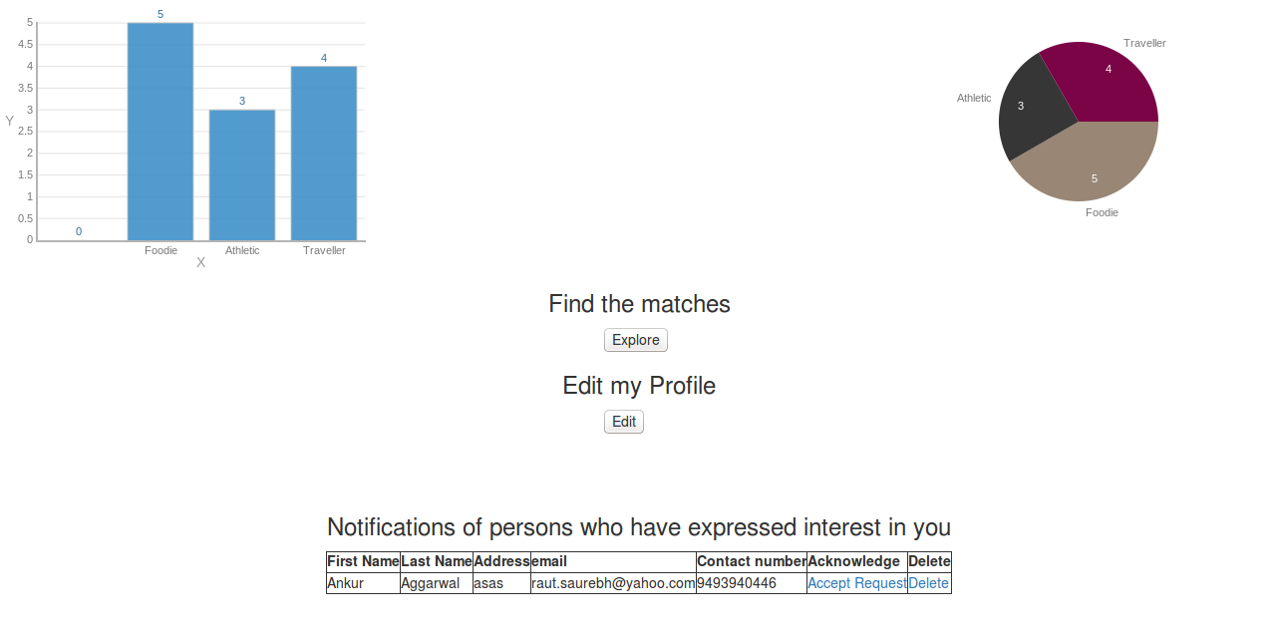
System Work Flow:-

Slide 5
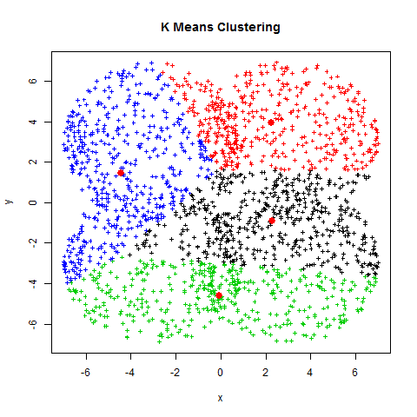
Recommendation-Flow
Get the user interests that are stored in database and also interest data of other people which acts as the raw data for the clustering algorithm.
We are using K-means clustering algorithm.
The value of K is dynamic and changes with the number of users.

Slide 6
Performance Evaluation
Time on local machine
Time on Amazon Instance
Number of People Entries | Database population (seconds) | Kmean (dynamic)
100 | 10.45 | 0.262
1,000 | 97.688 | 0.979
10,000 | 896.13 | 6.54
Number of People Entries | Database population (seconds) | Kmean (dynamic)
100 | 1.894 | 0.035
1,000 | 11.04 | 0.138
10,000 | 87.105 | 1.935
8 X Improvement in Database Population
6 X improvement in performance in Exploring new friends

Slide 7
Thank You!

