Slide 1
Implementation of Simple Cloud-based Distributed File System
Group ID: 4
Baolin Wu, Liushan Yang, Pengyu Ji

Slide 2
Motivation & Goals
Provide a layer between client companies and multiple cloud storage companies for data storage
Security: not a single cloud storage company can get a complete view of any single file
Fault tolerance: sometimes a cloud service can fail or delay, more copies on different services can solve the problem
More storage: by combining the several cloud services together, clients can get more storage without extra cost

Slide 3
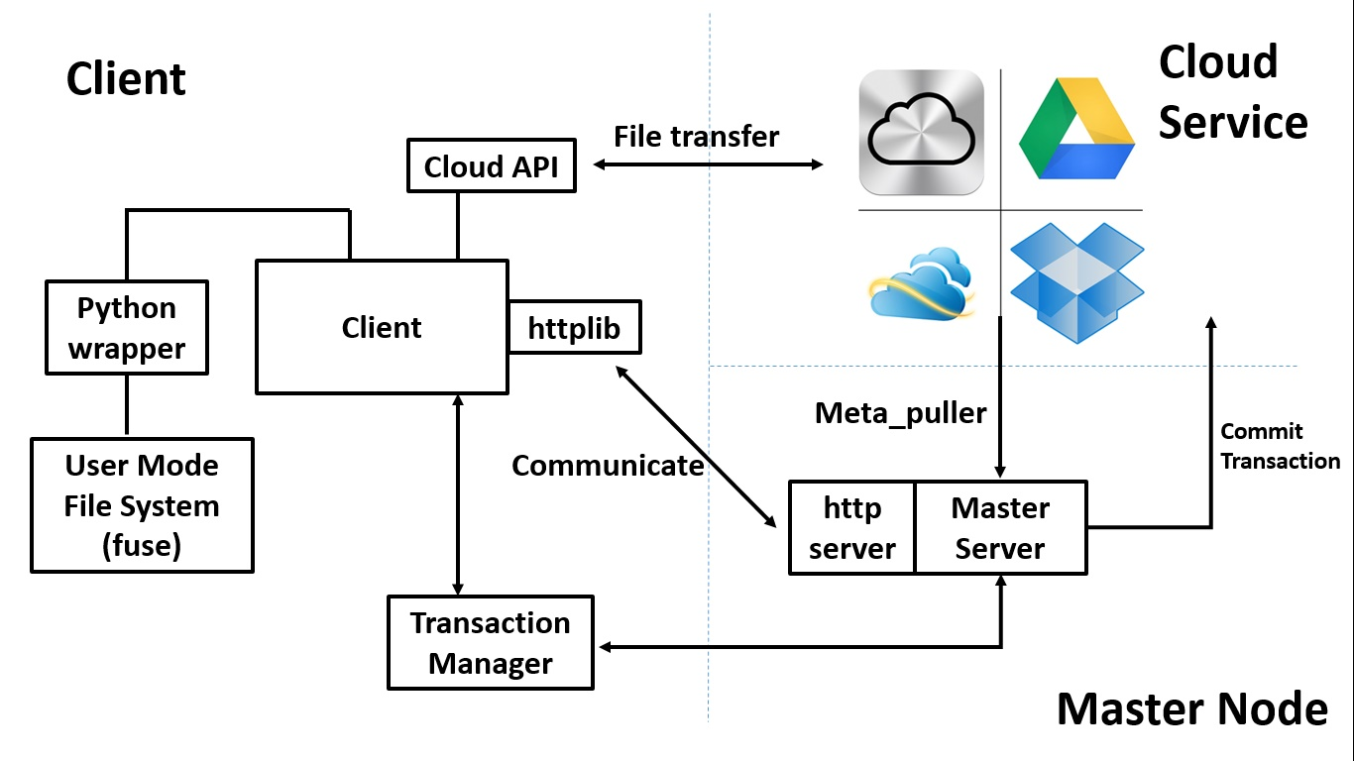
System Architecture

Slide 4
What we have done
Integrated Google Storage, Dropbox API. (Local API simulations when Dev)
File is replicated N times across different cloud servers
Server responsible to keep file version consistency in cloud.
Support directory create/remove, file create/open/read/write/close
Download/assemble when open, upload/splice when close, R/W to local file.
Server can do migration when one cloud node is down.

Slide 5
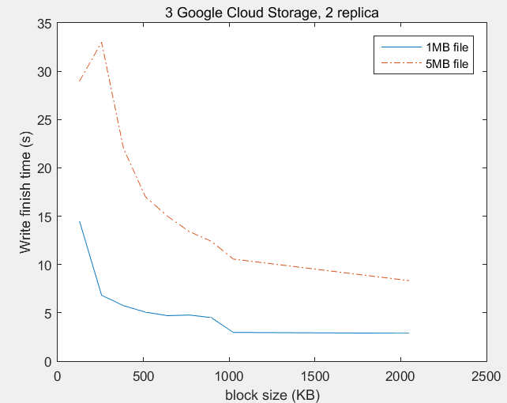
Implementation Detail
Cloud Storage
Block size & upload time
Folder is a special file:
6
2
Read/write workflow
Master node
4
5
1
3
Client
Request read block ids
Copy to temporary file in cloud
Return file name and server ids
Transfer temporary file
Commit transaction
Delete temporary file
We choose 1MB as the block size.
Files in cloud are all flat.

Slide 6
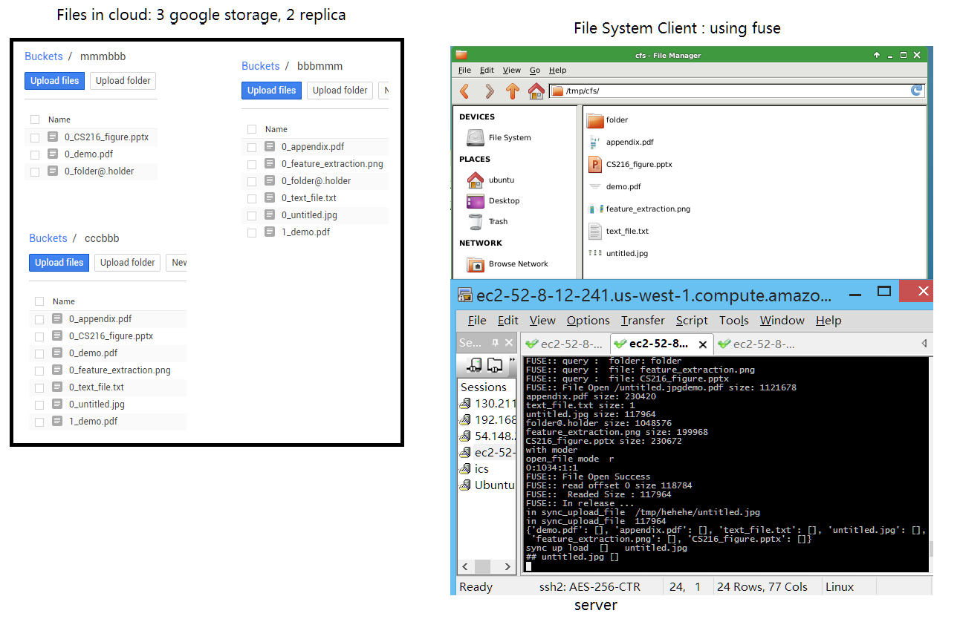
Demo Result
File System Client: using fuse
Files in cloud: 3 Google storage, 2 replica
server

