Slide 1
Crowd-sourced Lost and Found
Application
Jwala Mohith Girisha,
Rajani R Siddhanamatha
& Vijaykumar Koppad

Slide 2
Agenda
Motivation and Goals
Architecture
Implementation Details
Progress
References

Slide 3
Motivation and Goals
To find lost items is an intimidating task.
Reporting found article at Lost and Found department can be equally tedious.
Employ conglomeration of the current technologies to bridge the gap.
Present a simple, efficient and crowd sourced application to smartphone users.
Encourage crowd to report found articles on the fly and help in returning them to their rightful owners.

Slide 4
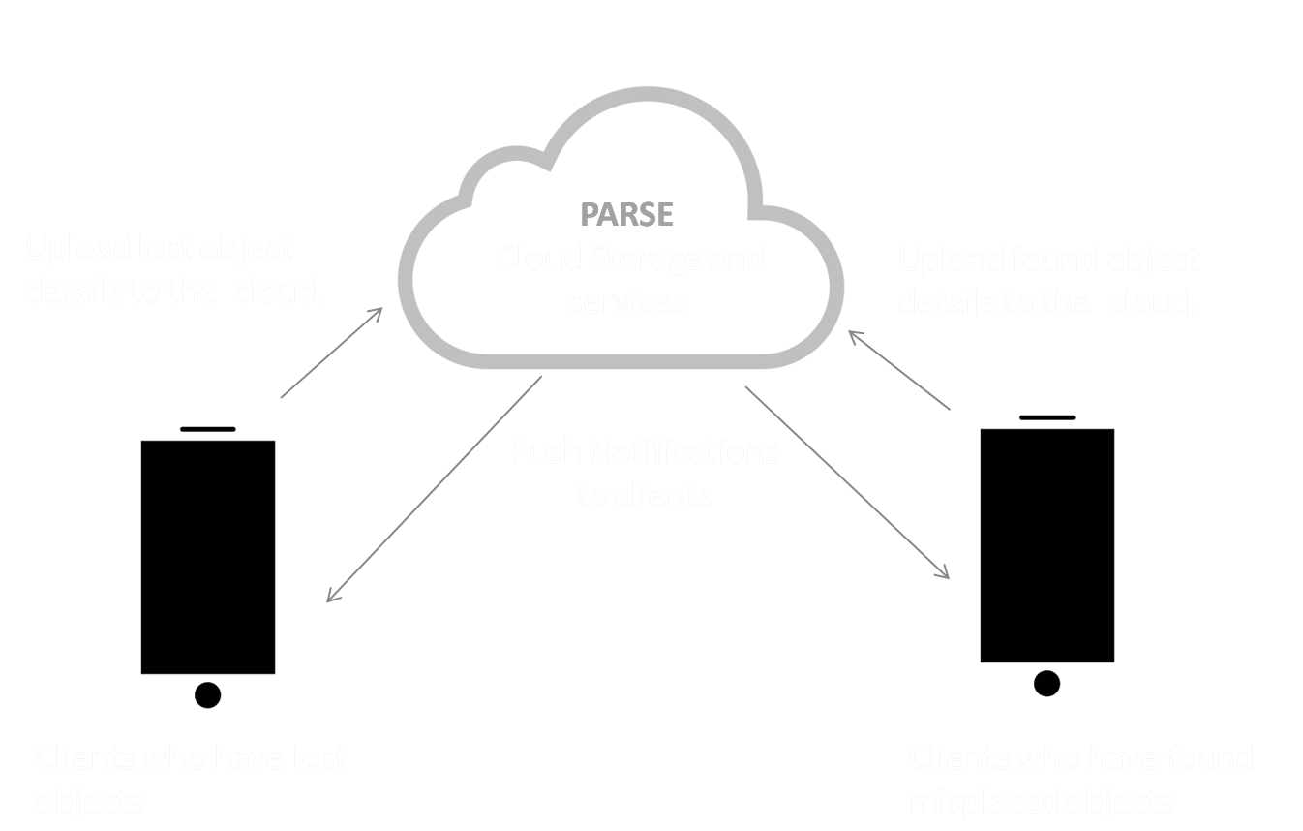
System Architecture
The solution incorporates a client server model.
Clients are the smartphone applications which aid users in reporting lost and found objects.
Server is a distributed cloud storage for user information and object records.

Slide 5
What is PARSE??
Parse is a Cloud-based backend as a service (BaaS)provider for mobile applications.
It supports different mobile platforms such as iOS, Android, Windows.
It is built on Amazon Web Services(AWS) platform.
Parse is suitable for high throughput, fast, scalable and I/O intensive operations.
Currently around 50000 applications are running on Parse.

Slide 6
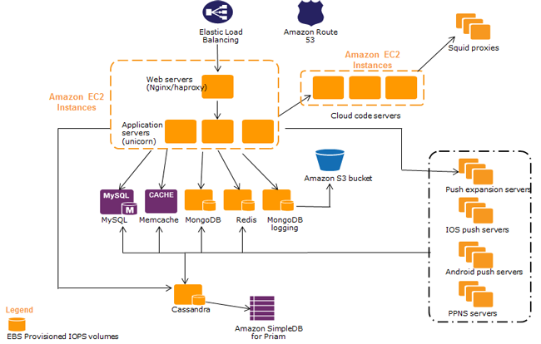
Parse - Back End Architecture
Image Coutesy: AWS case study (http://aws.amazon.com/solutions/case-studies/parse/)

Slide 7
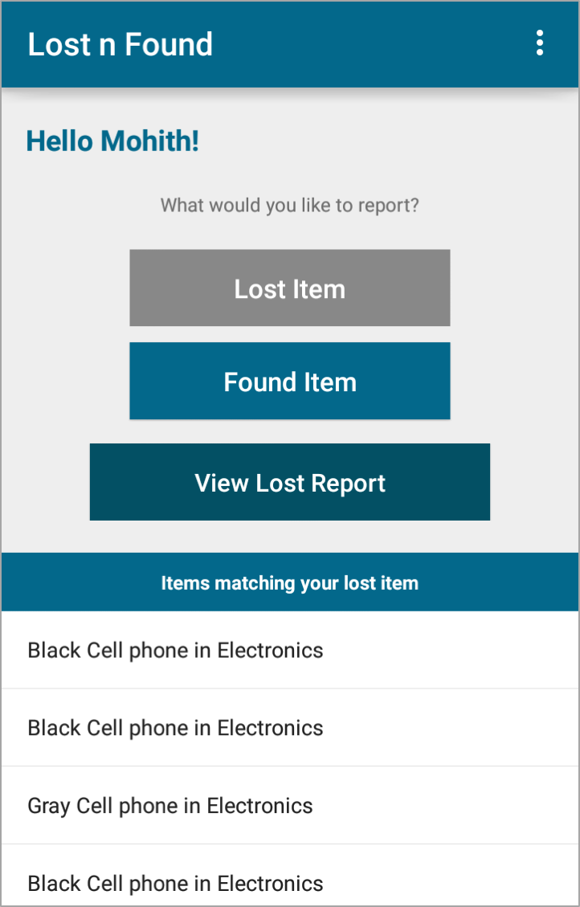
User Interface
Android app provides option to enter details along with brief description about lost/found objects.
Use REST APIs to gather so collected information on cloud.
Send push notifications to users on matching lost and found records.

Slide 8
