Slide 1
Auto-tagging of Media using Local Bluetooth Information
Emmanouil Alimpertis, Shonali Balakrishna

Slide 2
Motivation & Related Work
Photos volume has been exploded due to use of smartphones. Difficult for users to keep track of media generated of them.
Challenges: Photos are taken by many people at different events, making sharing difficult.
Necessity: a platform that allows immediate tagging and sharing of media, based on proximity information.
There is no widely known App for auto-tagging media during events. Bluetooth (BT) proximity is considered for several applications; however, no work exists for auto-tagging of media to help users keep track of and share photos.
Related project: A. Pullabhatla & H. Gomes, “Proximity Data Gathering for Android Through Bluetooth”, CSE 237B, UC San Diego, Fall 2009.

Slide 3
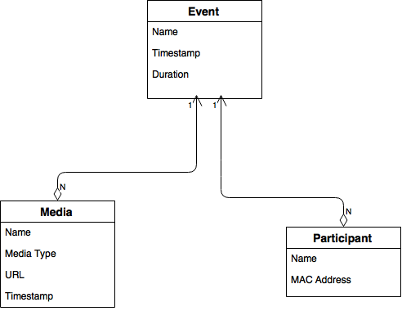
System Architecture
Android Application:
i) Scans for BT Proximity Devices
ii) Tags photo on capture
iii) Saves data locally in ORMLite DB.
iv) Uploads to Web Server using REST
v) Share URL with Participants with BT.
Bluetooth Android APIs were used for proximity discovery of participants and for media URL sharing.
ORMLite was used as the relational mapper to persist objects to database to store the schema.
REST API was used to upload photo to a HTTP web server running PHP. Server responds with a public URL

Slide 4
Evaluation & Use Cases
Application was evaluated using two Android devices, to send upload URL’s of generated media.
Basic Use Case:
i) Use Bluetooth to detect proximity devices (i.e. your friends)
ii) Create an event with location and duration.
iii) On creation of media, associate media with an event, upload to server and generate a URL
iv) Using Bluetooth, scan for friends and send a request for a tag.
iii) After acceptance, communicate media tag information and shares the URL with the participants.

Slide 5
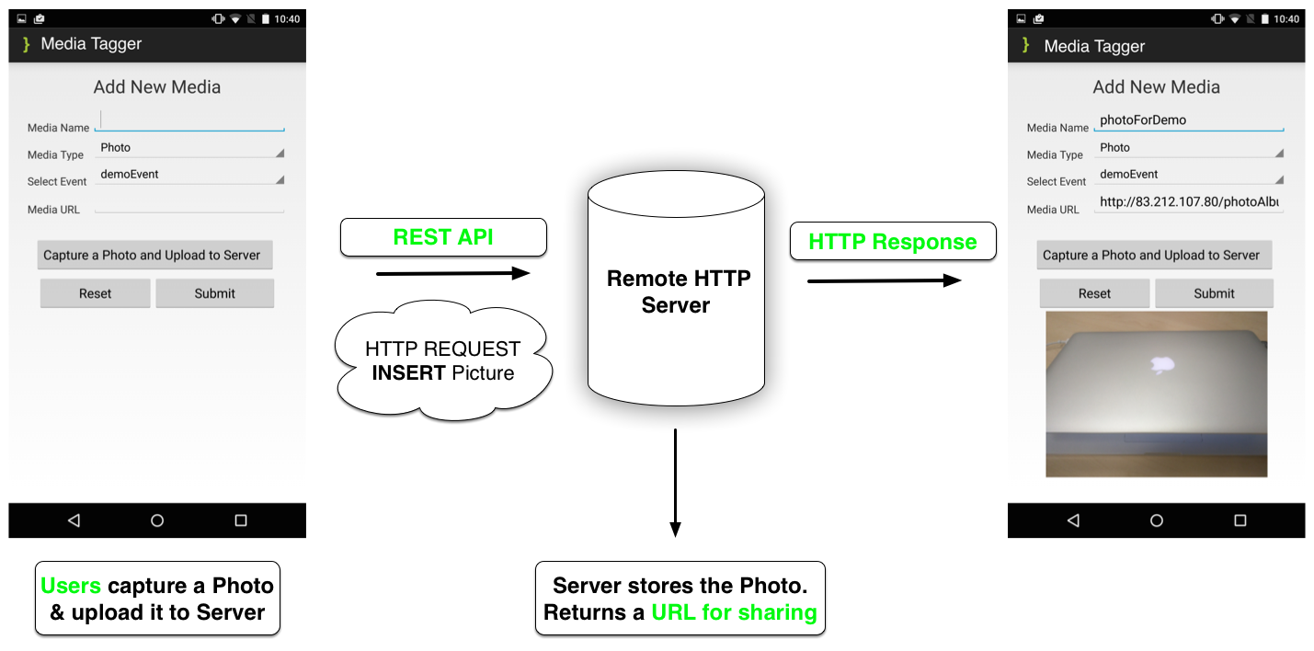
Results: Upload Photo

Slide 6
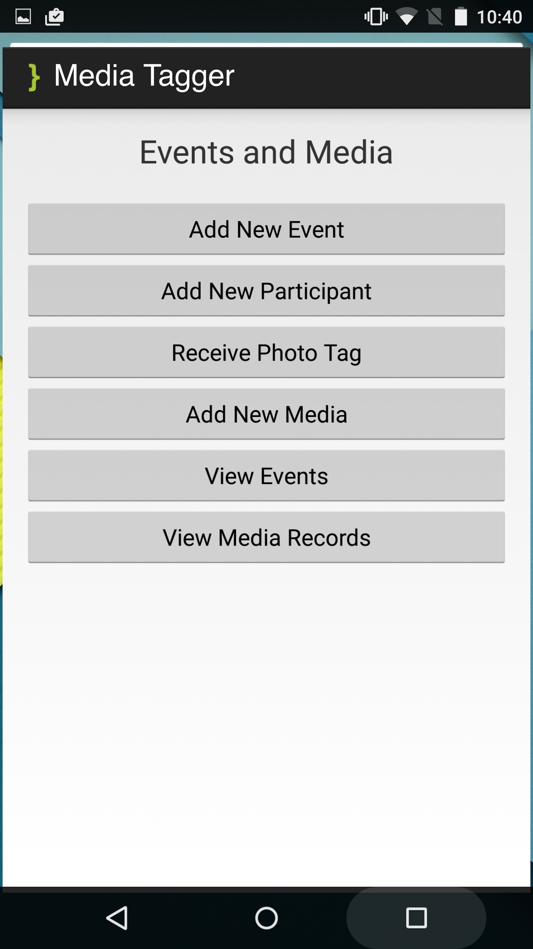
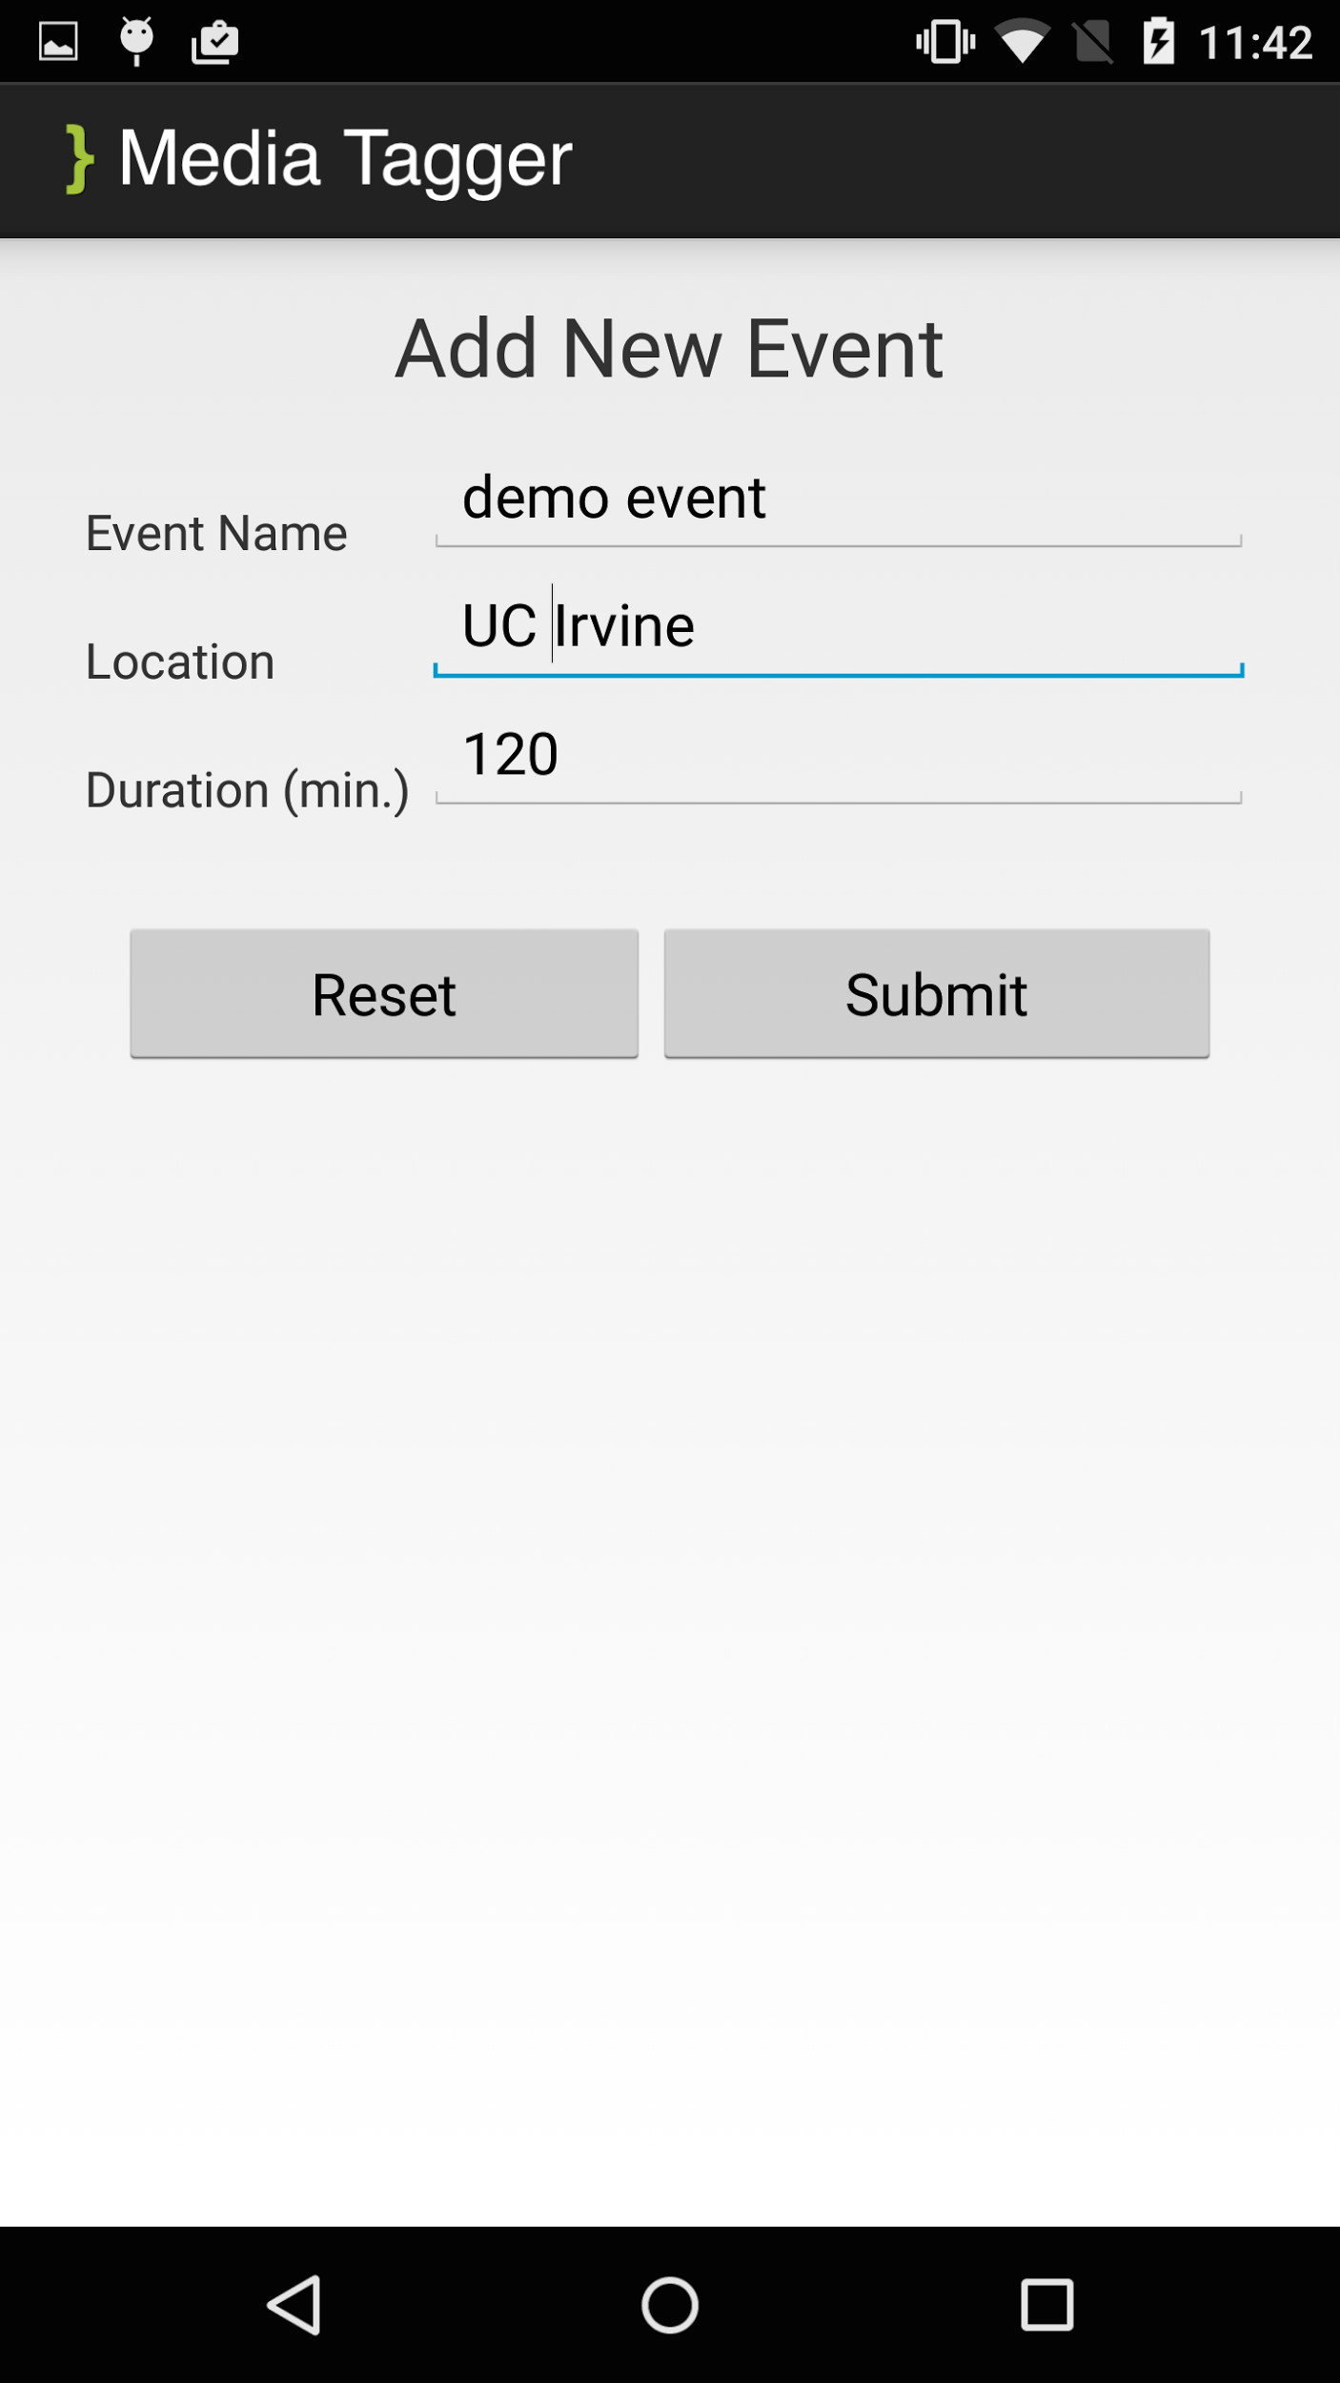
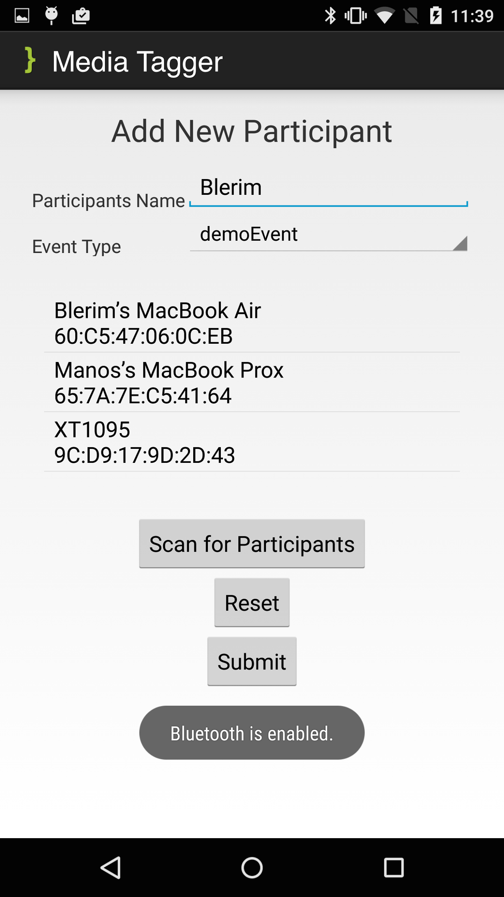
Results: Use BT to share URL

