Slide 1
DNS Antidote
Abhishek Madav(86378148)
Suhas Tikoo(22363556)
Urjit Khadilkar(24449837)

Slide 2
Motivation
To device a heterogeneous service that would monitor the resolution of the user’s requests across different browsers.
HTTP links accessed by the user would be checked for potential DNS poisoning against a DNS lookup performed by a secured server (one of the those kinds hosted by any anti-virus service).
The server enumerates the list of the IP addresses which can then be compared with the local look-up for making a secured redirection to the user.

Slide 3
Domain Name System
Integral part of the Internet, without which it will collapse.
Used to convert a domain name into an IP address.
OS asks the Resolving Name Server for the location of domain name.
If RNS has no information, it contacts the Root Name Server for the location.

Slide 4
DNS Poisoning
Input (UCLA)
Output (UCI)

Slide 5
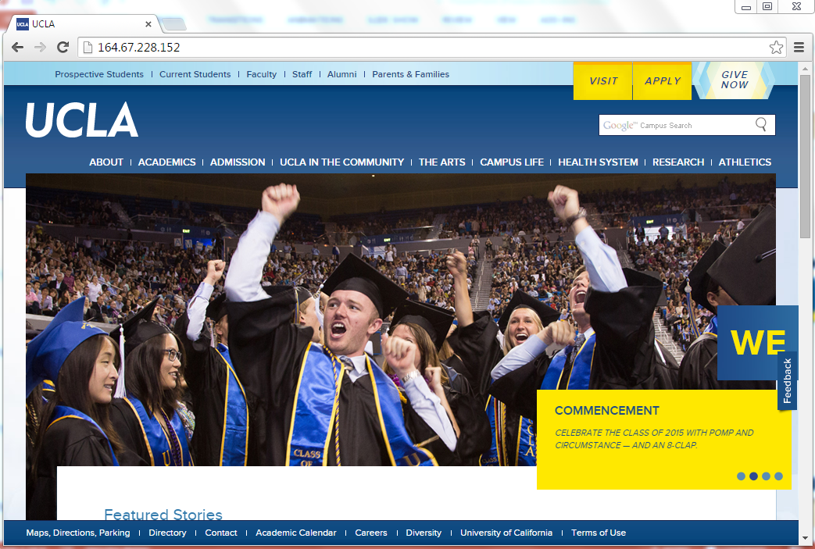
Block Diagram
2. query
Secure Server
1.request intercept
4. compare
3. response
5. redirect

Slide 6
Technologies used
Selenium Web Drivers
Chrome Driver
Firefox Driver
DNS
Web Services:
RESTful API JAX-RS
AWS Elastic Beanstalk

