Slide 1
Unified Cloud Storage
Group 9
Navneet Joshi
Apoorva Gupta
Gurinder Pal Singh

Slide 2
Motivation & Goal
Today there are a number of cloud storage services (Dropbox, Google drive, Box).
One has to manage each of these services individually.
Our application Anu is a web application that will provide a unified view of all these storage services. This will mean user has to manage just a single storage.
Our application supports upload, search and download functionalities.
Extended to include file sharing.

Slide 3
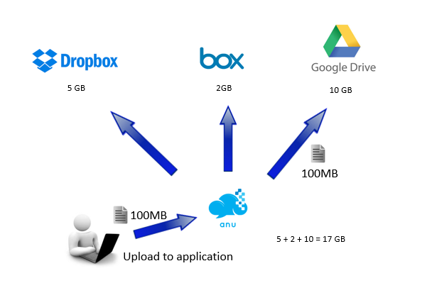
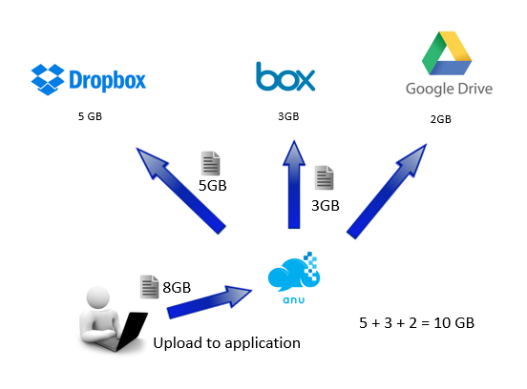
Unified Cloud Storage
Simple Upload
Fragmented Upload

Slide 4
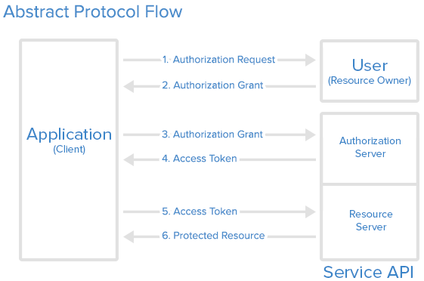
Authentication -Used OAuth 2.0 protocol for authentication.
Architecture
AuthenticationManager
Storage
REST APIs
UI
Servlets
Storage
REST APIs
WorkflowManager
Storage
REST APIs

Slide 5
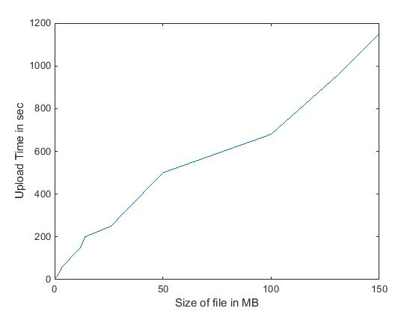
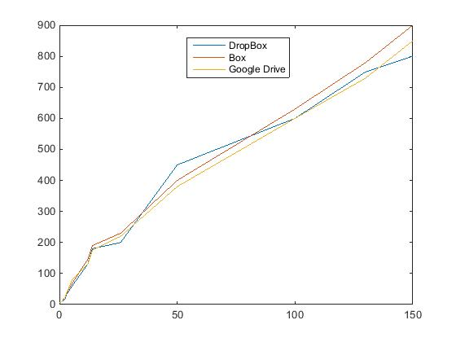
Evaluation

