Slide 1
A MIDDLEWARE LIBRARY FOR CONFLICT FREE REPLICATED DATA TYPES (CRDT)
Sai Teja Ranuva
Kishore Narendran

Slide 2
THE CAP Theorem
Consistency
Availability
CP Systems – Redis, MongoDB, financial applications
AP Systems – Cassandra, CouchDB, most internet applications (Facebook, Twitter)
CA Systems – MySQL, Elastic Search
CA
Partition Tolerance
CP
AP

Slide 3
EVENTUAL CONSISTENCY and CRDTs
CRDTs
Operation Based
Sets
Counters
Registers
State Based
G Set
2P Set
G Counter
PN Counter
LWWE Set
PN Set
LWWE Register
“If no new updates are made, all accesses to some data will yield a consistent result” (Vogels, 2009)
The solution of maintaining AP, and providing eventual consistency – CRDTs. (Shapiro et al. 2011)
CRDTs, specially designed data structures, which have mathematical proof of consistency.

Slide 4
OUR Solution
Redis Instance/Cluster
. . .
. . .
CRDT as a Service
Dedicated CRDT server, that can be deployed
Built with Python, using Flask using Redis key-value keystore
Provides mechanisms for reaching consistency
A CRDT python library, that exposes the CRDTs, as a programmable APIs.
Built with vanilla Python, and Requests
Library provides always available, highly replicated access to CRDT variables
CRDT-py Server
. .
. .
CRDT-py Library
CRDT-py Library
CRDT-py Library
. .
. .
Application
Application
Application

Slide 5
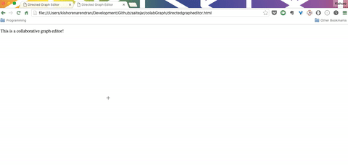
A Sample application
Collaborative Graph Drawing and Visualization Tool
Built using D3 and jQuery
Some other use cases
Distributed Counters for API monitoring
Timestamped event ordering.
Comment threads in social media.
eCommerce inventory management.
Distributed mapping, and cartography tools

