Slide 1
IFTTT RECIPES WITH NETWORK CONSIDERATION
PROJECT PRESENTATION
CS 237 DISTRIBUTED SYSTEMS MIDDLEWARE

Slide 2
INTRODUCTION
IFTTT website is the first large scale implementation of trigger-action (if-then) model for end-user programming. We have used its model as an inspiration for our project.
Developed an android app which is used to register to our service (written in Node.js).
When sensor events ( gas sensor, heath tracking device event etc.) are triggered, the service notifies the user (action).
It ensures that the user receives GCM notification if he is connected to internet else he receives a message or a call (using Twilio) in case of poor internet connectivity.
If the call is not acknowledged, his emergency contacts are alerted, thus ensuring the safety of the person in all situations.

Slide 3
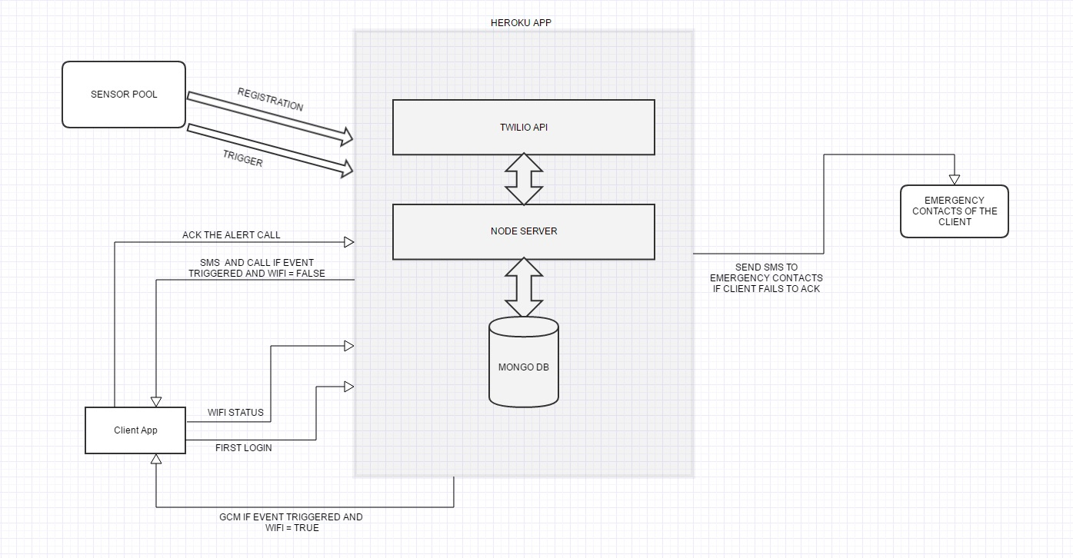
ARCHITECTURE

Slide 4
ISSUES ADDRESSED
IFTTT allows users to create recipes having only one action and one trigger but our system design allows us to integrate multiple triggers and respond with multiple actions.
IFTTT does not take into account network considerations but we ensure that the user receives the alert even if he is not connected to the internet.
This Rules based engine can be plugged in and easily configured for any device and sensor in contrast to IFTTT which works with only a few select sensors and offers less flexibility.

Slide 5
FUTURE SCOPE
Personalized service to the user by learning his activities and taking smart actions.
Ensuring sensor triggers are received by the back-end even if network connectivity is poor.

