Slide 1
CollabEvent
Collaborative Event Planning App
Purvi Kaul - 95626832
Prateek Malhotra - 18368632

Slide 2
INTRODUCTION
People collaborate when organizing events
Information exchange is scattered among various channels – emails/texts
Hard to keep track and coordinate for a group
Enterprise solutions exist, not meant for informal events/get-togethers

Slide 3
SOLUTION
Have all interactions in one place
Social, quick and interactive unlike enterprise solutions
Mobile app – ubiquitous and real-time

Slide 4
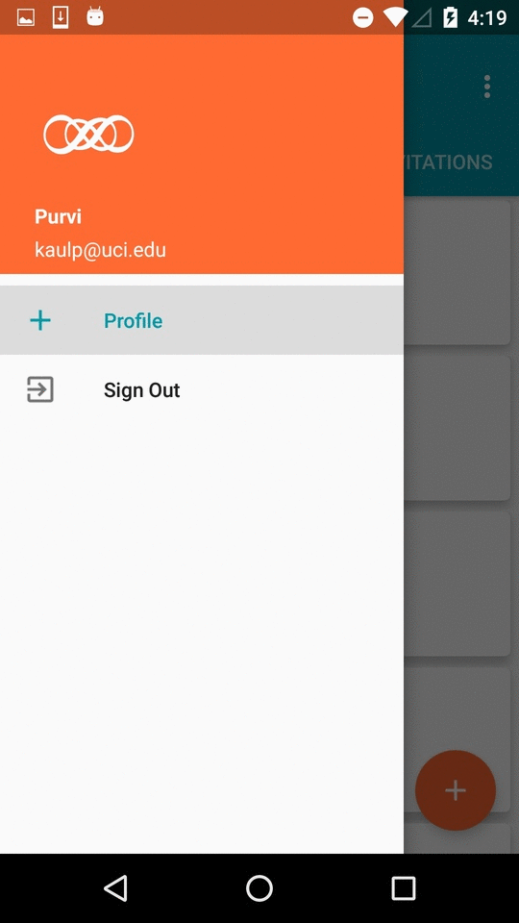
FEATURES
EVENTS - Create and manage events - Invite your friends
TASKS - Create tasks, assign them - Notifications for task updates - comment on task progress
DISCUSSIONS - Plan about the event and tasks - Post multimedia content - conduct polls to make decisions

Slide 5
SYSTEM ARCHITECTURE

Slide 6
Thank You!

