Slide 1
Distributed Crime Reporting System
Arjun Bhadra
Rishabh Shah
Soumya Mishra

Slide 2
Motivation and Goals
The main idea is to develop a distributed crime alert application to
connect witnesses/victims with (nearest)police station through a smartphone application
broadcast crime alerts to all users residing near the crime location in real time(similar to AMBER alerts)
receive feedback from witnesses on crime events occurring in their vicinity
detect spatial-temporal events and report as an aggregated event to the police
track and analyze historical crime data easily

Slide 3
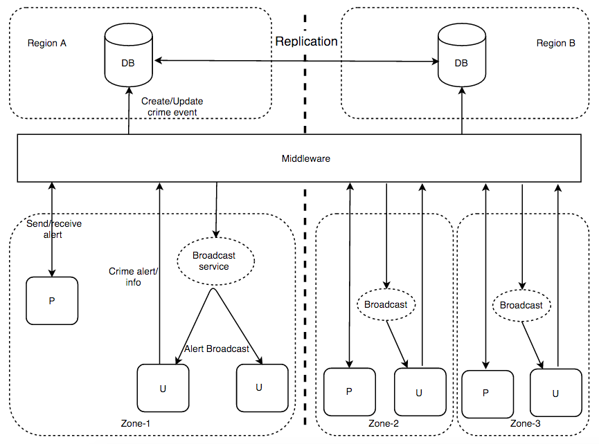
Architecture

Slide 4
Infrastructure
Android application (to report crimes and receive alerts)
MLab (mongodb hosting service to store crime & user information)
Google Cloud Messaging (to broadcast alerts)
Middleware in Java and Python provides web services for dispatching crime events, gathering information from witnesses and providing aggregated reports on crime data

Slide 5
Middleware
The web services will be hosted on an Amazon EC2 instance.
The Android application connects to this instance and populates user and crime information through a RESTful model of communication.
Middleware fetches relevant information from user and police, and populates into our MongoDB residing in mLAB (which is a MongoDB Hosting service)
Google Cloud Messaging fetches all the users near the crime spot from our DB and broadcasts crime alerts to them.

Slide 6
Working features
Android application:
User can report a crime event as a witness or victim (SOS).
Users can receive crime alerts and provide any additional information.
Middleware:
Store relevant information in MongoDB intelligently (spatial-temporal events).
Broadcast alerts to users residing around the crime location
Multithreaded implementation to support high volume of concurrent requests

Slide 7
Thank You

