Slide 1
Uber For Tutors :
A Web Application
Guided By :
Prof. Nalini Venkatasubramanian
Prepared By:
Prachi Parikh
Rakshith Ramegowda
Shivakiran Chimatadar
Rhythm Haji

Slide 2
MOTIVATION AND GOAL
GOAL:
Learned professionals from across the globe become tutors in their free time.
Tutees get an opportunity to get higher quality of education.
The Application would serve as a real time “Interactive platform for Tutors and Tutees” which will provide a personalized skill learning suggestions.
MOTIVATION:
On-demand tutoring
Round-the- clock service at last minute
Become a Techpreneur in free time
Overcome social,economic and geographic barriers in learning
Connect student on same campus , with same course -work ,easily and efficiently

Slide 3
RELATED RESEARCH
TutorVista
Wyzant
TutorSpree

Slide 4
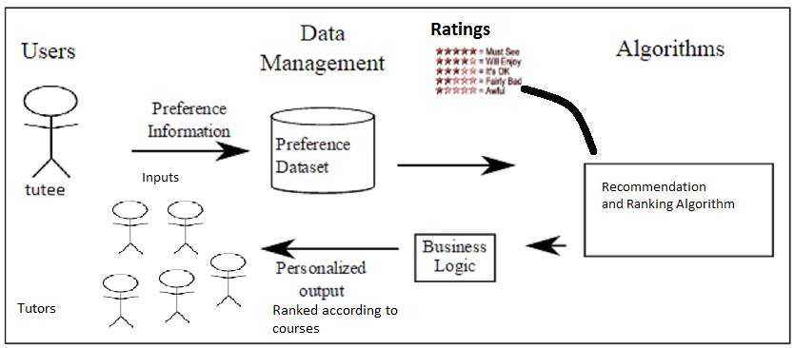
SYSTEM ARCHITECTURE
Ranking Algorithm: Personalized tutoring based on user’s language , known skills and tutoring rate
Content based Recommendation Technique: based on past skills as well as recent skills

Slide 5
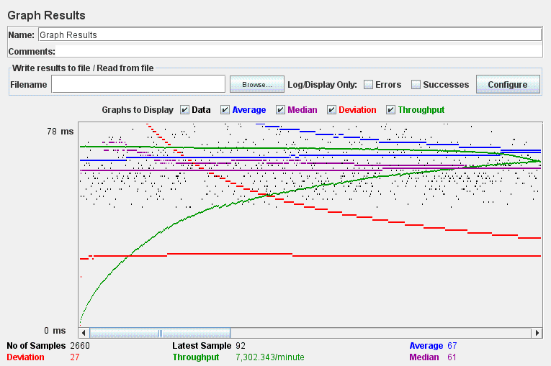
TESTING
Used Jmeter to test response time and load management on our website
Prevention from SQL injection -Prepared Statement and Google Recaptcha
Tested all web pages with numerous queries in different configurations and checked the functionality and performance of the website under heavy loads.
J-meter graph to prove scalability and load balancing

Slide 6
Questions ??

