Slide 1
Blaze - An IoT Analytics Engine
Project Slides
Sri Ranga Teja Kolli (31152056)
Prashanth Reddy Billa (60804572)
Sudeep Meduri (51884271)

Slide 2
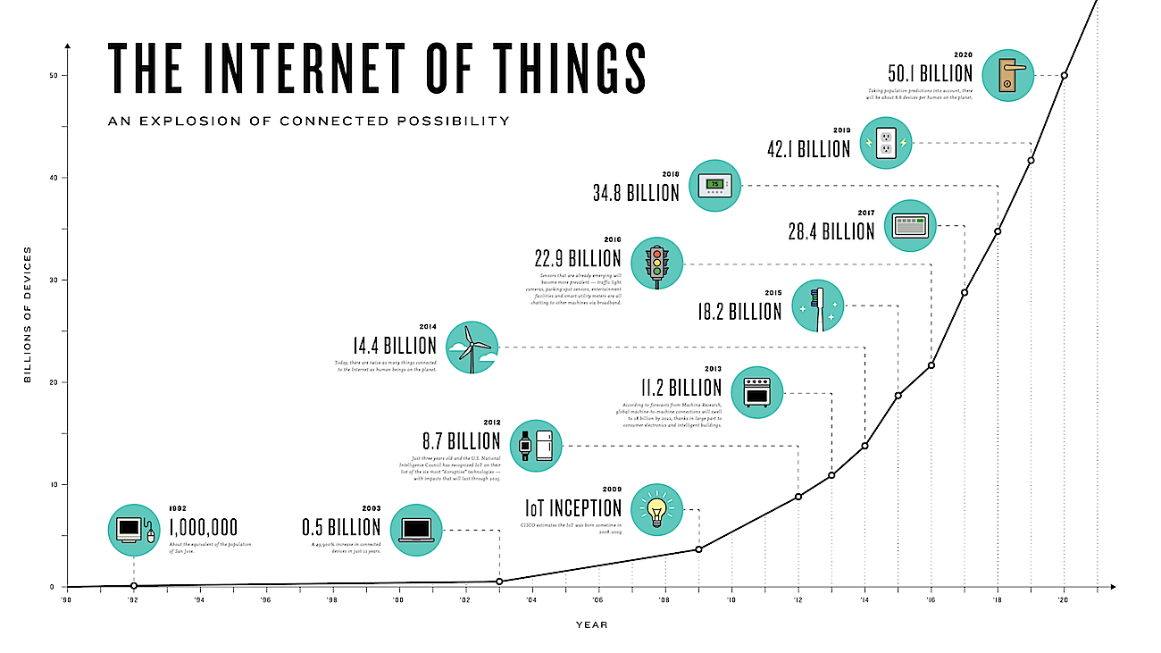
Motivation and Goals
Extremely rapid expansion of Internet of Things
Major service providers in the industry have or are developing custom platforms to cater to IoT
We wanted analytics framework to which any IoT system can be added to. This would enable multi variant queries or analytics to be done.
Goal of the project is to build an end-to-end system, and illustrate using sample use cases.
Image credit: http://www.i-scoop.eu/internet-of-things/

Slide 3
Related Work
MapReduce Processing on IoT Clouds, Ichiro Satoh
Published in:
2013 IEEE 5th International Conference on Cloud Computing Technology and Science (CloudCom)
MapReduce based Data Processing on IoT, Ichiro Satoh
Published in:
2014 IEEE International Conference on Internet of Things (iThings)
IEEE Green Computing and Communications (GreenCom)
IEEE Cyber, Physical and Social Computing(CPSCom)
A Data Processing Framework for Distributed Embedded Systems, Ichiro Satoh
Published in:
9th International Symposium on Intelligent Distributed Computing – IDC'2015, Guimarães, Portugal, October 2015

Slide 4
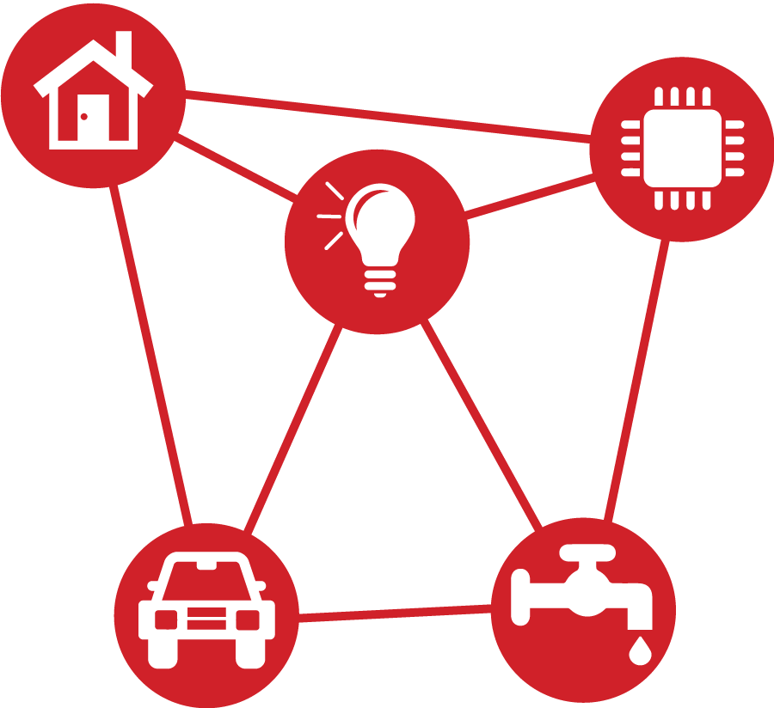
System Flow Diagram
MQTT Broker
User Interface
Visual Analytics and Text Results. JSON data tree view to analyze sensor information
Query Interface
Hive SQL
Generate Intermediate Files such as CSV and Store user query, results and other information
Hive JDBC Driver
JSON data
HiveServer2 - Hive Thrift Server, Hive Driver, Metastore, Apache Derby DB
Query Result
JSON data
MapReduce v2
Yarn Cluster Resource Management
Sensor devices
Hadoop Distributed File System

Slide 5
System Design Specifics
Prototype of complete system which we have developed
Sensor Data Publishing - Sensor data published to the MQTT broker
Sensor Data Ingestion - The data is pulled into our Hadoop Distributed File System
Hadoop and HiveServer2 - For processing the data and getting relevant information out of the huge data sets
Web UI and Analytics (JSP, HTML5, CSS3, Javascript, MySQL)
Login and Registration
Basic Mode - We can select a specific sensor and select a specific action to be executed
Advanced Mode - We can upload our own sensor data file (JSON) and perform custom Hive Query
Executed Tasks shown - System keeps tracks of user’s queries and all the tasks executed along with results
Hadoop and Hive Status - Status indicating whether the environment is ready or is it yet to be started

Slide 6
Testing of our system
Verify that the IoT endpoint is connected and stays live.
Verify all events being generated by IoT endpoint is being received downstream.
Verify that sensor data for each sensor is created properly into a separate file and pushed into HDFS.
Verify if continuous ingestion of data into the JSON file works simultaneously with user queries in the User Interface and does not lead to any locking issues.
Verify that during queries, a hive table with sensor schema and current data in sensor data file is created.
Verify that the maps and graphs rendered and consistent with the data set and also scaling is done properly.

Slide 7
Evaluation Plan
Comparison of response time: With the same sensor dataset pushed into relational database such as MySQL
Average Execution Time: (Tmap/M) + (Treduce/N)
Maximum Execution Time: Max(Tmap(i)) + Max(Treduce(j))
Minimum Execution Time: Min(Tmap(i)) + Min(Treduce(j))
Make Span: FinishTime(ReduceTask) = Time span from start to finish
Delay Time: Start Time(Map Task) + Start Time(Reduce Task) -­ Finish Time(Map task)
Network Cost: Delay Time * Network Cost per Unit Time

Slide 8
Conclusion and Future Scope of our project
Successfully demonstrated an end-to-end system to which any IoT environment could be connected, and different analytics could be run on the data generated by each.
Incorporate additional complex learning algorithms in the analytics part.
Thank You! :)

