Slide 1
A Real-time Driver-Rider Matching service based on Apache Samza
Group 22
Pan Kong, Zhangfan Dong, and Kaiyue Sun

Slide 2
Background
Ride-sharing is a trending topic both in research area and industry
Research on characterizing the behavior of carpoolers
overlap in people’s commute, upper bound to practical ride-sharing system, Prof. Markopoulou, UCI
In pratical, ride-sharing system
web-based, carpooling.com, eRideShare.com
mobile-based, promisingUber, Lyft
Notes:
- identify the individuals who are most likely to carpool and analysis what are the main factors that affect their decision.

Slide 3
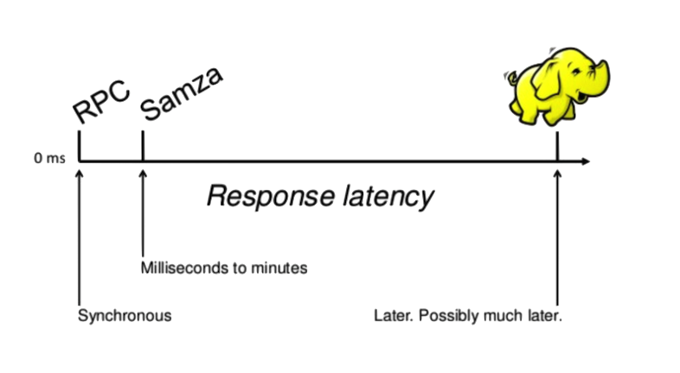
Three-tier Architecture
Desired properties:
Scalability
Low latency in processing big data
compare to hadoop
Presentation Tier
Presentation Tier
Throughput for popular databases
HBase: 2.5K op/sec
MySQL: 25K op/sec
MongoDB: 10K op/sec
Cassandra: 25K op/sec
(a single node,
read intensive workload)
UI on Browsers
UI on Browsers
Application Tier
Application Tier
Data Tier
Web Server
Web Server
Matching Engine
User Profiles
Problems
The driver location update and rider location are transitory data, no need to store in database
Database -> bottleneck, on high workload (Exclusive access, lock)
e.g 100,000 drivers, centralized database, driver update every 4sec,
throughput -> 25K write/sec
Matching engine is also a bottleneck
Stream Processing Tier
Apache Samza
User Profiles
Matching Engine

Slide 4
Architecture & Implementation
Architecture & Implementation
Push Kafka Msg
SAMZA
Matching result
Matching Engine
Input Topics:
- Driver Location
- Ride Request
Pull Kafka Msg
Driver updates
Ride requests
Query Server
Output Topics:
- Match
Push Kafka Msg
kafka
REST Proxy
HTTP Request
Client UI
Driver updates
Ride requests
HTTP Server
Driver updates
Ride requests
Pull Kafka Msg
HTTP Response
Matching result
Matching result
Live Demo
https://ec2-52-40-203-24.us-west-2.compute.amazonaws.com/

Slide 5
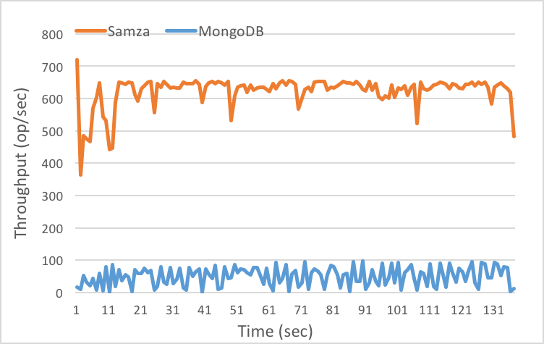
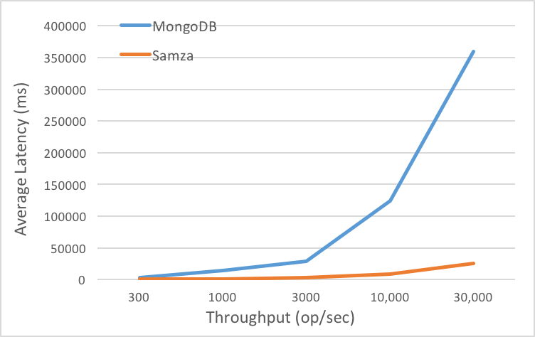
Performance Testing
fig.1 Throughput
fig.2 Latency

