Slide 1
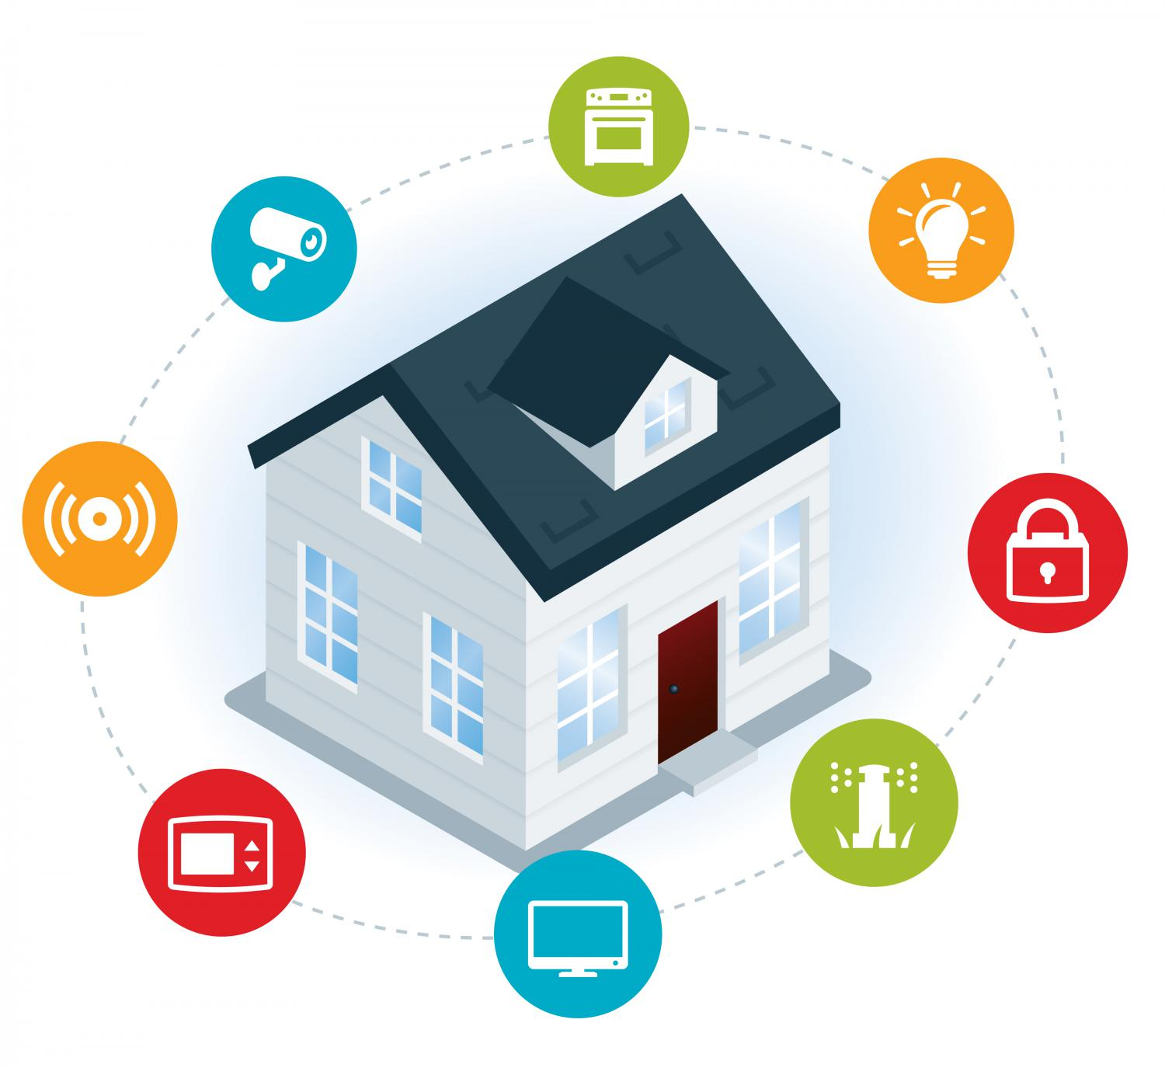
perpetual IoT awareness system
Intelligent Power Managing Middleware
25
Group 25: Nailah Alhassoun

Slide 2
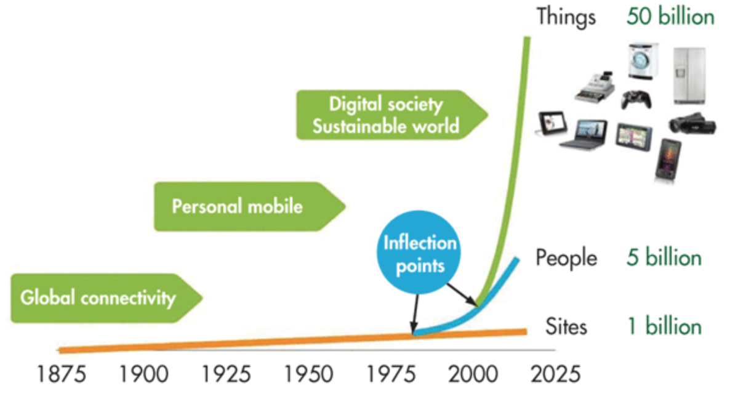
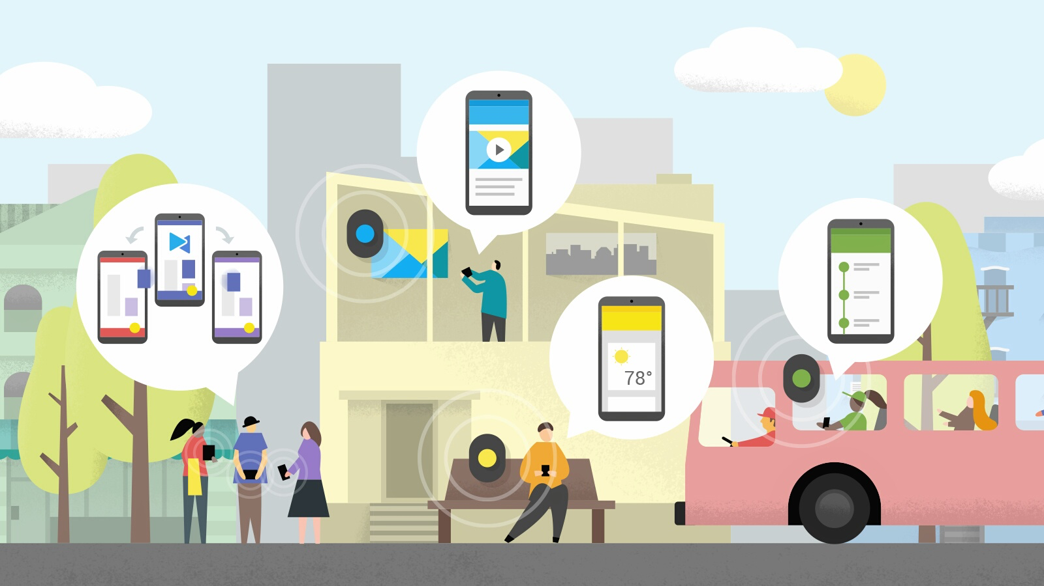
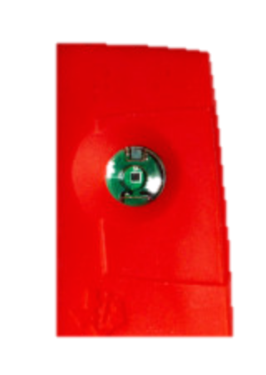
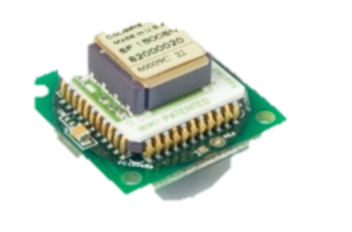
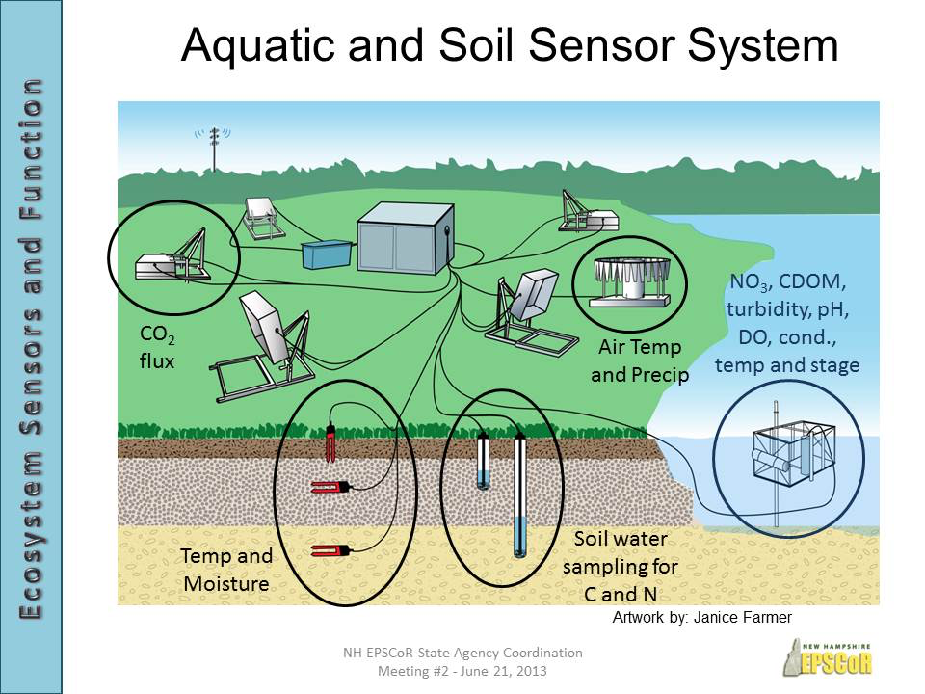
Motivations
Cisco predicts 50 billion interconnected devices by 2020.
Internet
WAN
IoT Computing Growth
Safety awareness system
(personal, home, community)
WLAN
Cellular Network
WPAN
Ad-hoc
Some IoT objects are small devices with restricted recourses
Some IoT objects in hard accessible environments
we are aiming to reduce energy consumption to reach a perpetual IoT awareness system.
Notes:
Nowadays, we are experiencing IoT Computing Growth which offers many ways to help us stay aware of a wide variety of things we are interested in the personal safety level, home, community scale)
monitoring environment using heterogeneous IoT objects for a long time to catch a critical event.
these IoT objects are small devices with restricted recourses
Some IoT objects in awareness systems are expected to be deployed in hard accessible environments such as under ground or in the walls, and some IoT objects are mobile and accessible; however, it is not reliable if it drains the battery fast.
Awareness systems should be

Slide 3
Related work
Many Approaches to optimize energy in IoT platforms:
Device-level
Circuit optimization & hardware improvements
Energy harvesting
Increased time in sleep mode (wake-up receiver)
Commination-level
802.15.4 radio
Bluetooth low energy
Wi-Fi low power
Network-level
WSN prediction-based data collection
WSN Subset nodes alive

Slide 4
Our Approach
Our approach is an adaptive perpetual IoT awareness system architecture that attempts to minimize the energy consumption in the device, connection, and network levels based on daily activities detection.
PC= PCs1 X T1+PCs2 X T2 +PCs3 XT3….+ PCsn X Tn
PC=Σ(PCsn X Tn) ∀s∈ System’s States
PCsn= = PCo1 X A+PCo2+PCo3 ….+ PCon
^{PC= Power Consumption}
^{o= IoT Object}
^{s= System’s State}
T= Active time → ΣTn=24 hours
A= object setting starting from 0
Notes:
We have different network sets with varies energy efficiency
We have different daily activity states
We will test the accuracy of capturing each activity in each network set

Slide 5
Our Approach Modeling
In any IoT safety awareness systems there are:
Heterogeneous participated IoT objects in
(Each object has multi connections M2M available which affects the power consumption)
Multiple system states based on different user daily activities
Object Number | Object | Role | IP/ No IP | Connection | Powering Level
Start
No Activity
Out of home
Night time
sleep mode
Activities of Dailey Living (ADLs)
No Activity
Walking
Standing
Falling
Multi-Standing
Standing
Walking
Multi-standing
Falling
Alert
FSM
Notes:
1-
How many IoT objects?
The power source for each?
IP connection availability in each IoT?
connections M2M availability?
The daily activities pattern?
How many ADL states?
2- Our middleware should analysis all the gathered information to define multi system states that will have different conservative power consumption

Slide 6
Our Approach Evaluation
Each State has its accuracy of capture with a level of IoT object density(# of objects+ sampling rate)
PCs= highest level of accuracy with the lowest power consumption, will be considered as best setting
The middleware ends with the characteristic of each State regarding to energy efficiency.
The middleware takes real-time decisions base on which state we are on to optimizing the energy by reducing the power consumption
Accuracy %
Notes:
We measure power consumption and the accuracy of capture the event for each object in a Varity of settings

Slide 7
Intelligent Power Managing Middleware System Architecture
Built-in Infrastructure
Middleware
Application
Observation phase
Sensing Module
User Defined Parameters
Output
Ambient sensors
Activates Charts
Video sensors
Historical Data
Alerts Messages
Wearable sensors
Analyzing phase
Power Consumption Estimations
Auxiliary Module
Energy Adaptation Phase
Extra Data
Notes:
Auxiliary Service: create features space from the digital signal mad by sensing module, such as geo-fencing status, identical history readings for a period of time

