Slide 1
AquaScale: Social Media Based Data Collection and Water Pipe Leakage Reporting & Querying System
Group3 :
Zhichun Ning
Huan Chen
Wei Wang

Slide 2
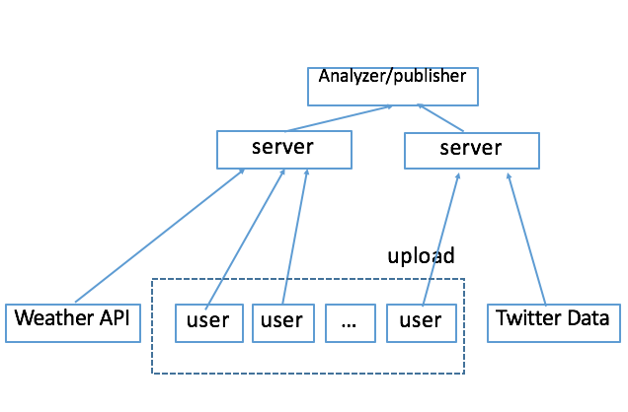
Project Aims
What is the problem?
The requirement of system for water leaking information share
Solution:
Implement an iOS phone interface and web server for user to upload water leak information
A mathematical model to analyze the message and classify them
Extra functions:
Real time map to show tweets messages data
Real time tweet data searching interface

Slide 3
Web app & Web server part Summary
Web interface for use to post and vote for the water leaking events
Login/register/history messages review/vote for suspect events
Web server response to web app & phone app request
Django/Bootstrap/sqlite3
Filter users & send message to recall user to post new event
HttpRequest/HttpResponse
Load supervised machine learning algorithm to classify the messages

Slide 4
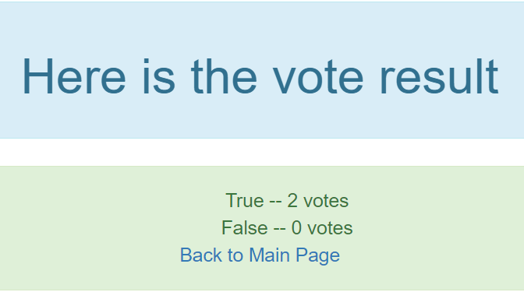
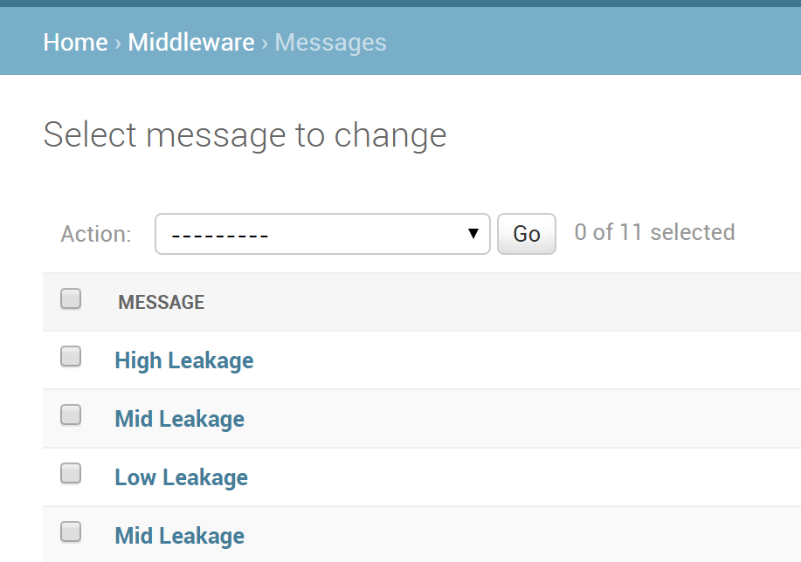
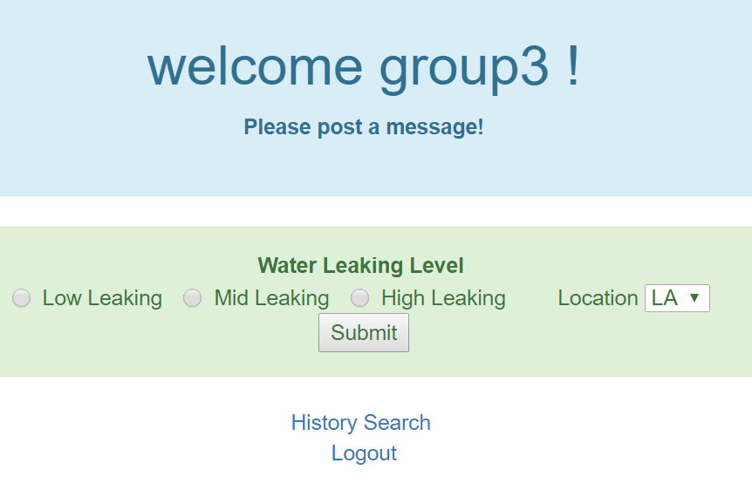
Message Board

Slide 5
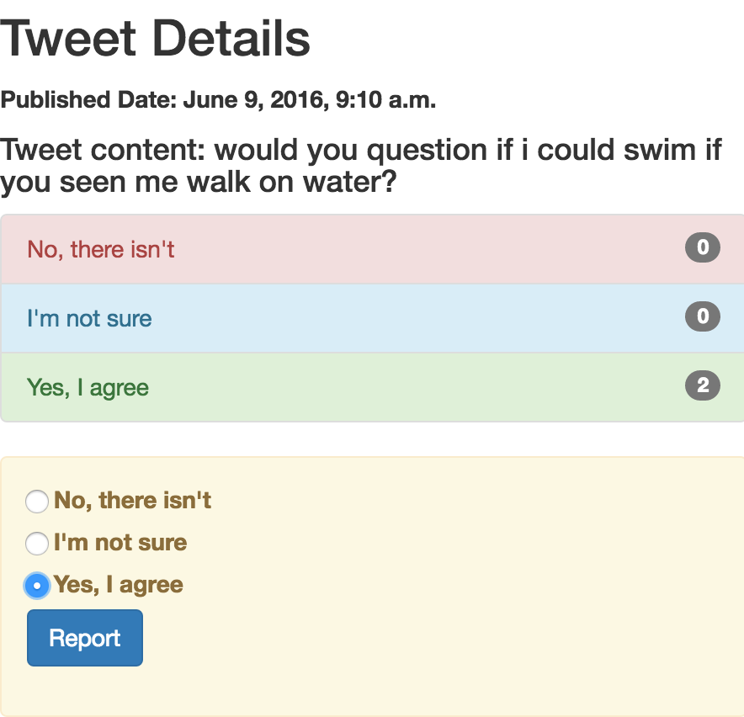
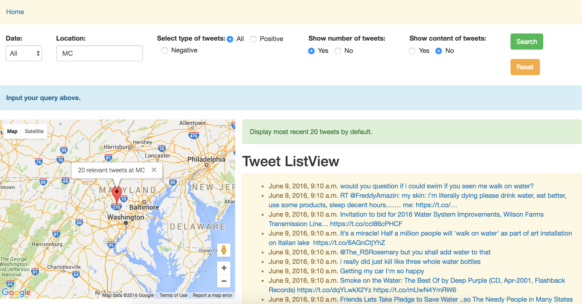
Web Query Interface & Live Tweets Feed

