Slide 1
AquaScale Data Collection Android Application
YUJIN XIE
YANG JIAO
XUE YANG

Slide 2
Motivation & Goal
Motivation
Gather water leakage information for public
Reduce damage caused by water leakage
Analyze water leakage information
Reduce resource wastage
Goal
Build an android application to implement the function: locating user’s real-time locations, report water leakage, display user’s report statistic information and push notification to target user
Design and implement user filter algorithm to help choose target push notification user

Slide 3
Related Work
Cloud Computing
MongoDB
Google Map real time location locating
Community Data Filter
Notification

Slide 4
System Design
User 1
Parse DB
Google Map Service
Report Leakage
Store Report Data
Algorithm
Push Notification
User 2
User 3
User 4

Slide 5
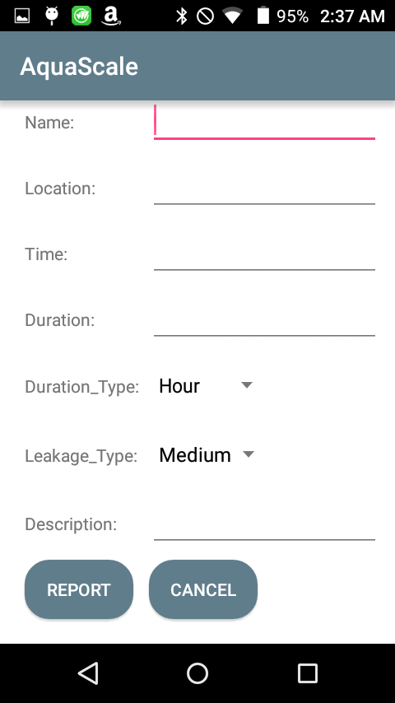
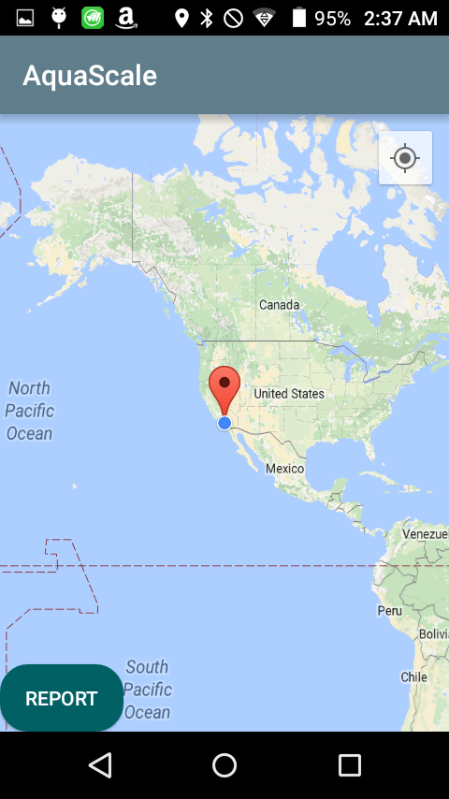
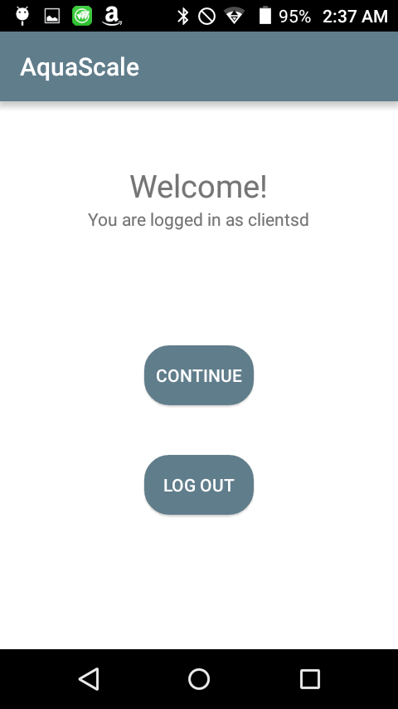
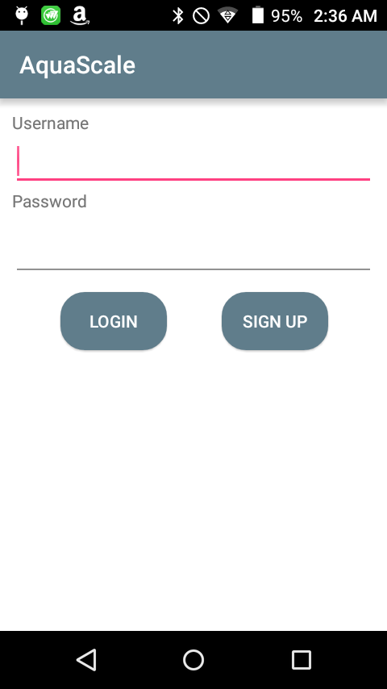
Test & Evaluation

