Slide 1
Wildlife Monitoring Publish-Subscribe
Team 13
Ashwin Achar
Kana Horie
Kelly Kwan

Slide 2
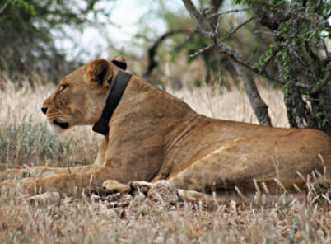
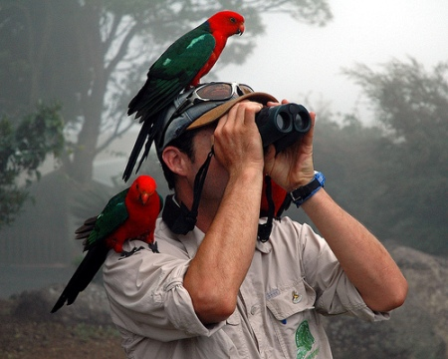
Introduction
Motivation
Track nearby wildlife
For researchers: to locate animals of interest to tag
For safety: to prevent encounters with dangerous animals
For hobbyists: for birdwatchers and animal lovers
Goals
Users can report animal sightings
Reports are filtered for relevance (animal sighting vs. mention)
Users can subscribe to a specific animal
Users get relevant animal sighting locations near them in real time
Notes:
Add pictures

Slide 3
Related Work
Wildlife Tracking [1]
Explore a region with prior knowledge of animal’s territory
Typically tags with geolocation are attached to animals
Tags transmit data to a base station to collect data
Data Collection/Relevance
Social media feed/text analysis for relevant information[2]
Filtering text to predict a location [3]
Location inaccuracies depending on time of report
References
[1] Juang, Philo, Hidekazu Oki, Yong Wang, Margaret Martonosi, Li Shiuan Peh, and Daniel Rubenstein. "Energy-efficient computing for wildlife tracking: Design tradeoffs and early experiences with ZebraNet." In ACM Sigplan Notices, vol. 37, no. 10, pp. 96-107. ACM, 2002.
[2] Diakopoulos, Nicholas, Mor Naaman, and Funda Kivran-Swaine. "Diamonds in the rough: Social media visual analytics for journalistic inquiry." In Visual Analytics Science and Technology (VAST), 2010 IEEE Symposium on, pp. 115-122. IEEE, 2010.
[3] Han, Bo, Paul Cook, and Timothy Baldwin. "Text-based twitter user geolocation prediction." Journal of Artificial Intelligence Research 49 (2014): 451-500.

Slide 4
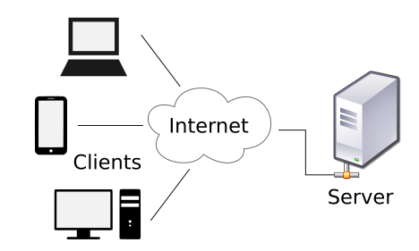
System Components
Relevant
Results
Data
User Location
Data
Publishers
Subscribers
Data
Broker
User Location
Relevant
Results
Text Filter for Relevance

Slide 5
Testing and Evaluation
Allow users to publish/submit supposed wildlife sightings
Filter submissions for relevant content (data enrichment)
Distinguish between likely actual sighting and possible false positive
Consideration to timing and location
Score submissions
Allow users to subscribe to different animals
Only show nearby wildlife
Notes:
Add snapshots

Slide 6
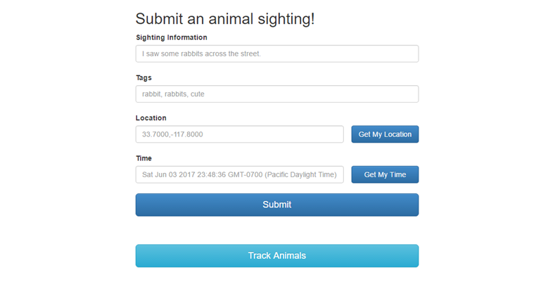
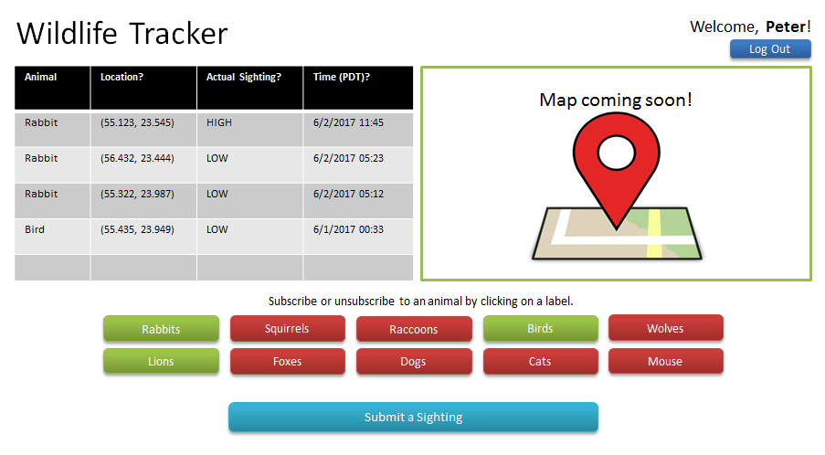
Testing and Evaluation (cont.)
Notes:
Add snapshots

Slide 7
Future Directions
Improve User Interface and User Experience
Integrating Social Media APIs as publishers
Improve filter (natural language processing)
Filtering data for overlapping/repeating information
Displaying locations to the user on a map

