Slide 1
Load Balancing in BAD Project
Hang Thi Thu Nguyen, Peeyush Gupta

Slide 2
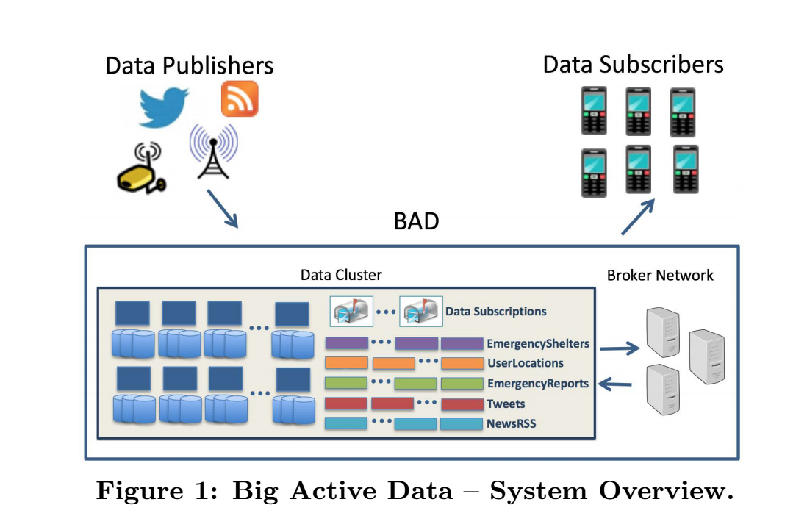
Motivation And Goals
Skewed load on brokers in BAD
Clients need to know about brokers beforehand
Broker can fail in case a lot of a large number of subscriptions or notifications to process
Some brokers always underloaded

Slide 3
Related Work
Cluster Based Approach For Load Balancing
Static and Dynamic Load Balancing Based on Ring Overlay Network
Load Balancing in Meghdoot
DHT based Pub/Sub System
Dynamic Load Balancing in PADRES
Distributed Content-Based Pub/Sub System

Slide 4
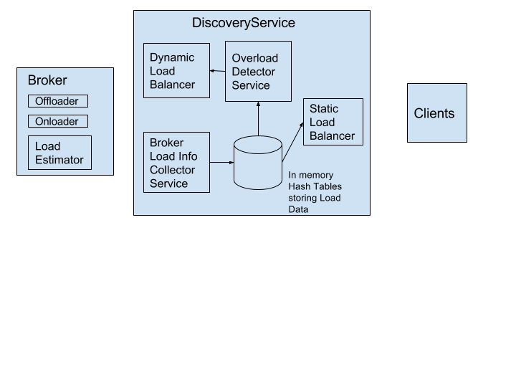
Broker Discover Service(Load Balancer)

Slide 5
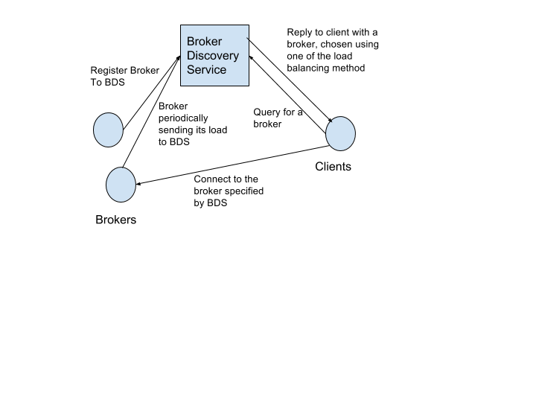
Static Load Balancing
Brokers register to the centralized
Discovery service and periodically
Send load information
Discovery service tells clients, which
Broker to connect to.

Slide 6
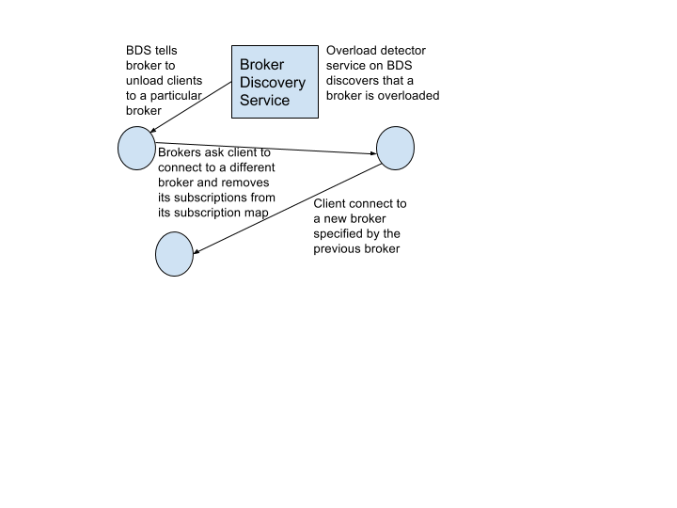
Dynamic Load Balancing
Discovery server detects overloaded
Broker
Broker offloads clients of its choice
To another broker
Client reconnects to new broker.

Slide 7
Testing And Evaluations
Test Setup
4 Brokers
10 Clients
100 Subscriptions
1000 Publications
Clients able to connect to brokers based on least load
Overloaded broker detection possible
Client offloading possible

