Slide 1
Implementation of Failover Handling of Broker Network in Big Active Data
Team 6: Ali Nickparsa, Yoshimichi Nakatsuka, Yuya Shiraki

Slide 2
Motivation & Goals
Project Goal
continuous feeding of information to subscribers in BAD architecture
Obstacles
broker’s potential to fail due to disasters, hardware issues, software errors, or human errors
Mission
implement a failover mechanism of a broker to have resiliency in the broker network
Failure detection
Failure handling via client reconnection
Side Benefits
reusability of proposed mechanism to other functions including load-balancing and handoffs of clients
failure
broker
broker
broker

Slide 3
Related Work
Components for Failover handling schemes
Replication
Copying DB of master node to all nodes and propagate update [Chubby]
Store data to multiple nodes on virtual ring [Dynamo DB]
Each data is stored to multiple nodes of the Placement Group [Ceph]
Failure Detection
Send periodic messages to each other [Chubby, Dynamo DB, Ceph]
Create a data structure of current active nodes [Zookeeper]
Recovery from failure
Re-elect a master node using a election algorithm [Chubby]
Old node is removed from group and a new node is added [Dynamo DB, Ceph]

Slide 4
Design Specifics
Broker↔BCS(Broker Coordinating Service)
BCS checks broker status periodically
BCS updates brokers list
Clients↔BCS
Client sends broker discovery message to BCS on broker-client disconnection
Clients↔Broker
Client reconnects to new broker
Client sends last received message sequence number to tell its state
Broker pulls clients subscription from AsterixDB
broker
broker
broker
connection request
periodic heartbeat
BCS
Broker discovery
brokers List

Slide 5
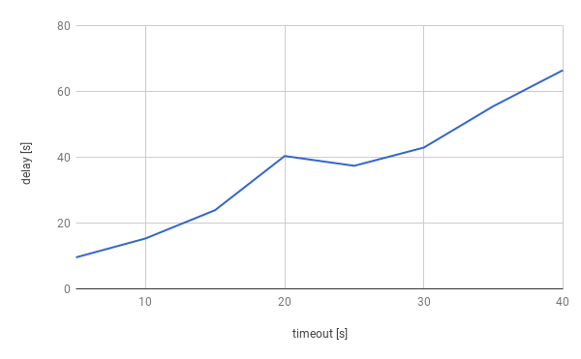
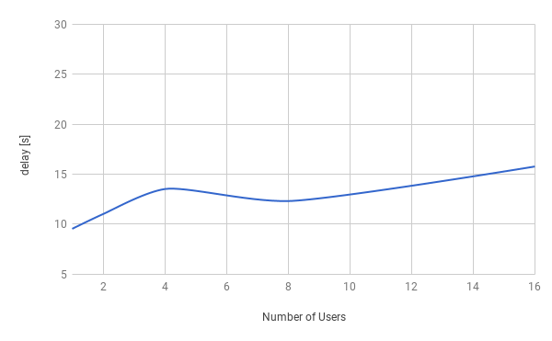
Testing & Evaluation Plan
Environment
Docker Containers
1 AsterixDB, 1BCS, 2 Brokers, Clients
Evaluation
Delay for reconnection vs. Timeout for periodic Websocket status check
Delay for reconnection vs. Number of users to move

