Slide 1
Design
What is it?

Slide 2
What is design?
We know it when we see it
Some terms are difficult to define
Consider ethics
Even so, we know them when we see them
Ethical / Unethical
Good design / poor design
Their innate, inherent, multiple characteristics are why we have trouble formally defining them
The issue arises from individual tastes, which makes definitions difficult to apply

Slide 3
What is design?
Full Definition of DESIGN (Merriam Webster)
transitive verb
1 : to create, fashion, execute, or construct according to plan : devise, contrive
2 a : to conceive and plan out in the mind <he designed the perfect crime>
b : to have as a purpose : intend <she designed to excel in her studies>
c : to devise for a specific function or end <a book designed primarily as a college
textbook>
4 a : to make a drawing, pattern, or sketch of
b : to draw the plans for <design a building>

Slide 4
What is design?
Oxford English Dictionary (noun)
A plan conceived in the mind, and related senses
That which is aimed at; an end in view; an ultimate goal or purpose
An artistic sketch, and related senses
The art of drawing or sketching; (hence) the process, practice, or art of devising, planning, or constructing something (as a work of art, structure, device, etc.) according to aesthetic or functional criteria; (also) this as a subject of study or examination.
The completed product or result of this process; the arrangement of features in something planned or produced according to aesthetic or functional criteria; a particular shape, style, or model.

Slide 5
What is design
Oxford English Dictionary (noun)
A plan conceived in the mind, and related senses
That which is aimed at; an end in view; an ultimate goal or purpose
An artistic sketch, and related senses
The art of drawing or sketching; (hence) the process, practice, or art of devising, planning, or constructing something (as a work of art, structure, device, etc.) according to aesthetic or functional criteria; (also) this as a subject of study or examination.
The completed product or result of this process; the arrangement of features in something planned or produced according to aesthetic or functional criteria; a particular shape, style, or model.

Slide 6
What is design?
“The process of selecting and organizing elements or components in order to fulfill a specific purpose” – Charlotte Jirousek, former Cornell professor of human ecology
In HCI and systems and software development, it is the structured creation of something functionally and aesthetically pleasing

Slide 7
What is design?
Let’s consider some characteristics
Creative / Conventional
Functional
Visual
Aesthetic
Organized
Subjective
Purposeful
A process

Slide 8
What is design?
There are many industries whose products or output hinge on design
Fashion design
Interior design
Systems design
Game design
Automotive design
Structural design
Product design
Industrial design
As we saw, you can even have designs ‘on’ something (another person, a job, a place; it’s a process by which you will achieve that thing)

Slide 9
What is design?
There are many industries whose products or output hinge on design
Fashion design

Slide 10
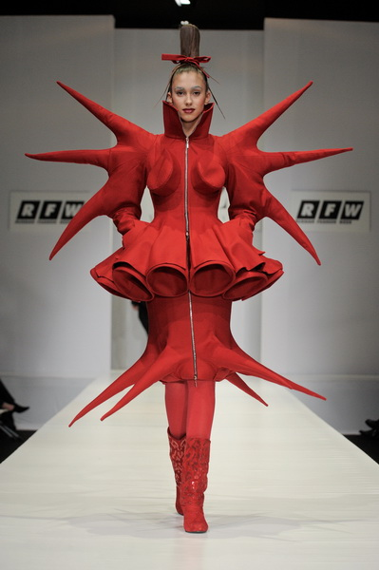

Slide 13
What is design?
There are many industries whose products or output hinge on design
Fashion design
Interior design

Slide 16
What is design?
There are many industries whose products or output hinge on design
Fashion design
Interior design
Systems design
Game design

Slide 19
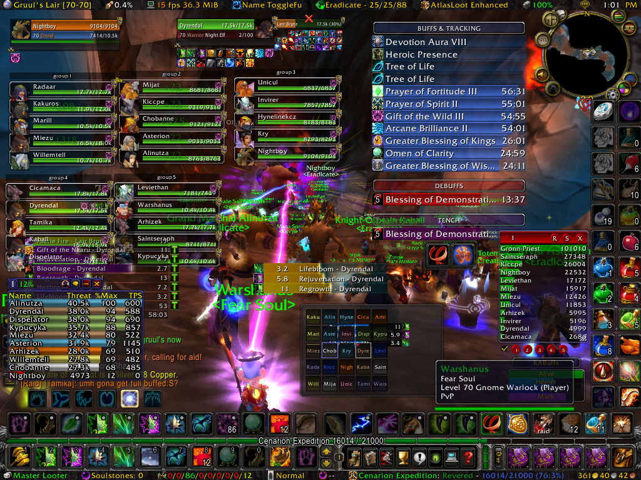

Slide 20
What is design?
There are many industries whose products or output hinge on design
Fashion design
Interior design
Systems design
Game design
Automotive design

Slide 26
What is design?
There are many industries whose products or output hinge on design
Fashion design
Interior design
Systems design
Game design
Automotive design
Structural design

Slide 29
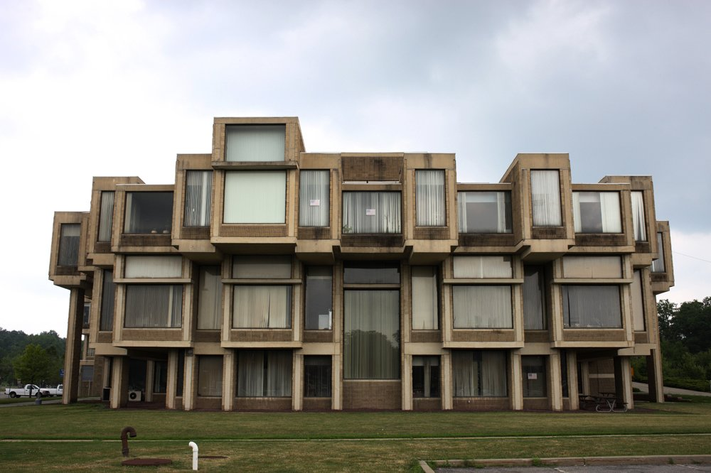
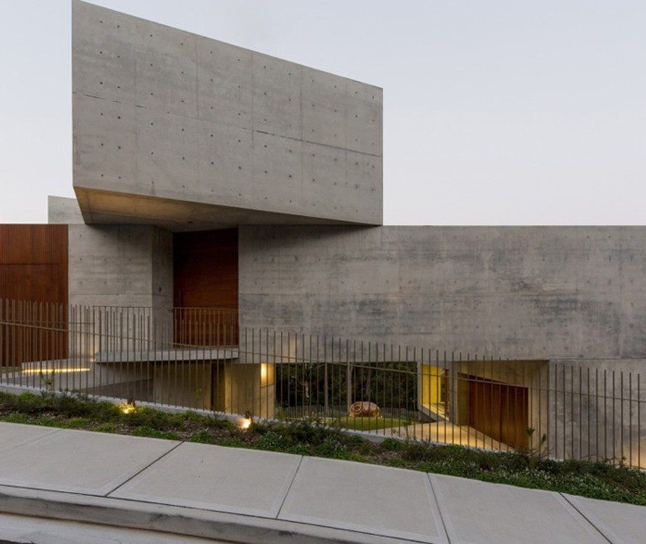
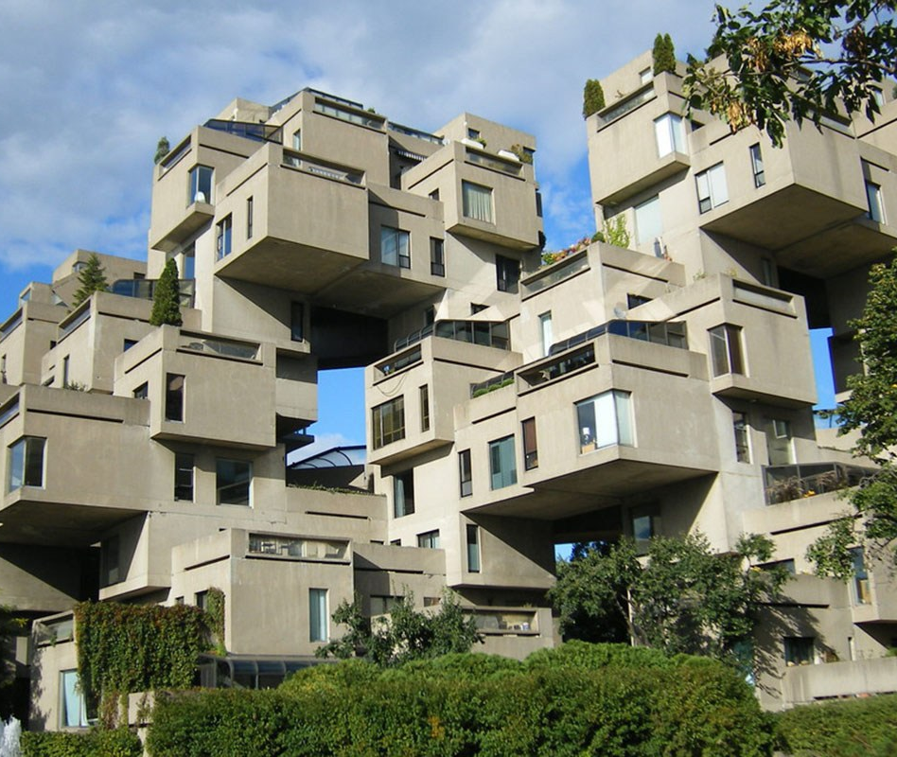
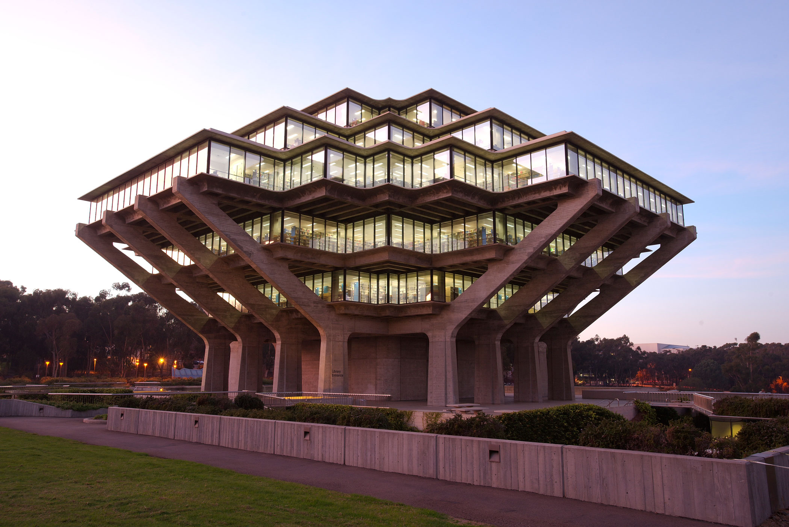
Brutalist Architecture

Slide 30
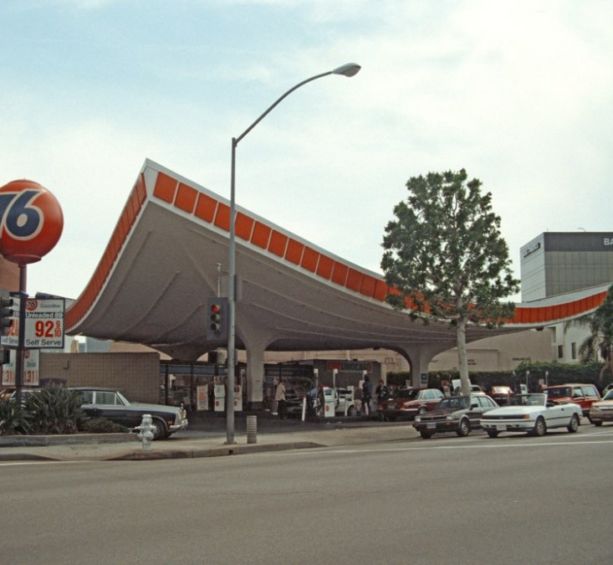
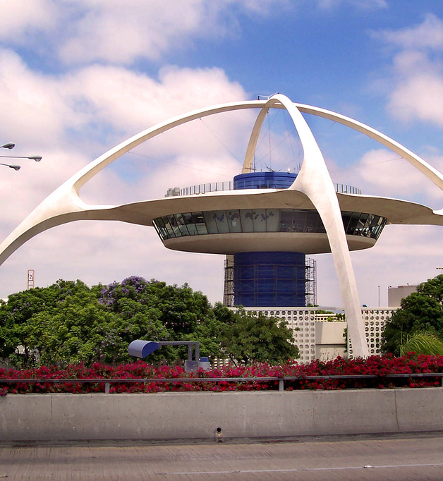
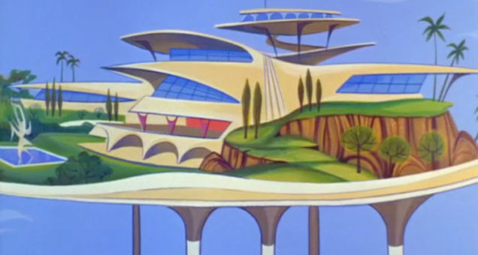
Googie Architecture

Slide 32
What is design?
There are many industries whose products or output hinge on design
Fashion design
Interior design
Systems design
Game design
Automotive design
Structural design
Product design
Industrial design

Slide 40
What is design?
There are many industries whose products or output hinge on design
Fashion design
Interior design
Systems design
Product design
Game design
Automotive design
Structural design
Product design
Industrial design

Slide 46
What is design?
There are many industries whose products or output hinge on design
Interface design

Slide 56
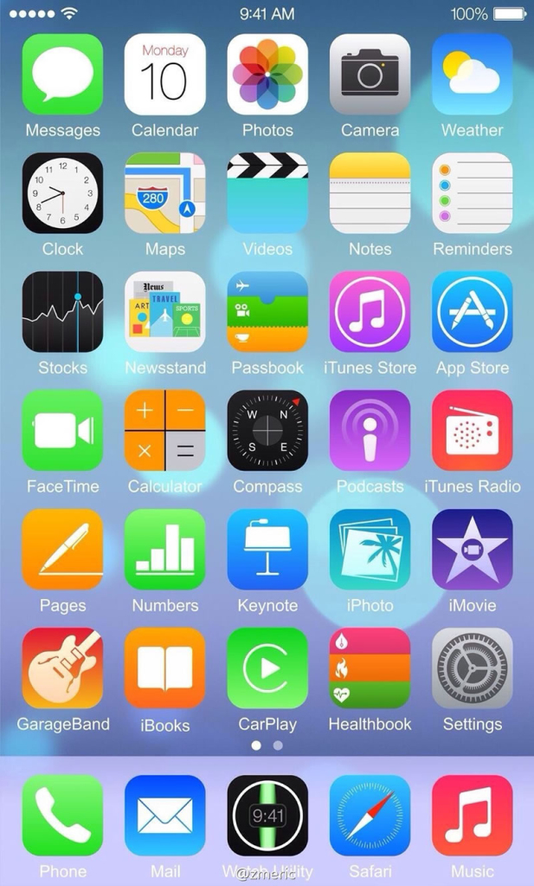

Slide 58
What is design?
A noun
The conceptual representation of something before it is produced

Slide 63
What is design?
A noun
The conceptual representation of something before it is produced
A verb
The process by which something is conceptualized and built
Or part of a larger process

Slide 65
What is design?
A noun
The conceptual representation of something before it is produced
A verb
The process by which something is conceptualized and built
An adjective
“This phone has bad design”

Slide 67
Image credit: cybershack.com.au

Slide 68
What is design?
What it needs to be
Many things to many people
No right or wrong, rather an evaluation of needs, form, and function
The bringing together of elements into a final, cohesive form

