Slide 1
Emotion / Trust
I don’t like you

Slide 2
What is emotion?
No one knows
A state of mind?
A response to stimulus?
A chemical reaction?
A genetic disposition?
A nature/nurture result?
A natural response
Sometimes referred to as affect (n.)

Slide 3
Emotion and tech
We know it exists
How can it be developed?
Can design contribute to an emotional response?
If so, how?
What elements can we use?
What design conventions can we use?
What human characteristics can we exploit?
How far does an emotional attachment go, especially compared to non-tech attachment?

Slide 4
Emotion and tech

Slide 5
Emotion and tech

Slide 6
Emotion and tech

Slide 7
Emotion and tech

Slide 8
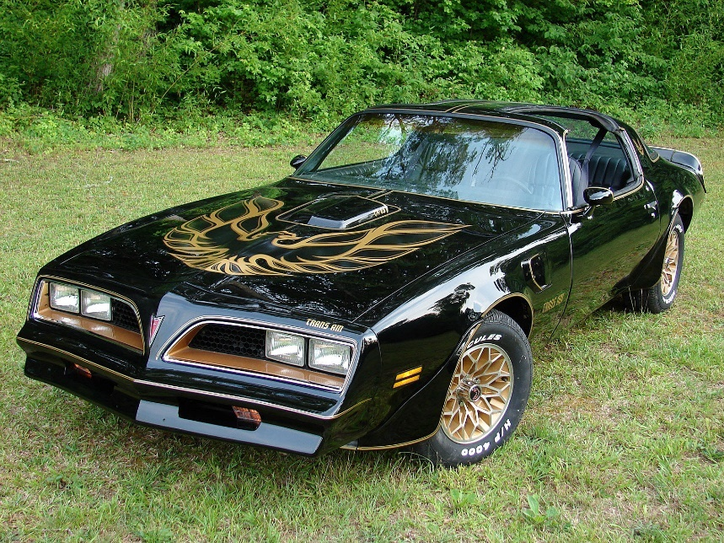
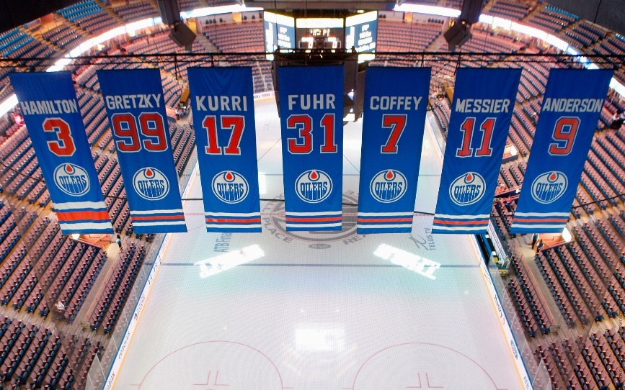
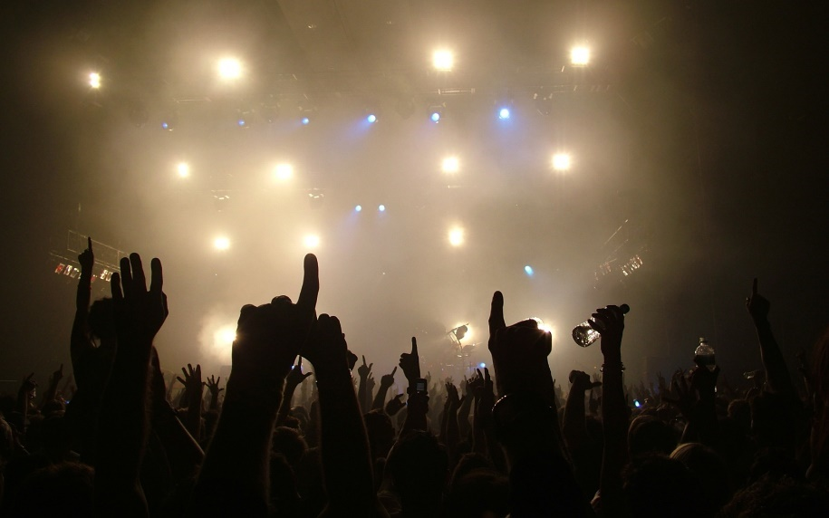
Emotion and tech

Slide 9
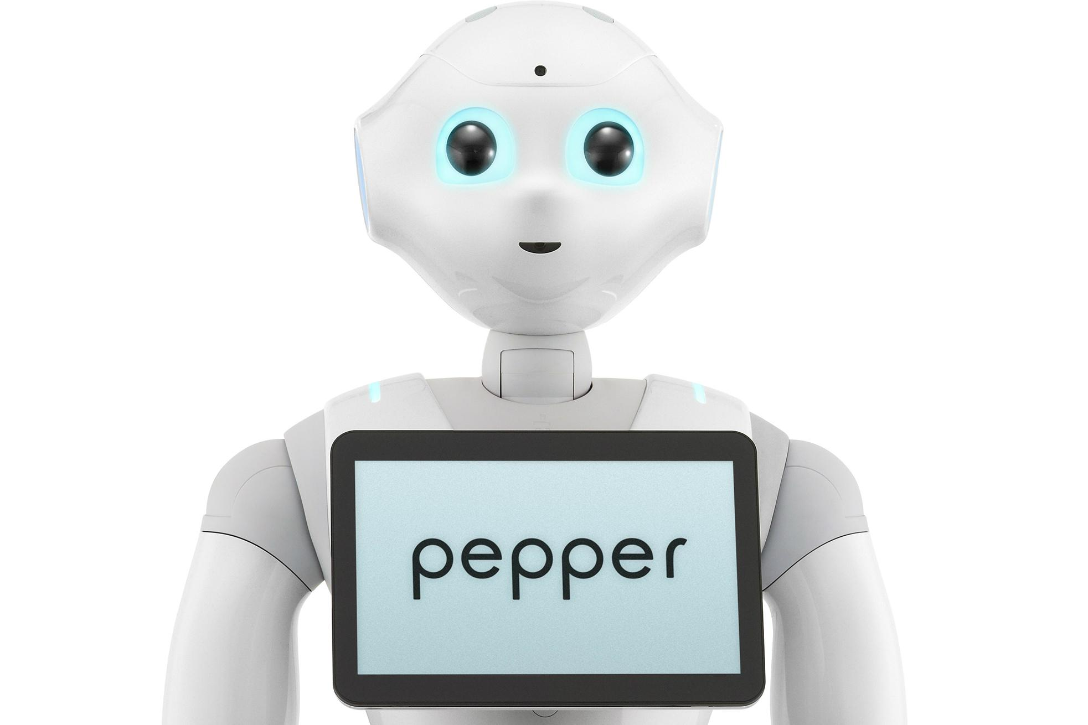
Emotion and robots
Pepper
Designed to interact with humans on an emotional level
Can react to emotional cues
Can react to environment
Capable of evolving emotionally
(Supposedly)
Deliberately designed

Slide 10
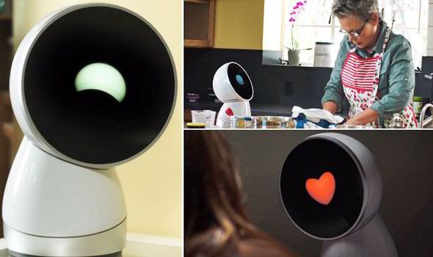
Emotion and robots
Jibo
Designed to interact with humans on an emotional level
Can react to emotional cues
Can react to environment
Capable of evolving emotionally
(Supposedly)
Deliberately designed

Slide 11
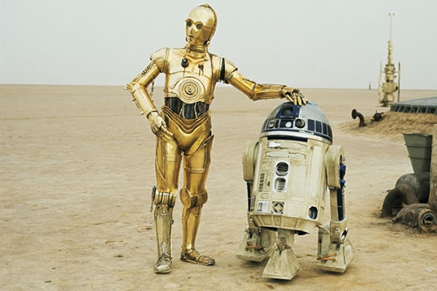
Emotion and robots

Slide 12
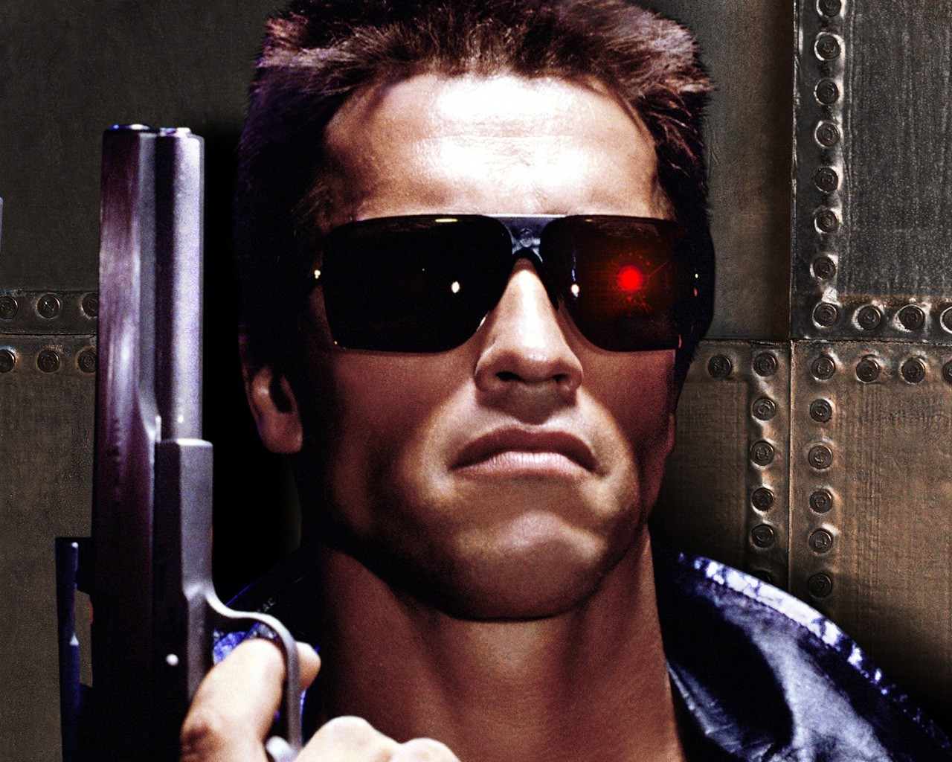
Emotion and robots

Slide 13
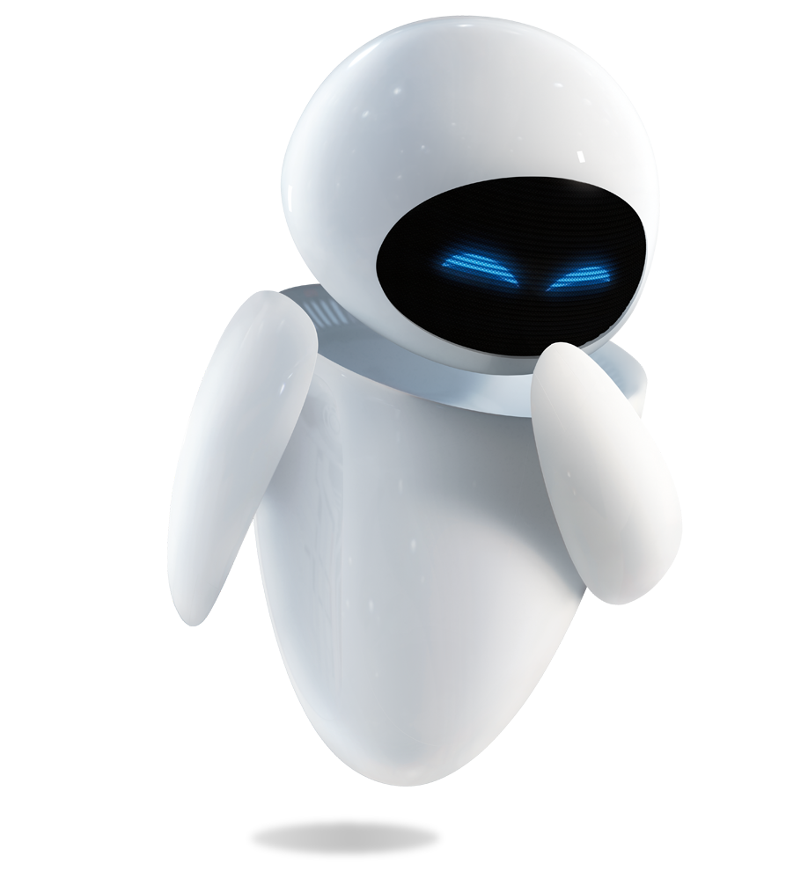
Emotion and robots

Slide 14
Emotion and robots

Slide 15
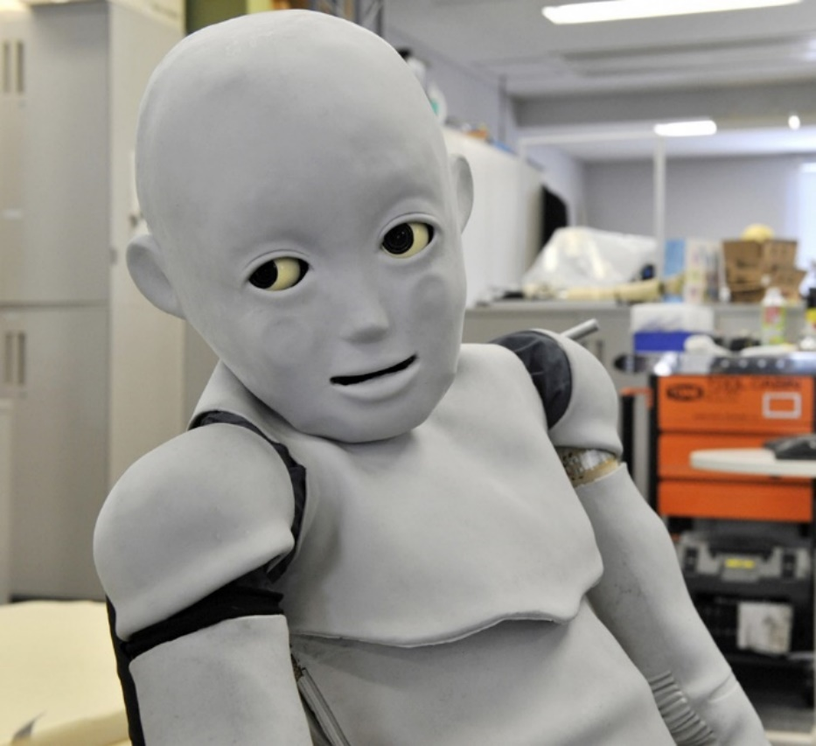
Emotion and robots
Must be aware of the uncanny valley
Have to sacrifice realism for emotion
Otherwise, repulsion

Slide 16
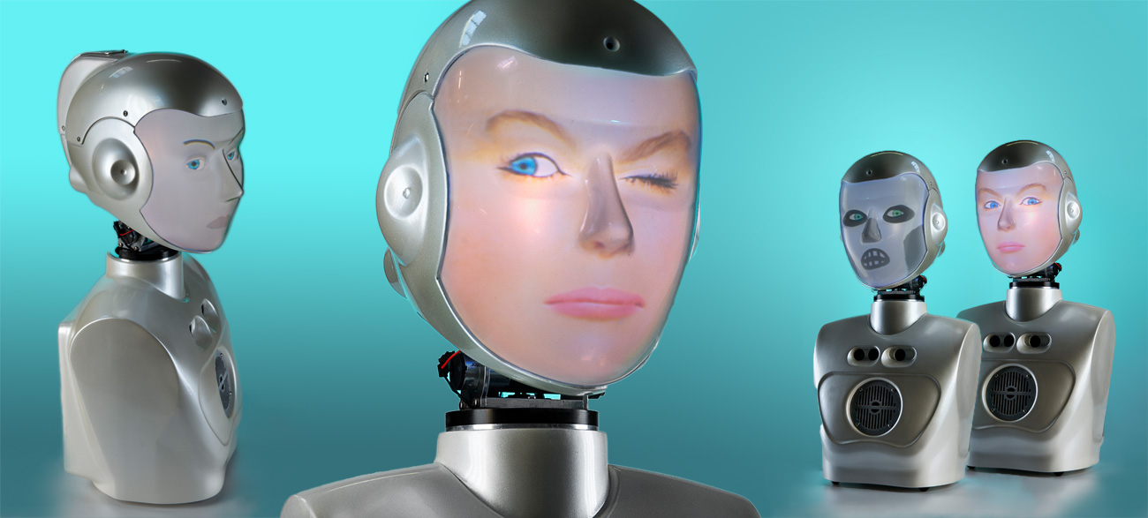
Emotion and robots
Must be aware of the uncanny valley
Have to sacrifice realism for emotion
Otherwise, repulsion

Slide 17
Trust
Developer familiarity
Personal history
Consistent, valid results
Personality / Relatedness
Configurability
Friends / Family / Others

