Slide 1
Interfaces
The only means of interaction

Slide 2
Two components
Action language
Presentation language
These are not interfaces, but components of each interface
Notes:
2

Slide 3
Types of interfaces
Natural language
Question and answer
Command line
Menu
Graphical user interface (WIMP and GUI)
Many new types of interfaces as well (touch, sound, speech, etc.)
Notes:
3

Slide 4
Natural language
Allows the user to use their own natural language, without concern of syntax or structure
Linguistic variations, even within language
And context, especially with text
Interface is easy, processing is hard
Needs to continually evolve, evidence of machine underpinnings always there
Examples
Notes:
4

Slide 5
Question and answer
In this type of interface, machine asks YOU the questions
Very limited in capability
Novice v. Experienced user
Very guided
Very handholding
Very controlled
Examples
Notes:
5

Slide 6
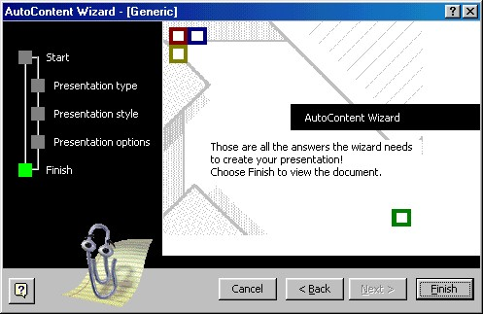

Slide 9
Command line
Uses a relatively non-descript prompt
Keys, especially key combos, can be assigned to functions
Benefits?
Difficulties, especially in terms of usability metrics
Notes:
9

Slide 10
Command-based
Commands such as abbreviations (e.g. ls) typed in at the prompt to which the system responds (e.g. listing current files)
Some are hard wired at keyboard, others can be assigned to keys
Efficient, precise, and fast
Large overhead to learning set of commands
Notes:
10

Slide 11
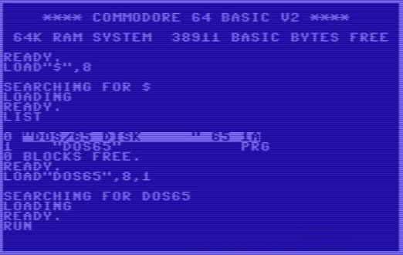

Slide 12
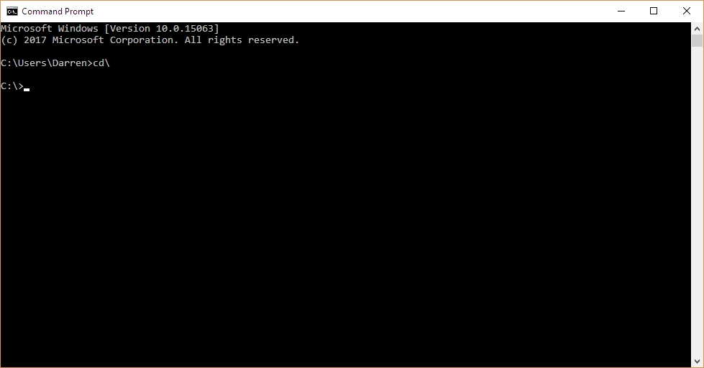

Slide 13
Menus
Multiple interface styles
Cascading, flat lists, drop-down, pop-up, contextual, etc.
Flat menus
good at displaying a small number of options at the same time and where the size of the display is small, e.g. iPods
but have to nest the lists of options within each other, requiring several steps to get to the list with the desired option
moving through previous screens can be tedious
Notes:
13

Slide 14
Expanding menus
Enables more options to be shown on a single screen than is possible with a single flat menu
Flexible navigation, allowing for selection of options to be done in same window as parents / main program
Most common are cascading menus
Primary, secondary, tertiary and more
Requires precise mouse control, or frustration ensues
Can result in incorrect selection, overshooting
Must weigh usability versus number of options, categorizations, and depth versus breadth
Notes:
14

Slide 15
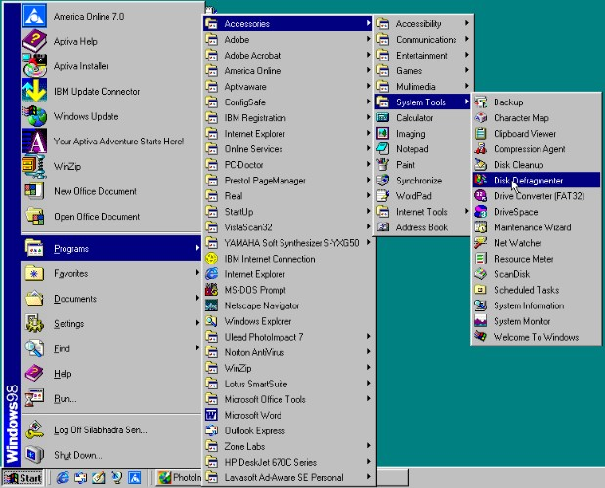
Cascading menu
Notes:
15

Slide 16
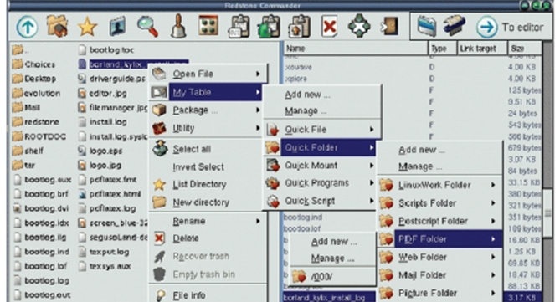
Cascading menu
Notes:
16

Slide 17
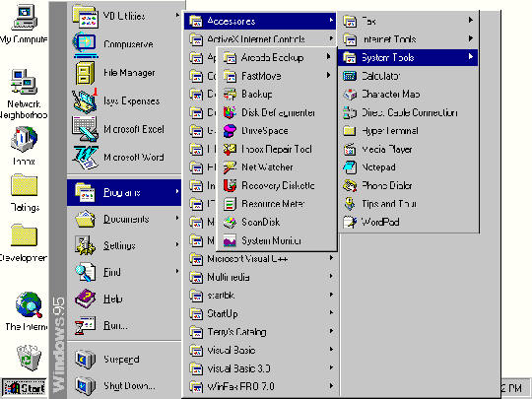
Cascading menu
Notes:
17

Slide 18
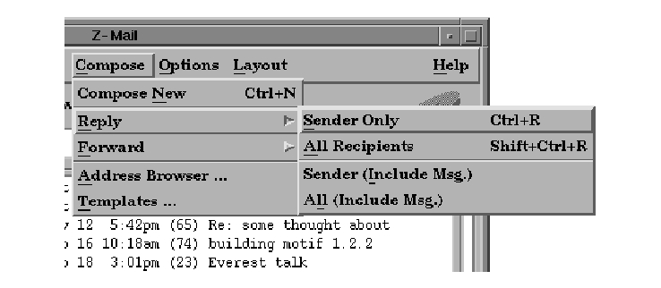
Cascading menu
Notes:
18

Slide 19
Contextual menus
Provide quick access to often-used commands that make sense in terms of the current task
Usually accessed via right-click
Helps overcome navigational and usability issues with standard cascading menus
Very helpful for novice users in limiting and guiding them (safety)
Utilizes the magic pixel (not yet)
Notes:
19

Slide 20
Standard menus
With standard menus, consistency and selection method are concerns
Cascades usually happen through new sub-menus
That’s inherently ok, however in practice can be difficult to see where you were, there’s no breadcrumbing
Home & Kitchen > Furniture > Living Room Furniture > Tables > Sofa & Console Tables
Still used surprisingly often
Notes:
20

Slide 21
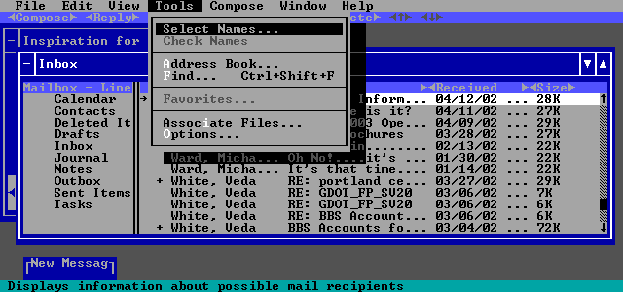

Slide 22
Design issues
What are best names/labels/phrases to use?
Placement in list is critical
Quit and save need to be far apart
Choice of menu to use determined by application and type of system
flat menus are best for displaying a small number of options at one time
expanding menus are good for showing a large number of options
Notes:
22

Slide 23
WIMP
Windows
Can Be scrolled, stretched, overlapped, opened, closed, and moved around using the mouse (even the keyboard), categorize functionality
Icons
Represent applications, objects, commands and tools that would activate when clicked on
logical v. conceptual
Menus
Offering lists of options that can be scrolled through, selected, and serve as list of shortcuts
Pointers
Mouse controls cursor as entry to interface, stylus, finger
Notes:
23

Slide 24
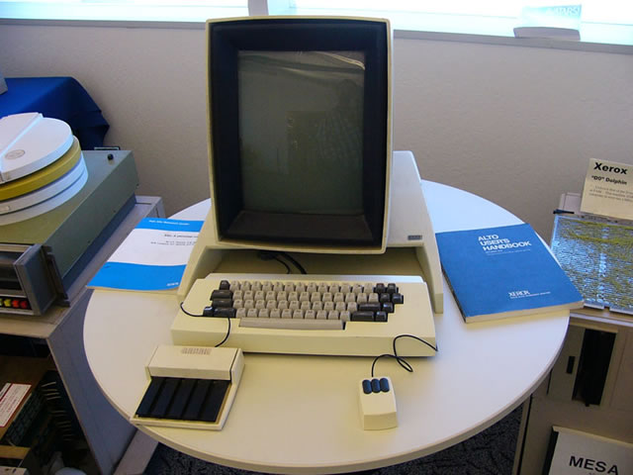

Slide 25
Fitts’ Law
$$MT=a+blog2 (\frac{2A}{W})$$
1954
Not originally for HCI…
…but now one of the most used and studied HCI principles
MT: Movement Time
a and b: Context and device dependent
The magic pixel, and most valuable screen real estate
Notes:
25

Slide 26
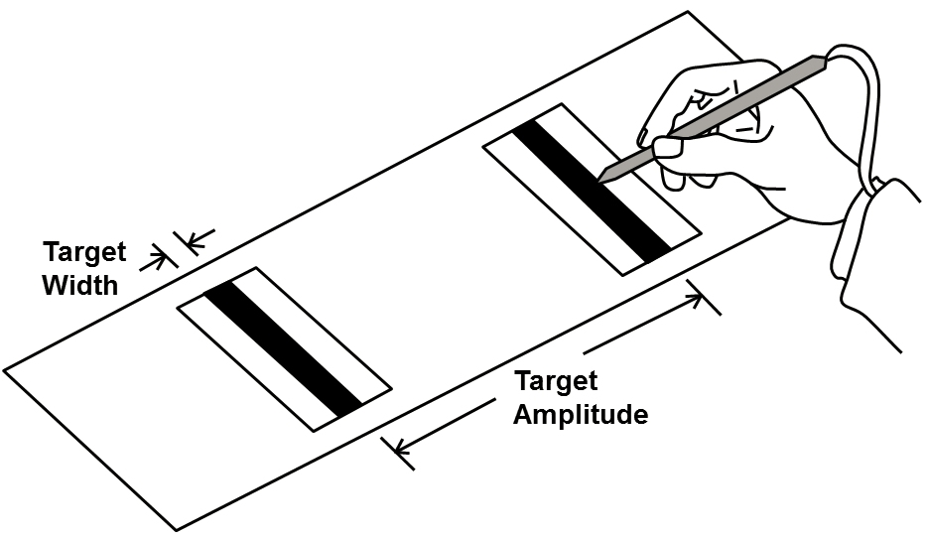

Slide 27
Fitts’ Law
$$MT=a+blog2 (\frac{2A}{W})$$
1954
Not originally for HCI…
…but now one of the most used and studied HCI principles
MT: Movement Time
a and b: Context and device dependent
The magic pixel, and most valuable screen real estate
Notes:
27

Slide 28
Fitts’ Law
$$MT=a+blog2 (\frac{2A}{W})$$
1954
Not originally for HCI…
…but now one of the most used and studied HCI principles
MT: Movement Time
a and b: Context and device dependent
The magic pixel, and most valuable screen real estate
Notes:
28

Slide 29
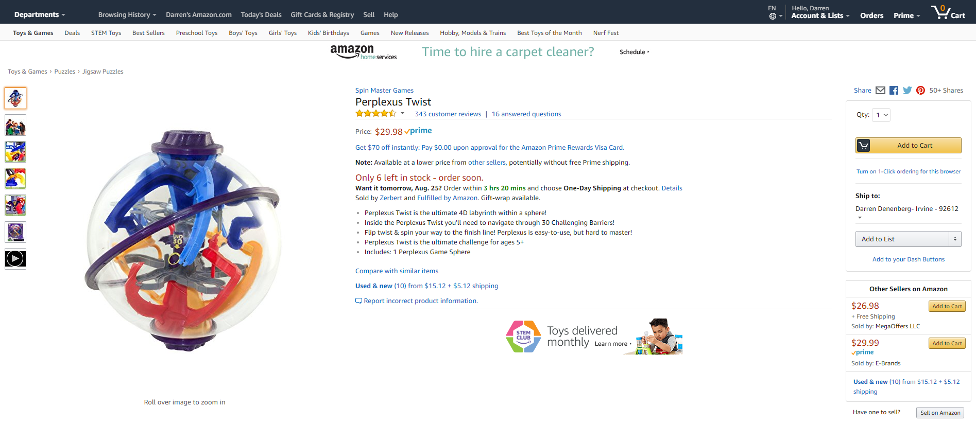

Slide 30
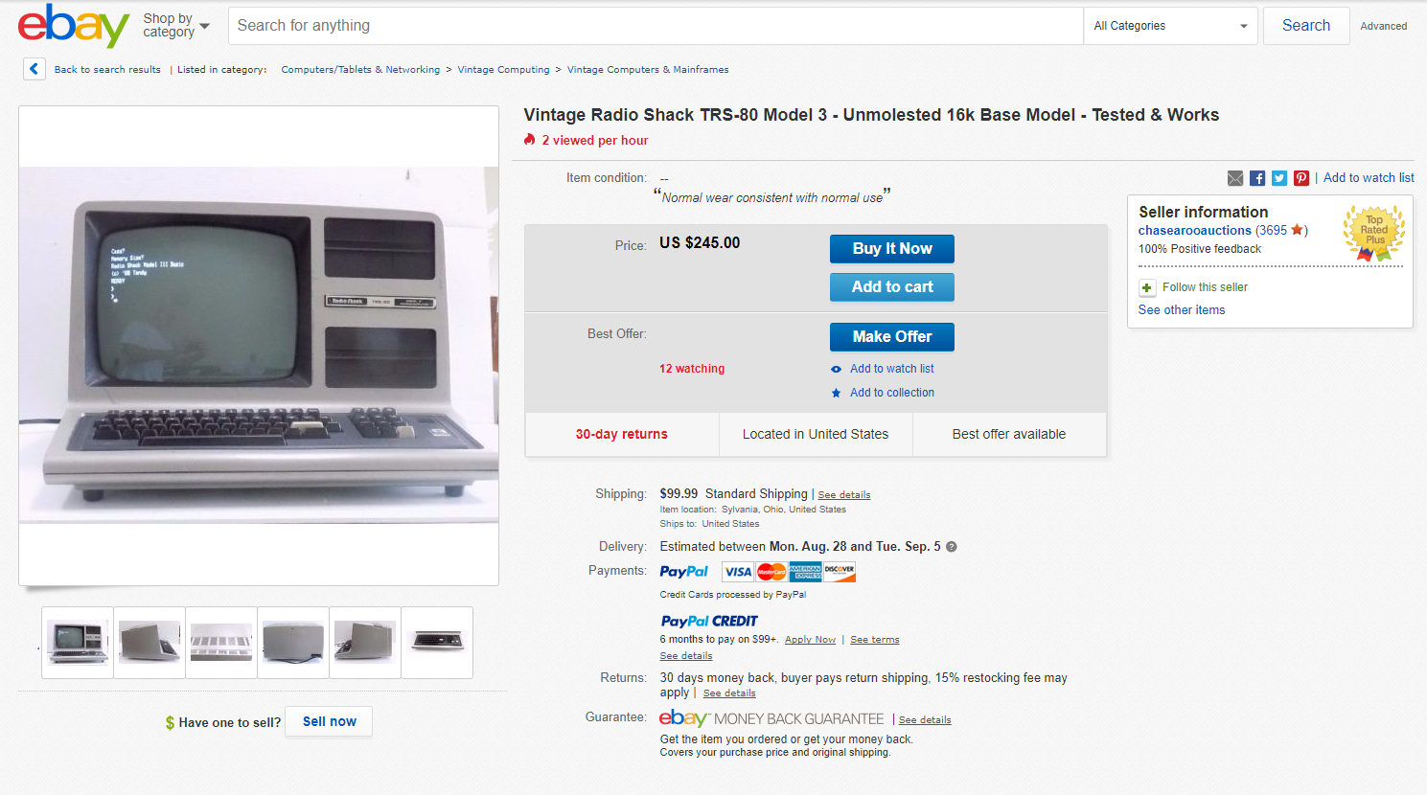

Slide 31
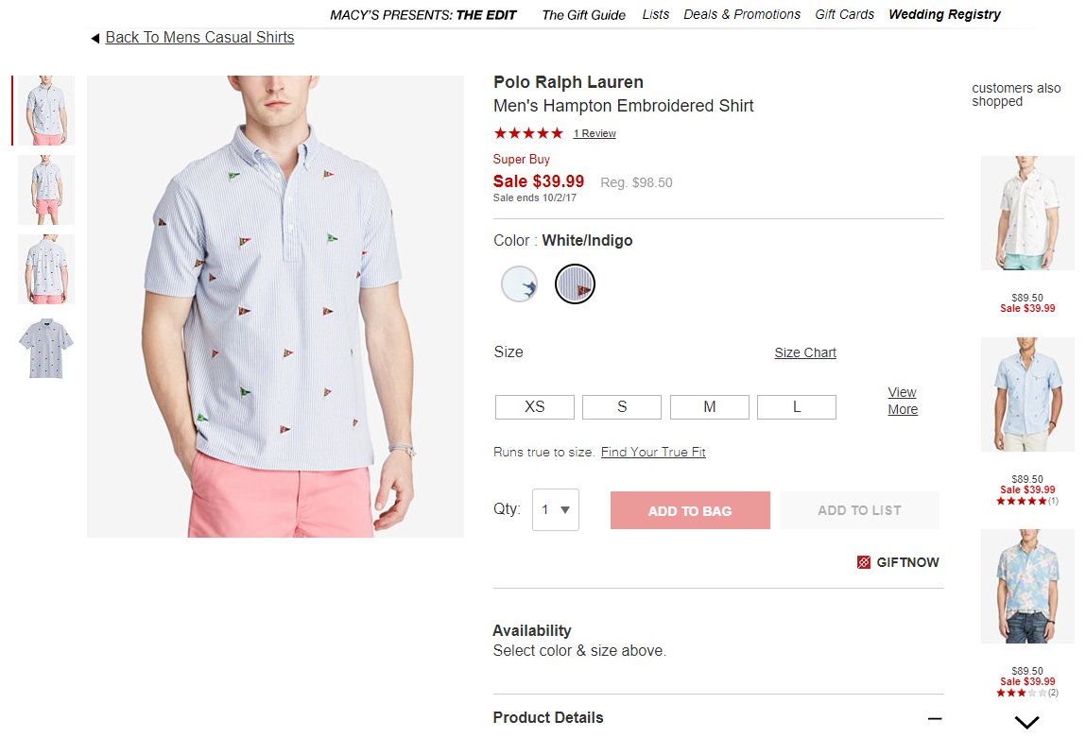

Slide 32
G.U.I.
Built off of and designed from a WIMP framework
Color, 3D, sound, animation
Many types of menus, icons, windows, nav. methods
Importance of familiarity, metaphorical design, consistency, standards, cognition, interpretation, etc.
New elements, continual development
Toolbars, docks, rollovers, multiple desktops, etc.
How do we adapt and re-invent for new interaction platforms?
Notes:
32

Slide 33
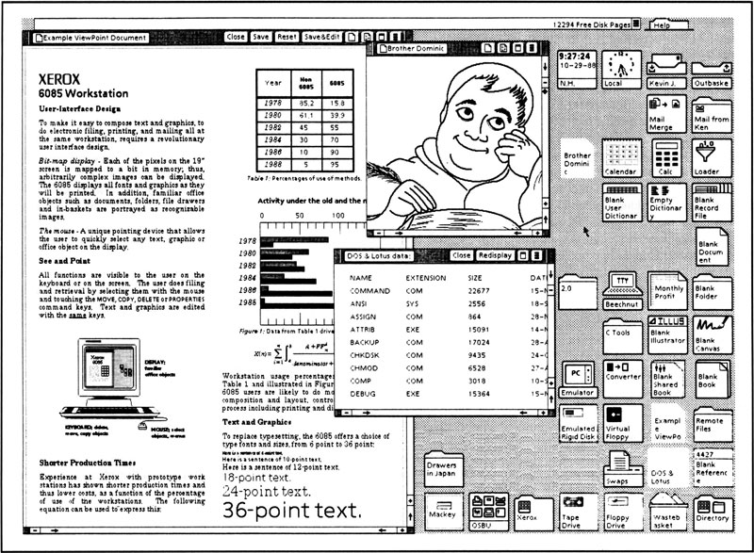

Slide 34
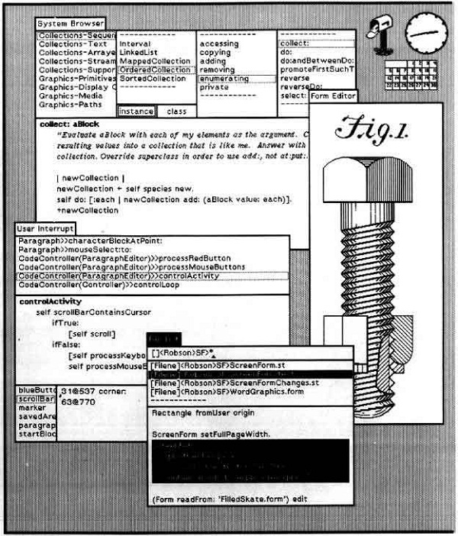

Slide 35
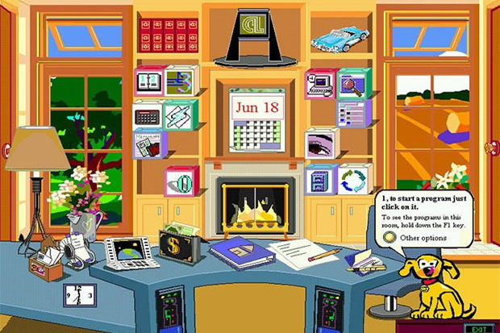

Slide 36
Windows
Developed to overcome design and interaction constraints of a standard interface / display
Enabled more information to be more easily viewed, produced, manipulated, and tasks to be performed
Scrollbars, text boxes, etc. allowed for access and viewing of more information
Windows overload is possible, so need interface elements and features to deal with that
Listing, iconizing, shrinking, multiple desktops
Notes:
36

Slide 37
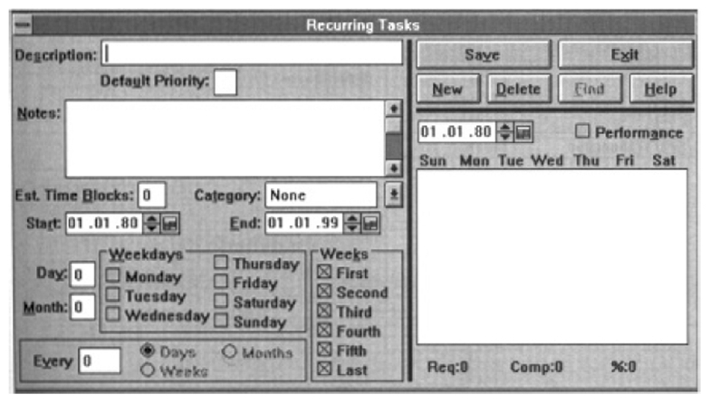

Slide 38
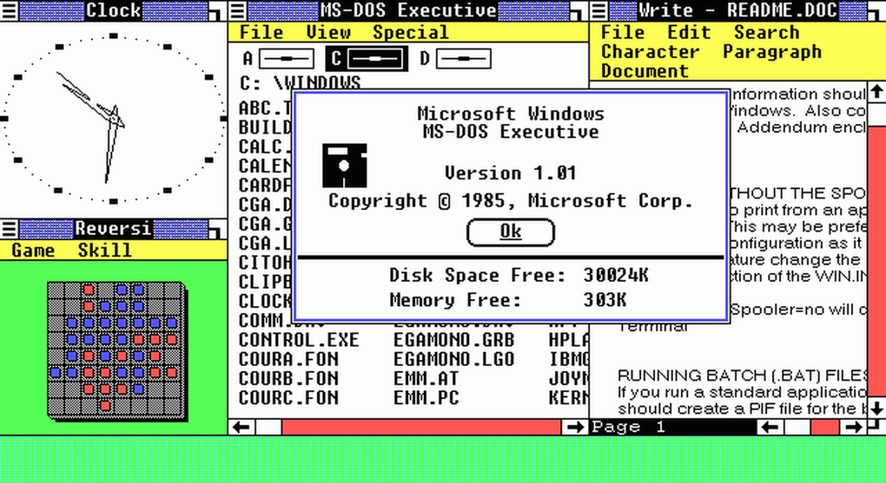

Slide 39
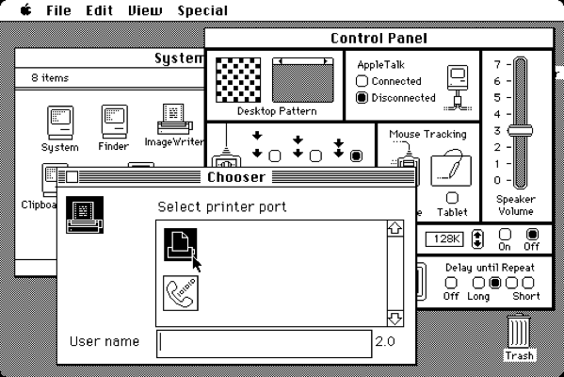

Slide 40
Notes:
40

Slide 41
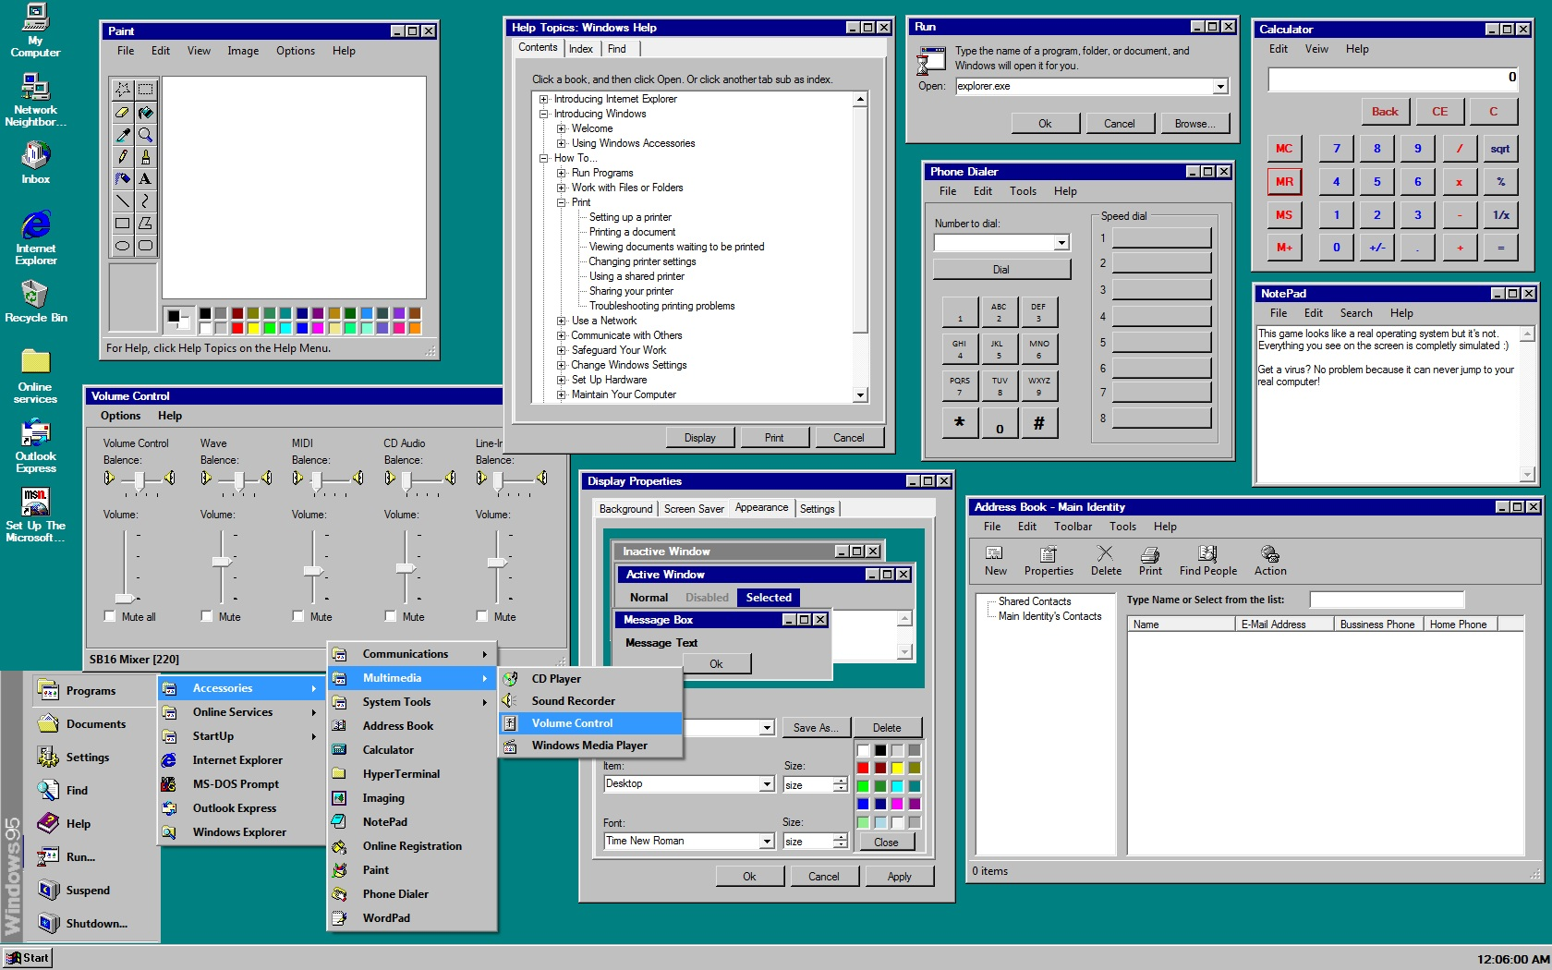
Notes:
41

Slide 42
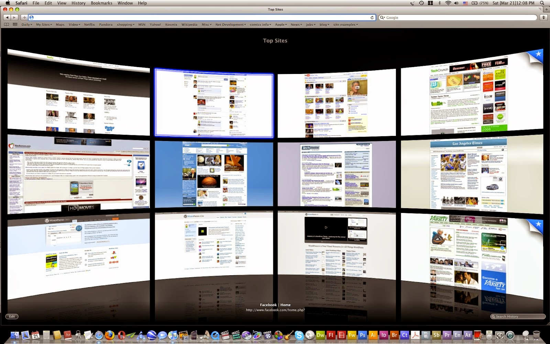

Slide 43
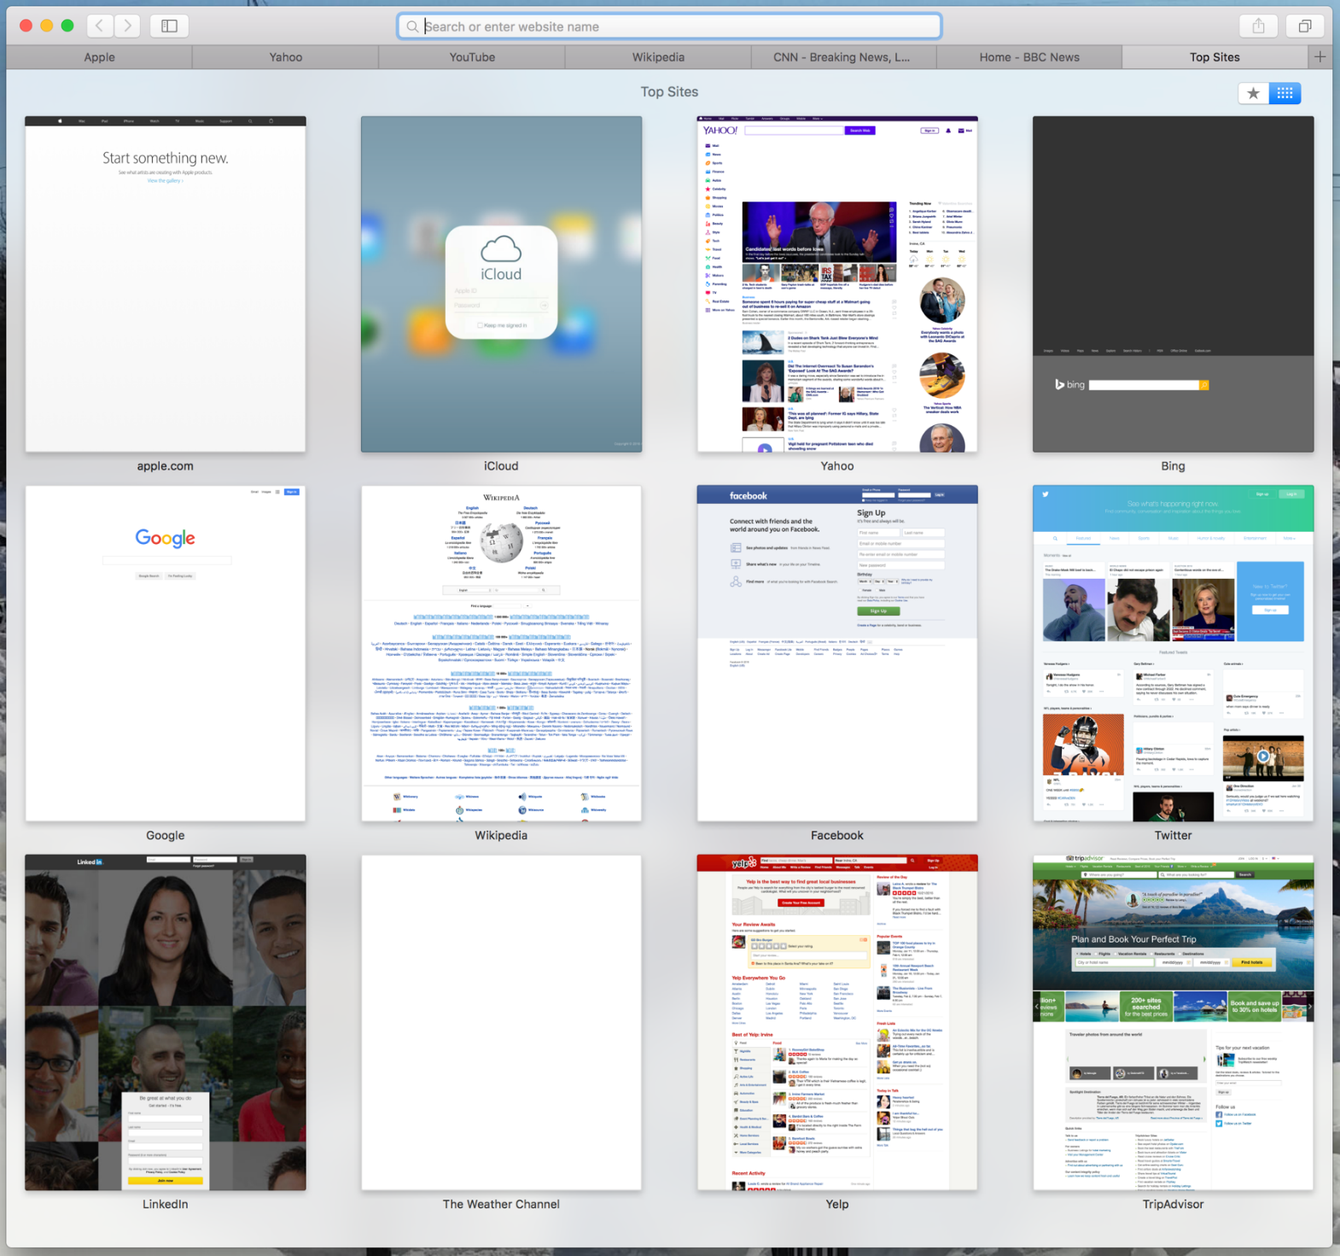

Slide 44
Research and design issues
Window management
enables users to move fluidly between different windows (and monitors)
How to switch attention between windows without getting distracted
Design principles of spacing, grouping, and simplicity should be used
Notes:
44

Slide 45
Icon Design
Icons are assumed to be easier to learn and remember than commands
Compact, variably positioned, visually communicative, afforded, but must adhere to standards for design
Pervasive in every interface
e.g. represent desktop objects, tools (e.g. paintbrush), applications (e.g. web browser), and operations (e.g. cut, paste, next, accept, change)
Notes:
45

Slide 46
Icons
Since the Xerox Star days icons have changed in their look and feel:
black and white -> color, shadowing, photorealistic images, 3D rendering, and animation
Many designed to be very detailed and animated, making them both visually attractive and informative
GUIs now highly inviting, emotionally appealing, and feel alive
Notes:
46

Slide 47
Icon forms
The mapping between the representation and underlying referent can be:
similar (e.g., a picture of a file to represent the object file)
analogical (e.g., a picture of a pair of scissors to represent ‘cut’)
arbitrary (e.g., the use of an X to represent ‘delete’)
Most effective icons are similar ones
Many operations are actions making it more difficult to represent them
use a combination of objects and symbols that capture the salient part of an action
Notes:
47

Slide 48
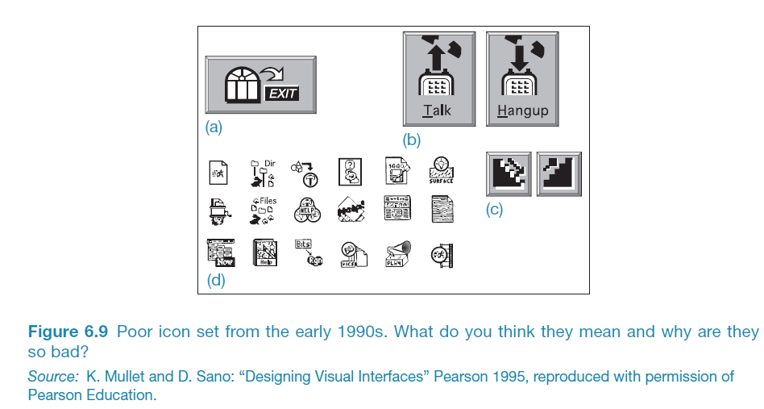
Early icons
Notes:
48

Slide 49
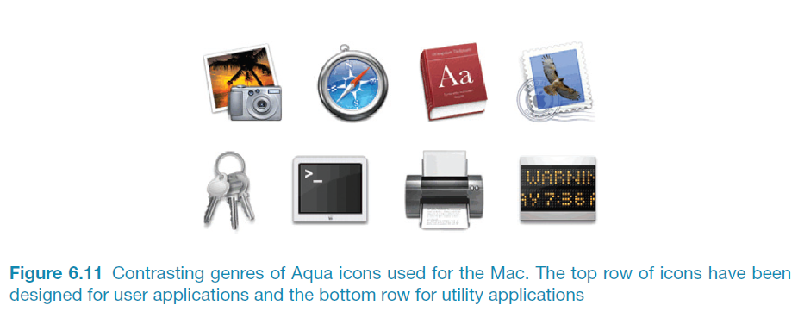
Newer icons
Notes:
49

Slide 50
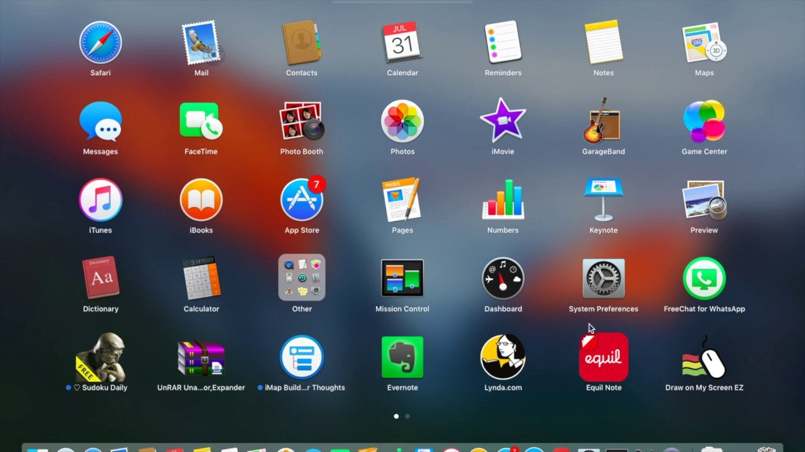
Even newer icons
Notes:
50

Slide 51
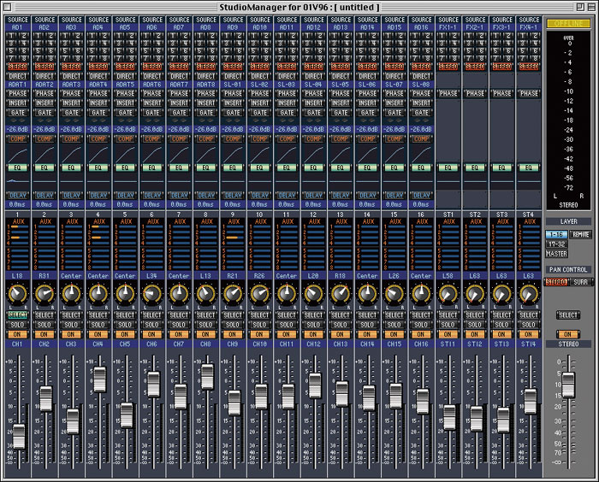
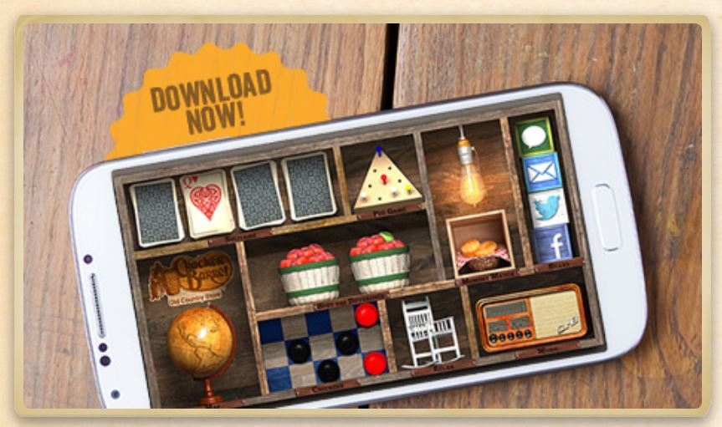
Icon forms
Skeuomorphism
Just like the real world
Has almost limitless reference
Curiously, we have been moving away from it, to more flat design
Notes:
51

Slide 52
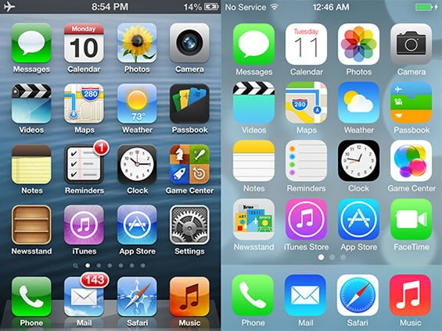

Slide 53
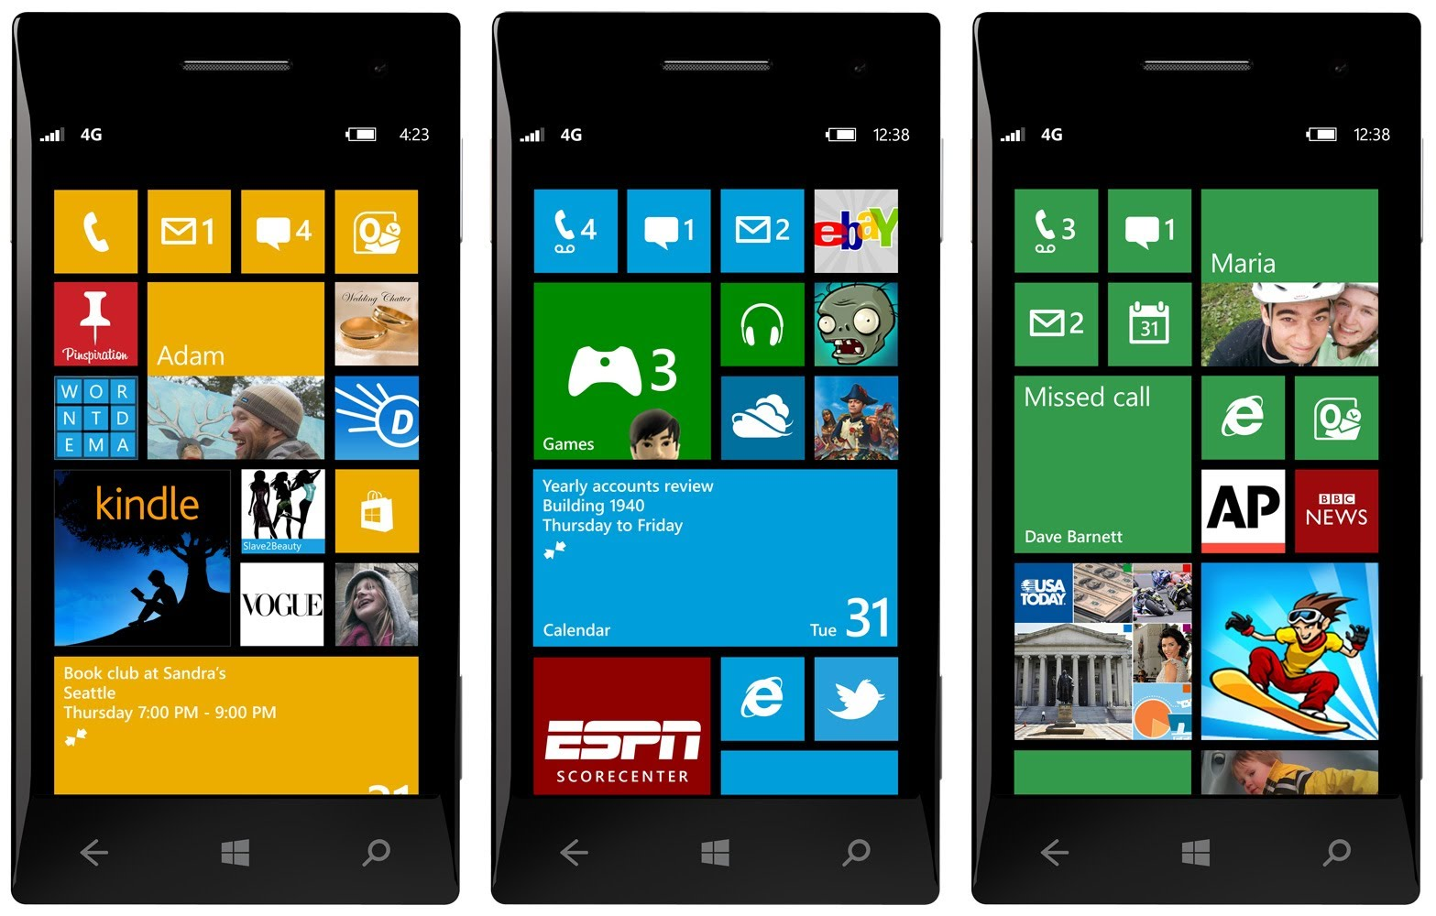

Slide 54
Research and design issues
There is a wealth of resources now so do not have to draw or invent new icons from scratch unless necessary
Guidelines, style guides, icon builders, libraries
Can still stick to convention
Text labels can be used alongside icons to help identification for small icon sets
For large icon sets (e.g. photo editing or word processing) use rollovers
Notes:
54

Slide 55
Future (current) interfaces
What are some of the new interfaces we will be (are) using?
New interaction methods require new research, new investigation, new design, new user requirements, new thinking, new expertise, new understanding, new…
Many of these interfaces are still evolving, still in their infancy, while others are more mature.
What counts as a new interface? A novel interface? How can we determine what works and what doesn’t?
Notes:
55

Slide 56
Voice / Speech
Already talked about this, sort-of
Same foundational concerns as natural language
However now requires faster response, and prosodic interpretation
Easy for humans, hard for machines
Continuous
Discrete
Notes:
56

Slide 57
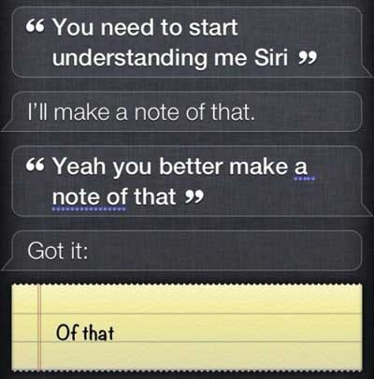

Slide 58
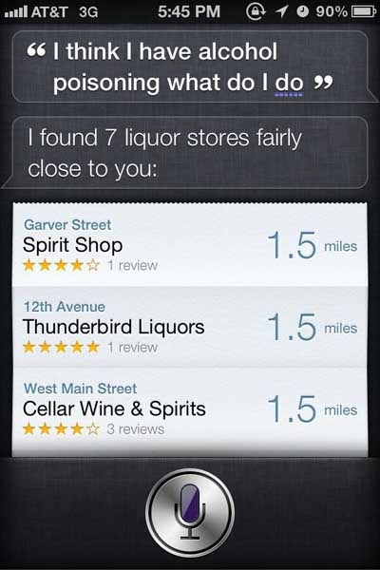

Slide 59
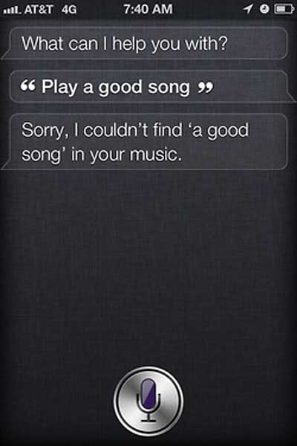

Slide 60
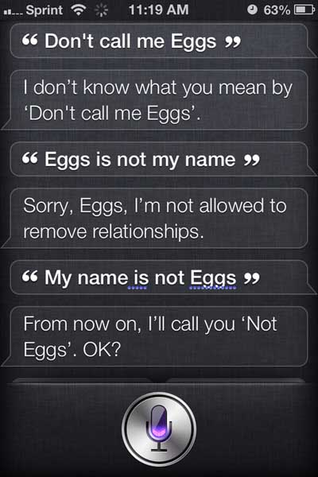

Slide 61
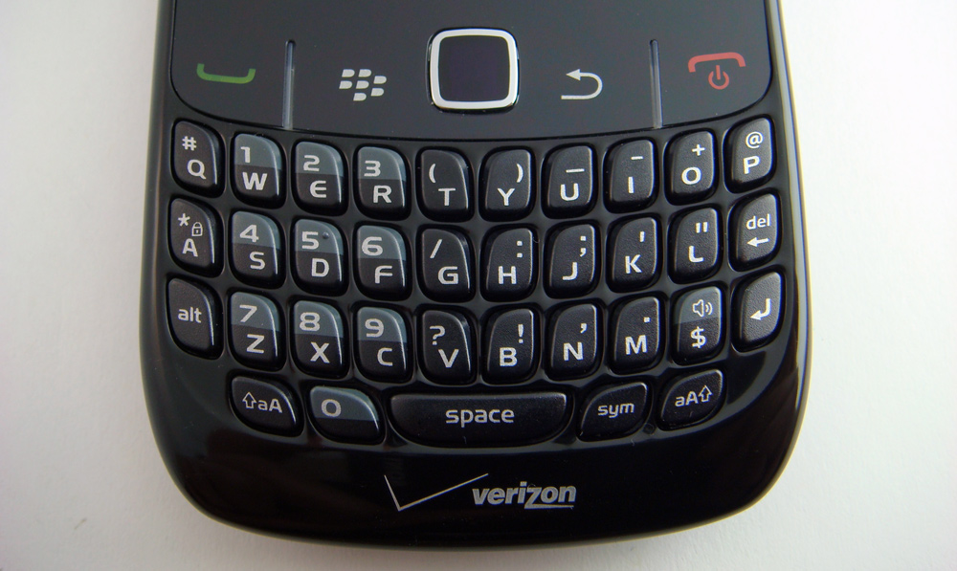

Slide 62
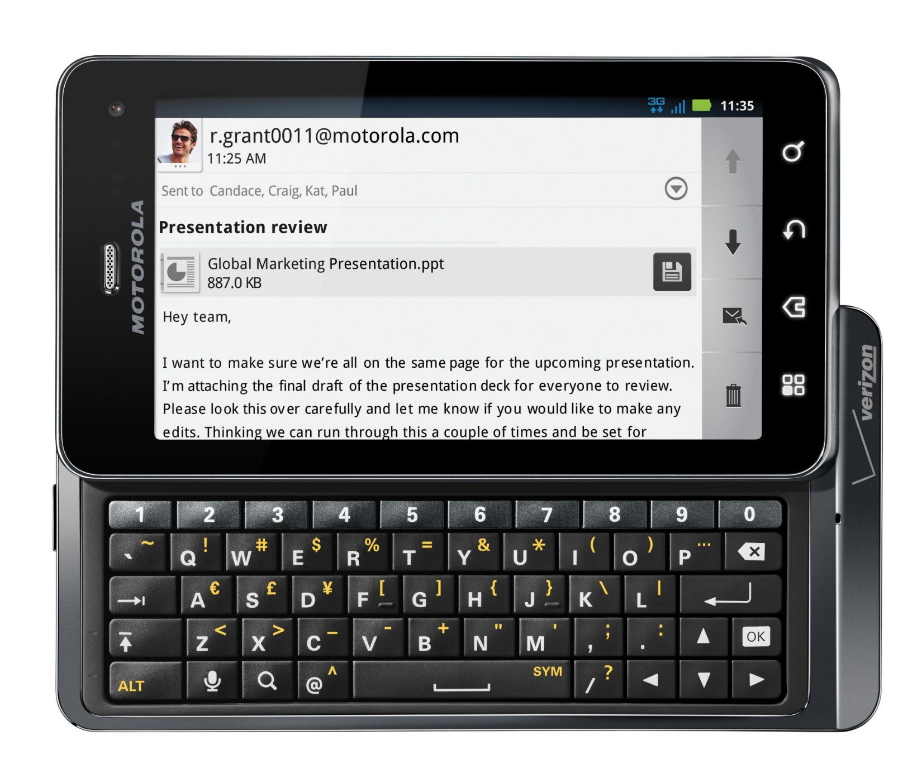

Slide 63
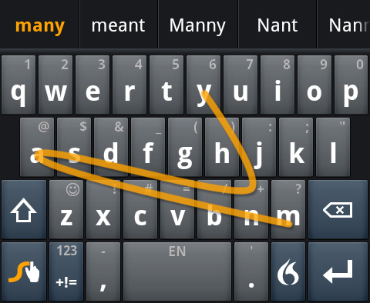

Slide 64
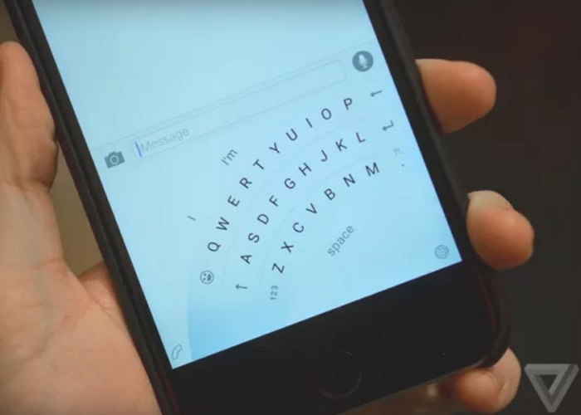

Slide 65
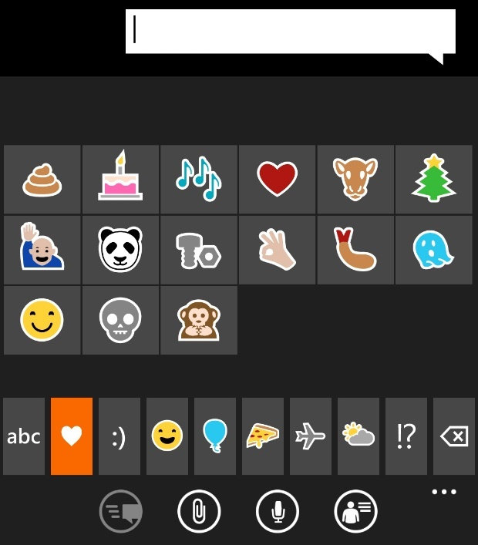
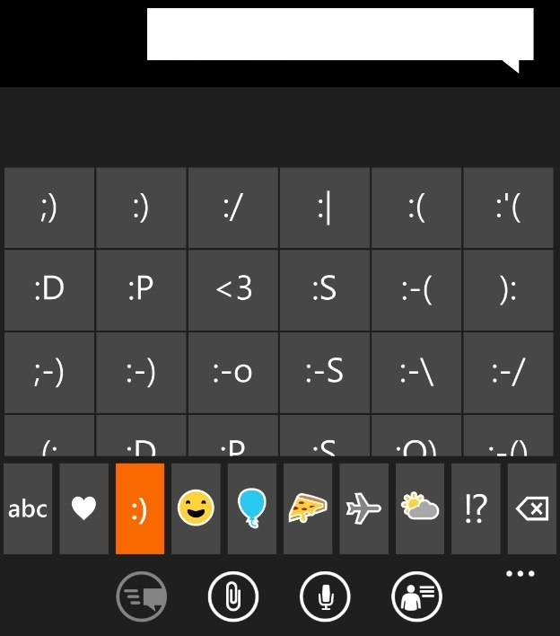
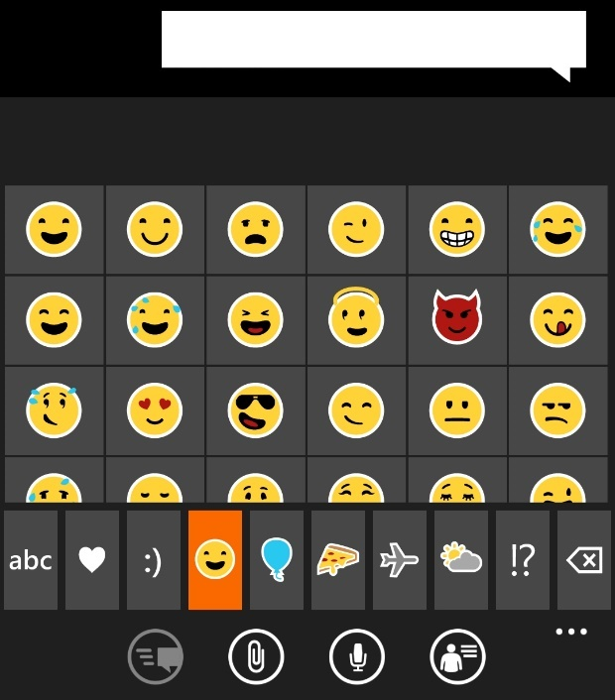
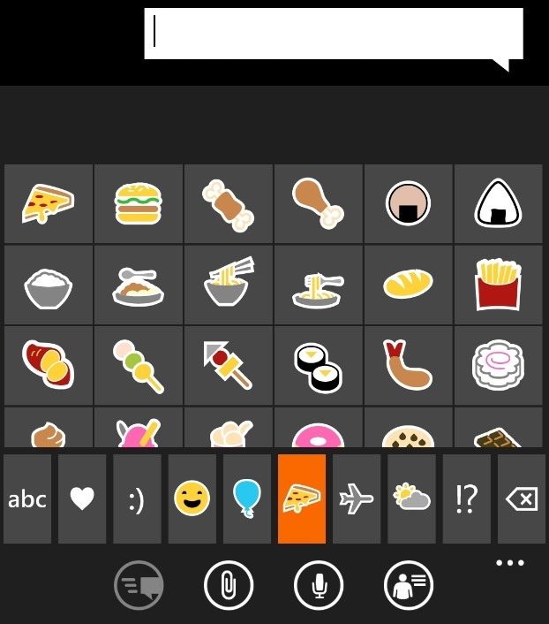
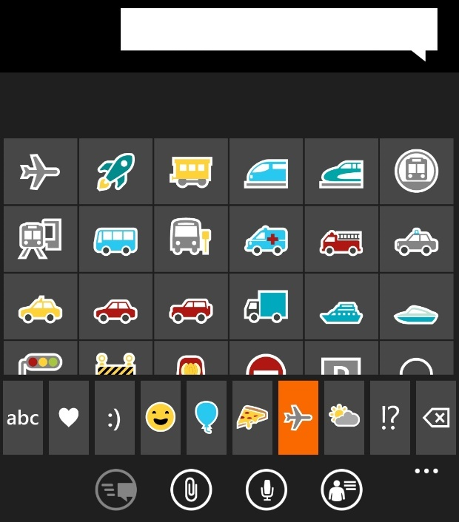
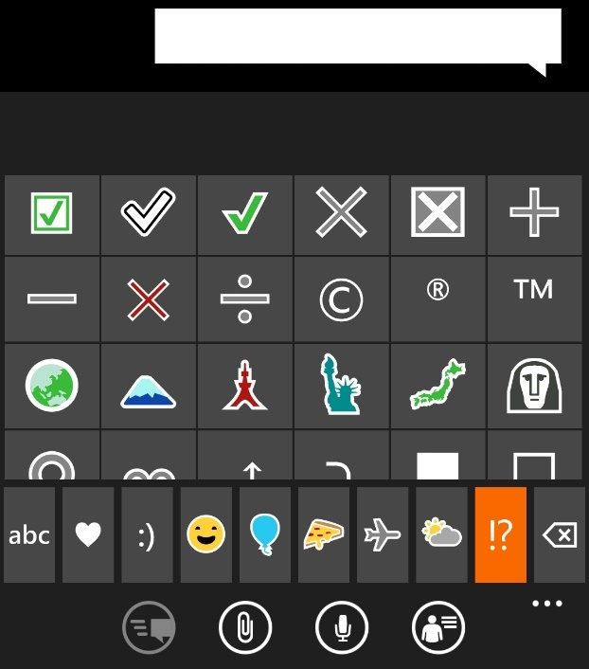

Slide 66
Gaming
Significant evolution in input methods
Joysticks, paddles, keys, gamepads, footpads, motion detection, now we just have ‘controllers.’
Notes:
66

Slide 67
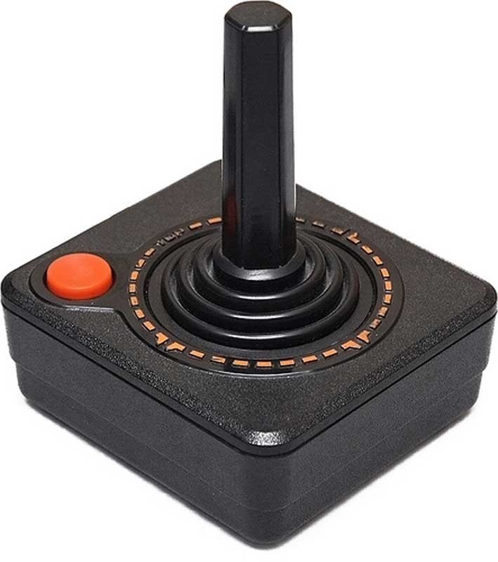
Notes:
67

Slide 68
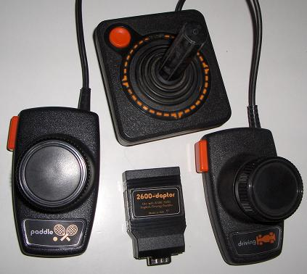
Notes:
68

Slide 69
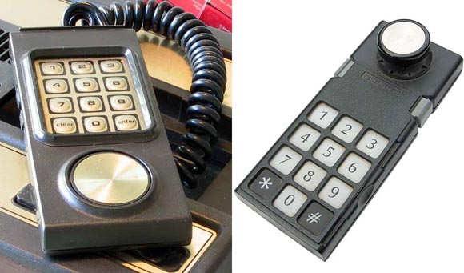
Notes:
69

Slide 70
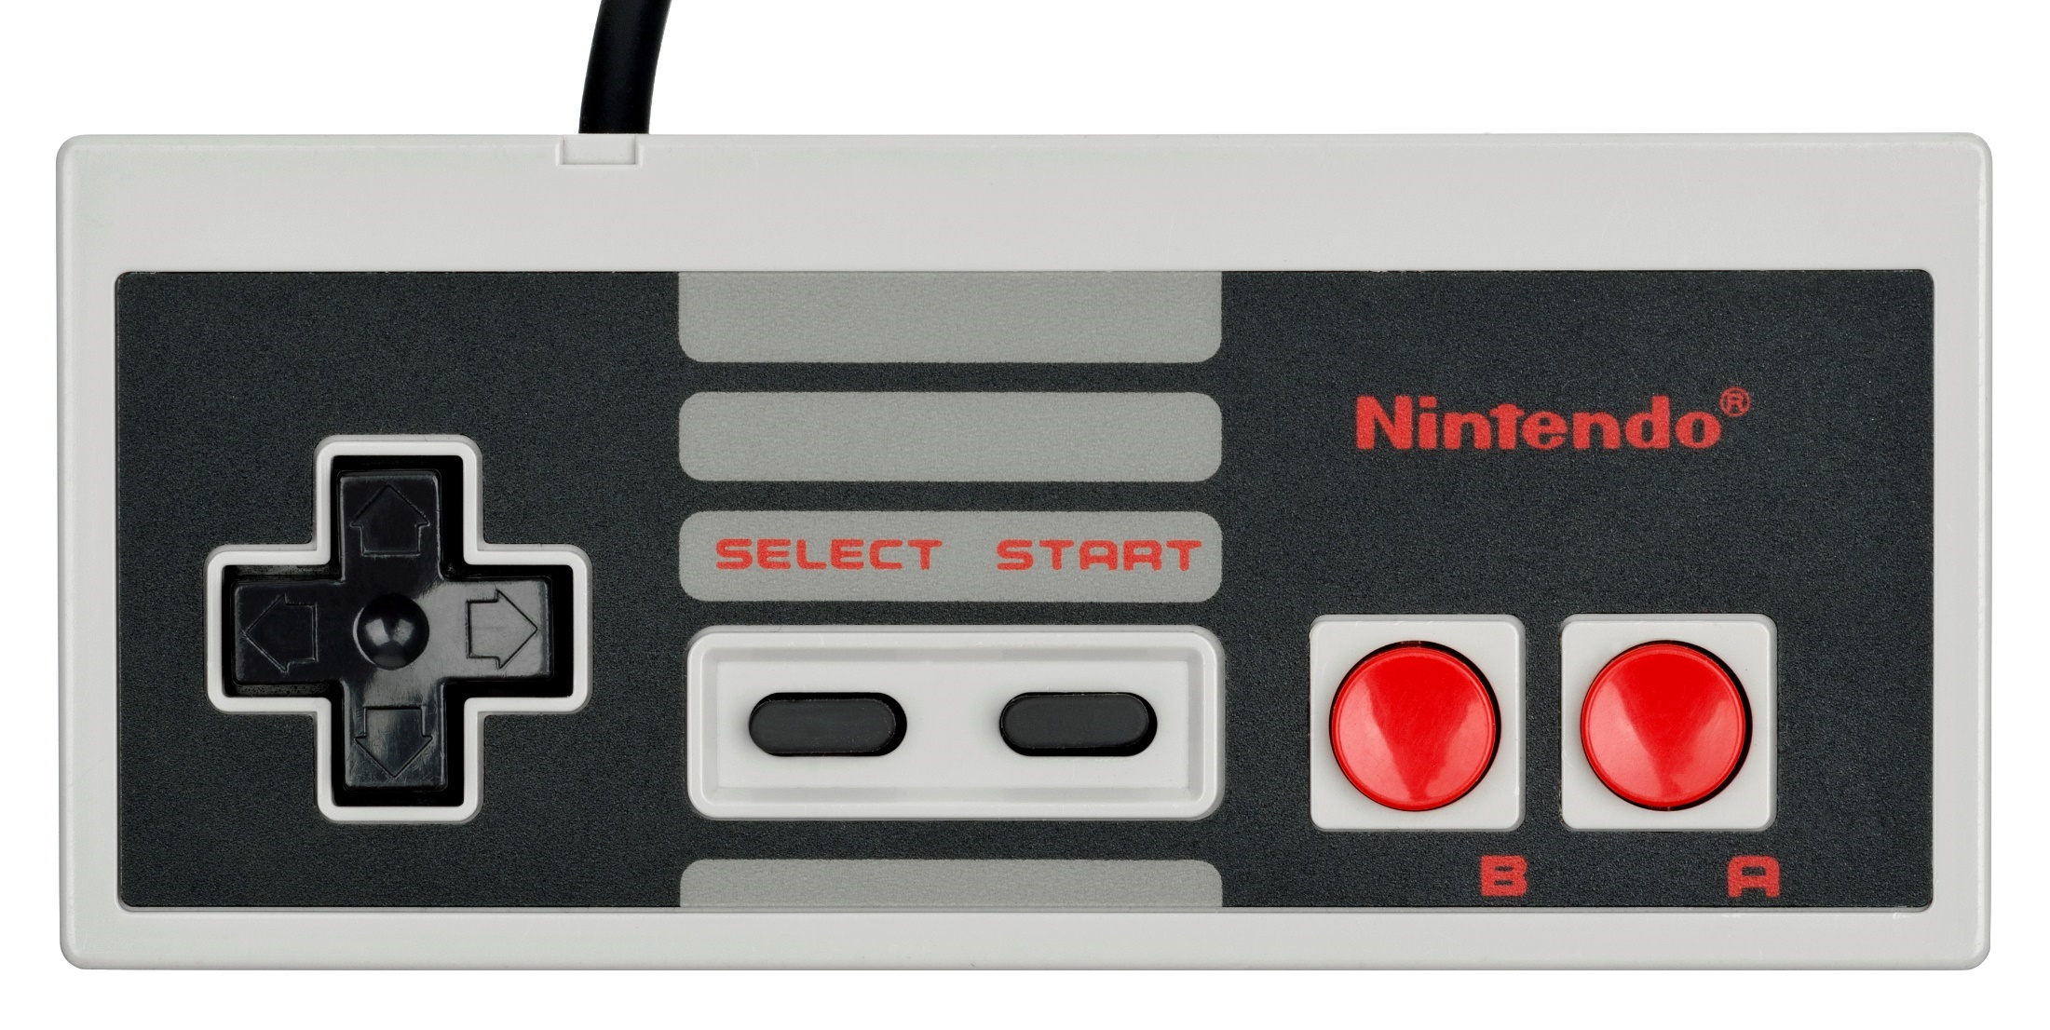
Notes:
70

Slide 71
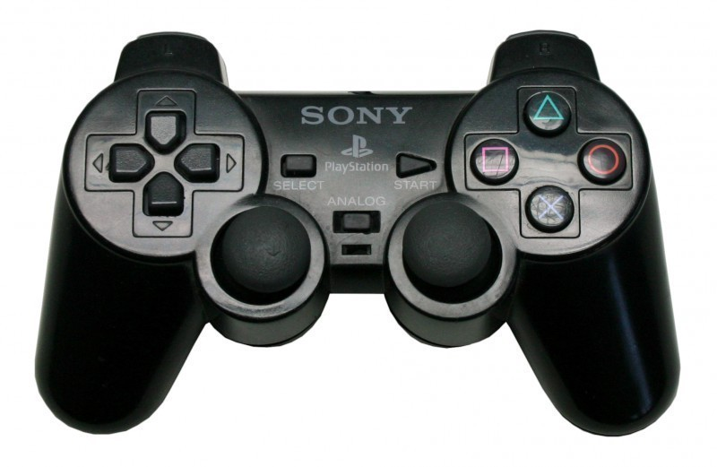
Notes:
71

Slide 72
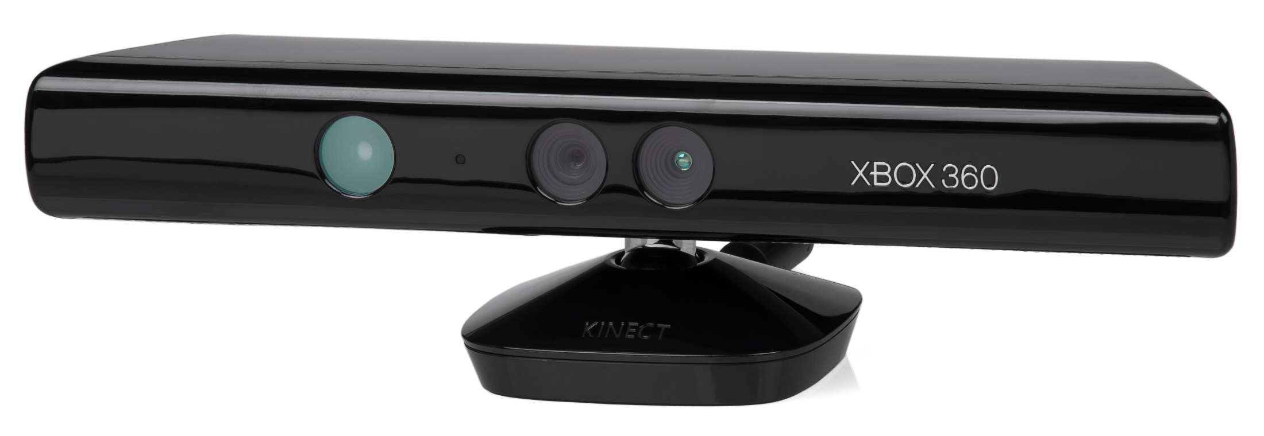
Notes:
72

Slide 73
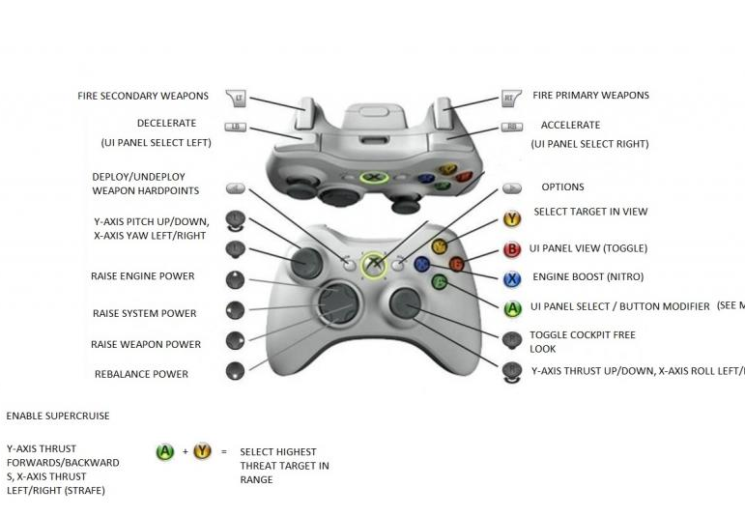
Notes:
73

Slide 74
Notes:
74

Slide 75
Notes:
75

Slide 76
Some other examples
Consumer interfaces are standardized, well-informed, commonplace, this aids in the design process
Other interfaces do not have this luxury, and significant investigation, research, and requirements determination must inform their development.
Can use interdisciplinary / industry standards
Notes:
76

Slide 77
Notes:
77

Slide 78
Notes:
78

Slide 79
Notes:
79

Slide 80
Notes:
80

Slide 81
Notes:
81

Slide 82
Consumer products
Wide variety of goals
Limited variety of interaction methods
Very device / domain dependent
Product design is (usually) important
Notes:
82

Slide 83
Notes:
83

Slide 84
Notes:
84

Slide 85
Notes:
85

Slide 86
Notes:
86

Slide 87
Notes:
87

Slide 88
Notes:
88

Slide 90
VR
Brand new domain, still very young
Interaction methods aren't anywhere close to being worked out
Significant strides have made, but much more to be done
Control, or lack thereof, often informs design
Notes:
90

Slide 91
Notes:
91

Slide 92
Notes:
92

Slide 93
Notes:
93

Slide 96
Notes:
96

Slide 97
The Web
Not the Internet
Used to be websites were informational, with occasional links
Information was meant to be accessed easily and quickly
Now, emphasis is on making webpages interactive, aesthetically pleasing, enjoyable, usable, configurable, etc.
New interaction methods have forced a rethink of web page design, seen primarily in responsive design
Developers should consider the purpose and platform of the site, visitors can want many things in terms of content, interaction method, and experience
Sites need to be ‘sticky’
Notes:
97

Slide 98
Notes:
98

Slide 99
Notes:
99

Slide 100
Notes:
100

Slide 101
Notes:
101

Slide 102
The advent of the (iPhone) app
A whole new user experience that was designed primarily for people to enjoy
many apps not designed for any need, want or use but purely for idle moments to have some fun (and utilize available technologies)
e.g. iBeer developed by magician Steve Sheraton
clever use of the accelerometer that is inside the phone

Slide 103
iBeer app

Slide 104
The advent of the (iPhone) app
A whole new user experience that was designed primarily for people to enjoy (originally)
Now, mobile apps are used more than desktop applications, and for many tasks.
Banking, airline tickets, mortgage applications, etc.
Still uses integrated phone features, but for things like the ‘quantified self.’

Slide 105
Square app

Slide 106
Quantified self

Slide 107
So
The point is, interaction methods are evolving rapidly, as they always have
New challenges will be addressed through research and design
We are already seeing the evolution of interface design in and within novel interfaces
There is still a long, fun, infuriating way to go

