Slide 1
Human Computer Interaction (HCI, HCC)
An introduction

Slide 2
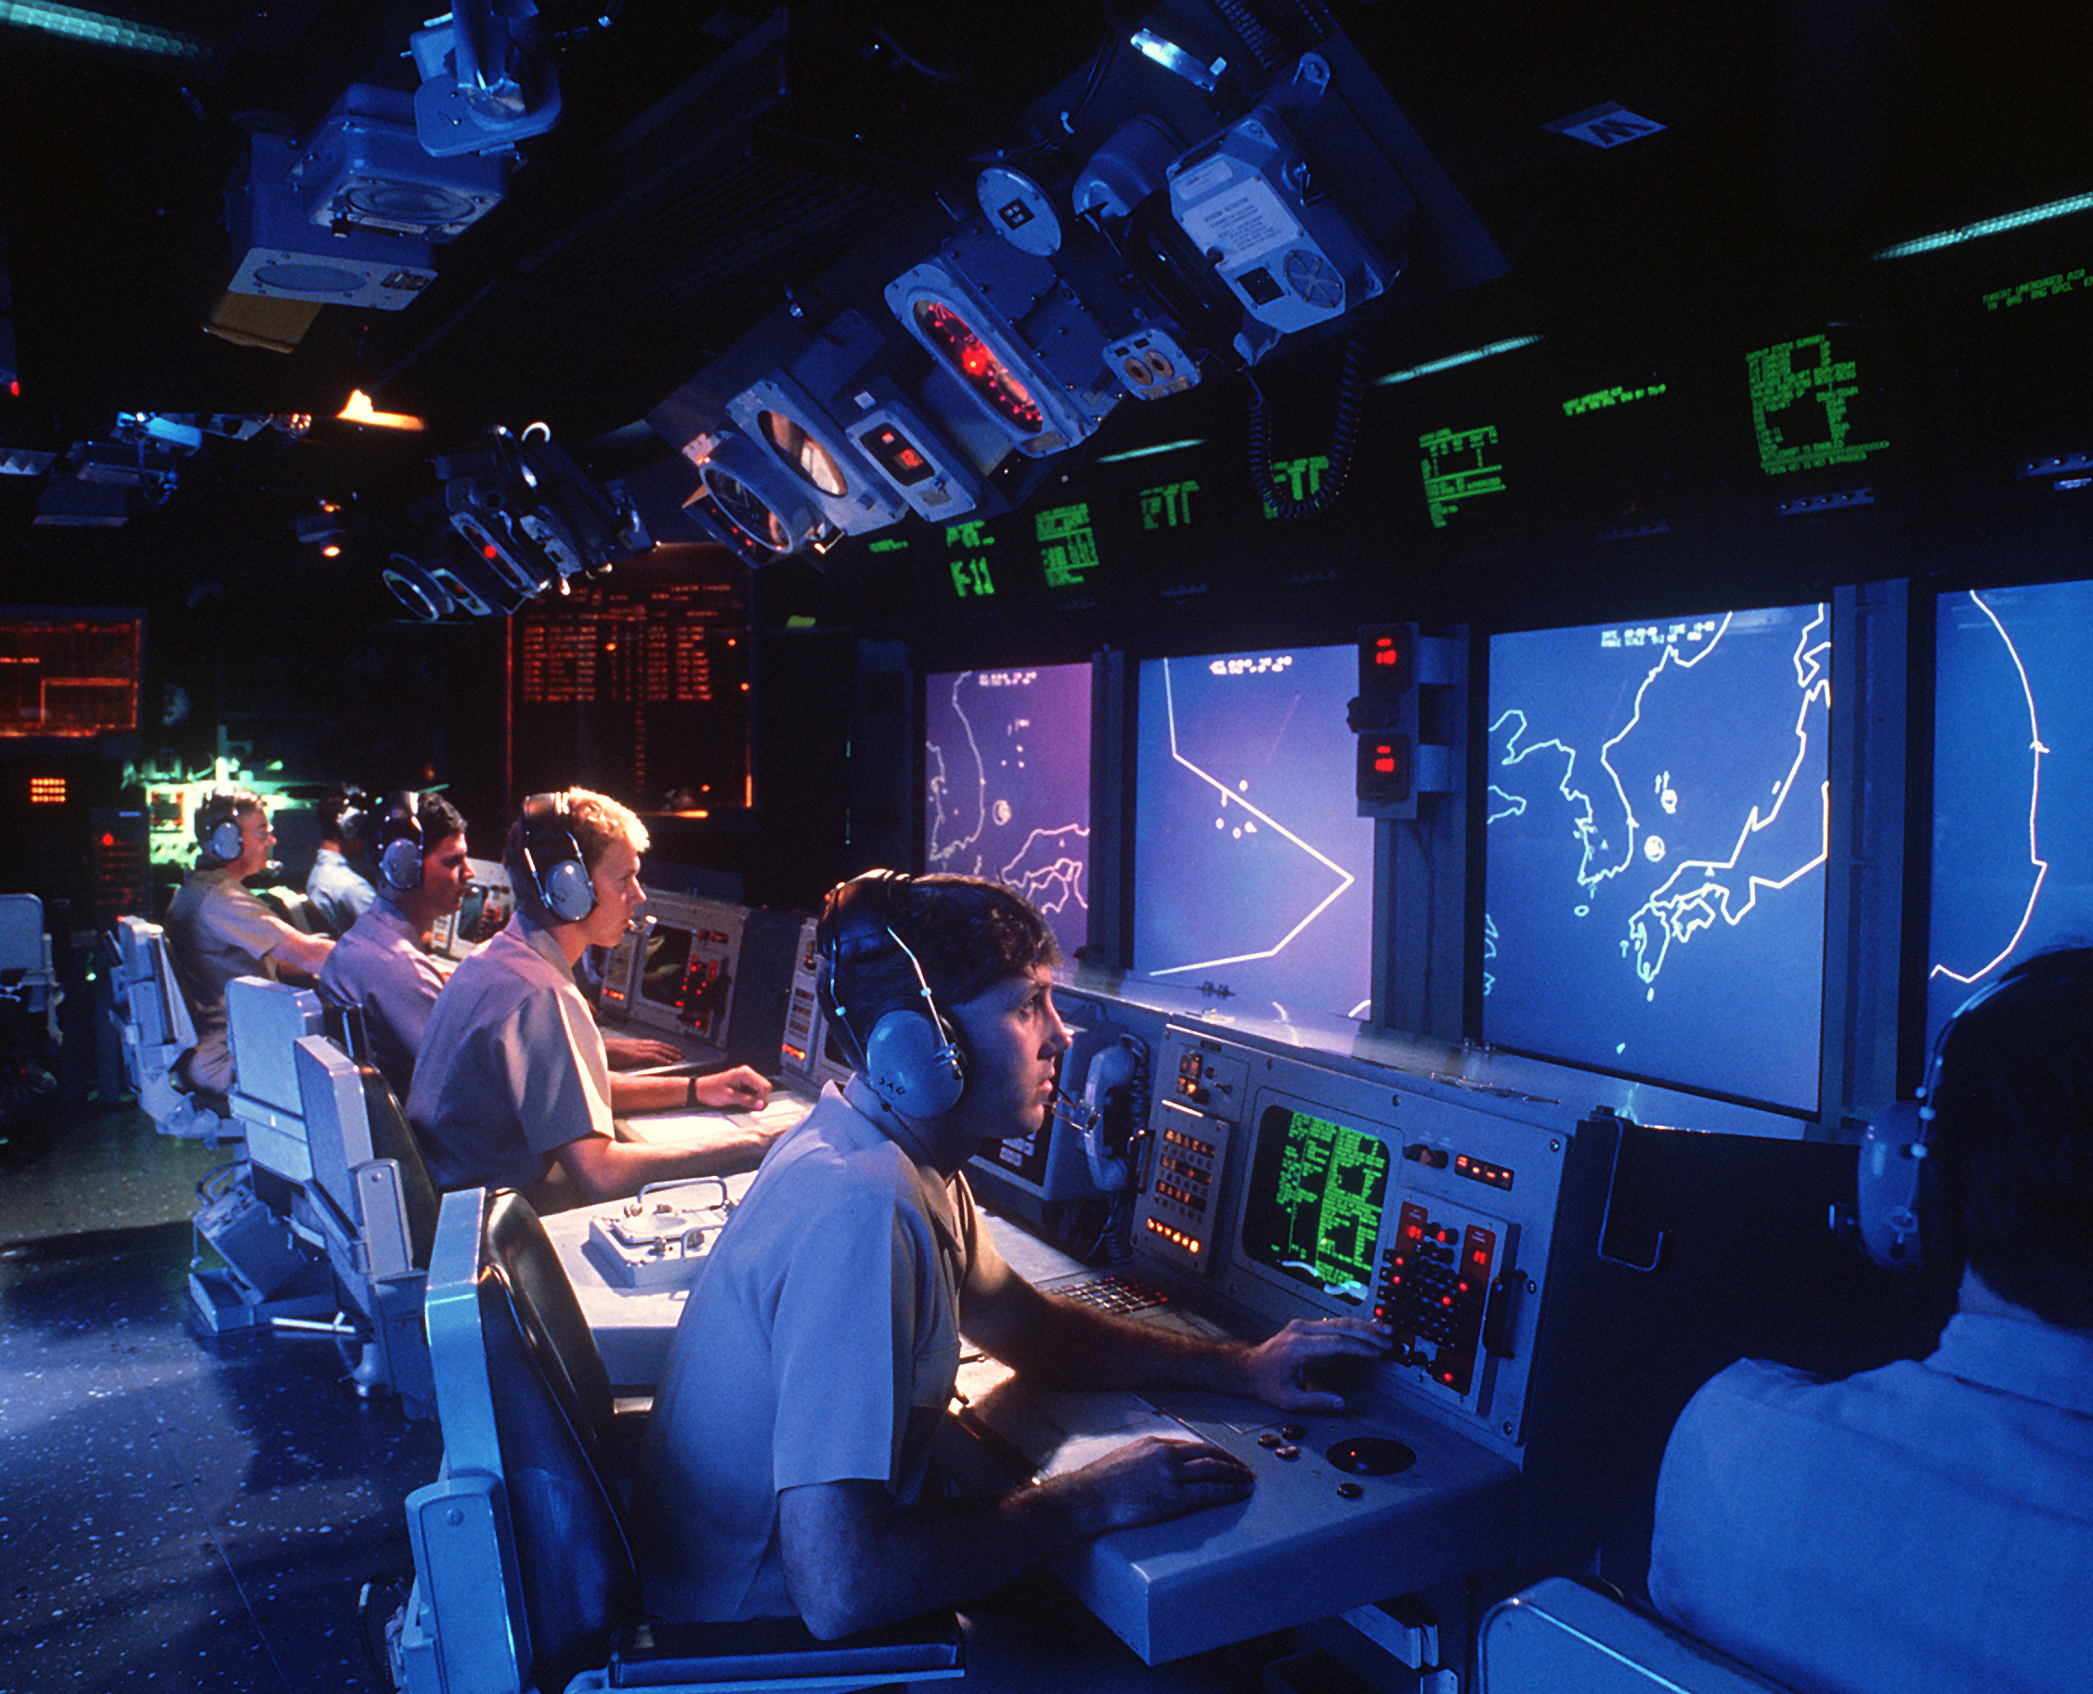
Human Computer Interaction
Why are we here?
It may seem trite, but user interfaces matter: For efficiency, for convenience, for accuracy, for success, even for life and death
The Vincennes, and Aegis RADAR system

Slide 3
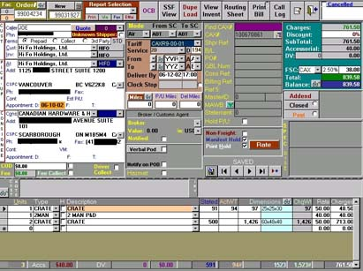
Human Computer Interaction
Why are we here?
It may seem trite, but user interfaces matter: For efficiency, for convenience, for accuracy, for success, even for life and death
The Vincennes, and Aegis RADAR system
People time is more expensive than computer time (normally)
Everyone has a story of a bad interface, and the trouble it caused
A well-designed interface makes for a good system, and a happy (and efficient) user
(This is a bad interface)

Slide 4
Human Computer Interaction
Sub-discipline of the multi-discipline Human Factors and Ergonomics
Psychology (many types)
Design
Engineering
Social sciences
Both deal with the design of everyday (and not-so-everyday) things
Involve questions such as, but not limited to:
Is it easy to use?
Is it easy to understand?
Is it easy to discover?
Is it comfortable to use?
Is it sensible to use?

Slide 8
Human Computer Interaction

Slide 9
Human Computer Interaction
Each word is important
In order to understand the discipline, we must understand:
The Human
The Computer
The Interaction
These three components come together (interact!) to form what will hopefully be the User experience
None of these components can be left out, or ignored, they are all required for the development of a successful interface
A well-developed and designed interface is of singular importance, because it is the sole gateway to any system

Slide 10
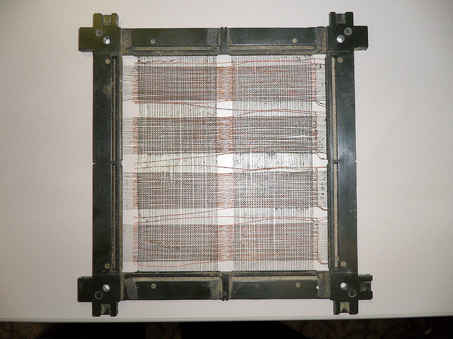
Human Computer Interaction
For many years, this was not a consideration
In other words, what it was, was nothing
Very early on, machines had to be hardwired

Slide 11
Human Computer Interaction
For many years, this was not a consideration
In other words, what it was, was nothing
Very early on, machines had to be hardwired
Later, commands were entered one line at a time
Attempts were made to make this easier, but that was difficult due to technological limitations
Some intuitiveness was included, but not much
Still early, and in large part still the domain of hobbyists and scientists
Cryptic, undecipherable code
“The Software Crisis”
Can have long-lasting impacts, as seen in the Y2K problem

Slide 12
Human Computer Interaction

Slide 13
Human Computer Interaction

Slide 14
Human Computer Interaction

Slide 15
Human Computer Interaction

Slide 16
Human Computer Interaction

Slide 17
Human Computer Interaction
However, this time period also saw expansion of the field of ergonomics, HCI, and the disciplines involved
Originally used primarily for word processors and spreadsheets
Still very cumbersome to use
Often required many-key combinations to perform tasks
Keyboard overlays were standard
This was all a result of, but also evolution of, the interface
A slow movement away from technical manuals, and towards user manuals, was also budding

Slide 18
Human Computer Interaction

Slide 19
Human Computer Interaction

Slide 20
Human Computer Interaction

Slide 21
Human Computer Interaction

Slide 22
Human Computer Interaction

Slide 23
Human Computer Interaction
However, this time period also saw expansion of the field of ergonomics, HCI, and the disciplines involved
A slow movement away from technical manuals, and towards user manuals, was also budding

Slide 24
Human Computer Interaction

Slide 25
Human Computer Interaction

Slide 26
Human Computer Interaction

Slide 27
Human Computer Interaction
However, this time period also saw expansion of the field of ergonomics, HCI, and the disciplines involved
A slow movement away from technical manuals, and towards user manuals, was also budding
Most importantly, system and software design and development began to focus on the experience, as opposed to just the hardware and software
Usability
Maintenance / Support
Graphical interface
All of which end at the user
Understanding them
Listening to them
Designing for them

Slide 28
Human Computer Interaction
Usability is really the ultimate focus, the ultimate goal
But what does it mean?
The term is a nebulous, living thing
Frequently changing
Frequently expanding
Frequently being added to
Usability doesn’t mean simply ‘able to be used.’
Distinction between UI/UX
HCI’s multidisciplinary nature can lead to complexities in approach and definition
HCI (Human Factors, really) is also one of the most co-opted and diluted disciplines there is
However that also gives it its strength

Slide 29
Human Computer Interaction

Slide 30
Human Computer Interaction

Slide 31
Human Computer Interaction

Slide 32
Human Computer Interaction

Slide 33
Human Computer Interaction

Slide 34
Human Computer Interaction

Slide 35
Human Computer Interaction

Slide 36
Human Computer Interaction

Slide 37
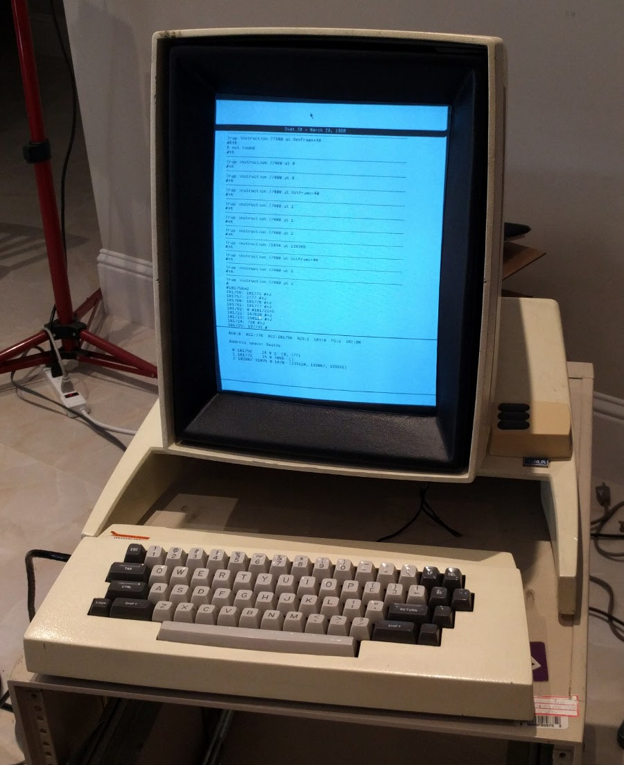
Human Computer Interaction
Eventually, there was a sea change
Xerox Star
Apple Macintosh
Microsoft Windows

Slide 38
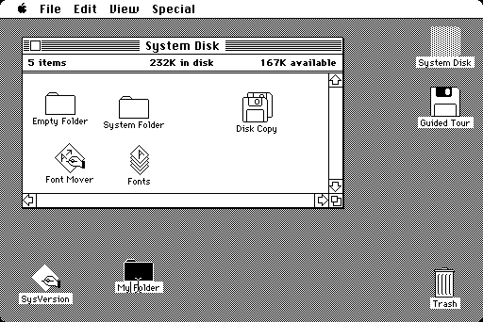
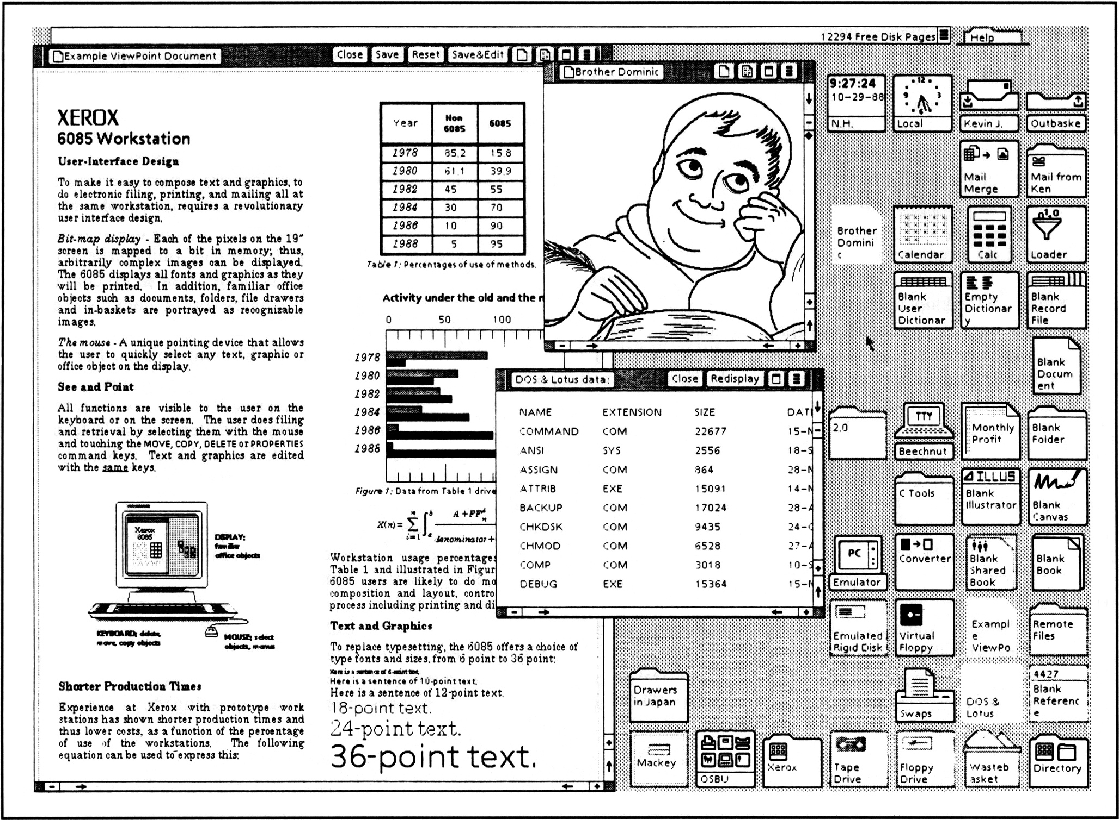
Human Computer Interaction

Slide 39
Human Computer Interaction
Provided brand new methods of interaction
WIMP
New interaction types
Instructing
Conversing
Manipulating
Exploring
This led to an explosion in HCI, in all areas
New interaction methods
New conceptual models
Metaphors
Affordances
Increased accessibility, and also increased accessibility
This also led to a host of new problems

Slide 40
Human Computer Interaction

Slide 41
Human Computer Interaction
Standards and guidelines have been developed and incorporated into interface design for decades
However, two researchers have contributes sets of rules that have been tested, verified, and incorporated more than any other
Jakob Neilsen
10 Usability Heuristics for Interface Design
Ben Schneiderman
The Eight Golden Rules of Interface Design
Each of these are considered canon in the design field
But first, Dieter Rams

Slide 42
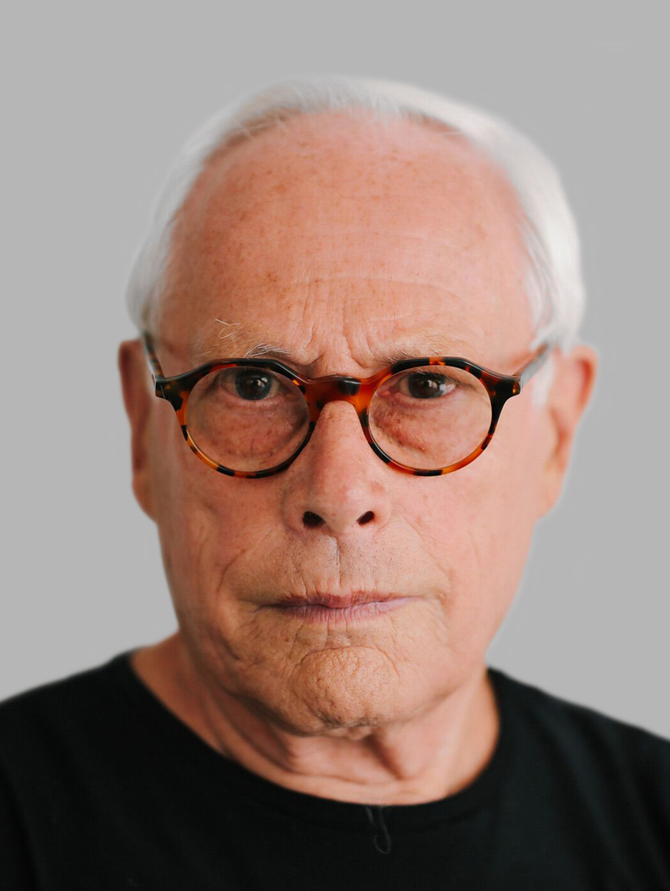
Human Computer Interaction
Dieter Rams
Trained as an architect
Believes that:
Form follows function
People inform the form and function
Good design necessarily comes from teams
Everything has purpose
Also believes in the Ulm School approach to design
Post Bauhaus
Made his design mark at Braun
Developed the “Ten Principles for Good Design”

Slide 43
Human Computer Interaction
Dieter Rams – Ten Principles of Good Design
Good Design is Innovative
Good Design Makes a Product Useful
Good Design is Aesthetic
Good Design Makes a Product Understandable
Good Design is Unobtrusive
Good Design is Honest
Good Design is Long-Lasting
Good Design is Thorough
Good Design is Environmentally Friendly
Good Design is as Little Design as Possible

Slide 44
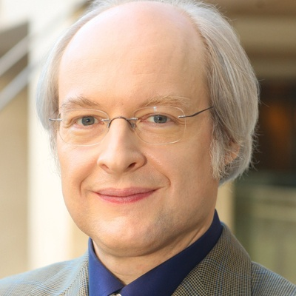
Human Computer Interaction
Jakob Neilsen
Ph. D. in Human-Computer Interaction from the Technical University of Denmark
Founder of the Neilsen-Norman Group, a global usability consultancy
Author of numerous books and publications on usability
Repeatedly referred to as a usability guru, and was once even called the usability Pope!
Developed the “10 Usability Heuristics for User Interface Design”

Slide 45
Human Computer Interaction

Slide 46
Human Computer Interaction
The 10 Usability Heuristics for User Interface Design
Visibility of system status
Match between system and the real world
User control and freedom
Consistency and standards
Error prevention
Recognition rather than recall
Flexibility and efficiency of use
Aesthetic and minimalist design
Help users recognize, diagnose, and recover from errors
Help and documentation

Slide 47
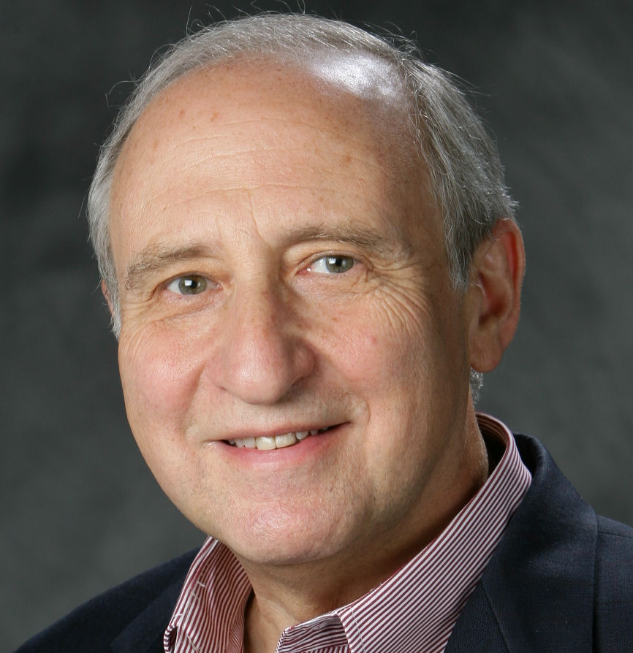
Human Computer Interaction
Ben Schneiderman
Professor at the University of Maryland Institute for Advanced Computer Studies
Founder of U of M’s Human-Computer Interaction Lab
Recognized as one of the leading global authorities on interface design
Author of numerous books and publications on usability
Developed the concept of “treemapping,” which displays hierarchical data as groupings
Developed the “Eight Golden Rules of Interface Design”

Slide 48
Human Computer Interaction
The Eight Golden Rules of Interface Design
Strive for consistency
Cater to universal usability
Offer informative feedback
Design dialogs to yield closure
Prevent errors
Permit easy reversal of actions
Support an internal locus of control
Reduce short term memory load

Slide 49
Human Computer Interaction
Usability goals
Effectiveness
Efficiency
Safety
Utility
Learnability
Memorability
User experience goals
Desirable aspects
Undesirable aspects

Slide 50
Human Computer Interaction
Eventually, there was movement beyond the PC
How do we address the nearly infinite amount of objects we can store?
Internet (Command to graphical, Lynx to browsers)
Communication / Collaboration
LOL U WOT M8
Evolution and place of the computing environment
Background devices
Used by everyone (and why?)
Significant functionality in individual devices
Embedded systems
With this evolution, the discipline evolves as well

Slide 51
Human Computer Interaction

Slide 52
Human Computer Interaction
Invention to Maturity

Slide 53
Human Computer Interaction
With the increase in user-generated content, and the evolution of ‘Web 2.0,’ there has become a drastic increase in the need to access, manage, display, and manipulate the vast amounts of data available to us
Russell Ackoff addressed the handling of computer-generated information back in 1967
Five assumptions
Decision makers lack relevant information
Decision makers need information they want
Needed information leads to better decisions
Better communication among decision makers leads to better decisions
How the IS works is less important than how to use it

Slide 54
Human Computer Interaction
With the increase in user-generated content, and the evolution of ‘Web 2.0,’ there has become a drastic increase in the need to access, manage, display, and manipulate the vast amounts of data available to us
Ackoff addressed the handling of computer-generated information back in 1967
How did we do it before?
File cabinets
Ledgers
Index cards / card catalog
Operating computers was a specialized affair
Programmers
Keypunchers
Computer operator

Slide 55
Human Computer Interaction
1970s
User manuals
Testing labs
Prototypes
Goal-oriented design
1980s
Research began on VDTs
General design guidelines were first published
ANSI standards were first developed

Slide 56
Human Computer Interaction
With the increase in user-generated content, and the evolution of ‘Web 2.0,’ there has become a drastic increase in the need to access, manage, display, and manipulate the vast amounts of data available to us
As storage capacity increased, data increased, and our ability to use that data increased
Punch cards

Slide 57
Human Computer Interaction

Slide 58
Human Computer Interaction
With the increase in user-generated content, and the evolution of ‘Web 2.0,’ there has become a drastic increase in the need to access, manage, display, and manipulate the vast amounts of data available to us
As storage capacity increased, data increased, and our ability to use that data increased
Punch cards
Magnetic media

Slide 59
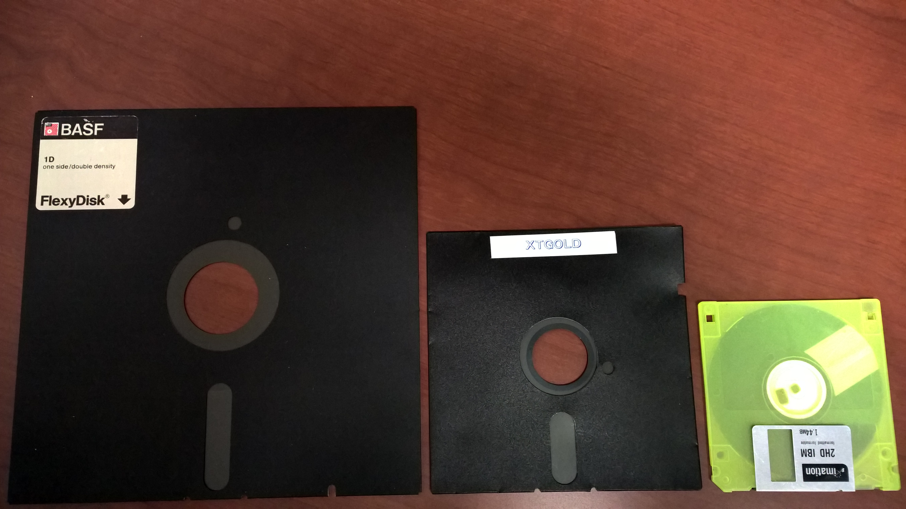
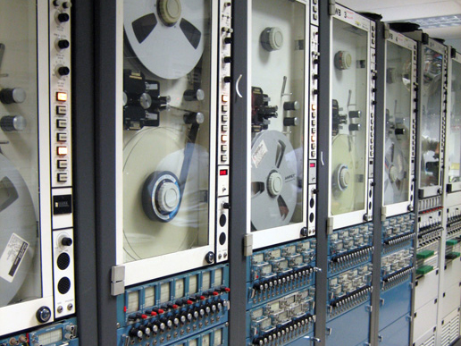
Human Computer Interaction

Slide 60
Human Computer Interaction
With the increase in user-generated content, and the evolution of ‘Web 2.0,’ there has become a drastic increase in the need to access, manage, display, and manipulate the vast amounts of data available to us
As storage capacity increased, data increased, and our ability to use that data increased
Punch cards
Magnetic media
Optical media

Slide 61
Human Computer Interaction

Slide 62
Human Computer Interaction
With the increase in user-generated content, and the evolution of ‘Web 2.0,’ there has become a drastic increase in the need to access, manage, display, and manipulate the vast amounts of data available to us
As storage capacity increased, data increased, and our ability to use that data increased
Punch cards
Magnetic media
Optical media
Cloud

Slide 63
Human Computer Interaction

Slide 64
Human Computer Interaction

Slide 65
Human Computer Interaction
With the increase in user-generated content, and the evolution of ‘Web 2.0,’ there has become a drastic increase in the need to access, manage, display, and manipulate the vast amounts of data available to us
As storage capacity increased, data increased, and our ability to use that data increased
Punch cards
Magnetic media
Optical media
Cloud
How do we interact with all this information?

Slide 66
Human Computer Interaction
Now, HCI applies to many types of systems, interactions, and experiences
Medical information systems / equipment
Accessibility (Blind, deaf, infirmed, incapacitated)
Gaming
Large information environments (cockpits, power plants)
Social media
Smart TVs
Portable devices
Education
Military
Hard sciences
Business / Manufacturing

Slide 67
Human Computer Interaction
What about the future?
Artificial intelligence
Virtual reality
Ubiquitous systems
Autonomous vehicles (planes too? Maybe boats?)
Cybernetics
How will we interact with these?
How will we design these systems so we *can* interact with them?
Ultimately, who will be in control? Can we maintain control? Do we want to?

