Slide 1
Prototyping
“It’s only a model”

Slide 2
Lifecycles
Structured development approach for many projects
Important to have a beginning, milestones, and an end
Without a structured approach, will suffer many types of project management issues:
Creep
Time
Cost
Scope
Feature

Slide 3
Waterfall Model

Slide 4
Spiral Model

Slide 5
Structured SDLC
Planning
Analysis
Design
Implementation
Maint. / Support

Slide 6
The Prototype
Agile modeling is built almost completely around developing models based on requirements
Users are heavily involved in the beginning
Prototypes are developed rapidly
Feedback is solicited
Revisions are made
Feedback is taken again

Slide 7
The Prototype
A model
Serves as a conceptualization to test ideas before full development
Very effective at soliciting user feedback at the early stages (more so in Agile development)
Feedback can be gathered formally
Comparative testing
Split testing
Test multiple, but limited, variants if possible
Can simply be observational
Doesn’t require words or full sentences
Changes to prototypes are (usually) inexpensive and rapid, changes to final product or late-stage schedule are very expensive
Test multiple designs if possible

Slide 8
Types of physical prototypes
Non-operational
Patched-up
Selected features
First-of-a-series
None of these are mutually exclusive
There can even be overlap

Slide 9
Types of physical prototypes

Slide 10
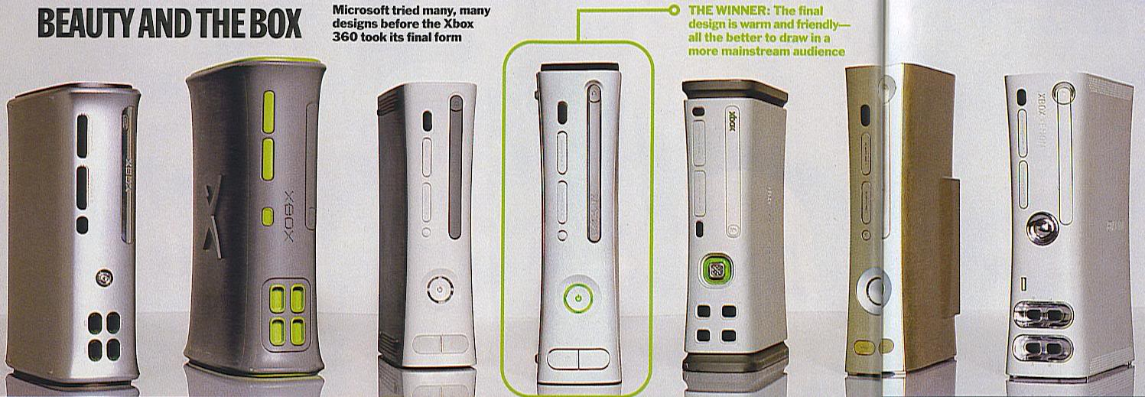
Types of physical prototypes

Slide 11
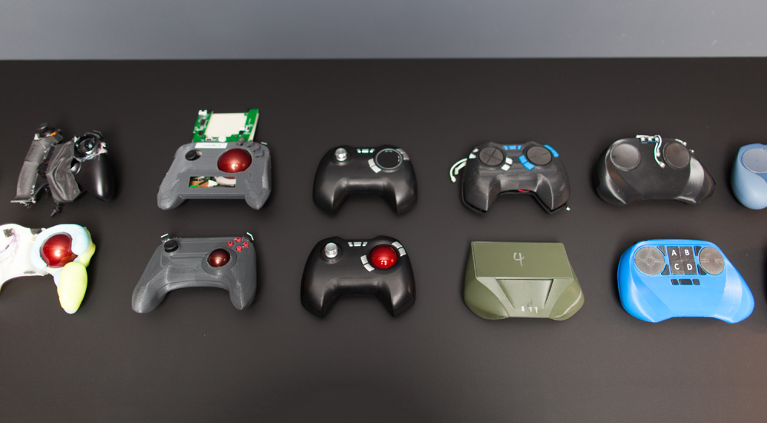
Types of physical prototypes

Slide 12
Types of physical prototypes

Slide 13
Types of physical prototypes

Slide 14
Types of interface prototypes
Low fidelity
Does not have to represent final form
Even a use-case can be a prototype
Can include paper – even napkin – sketches, index cards, Storyboards, Post-It notes
Many of those overlap
Doesn’t normally require specialized tools
Consult personas, scenarios, and existing examples for assistance / inspiration
Examples:

Slide 15
Types of interface prototypes

Slide 16
Types of interface prototypes

Slide 17
Types of interface prototypes

Slide 18
Types of interface prototypes

Slide 19
Types of interface prototypes

Slide 20
Types of interface prototypes

Slide 21
Types of interface prototypes

Slide 22
Types of interface prototypes
High(er) fidelity
Dreamweaver, visual design tools
Wireframing
Mockups
Functional prototypes

Slide 23
Types of interface prototypes

Slide 24
Types of interface prototypes

Slide 25
Types of interface prototypes

Slide 26
Screen flow / Hierarchy / Nav. Map / GTN

Slide 27
Screen flow / Hierarchy / Nav. Map / GTN

Slide 28
Screen flow / Hierarchy / Nav. Map / GTN

Slide 30
Types of interface prototypes
Horizontal
Vertical
These refer primarily to larger websites, but can include any complex system

Slide 31
But be careful
Prototypes are not the final ‘thing’
Don’t let them be
Don’t allow them to serve as a vehicle for rushing the project
If that happens, blame will fall on the designer
Especially with certain types of systems design
They are meant to be Iterated / Redesigned / Improved Upon / Scrapped

