Slide 1
Human-Computer Interaction
Requirements gathering

Slide 2
Requirements gathering
What needs to be achieved?
Understand about users, task and context
Produce a stable, valid requirements set
How can this be done?
Data gathering activities
Data analysis activities
Expression as requirements
This process, like all development, is iterative

Slide 3
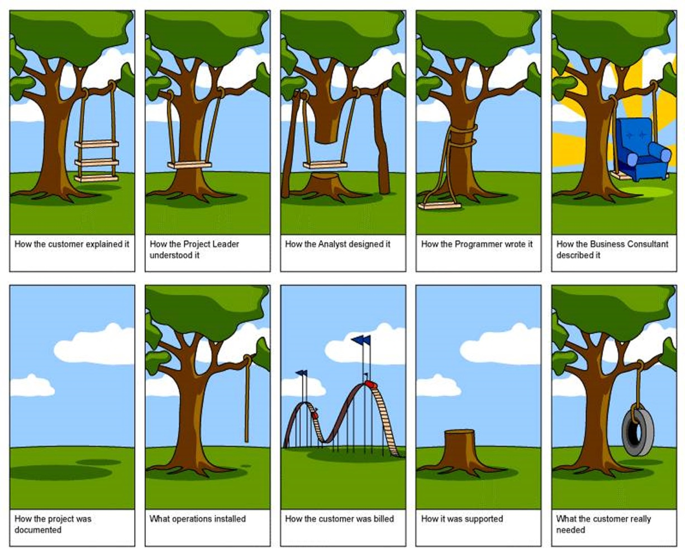
Requirements gathering
Who cares?
The problem is, this is the stage where failure most commonly occurs
It is absolutely mandatory requirements determination is done properly
The cost of fixing errors here later on is significant

Slide 4
Establishing requirements
What do users want? What do they need? It’s important to:
Iterate
Clarify
Verify
Refine
Rescope
We need to establish requirements because they are derived from users’ needs
They can be tied back to various types of data

Slide 6
Different types of requirements
Functional
What the system should do
Non-functional
Security
Response time
Theme
Etc.
Data
What type of data will be stored
How will that data be stored
In what format will that data be stored
Who will have access to that data

Slide 7
Different types of user
Users: Who are they?
Characteristics
Nationality
Educational background
Technology position
Familiarity with technology
Novice: Prompted, guided, constrained, hand-held, clear
Expert: Flexibility, access, control
Frequent: Short cuts
Casual / infrequent: Clear paths ahead and back

Slide 8
Personas
Capture a set of user characteristics (a profile)
Not real people, but an amalgamation of real users
Should not be idealized, should be realized
Be detailed, make them real: Name, characteristics, background, goals, interests, etc.
Develop a small set of personas (perhaps two to represent each user group, have one be the primary user)

Slide 9
Personas

Slide 10
Personas

Slide 16
Scenarios
Informal narrative description
A story
Allows for exploration and discussion
Doesn’t necessarily describe use of technology
Uses the language of the user, as opposed to the designer / developer
User tells you
Often the first investigatory step in requirements gathering
Very natural human activity
Rich detail
Often goal oriented
Allows designer / developer to identify additional stakeholders and participants
Can be used to describe future use cases

Slide 17
“Say I want to find a movie directed by Martin Scorsese. I don’t remember the title but I know it came out in the theater around ‘06 or ‘07. I go to the website and choose the director option. A huge list of directors is displayed – I had no idea there were so many directors whose last names begin with S! After scrolling through the list, I find Martin Scorsese and choose to see further details about him. Another long list of movies eventually leads me to the movie I was looking for; The Departed. As an existing subscriber, I need to log into be able to rent the movie. Once my login has been confirmed, I can choose the rental period and payment method. I have my preferences already registered in the system, so I just choose the defaults and download my movie.”
- Adapted from Preece, Rogers, Sharp “Interaction Design,” 2015

Slide 18
“The Thomson family enjoy outdoor activities and want to try their hand at sailing this year. There are four family members: Sky (10 years old), Martin (15 years old), Claire (35), and Will (40). One evening after dinner they decide to start exploring the possibilities. They all gather around the travel organizer and enter their initial set of requirements – a sailing trip for four novices in the Mediterranean. The console is designed so that all members of the family can interact easily and comfortably with it. The system’s initial suggestion is a flotilla, where several crews (with various levels of experience) sail together on separate boats. Sky and Martin aren't very happy at the idea of going on vacation with a group of other people, even though the Thomsons would have their own boat. The travel organizer shows them descriptions of flotillas from other children their ages and they are all very positive, so eventually, everyone agrees to explore flotilla opportunities. Will confirms this recommendation and asks for detailed options. As it’s getting late, he asks for the details to be saved so everyone can consider them tomorrow. The travel organizer emails them a summary of the different options available.”
- Adapted from Preece, Rogers, Sharp “Interaction Design,” 2015

Slide 22
Data gathering
Interviews
Sample scenarios and prototypes can be used
Good for exploring issues
Development team members can connect with stakeholders
Gives those affected a sense of ownership and involvement
That leads to vested interest in the success of the system
Question types
Open-ended
Closed

Slide 23
Data gathering
Interview Question types
Open-ended
Closed
Binary
Concerns / Biases
Interview Structures
Pyramid
Funnel

Slide 24
Data gathering
Setting up
Time (and time requirement)
Place
Recording the interview
Notes
Audio recording
Video recording

Slide 25
Data gathering
Questionnaires / surveys
Often used in conjunction with other techniques
Can give qualitative or quantitative data
Good for getting general ideas, reaching a group of dispersed people
Question types
Open-ended
Closed
Likert (ratios, balance, biases, neutral responses)
Statistical Measurement Scales

Slide 26
Data gathering
Questionnaires / surveys
Often used in conjunction with other techniques
Can give qualitative or quantitative data
Good for getting general ideas, reaching a group of dispersed people
Question types
Open-ended
Closed
Likert
Bad questions / Bad responses
Statistical Measurement Scales

Slide 27
Data gathering
"Should the plan of agreement be accepted, which was submitted by the European Commission, the European Central Bank, and the International Monetary Fund in the Eurogroup of 25.06.2015 and comprises of two parts, which constitute their unified proposal? The first document is entitled "Reforms For the Completion Of The Current Programme And Beyond" and the second "Preliminary Debt Sustainability Analysis".
NOT ACCEPTED / NO
ACCEPTED / YES

Slide 28
Data gathering
Questionnaires / surveys
Often used in conjunction with other techniques
Can give qualitative or quantitative data
Good for getting general ideas, reaching a group of dispersed people
Question types
Open-ended
Closed
Likert
Bad questions / Bad responses
Statistical Measurement Scales

Slide 29
Data gathering
Researching similar products
Novel or standard domain / application?
If novel, data gathering is more important
If done before, note similarities / differences / evolution
Direct observation
Gain insight into specific tasks
Can get significant information from body language / verbal and non-verbal cues
Requires dedicated notetaking
Time-consuming

Slide 30
Data gathering
Evaluating documentation and manuals
Repository of all related knowledge about system
Procedures and rules are well-documented
Steps involved are delineated
Regulations, if any, are also presented
Can be used as a sole requirements-gathering source
Can be done without requiring involvement from users / stakeholders, which is a limitation of the other techniques

Slide 31
Contextual inquiry
Ethnographic observation
User is expert
Designer is novice
An interview, however
At workstation
2 – 3 hours long
Four main drivers (be aware of sampling!)
Context (see workplace and what happens – verify)
Partnership (User and designer are collaborators)
Interpretation (User and designer evaluate results as a team)
Focus (Be aware of what you are trying to discover or learn)

Slide 32
Concerns of Data Gathering
Identifying stakeholders
Who are they
Involving stakeholders
Through data gathering
Make them part of the team
Users v. managers and others
Their needs are often very different
Dominance of certain stakeholders
May need to be leveled
Domain info difficult to acquire, articulate, or very new

Slide 33
Concerns of Data Gathering (continued)
Political issues within organization
Communication
Effectiveness
Willingness
Capability
Business environment changes
Balancing functional demands with usability demands

Slide 34
Concerns of Data Gathering (continued)
Communication between parties
Within development team
With / between users
Between users and developers
Domain knowledge
Implicit
Explicit
Availability and commitment of key people
Especially managers / executives

Slide 35
Data gathering guidelines
Focus on determining stakeholder needs
Involve all the stakeholder groups
Involve more than one representative from each group
Use a combination of data gathering techniques
Support the process with props, prototypes, task descriptions, etc.

Slide 36
Data interpretation and analysis
Don’t wait, start soon after data gathering
Do a cursory interpretation and analysis
Doesn’t need to be in-depth
Doesn’t need to be a formal process
Indicate some general, initial thoughts and impressions
Sometimes will need to diagram underlying system to determine / clarify user involvement
Class diagrams
Entity Relation diagrams
Data flow diagrams

Slide 37
Use cases
Focused on:
User-system interaction
Still user perspective (In use cases referred to as “actors”)
Goal-oriented
Normal course
Alternative course

Slide 38
Use case (Normal course)
1. The system displays options for investigating visa and vaccination requirements.
2. The user chooses the option to find out about visa requirements.
3. The system prompts user for the name of the destination country.
4. The user enters the country’s name.
5. The system checks that the country is valid.
6. The system prompts the user for her nationality.
7. The user enters her nationality.
8. The system checks the visa requirements of the entered country for a passport holder of her nationality.
9. The system displays the visa requirements.
10. The system displays the option to print out the visa requirements.
11. The user chooses to print the requirements.

Slide 39
Use case (Alternative courses)
6. If the country name is invalid:
6.1 The system displays an error message.
6.2 The system returns to step 3.
8. If the nationality is invalid:
8.1 The system displays an error message.
8.2 The system returns to step 6.
9. If no information about visa requirements is found:
9.1 The system displays a suitable message.
9.2 The system returns to step 1.

Slide 40
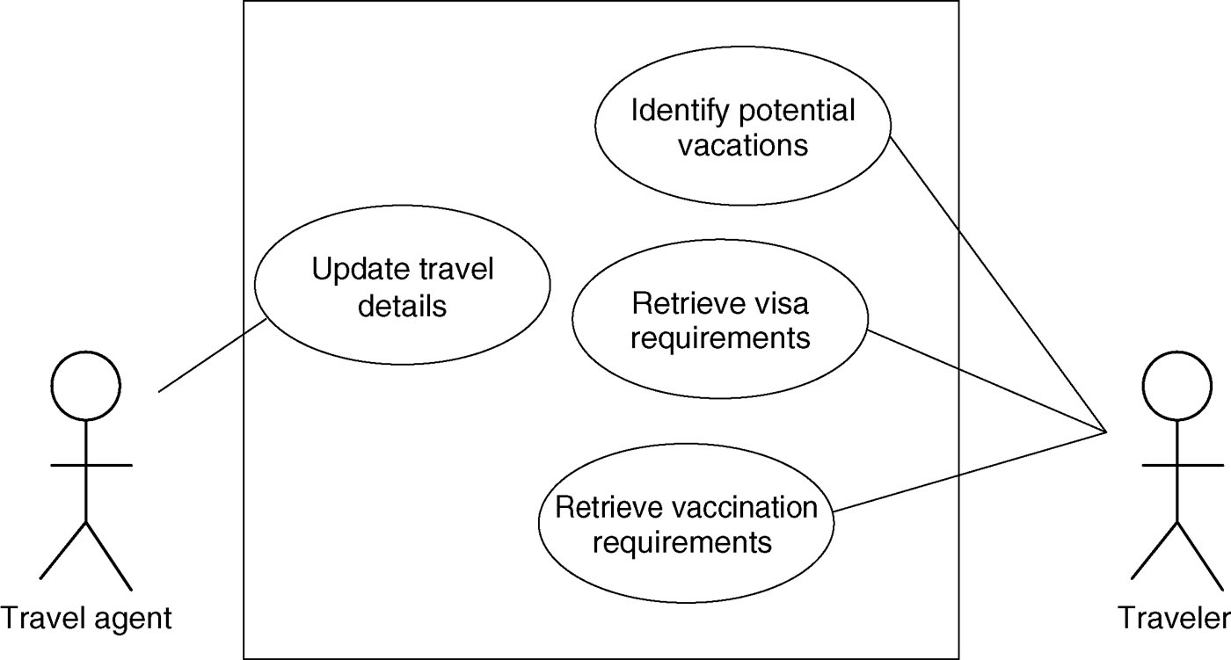
Use case diagram

Slide 41
Essential use cases
Constantine and Lockwood, 1999
Based on limitations of scenarios and use cases
Broad, avoids generalities of a scenario and assumptions of a use case
Three parts:
Name expressing user intention
Sequence of user actions
Sequence of system responsibilities
This divides user from the system, while maintaining relationship
Helps with task allocation and system scope: Which component does what?

Slide 42
Essential use cases
retrieveVisa
USER INTENTION | SYSTEM RESPONSIBILITY
find visa requirements | request destination and nationality
supply required information | obtain appropriate visa information
obtain personal copy of visa information | offer information in different formats
choose suitable format | provide information in chosen format

Slide 43
Task Analysis
Task descriptions are often used to envision new systems or devices
Task analysis is used mainly to investigate an existing situation
It is important not to focus on superficial activities
What are people trying to achieve?
Why are they trying to achieve it?
How are they going about it?
Many approaches, the most popular being Hierarchical Task Analysis (HTA)

Slide 44
Task Analysis (Example)
0. To buy a DVD
1. Locate DVD
2. Add DVD to shopping basket
3. Enter payment details
4. Complete address
5. Confirm order
plan 0: If regular user, do: 1-2-5. If new user, do: 1-2-3-4-5.

Slide 45
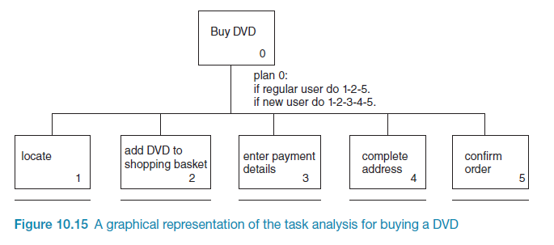
Hierarchical Task Analysis (Example)

Slide 46
Hierarchical Task Analysis (Example)
Getting requirements right, and early on, is crucial
There are different kinds of requirement, each is significant for interaction design
The most commonly-used techniques for data gathering are: questionnaires, interviews, focus groups, direct observation, studying documentation and researching similar products
Scenarios, use cases and essential use cases can be used to articulate existing and envisioned work practices
Task analysis techniques such as HTA help to investigate existing systems and practices

Slide 47
Requirements gathering
Understand your users
1
Know what your users want / need
2
Understand and ideate on how they can achieve those goals
3
Use that as a framework for your design
4
Be aware of pitfalls
5

