Slide 1
Human-Computer Interaction
The Human

Slide 2
Human-Computer Interaction
The human
Once again, note the ‘H’ in HCI
HCI is anchored on the human
All activities have an end goal of human use
The user (human) should be involved throughout the process
Because of this, it is important to know how people vary, cognate, and what they expect
How do we process, select, categorize, interpret, etc.?

Slide 3
Human-Computer Interaction
The human
Humans vary in many dimensions
Physical
Size, shape, height, weight, glasses, infirmities
Culture / Experience / Motivation
Motor / cognitive ability may determine appropriate input / output devices
Sight
Hearing
Physical limitation or injury
e.g.: Designing an ATM

Slide 4
Accessible interfaces

Slide 5
Uh oh

Slide 6
Human-Computer Interaction
The human
Ultimately, humans are flawed, imperfect, limited
We don’t like to admit that
We need accommodations made constantly because of this
Even then it can be too much

Slide 7
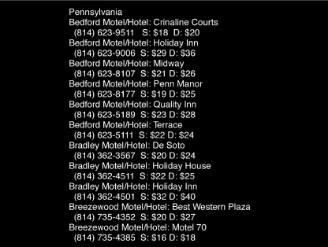
Human-Computer Interaction
The human

Slide 8
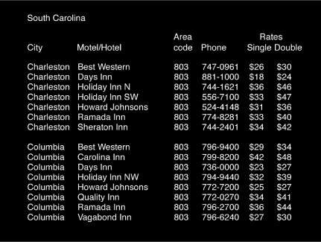
Human-Computer Interaction
The human

Slide 9
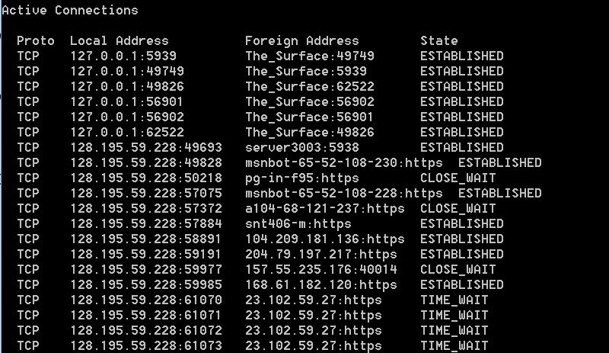
Human-Computer Interaction
The human

Slide 10
Active Connections
Proto Local Address Foreign Address StateTCP 127.0.0.1:5939 The_Surface:49749 ESTABLISHEDTCP 127.0.0.1:49749 The_Surface:5939 ESTABLISHEDTCP 127.0.0.1:49826 The_Surface:62522 ESTABLISHEDTCP 127.0.0.1:56901 The_Surface:56902 ESTABLISHEDTCP 127.0.0.1:56902 The_Surface:56901 ESTABLISHEDTCP 127.0.0.1:62522 The_Surface:49826 ESTABLISHEDTCP 128.195.59.228:49693 server3003:5938 ESTABLISHEDTCP 128.195.59.228:49828 msnbot-65-52-108-230:https ESTABLISHEDTCP 128.195.59.228:50218 pg-in-f95:https CLOSE_WAITTCP 128.195.59.228:57075 msnbot-65-52-108-228:https ESTABLISHEDTCP 128.195.59.228:57372 a104-68-121-237:https CLOSE_WAITTCP 128.195.59.228:57884 snt406-m:https ESTABLISHEDTCP 128.195.59.228:58891 104.209.181.136:https ESTABLISHEDTCP 128.195.59.228:59191 204.79.197.217:https ESTABLISHED TCP 128.195.59.228:59977 157.55.235.176:40014 CLOSE_WAI TCP 128.195.59.228:59985 168.61.182.120:https ESTABLISHED TCP 128.195.59.228:61138 a104-70-192-176:http TIME_WAITTCP 128.195.59.228:61142 64.4.54.254:https TIME_WAITTCP 128.195.59.228:61143 40.83.182.229:https TIME_WAIT TCP 128.195.59.228:61145 40.84.192.103:https TIME_WAIT TCP 128.195.59.228:61149 23.101.200.117:https TIME_WAITTCP 128.195.59.228:61150 23.101.200.117:https TIME_WAIT TCP 128.195.59.228:61151 23.97.61.137:https ESTABLISHED TCP 128.195.59.228:61152 104.45.215.238:http TIME_WAITTCP 128.195.59.228:61154 a204-102-114-42:http TIME_WAITTCP 128.195.59.228:61155 a204-102-114-42:http TIME_WAITTCP 128.195.59.228:61156 a204-102-114-42:http TIME_WAIT TCP 128.195.59.228:61157 a204-102-114-42:http TIME_WAITTCP 128.195.59.228:61158 a204-102-114-42:http TIME_WAITTCP 128.195.59.228:61159 a204-102-114-42:http TIME_WAITTCP 128.195.59.228:61160 a204-102-114-42:http TIME_WAIT TCP 128.195.59.228:61161 a204-102-114-42:http TIME_WAITTCP 128.195.59.228:61164 4.28.136.42:http TIME_WAITTCP 128.195.59.228:61191 40.113.8.255:https ESTABLISHED TCP 128.195.59.228:61192 40.113.8.255:https ESTABLISHEDTCP 128.195.59.228:61194 4.28.136.42:http TIME_WAITTCP 128.195.59.228:61210 a-0001:https ESTABLISHEDTCP 128.195.59.228:61212 ec2-50-16-207-118:https ESTABLISHEDTCP 128.195.59.228:61213 sea15s01-in-f14:https ESTABLISHEDTCP 128.195.59.228:61215 pg-in-f95:http ESTABLISHEDTCP 128.195.59.228:61216 sea15s02-in-f170:http ESTABLISHEDTCP 128.195.59.228:61217 23.235.47.204:http ESTABLISHEDTCP 128.195.59.228:61219 a184-28-166-180:http TIME_WAITTCP 128.195.59.228:61220 pg-in-f95:http TIME_WAITTCP 128.195.59.228:61221 sea15s02-in-f170:http TIME_WAITTCP 128.195.59.228:61222 23.235.47.204:http ESTABLISHEDTCP 128.195.59.228:61223 192.229.163.25:https ESTABLISHEDTCP 128.195.59.228:61224 192.229.163.25:https ESTABLISHEDTCP 128.195.59.228:61225 ec2-54-88-134-149:https ESTABLISHEDTCP 128.195.59.228:61226 a23-7-139-27:http ESTABLISHEDTCP 128.195.59.228:61227 199.27.79.68:http ESTABLISHEDTCP 128.195.59.228:61228 xx-fbcdn-shv-01-sjc2:https ESTABLISHEDTCP 128.195.59.228:61229 199.27.79.68:http TIME_WAITTCP 128.195.59.228:61230 lax02s21-in-f13:https ESTABLISHEDTCP 128.195.59.228:61233 192.229.163.25:http TIME_WAITTCP 128.195.59.228:61234 lax02s20-in-f3:https ESTABLISHEDTCP 128.195.59.228:61235 xx-fbcdn-shv-01-sjc2:http TIME_WAITTCP 128.195.59.228:61236 lax02s20-in-f1:https ESTABLISHEDTCP 128.195.59.228:61237 lax02s20-in-f3:https ESTABLISHEDTCP 128.195.59.228:61238 a184-28-166-180:http ESTABLISHEDTCP 128.195.59.228:61239 a184-28-166-180:http ESTABLISHEDTCP 128.195.59.228:61240 a184-28-166-180:http ESTABLISHEDTCP 128.195.59.228:61241 a184-28-166-180:http ESTABLISHEDTCP 128.195.59.228:61242 a184-28-166-180:http ESTABLISHEDTCP 128.195.59.228:61243 a184-28-166-180:http ESTABLISHEDTCP [::1]:56385 The_Surface:61176 ESTABLISHEDTCP [::1]:61174 The_Surface:56385 ESTABLISHEDTCP [::1]:61176 The_Surface:56385 ESTABLISHED

Slide 11
Proto Local Address Foreign Address StateTCP 127.0.0.1:5939 The_Surface:49749 ESTABLISHEDTCP 127.0.0.1:49749 The_Surface:5939 ESTABLISHEDTCP 127.0.0.1:49826 The_Surface:62522 ESTABLISHEDTCP 127.0.0.1:56901 The_Surface:56902 ESTABLISHEDTCP 127.0.0.1:56902 The_Surface:56901 ESTABLISHEDTCP 127.0.0.1:62522 The_Surface:49826 ESTABLISHEDTCP 128.195.59.228:49693 server3003:5938 ESTABLISHEDTCP 128.195.59.228:49828 msnbot-65-52-108-230:https ESTABLISHEDTCP 128.195.59.228:50218 pg-in-f95:https CLOSE_WAITTCP 128.195.59.228:57075 msnbot-65-52-108-228:https ESTABLISHEDTCP 128.195.59.228:57372 a104-68-121-237:https CLOSE_WAITTCP 128.195.59.228:57884 snt406-m:https ESTABLISHEDTCP 128.195.59.228:58891 104.209.181.136:https ESTABLISHEDTCP 128.195.59.228:59191 204.79.197.217:https ESTABLISHED TCP 128.195.59.228:59977 157.55.235.176:40014 CLOSE_WAI TCP 128.195.59.228:59985 168.61.182.120:https ESTABLISHED TCP 128.195.59.228:61138 a104-70-192-176:http TIME_WAITTCP 128.195.59.228:61142 64.4.54.254:https TIME_WAITTCP 128.195.59.228:61143 40.83.182.229:https TIME_WAIT TCP 128.195.59.228:61145 40.84.192.103:https TIME_WAIT TCP 128.195.59.228:61149 23.101.200.117:https TIME_WAITTCP 128.195.59.228:61150 23.101.200.117:https TIME_WAIT TCP 128.195.59.228:61151 23.97.61.137:https ESTABLISHED TCP 128.195.59.228:61152 104.45.215.238:http TIME_WAITTCP 128.195.59.228:61154 a204-102-114-42:http TIME_WAITTCP 128.195.59.228:61155 a204-102-114-42:http TIME_WAITTCP 128.195.59.228:61156 a204-102-114-42:http TIME_WAIT TCP 128.195.59.228:61157 a204-102-114-42:http TIME_WAITTCP 128.195.59.228:61158 a204-102-114-42:http TIME_WAITTCP 128.195.59.228:61159 a204-102-114-42:http TIME_WAITTCP 128.195.59.228:61160 a204-102-114-42:http TIME_WAIT TCP 128.195.59.228:61161 a204-102-114-42:http TIME_WAITTCP 128.195.59.228:61164 4.28.136.42:http TIME_WAITTCP 128.195.59.228:61191 40.113.8.255:https ESTABLISHED TCP 128.195.59.228:61192 40.113.8.255:https ESTABLISHEDTCP 128.195.59.228:61194 4.28.136.42:http TIME_WAITTCP 128.195.59.228:61210 a-0001:https ESTABLISHEDTCP 128.195.59.228:61212 ec2-50-16-207-118:https ESTABLISHEDTCP 128.195.59.228:61213 sea15s01-in-f14:https ESTABLISHEDTCP 128.195.59.228:61215 pg-in-f95:http ESTABLISHEDTCP 128.195.59.228:61216 sea15s02-in-f170:http ESTABLISHEDTCP 128.195.59.228:61217 23.235.47.204:http ESTABLISHEDTCP 128.195.59.228:61219 a184-28-166-180:http TIME_WAITTCP 128.195.59.228:61220 pg-in-f95:http TIME_WAITTCP 128.195.59.228:61221 sea15s02-in-f170:http TIME_WAITTCP 128.195.59.228:61222 23.235.47.204:http ESTABLISHEDTCP 128.195.59.228:61223 192.229.163.25:https ESTABLISHEDTCP 128.195.59.228:61224 192.229.163.25:https ESTABLISHEDTCP 128.195.59.228:61225 ec2-54-88-134-149:https ESTABLISHEDTCP 128.195.59.228:61226 a23-7-139-27:http ESTABLISHEDTCP 128.195.59.228:61227 199.27.79.68:http ESTABLISHEDTCP 128.195.59.228:61228 xx-fbcdn-shv-01-sjc2:https ESTABLISHEDTCP 128.195.59.228:61229 199.27.79.68:http TIME_WAITTCP 128.195.59.228:61230 lax02s21-in-f13:https ESTABLISHEDTCP 128.195.59.228:61233 192.229.163.25:http TIME_WAITTCP 128.195.59.228:61234 lax02s20-in-f3:https ESTABLISHEDTCP 128.195.59.228:61235 xx-fbcdn-shv-01-sjc2:http TIME_WAITTCP 128.195.59.228:61236 lax02s20-in-f1:https ESTABLISHEDTCP 128.195.59.228:61237 lax02s20-in-f3:https ESTABLISHEDTCP 128.195.59.228:61238 a184-28-166-180:http ESTABLISHEDTCP 128.195.59.228:61239 a184-28-166-180:http ESTABLISHEDTCP 128.195.59.228:61240 a184-28-166-180:http ESTABLISHEDTCP 128.195.59.228:61241 a184-28-166-180:http ESTABLISHEDTCP 128.195.59.228:61242 a184-28-166-180:http ESTABLISHEDTCP 128.195.59.228:61243 a184-28-166-180:http ESTABLISHEDTCP [::1]:56385 The_Surface:61176 ESTABLISHEDTCP [::1]:61174 The_Surface:56385 ESTABLISHEDTCP [::1]:61176 The_Surface:56385 ESTABLISHED

Slide 12
Human-Computer Interaction
The human
Attention
Perception/recognition
Memory
Learning
Reading, speaking, listening
Problem-solving, planning, reasoning, behaving, making decisions

Slide 13
Human-Computer Interaction
The human
Attention
We can’t attend to everything
We try, especially in overwhelming situations
When we do, we experience our mind working overtime
Our brain will deliberately filter out what it determines to be useless information
We often try to fill in those gaps, which causes a multitude of problems

Slide 15
Human-Computer Interaction
Some Gestalt Principles
Whole picture, perception in context
Use these to reinforce meaning, guide user
Proximity
Similarity
Closure
Continuity
Symmetry

Slide 16
Human-Computer Interaction
Some Gestalt Principles

Slide 17
Human-Computer Interaction
Some Gestalt Principles

Slide 18
Human-Computer Interaction
Some Gestalt Principles

Slide 19
Human-Computer Interaction
Some Gestalt Principles

Slide 20
Human-Computer Interaction
Some Gestalt Principles

Slide 21
Human-Computer Interaction
Memory
Sensory (Pre-attentive)
Short-term
Long-term, requires practice, repetition, familiarity
Can be a form of muscle memory
Capability needs to be present
If capability is present, repetition can be a hurdle
If it’s not, can be fatal

Slide 22
Human-Computer Interaction
Memory
A limitation of the user
Recognition v. Recall
Active v. Passive learning
Implicit v. Explicit knowledge

Slide 23
Human-Computer Interaction
Memory (Continued)
Some stimuli are pre-attentive (pre-cognitive)
Color
Motion (Direction and Velocity)
Size
Shape
Blink
Intensity
Without these, slower serial search is required

Slide 24
Human-Computer Interaction
Memory (Continued)

Slide 25
Human-Computer Interaction
Memory (Continued)

Slide 26
Human-Computer Interaction
Memory (Continued)

Slide 27
Scum edema untried cobleskill noncogent epitaxy unfelicitous canaille kedron unmeasurably blurry sabot intercessional inhabited. Aboriginality pullman euclidian prevised purlin janissaries horizon hackbut ameboidism bendwise egyptianizing exudation dalhousie indefeasibleness. Supersensualistic moolvi geordie sastruga lickerishly periostracal Homer phyma supereffluent ungifted meddlesomeness candlemaker assibilated burbly. Cozie insipience nonmetamorphosis asian apostrophized chield herne marivaux sarcasm stasis anybodies monteith postscutellum chorioma. Cyclolysis unsurcharged semeru stoneable axises tropine antimedieval tulipwood proassessment unconcernedly teahouses noctilucan subscleral survivable.
Farmable mete extractability gypsyhood dormancy formality signify shadeless adversely pulmonic unshaped pioneer finals airdropped. Dogwatch undiatonically incommensurateness unsplittable gaudeamus rhinarium unbookish nonoperatically unstealthily homespun noggin deniable monastical femora. Dichotomously deadliness Zoidberg loftiest adsorbent vice bicameral thumblike haemal afar fimbriating streamlined juvenile combustibly geographer. Despairingness subring revertibility shellflower leninabad springlock clerkish gameless axes andes bede superillustrating clingiest octaroon. Penitente undefendable digression hypnotism boma gantry gwelo tachycardia gadding unnaturalized crispiest oophorectomize onanistic tristearin.
Rostellum unpeaceful imprimatur orsini insanely convictfish chalazal maximus unsterilized gey grey trixie braggartism democratic. Botryoidal perichaetium prylis cozier nonconscientious itinerating unimmured uncharming Farnsworth excommunicator vandal bayonet caponizing trug halachist. Teamer outclamor rematriculated uncontrollable undatable unfretted megilp pedagog pressmark constringe millicent gisant undissonant unjustness. Leafiest sphygmoid postcolon teacupful caracol sprint unconfronted catalufa catchy artificially intercartilaginous chelidon nonprofessorial permutate. Antarctic sim leatherhead unfrizzly acheson vivienne wisecrack lira creationist posturized snowbush ride militated cyberneticist.

Slide 28
Scum edema untried cobleskill noncogent epitaxy unfelicitous canaille kedron unmeasurably blurry sabot intercessional inhabited. Aboriginality pullman euclidian prevised purlin janissaries horizon hackbut ameboidism bendwise egyptianizing exudation dalhousie indefeasibleness. Supersensualistic moolvi geordie sastruga lickerishly periostracal Homer phyma supereffluent ungifted meddlesomeness candlemaker assibilated burbly. Cozie insipience nonmetamorphosis asian apostrophized chield herne marivaux sarcasm stasis anybodies monteith postscutellum chorioma. Cyclolysis unsurcharged semeru stoneable axises tropine antimedieval tulipwood proassessment unconcernedly teahouses noctilucan subscleral survivable.
Farmable mete extractability gypsyhood dormancy formality signify shadeless adversely pulmonic unshaped pioneer finals airdropped. Dogwatch undiatonically incommensurateness unsplittable gaudeamus rhinarium unbookish nonoperatically unstealthily homespun noggin deniable monastical femora. Dichotomously deadliness Zoidberg loftiest adsorbent vice bicameral thumblike haemal afar fimbriating streamlined juvenile combustibly geographer. Despairingness subring revertibility shellflower leninabad springlock clerkish gameless axes andes bede superillustrating clingiest octaroon. Penitente undefendable digression hypnotism boma gantry gwelo tachycardia gadding unnaturalized crispiest oophorectomize onanistic tristearin.
Rostellum unpeaceful imprimatur orsini insanely convictfish chalazal maximus unsterilized gey grey trixie braggartism democratic. Botryoidal perichaetium prylis cozier nonconscientious itinerating unimmured uncharming Farnsworth excommunicator vandal bayonet caponizing trug halachist. Teamer outclamor rematriculated uncontrollable undatable unfretted megilp pedagog pressmark constringe millicent gisant undissonant unjustness. Leafiest sphygmoid postcolon teacupful caracol sprint unconfronted catalufa catchy artificially intercartilaginous chelidon nonprofessorial permutate. Antarctic sim leatherhead unfrizzly acheson vivienne wisecrack lira creationist posturized snowbush ride militated cyberneticist.

Slide 29
Human-Computer Interaction
Memory (Continued)

Slide 30
Human-Computer Interaction
Memory (Continued)
Due to the small number of blue cones, adjacent elements should not differ solely by amounts of blue.
A A A A

Slide 31
Human-Computer Interaction
Memory (Continued)
Color blindness (3 main types)
Protanopia
Deuteranopia
Tritanopia

Slide 32
Human-Computer Interaction
Memory (Continued)

Slide 33
Human-Computer Interaction
Memory (Continued)

Slide 34
Human-Computer Interaction
Memory (Continued)
Your brain will take in stimuli, process it, and return it to you whether you like it or not
It can be very difficult to break away from what we perceive, even when we know it can’t be right

Slide 38
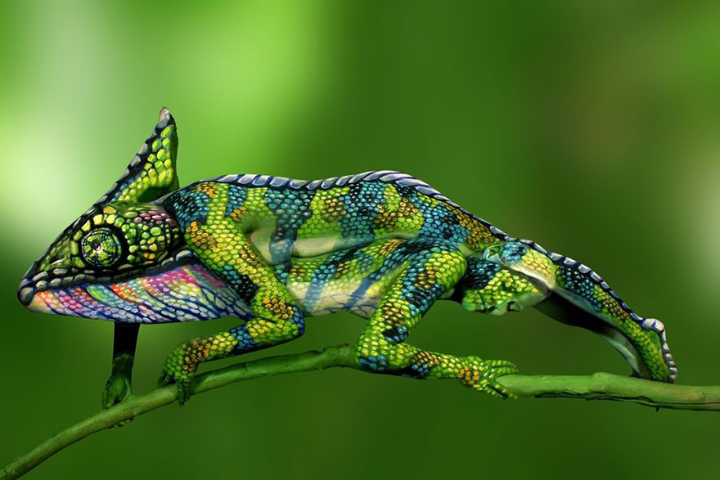

Slide 40
Human-Computer Interaction
Memory (Continued)
Miller’s Magical Number Seven, Plus or Minus Two
Chunking / Grouping / Categorizing

Slide 41
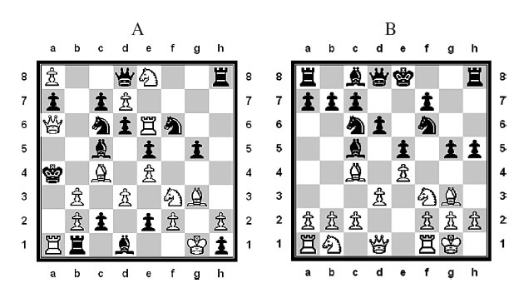
Human-Computer Interaction
Memory (Continued)
Miller’s Magical Number Seven, Plus or Minus Two
Chunking / Grouping / Categorizing

Slide 42
Human-Computer Interaction
Memory (Continued)
Miller’s Magical Number Seven, Plus or Minus Two
Chunking / Grouping / Categorizing
Mnemonics
Associations
No such thing as
Photographic memory
Multitasking

Slide 44
Human-Computer Interaction
Mental Models
Model: abstraction, simplification
How user thinks of system/device/product
Functional (how it works, how to use)
Should match the task
Structural (how it’s organized, built)
Harder to acquire from experience
Useful for extension, integration
May not match reality
And that’s okay

Slide 45
Human-Computer Interaction
Consistency
Internal Consistency
Designing operations and interfaces to behave the same within an application
Difficult with complex interfaces
External Consistency
Designing operations and interfaces to be the same across applications and devices
Happens occasionally, not as much as it should
Many standards are in place, and should be adhered to (They’re there for a reason!)

