Slide 1
Human Computer Interaction (HCI, HCC)
The Process

Slide 2
HCI Design
It is a process
Goal-directed
Problem solving
Informed by:
Intended use
Target domain
Materials
Cost
Feasibility
Generating alternatives and choosing among them is paramount

Slide 3
HCI Design
Many roles (HCI designers, graphic designers/artists, tech writers, user reps, management reps, programmers)
Determining users’ needs, requirements
Must precede coding
Adhere to standard, accepted guidelines (for process, not necessarily design)
Evaluation throughout process

Slide 4
HCI Design
Reinforcing the role of the user
Importance of involving users
Degrees of user involvement
What is a user-centered approach?
Four basic activities

Slide 5
Importance of involving users
Expectation management
Realistic expectations from the beginning, on both parts
No surprises, and therefore no disappointments
Timely training
Communication, but no hype
Ownership
The users become active stakeholders
More likely to forgive or accept problems and limitations
Can make or break the acceptance, use and success of a product

Slide 6
Degrees of user involvement
Member of the design team
Full-time: constant input, but lose touch with actual / all users
Part-time: intermittent input, and stressful to the user
Short term: Inconsistent during project duration
Long term: Consistent, but can also lose touch with actual / all users
Project updates and announcements
Reach a wider cross-section of users
Can be too one-way, need to ensure bi-directional flow of info
User involvement after product is released
Combination of these approaches

Slide 7
What is a user-centered approach?
Based on:
Early focus on users and tasks:
Cognitive
Behavioral
Anthropomorphic
Attitude
Empirical measurement
Observe, record, and analyze user reactions and performance to metrics (Scenarios, manuals, simulations, prototypes)
Iterative design
During user testing, find and fix issues, then re-test

Slide 8
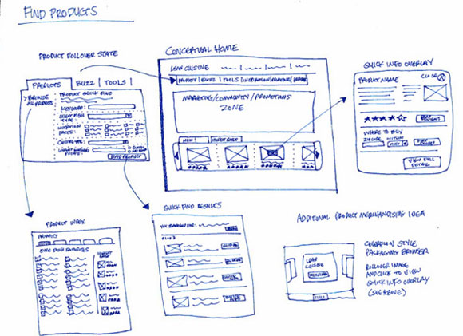
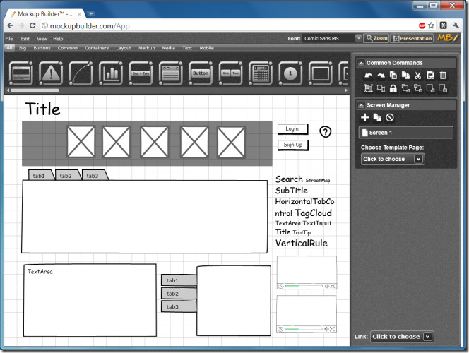
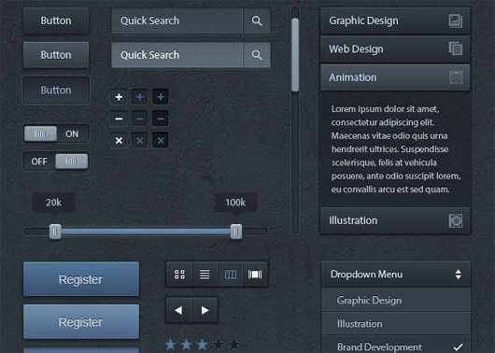
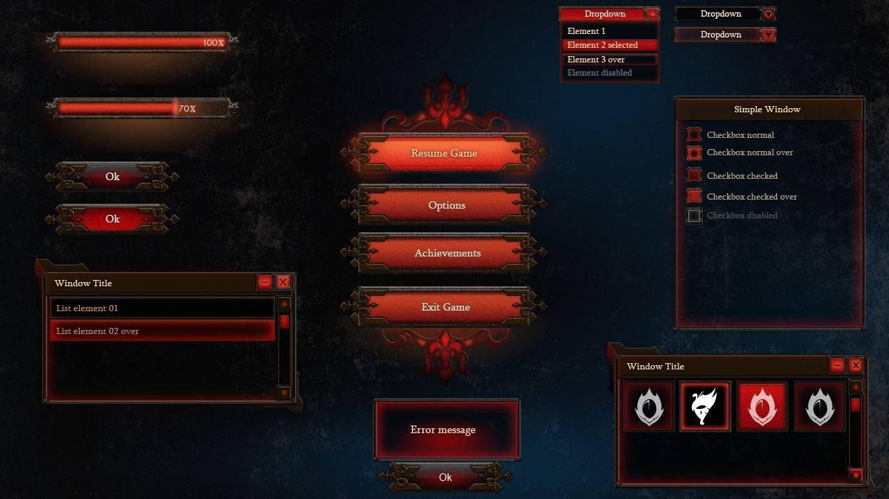
Four basic activities
Establish requirements
Requirements gathering
Card sorts / affinity diagrams
Design alternatives
Design Jam
Brainstorm
Sketch (maybe)
Develop prototypes
Sketch
Wireframe
Mockup
Prototype
Evaluate

Slide 9
Four basic activities
Establish requirements
What are you doing
Why are you doing it
Who are you doing it for
What is their goal
What are their wants
What are their needs

Slide 10
Four basic activities
Design alternatives
Based on previous activity
Two distinct yet related sub-activities
Conceptual design
Concrete design
Alternatives are always considered, all the time
How do you create these alternatives? Where do you begin?
Brainstorm (Group / Individual)
Random sketches
The Drawer / Inspirations
Design Jam

Slide 11
Four basic activities
Prototyping
Very powerful method of user feedback
Many different types
Functionality is not always necessary
Can be conceptual or concrete
Can be done at various stages

Slide 12
Four basic activities
Evaluating
Different types of evaluation
Can take place at different times, with different people

Slide 13
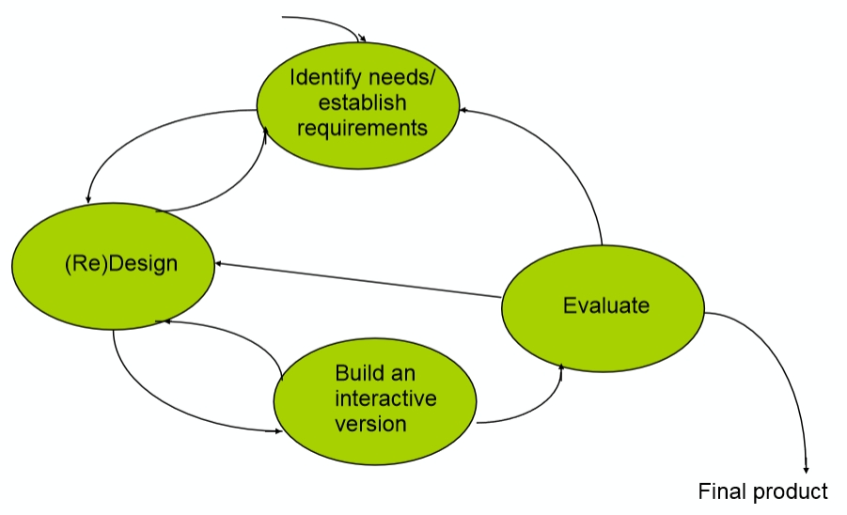
Interaction design lifecycle (Preece)

Slide 14
HCI Design process (McCracken)
Needs analysis
User and task analysis
Functional analysis
Requirements analysis
Setting usability specifications
Design
Prototyping
Evaluation

Slide 15
HCI Design
Some practical issues
Who are the users?
What are ‘needs’?
Where do we find alternatives?
How to choose among alternatives
How to integrate interaction design activities in other lifecycle models?

Slide 16
Who are the users and stakeholders?
Not as obvious as it might seem
Those who interact directly with the product
Those who manage direct users
Those who receive output from the product
Those who make decisions involving, or because of, the product
Those who make the purchasing decisions
Those who use competitor’s products
Three categories of user (Eason, 1987)
Primary
Secondary
Tertiary

Slide 17
Who are the users and stakeholders?
Consider who the users and stakeholders might be for a:
Grocery store
Movie theater
Commercial airline
Concert hall
Funeral parlor
Hotel
How can you vest them?

Slide 18
What are user needs?
Users don’t always know what is possible
Sometimes, not often
They often can’t tell you what they need to achieve their goal
Back to goal and task analysis
So look at existing tasks
The context
Required information
Who collaborates to achieve the goal?
Why is the task achieved the way it is?
Envisioned tasks
Can be rooted in existing behavior
Can be described as future scenarios

Slide 19
Generating alternatives
Humans normally stick to what works / what’s familiar
Previous experience
Familiarity
Brand loyalty
Social adherence
Considering alternatives is very important
This is true in all aspects of design
The designer’s job, in part, is to think creatively
How?
Many ways
Many sources of inspiration

Slide 20
How to select among alternatives
Evaluation of prototypes with users and peers
In some cases, feasibility may not be there
Evaluate in terms of usability goals (which should be monitored throughout the process)
Effectiveness
Efficiency
Safety
Utility
Learnability
Memorability

Slide 21
So:
Four basic activities in the design process:
Establishing requirements
Designing alternatives
Prototyping
Evaluating
User-centered design is founded on three principles
Early focus on users and tasks
Empirical measurement using quantifiable and measurable usability criteria
Iterative design

