Slide 1
Fonts
fonts

Slide 2
Fonts
fonts

Slide 3
Fonts
fonts

Slide 4
Fonts
fonts

Slide 5
Fonts
fonts

Slide 6
Fonts
fonts

Slide 7
Fonts
fonts

Slide 8
Fonts
fonts

Slide 9
Fonts
fonts

Slide 10
Fonts
fonts

Slide 11
Fonts
fonts

Slide 12
Fonts
fonts

Slide 13
Fonts
fonts

Slide 14
Fonts
fonts

Slide 15
Fonts
fonts

Slide 16
Fonts
fonts

Slide 17
Fonts
fonts

Slide 18
Fonts
fonts

Slide 19
Fonts
fonts

Slide 20
Fonts
fonts

Slide 21
Enough of that
fonts

Slide 22
Fonts
Arial
Times New Roman
Sans Serif (Century Gothic)
Georgia
Franklin Gothic
Verdana

Slide 23
It seems simple
Something as apparently basic as font choice requires consideration
Alignment
Contrast
Spacing
Serif (or not)
Lean
Bold / Underline / Italic / Ligature / Non-breaking space

Slide 24
It seems simple
Something as apparently basic as font choice requires consideration
Alignment
Contrast
Sp acing (Monospace v. Proportional)
Serif (or not)
Lean
Bold / Underline / Italic / Ligæture / Non-breaking space
(Ultimately, we’re talking about “kerning”)

Slide 25
It seems simple (Courier)
// Hit (): return true if mouse is inside bug
// and update hit taken count
Bool Bug::IsHit(const Position &MousePosition) {
if (GetBmp(GetDirection()).IsInside(MousePosition)) {
++HitsTaken;
return true;
}
else
return false;
}

Slide 26
It seems simple (Courier)
// Hit (): return true if mouse is inside bug
// and update hit taken count
Bool Bug::IsHit(const Position &MousePosition) {
if (GetBmp(GetDirection()).IsInside(MousePosition)) {
++HitsTaken;
return true;
}
else
return false;
}

Slide 27
It seems simple (Times new Roman)
// Hit (): return true if mouse is inside bug
// and update hit taken count
Bool Bug::IsHit(const Position &MousePosition) {
if (GetBmp(GetDirection()).IsInside(MousePosition)) {
++HitsTaken;
return true;
}
else
return false;
}

Slide 28
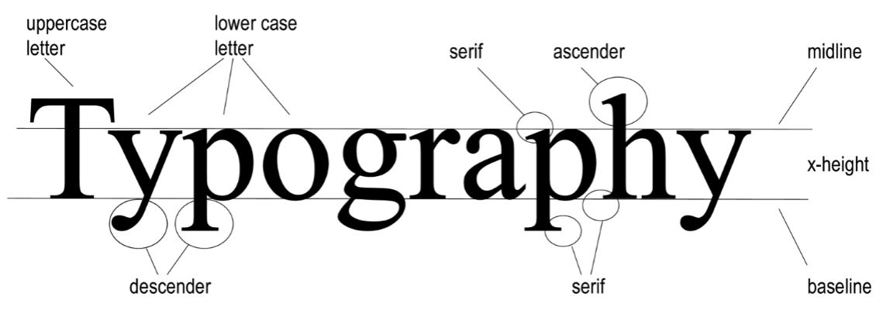
Kerning

Slide 29
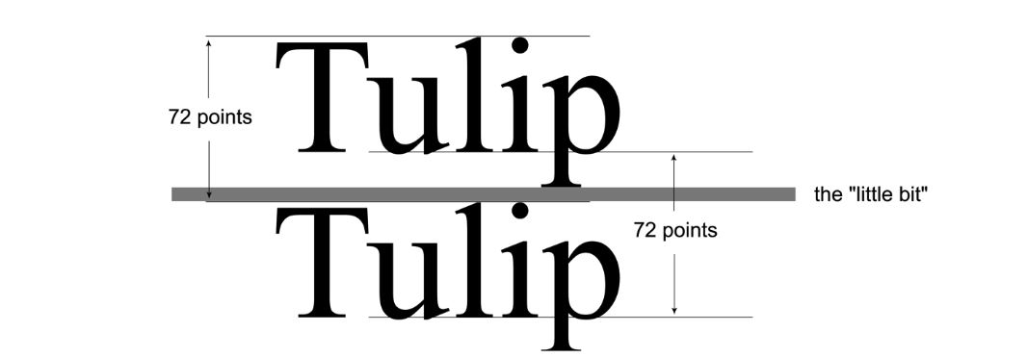
Kerning

Slide 30
Kerning

Slide 31
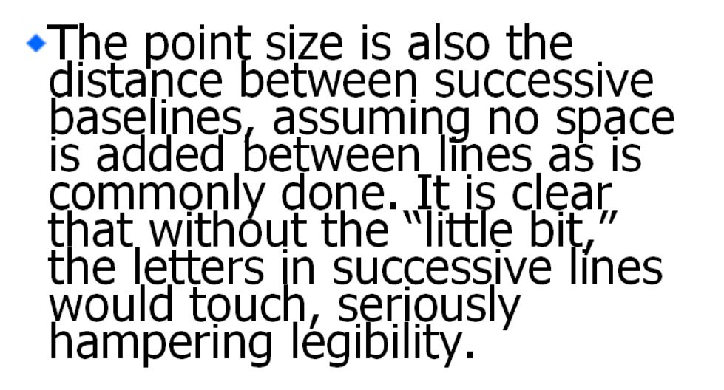
Kerning

Slide 32
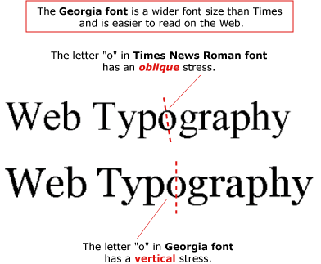
Kerning

Slide 33
Kerning

Slide 34
Kerning
This is 12 point Times New Roman. By looking at the font and reading these words, you can see the structure and characters of the font and how they impact legibility. While the differences may be subtle, it is those differences that often make the difference between a legible and illegible, or at least difficult-to-read, typeface.
This is 12 point Georgia. By looking at the font and reading these words, you can see the structure and characters of the font and how they impact legibility. While the differences may be subtle, it is those differences that often make the difference between a legible and illegible, or at least difficult-to-read, typeface.

Slide 35
Kerning
Again, it seems simple, but when kerning goes wrong, it goes very, very wrong.
Let’s watch!

