Slide 1
Zigbee and WiZi Cloud
Adithya Gajulapally
Mihir Kulkarni
Sundar Ramamoorthy

Slide 2
What is Zigbee?
Zigbee is a technological standard designed for control and sensor networks
Based on the IEEE 802.15.4 Standard (LR-WPANs)
Created by the Zigbee Alliance
Operates in Personal Area Networks (PAN’s) and device-to-device networks
Connectivity between small packet devices
Control of lights, switches, thermostats, appliances, etc.

Slide 3
Characteristics
Low cost (half of Bluetooth)
Low power consumption (6 months to 5 years battery life)
Low data rate requirements (few bits to 250kbps sufficient )
Relatively short transmission range
Scalability
Reliability
Flexible protocol design suitable for many applications

Slide 4






Some Applications
monitors
sensors
automation
control
INDUSTRIAL & COMMERCIAL
CONSUMER ELECTRONICS
TV VCR
DVD/CD
Remote control
PERSONAL HEALTH CARE
Zigbee
LOW DATA-RATE
RADIO DEVICES
PC & PERIPHERALS
monitors
diagnostics
sensors
mouse
keyboard
joystick
TOYS &
GAMES
HOME AUTOMATION
consoles
portables
educational
security
HVAC
lighting
closures

Slide 5
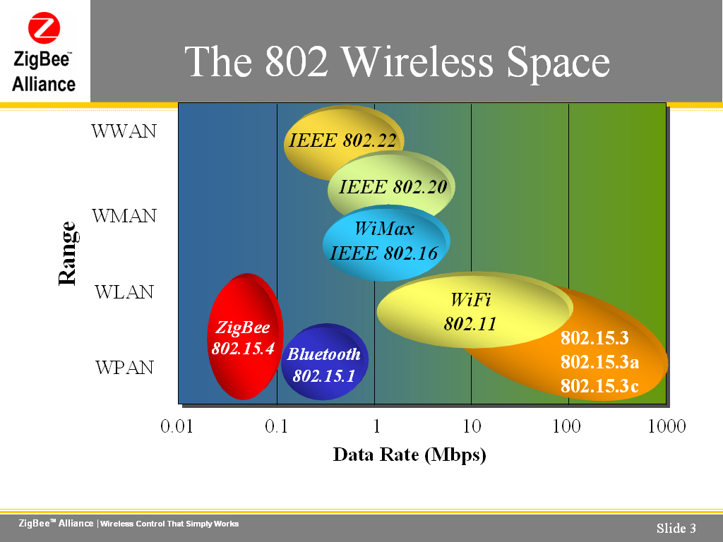
Where is Zigbee?

Slide 6
Zigbee Device Types
Primary device types
  Coordinator – most power and resource consuming
  Router
  End Device – least power and resource consuming
Each node/unit has the following
  Unique 64bit IEEE address per device in the world like MAC address
  16bit network address like IP address

Slide 7
Topologies
Mesh
Star
Cluster Tree
PAN coordinator
Full Function Device
Reduced Function Device

Slide 8
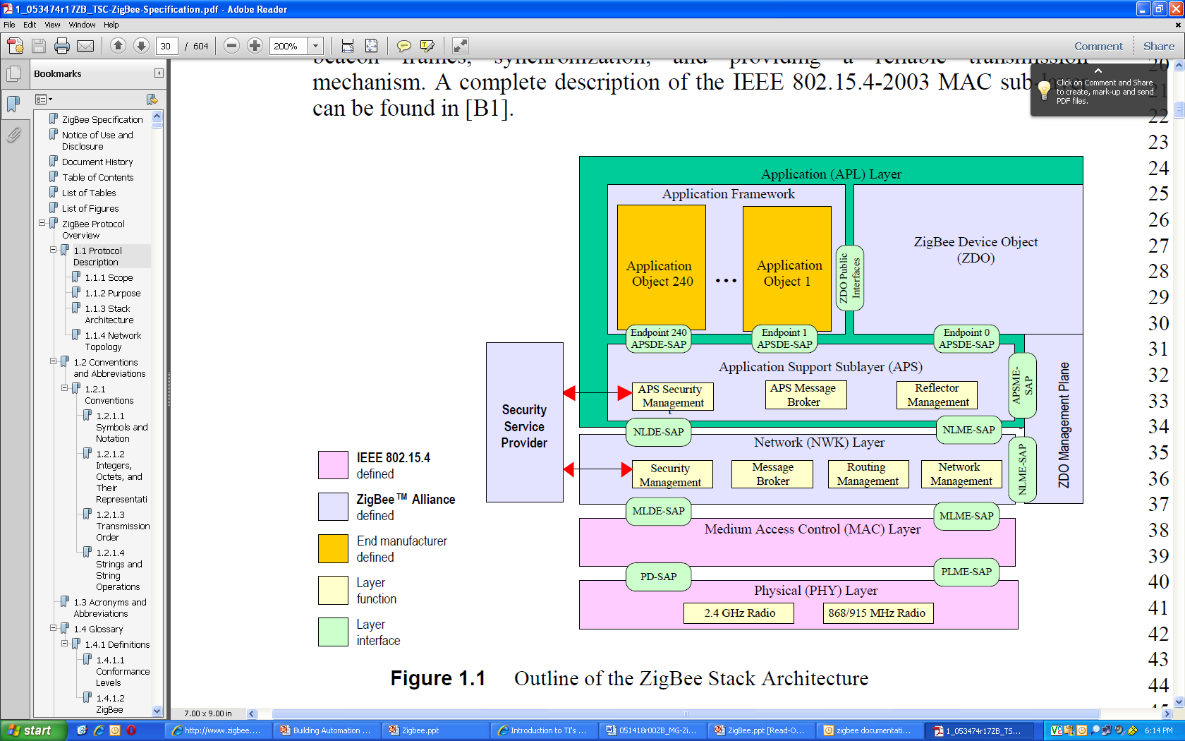
Zigbee Stack

Slide 9
MAC+PHY
IEEE 802.15.4 2003 specification
Operates in Unlicensed Bands
  ISM 2.4 GHz Global Band at 250kbps
  868 MHz European Band at 20kbps
  915 MHz North American Band at 40kbps
Two types of Devices
  FFD - PAN coordinator
  RFD – simple devices that talk to FFD

Slide 10
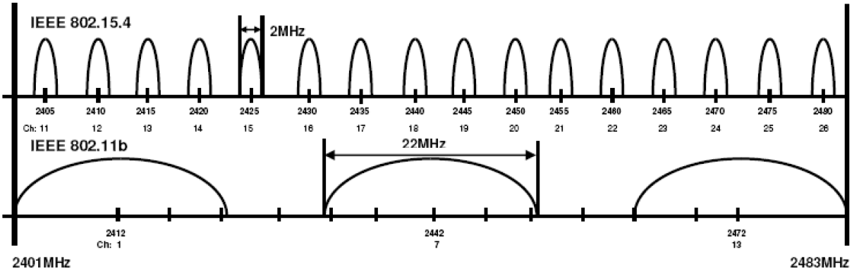
Zigbee & Wi-Fi Coexistence
2.4 GHz is shared by Zigbee, Wi-Fi and Bluetooth
915 MHz sometimes overlaps with 900MHz GSM

Slide 11
Addressing Modes
Group Addressing
  APSIB and NIB
Broadcasting
IEEE Address
Network Address

Slide 12
Zigbee Cluster Library and Profiles
Zigbee Cluster Library (ZCL) defines clusters
  Cluster have client side and server-side
  Clusters have attributes & commands
  Attributes and their datatypes are defined
  Commands can be universal or cluster specific
Profile defines devices & SAS and sometimes clusters
  Devices have compulsory clusters and optional clusters
  Clusters and attributes are reused to maintain consistency

Slide 13
NetWork Layer (NWK)
Creating, joining, leaving, rejoining network & 16-bit addressing
Maintains Routing Information
Maintains group address table
Rx control
Neighbor discovery
Uses Security Service Provider (SSP) to encrypt frames

Slide 14
APplication Support sub-layer (APS)
Its like Transport Layer of OSI stack
It handles the following
  Sending the received frame to the right Application object
  Fragmentation (optional)
  Group address filtering
  End to end retries and ACK
  Duplicate message rejection
  Handles inter-object communication within the same node
  Link security
  Binding

Slide 15
Application Layer
Application objects reside here
Zigbee Device Object (ZDO) at End Point 0 does the following:
  Device Discovery: Finding address
  Service Discovery: Find capability of end points
  Application Objects can use ZDO Public Interface to control the device

Slide 16
Zigbee Stack

Slide 17
Zigbee Profiles
Profile IDs: 16bit
  Can be Public Profile (PP) or Manufacturer Specific Profile (MSP)
Device Profile:
  Is a template defined by ZA
Device descriptor:
  List of EPs and their input and output clusters IDs
Standardization vs Flexibility
  Zigbee Cluster Library (ZCL)
  Extensions to PP if allowed
  MSP

Slide 18
Startup Attribute Set & Commissioning
SAS controls start-up sequence
  A device should be able to indicate to the user that it has decided to become the coordinator of a network.
  A device should be able to indicate to the user, that it has successfully joined a network.
  A device should be able to indicate to the user, that it is in the process of searching for or joining a network.
Commissioning Modes
  A-Mode: Automatic
  E-Mode: Easy
  S-Mode: System

Slide 19
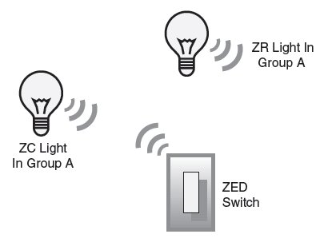
Home Automation: Lights/Switches example
Starting/Joining
  Flicker 5 times to indicate new
  Flicker 2 times to join existing & nearest zr/zc signals
  Flicker once to indicate adding a device
  Slow flash to identify
Binding
  4 times – binding start/stop
  7 times – group binding start/stop
  1 time – add or remove
  2 times - cycle

Slide 20
Zigbee and Bluetooth Comparison
Feature(s) | Bluetooth | ZigBee
Power Profile | days | years
Complexity | complex | Simple
Nodes/Master | 7 | 64000
Latency | 10 seconds | 30 ms – 1s
Range | 10m | 70m ~ 300m
Extendibility | no | Yes
Data Rate | 1 Mbps | 250 Kbps
Security | 64bit, 128bit | 128bit AES and Application Layer

Slide 21
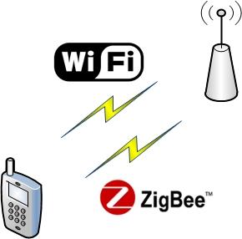
What is WiZi- Cloud?
WiZi-Cloud is a dual-radio solution for scalability and energy efficiency of mobile phones' Internet access.
It consists of a set of protocols, and hardware/software components integrating WiFi and ZigBee radios on mobile phones and access points.
WiZi-Cloud aims at providing:
1.ubiquitous connectivity,
2.high energy efficiency,
3.transparent intra-device/
inter-AP handover.

Slide 22
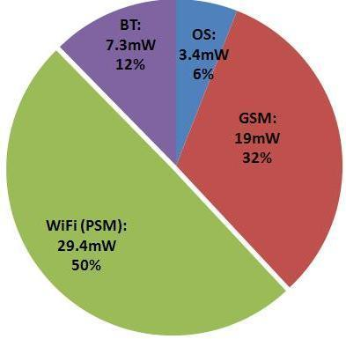
Motivation
                Energy Consumption in a Smartphone
ever increasing density of WiFi Access Points and large unlicensed RF bandwidth over which they operate. deployment challenges and limited RF spectrum for cellular networks. maintaining connectivity through WiFi results in depleting the mobile phone's battery in a short time.

Slide 23
Why ZigBee?
It has zero-time connection establishment
Good radio range (a significant advantage over Bluetooth).
ZigBee is also available as a low cost System on Chip (SoC) with an integrated low power microcontroller .
These features allow the mobile phone to be in sleep mode while the microcontroller handles the wakeup and some of the network functionality.

Slide 24
System Design
Extend mobile phones and access points with ultra low power, low data rate zigbee interface.
Phone can switch seamlessly between WiFi and ZigBee interfaces while communicating WiZi-enabled AP.
During low traffic WiFi is turned off and the ZigBee interface is responsible for connection with WiZi AP.
The WiFi interface is woken up under large data transfer.
WiZi software stack monitors traffic, switches interface and also notifies the AP.

Slide 25
WiZi-Cloud features
The Key features of WiZi-Cloud are –
Energy-Efficiency: WiZi-Cloud system is extremely efficient low rate applications in terms of energy consumption. Ex.: VoIP and streaming music
Leverage of existing HW/SW: WiZi-Cloud system runs on off-the-shelf mobile phones and wireless routers without hardware modifications.
Flexibility: A mobile phone is able to determine the network interface to use according to a user-specified policy. The WiZi-Cloud provides the mechanism to switch between WiFi and ZigBee interfaces.
Seamless: WiZi-Cloud system and its protocols are completely transparent to the applications running on the mobile phones and peer entities in the Internet.

Slide 26
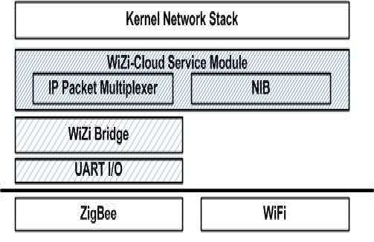
System Framework
WiZi-Cloud Infrastructure

Slide 27
System Infrastructure
Hardware:
WiZi-kit, a fully custom made ZigBee module which can be attached externally to mobile phones and wireless APs.
Software:
WiZi-Cloud software stack has four major components:
WiZi-Cloud Service Module
WiZi Bridge,
UART I/O, and
ZigBee logic.

Slide 28
Software
WiZi-Cloud Service Module:
serves as an interface manager, which monitors the status of ZigBee and WiFi interfaces.
decides when to carry out the interface switching.
IP Packet Multiplexer determines how to propagate the ingress and egress IP packets through OS given currently active interface.
NIB (NIC Information Base) maintains the accounting data for each interface.
At AP side, NIB also records the mode in which each LAN client is functioning.

Slide 29
WiZi Bridge:
The maximum packet length in IP protocol (1500bytes) and ZigBee protocol (116bytes) are different.
WiZi Bridge fragments the egress IP packets into multiple ZigBee packets, and reassemble the received ZigBee packets into single IP packet.
UART I/O:
reponsible for reliable communication on UART link between the host device (mobile phone or AP) and WiZi-Kit.
ZigBee Modem:
provides basic read/write operations on the ZigBee link and is responsible for reliable UART communication.

Slide 30
WiZi-Cloud Protocols Design
Registration of a Mobile device:
Mobile device associates with the registration-AP and gets the IP address.
As the device moves it may get new IP address but the IP address with the virtual interface remains same.
This makes the network changes transparent to the application.
The mobile device updates its registration AP about its current AP called the primary-AP.
Thus any incoming or outgoing packet passes through registration-AP, primary-AP and the WiFi or ZigBee interface.

Slide 31
Protocol Design cont…
Ubiquitous Reachability:
In order to guarantee ubiquitous reachability all devices need to be reached by WiZi-Cloud AP.
A beaconing mechanism is used to reduce the energy consumption while maintaining low system complexity.
APs periodically broadcast beacons using ZigBee at regular units of time.
The mobile devices periodically wake up to listen for the beacons and is synchronized with the primary-AP.
It also maintains a list of AP that cover his current location called the Coverage Set.
In case of issues with current primary-AP, the device can choose a new primary-AP.

Slide 32
Protocol Design Cont…
Paging Mechanism:
Paging message is used to inform the mobile device to wakeup and start receiving data packets.
The paging message includes a list of mobile nodes to wakeup.
In phase-I, the registration-AP informs primary-AP and it then pages to all the mobile devices.
In phase-II, if primary-AP fails all the APs in the coverage set are asked to page the mobile device.
The two phase mechanism helps to keep the chances of success high but experiences higher delay when the primary-AP fails.

Slide 33
Protocol Design Cont…
Handover:
Intra-device handover and traffic scheduling: WiZi-Cloud AP has a traffic scheduler that monitors the network traffic on the ZigBee link.
When the load gets high it instructs the mobile device to use the WiFi link.
Seamless inter-AP handover: The mobile device achieves a seamless handover by maintaining both the ZigBee link to the old AP, and the WiFi link to the new AP.

