Slide 1
Upload Planning for Mobile Data Collection in Smart Community IoT Deployments
Qiuxi Zhu, Yusuf Sarwar, Zhijing Qin,
Nalini Venkatasubramanian
University of California, Irvine

Slide 2
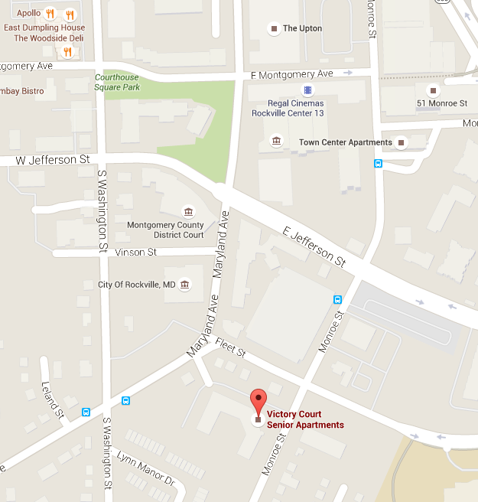
Background and motivation
Communities and cities are interested in IoT systems
Large-scale IoT systems are limited by
Dependency on public infrastructures
Sensors that are only useful in special events
Terrain limitations
Mobile devices are popular
Multiple sensors
Multiple networks
Leverage these mobile devices to improve the resilience of community IoT deployments
Mobile data collection is a promising solution
How to leverage the knowledge of IoT deployments and infrastructures to improve the efficiency of data collection?
Notes:
We have deployed a few multi-sensor boxes in the Victory Court Senior Apartments in Montgomery County, MD and on UCI campus as part of the SCALE system, which is one of our on-going projects.
However, as the project went on we found there are several limitations in large-scale IoT systems like this….
Therefore, we are looking for a flexible and scalable solution to extend the community IoT systems and improve their resilience.
At the same time, we found mobile devices and mobile computing are popular…

Slide 3
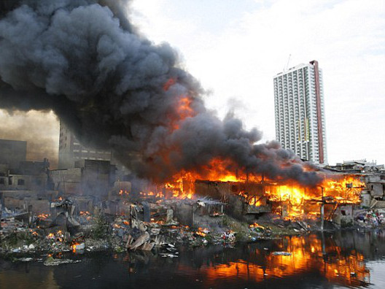
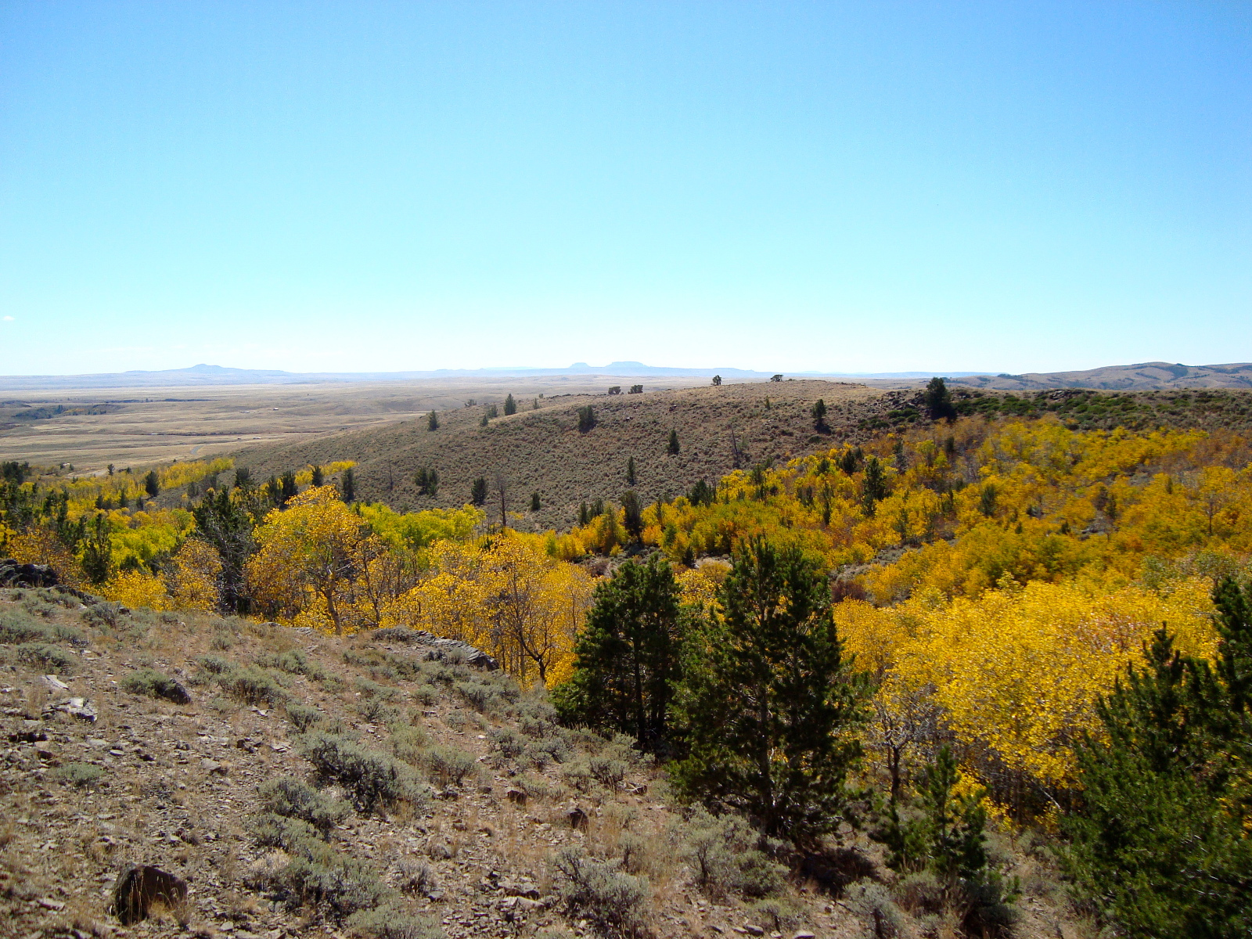
Other applicable scenarios
Emergency response (e.g. fire, earthquake, etc.)
Collect sensor data and take pictures/videos at some spots
Mobile data collectors are equipped with sensors/cameras
Upload opportunities are Wi-Fi access points and cellular towers that are still working in these disasters
Environment-centric sensing in the wild
Deploy in-situ sensing devices with storage capacity and short-range communication ability
Mobile data collector can communicate with sensors and fetch data
Upload opportunities are stations that have constant connectivity to the backend server

Slide 4
Related works
Internet of Things for smart city/community
A. Zanella (IEEE Internet of Things Journal, 2014)
SCALE (IEEE Communications Magazine, 2015)
R. Jalali (ICIN 2015)
Mobile sensing systems
BikeNet (SenSys 2007) – ZebraNet (SenSys 2004)
CarTel (SenSys 2006) – PCS (SenSys 2013)
Message ferries and data exchange
Computational ferrying (WoWMoM 2015)
Mobile data collection with environmental uncertainties
Shanty town emergency response (GLOBECOM 2015)
On disaster information gathering (GHTC-SAS 2014)

Slide 5
Problem description
A mobile data collector (MDC) is given a path, where there are several sites to fetch data, and several access points to upload data.
Plan for data fetched from data sites, which opportunities to use to upload them, in order to improve the overall timeliness.
Challenges
Network availability
Data heterogeneity
Size/type
Importance level
Timing requirements
Environmental dynamics
Notes:
There are several difficulties in solving such a planning problem.
Connectivity: UCI campus is intended to provide students with ubiquitous Internet access, but the reality is not perfect. Wi-Fi coverage is not uniform, resulting in relatively poor coverage is some areas. Avoid poor connectivity.

Slide 6
Two-phase approach
Developing an optimal and comprehensive plan requires thorough knowledge about the state of the entire system, which is computationally complex and difficult to achieve in real-time.
Static planning phase
Make a comprehensive plan using prior knowledge
Computation intensive algorithms
Done on the backend server before departure of the MDC
Dynamic adaptation phase
Adjust plan for dynamics in environment and network
Simple policies, done on the MDC

Slide 7
Upload planning problem
Problem formulation
Assumptions
Terms, and notations
Upload planning as a constrained optimization
Two-phase approach
Static planning algorithms
Dynamic adaptation policies
Prototype platform and measurements
Performance evaluation and simulation results

Slide 8
Assumptions
Mobile data collector
Independent MDCs: Plan for only one MDC at any time
Constant speed: Moving time is predictable
Unlimited power and storage
Path and data
Fixed path: Given by another planner, cannot be changed
Indivisible data chunks
Communication
Stop and stay for communication
Constant data rate for data collection
Limited knowledge of upload opportunities: Actual data rate is unknown before MDC arrives

Slide 9
Terms and notations
Upload opportunity
$$u=\left(x,r\right)$$
$x$ – Location
$r$ – Data rate
Plan $P=\left(λ,l\right)$
$λ$ – Global plan
$l$ – Local ordering
Data chunk
$$a=\left(x,s,d,p\right)$$
$x$ – Location
$s$ – Size
$d$ – Deadline
$p$ – Priority
Global plan is represented in three ways
Mapping $λ$ $λ\left(a_{i}\right)=u_{h}$
Vector $j$ $j_{i}=h$
Matrix $Λ$ $Λ_{i,h}=1$
Path
Mobile data collector
Data site at
location $x$
Location $x$
Notes:
A network-enabled mobile agent that collects data and uploads them to the server. The data can be sensed on the MDC, or fetched from other sensor or sensing devices.

Slide 10
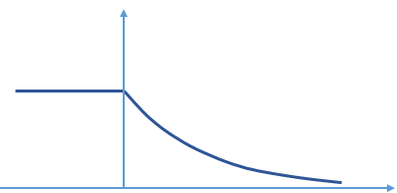
Definition of utility
Utility of a data chunk depends on whether it is uploaded in a timely fashion or not.
Utility function $f\left(Δ\right)$: Evaluation of efficiency. $Δ\left(a_{i},λ,l\right)=t\left(a_{i},λ,l\right)−d\left(a_{i}\right)$.
$$f\left(Δ\right)=\left\{\begin{matrix}1 & ,Δ<0 \\ \exp\left(−Δ/{T_{f}}\right) & ,Δ>0\end{matrix}\right.$$
Weighted overall utility (WOU) $U\left(λ,l\right)$: $U\left(λ,l\right)={\sum_{i=1}^{N}{p\left(a_{i}\right)⋅f\left(Δ\left(a_{i},λ,l\right)\right)}}/{\sum_{i=1}^{N}{p\left(a_{i}\right)}}$
$$f(Δ)$$
Actual time of delivery
Deadline
$$1$$
$$0$$
$$Δ$$

Slide 11
Constrained optimization
Cause-and-effect constraint $C$: $C_{i,j}=1$ if and only if $x\left(a_{i}\right)≤x\left(u_{j}\right)$, otherwise $C_{i,j}=0$. $Λ_{i,j}=1$ only if $C_{i,j}=1$. A data chunk cannot be uploaded before it is collected.
NP-hardness: 0-1 knapsack can be reduced to this problem.
Given an ordered list of data chunks $\left\{a_{i}\right\},i=1,…,N$, with increasing $x\left(a_{i}\right)$, and an ordered list of opportunities $\left\{u_{j}\right\},j=1,…,M$, with increasing $x\left(u_{j}\right)$.
Find global plan $λ$ and its corresponding plan matrix $Λ$, to maximize the WOU subject to the cause-and-effect constraint, i.e.
$$\operatorname{maximize}{U\left(λ,l\right)={\sum_{i=1}^{N}{p\left(a_{i}\right)⋅f\left(Δ\left(a_{i},λ,l\right)\right)}}/{\sum_{i=1}^{N}{p\left(a_{i}\right)}},}$$
$$s.t.Λ_{i,j}≤C_{i,j},∀i=1,…,N,∀j=1,…,M.$$
Notes:
Please refer to the paper and our technical report for details.

Slide 12
Static planning
Done before departure of the MDC, without knowledge of actual date rates $r\left(u\right)$.
Assume an earliest deadline first (EDF) local strategy, if multiple data chunks are planned to be uploaded at the same opportunity.
Algorithms
Brute force search (optimal, very slow)
First opportunity (naïve, purely opportunistic, fast)
Genetic algorithm: Using plan $j$ as chromosome
Balanced Delay-Opportunity-Priority
Notes:
Recall that we proposed a two-phase approach to solve the upload planning problem. The first phase is static planning…
We can use several strategies/algorithms to solve the static planning problem. Here we have…
Given the limited time we have, I will only describe BDOP, which is our proposed algorithm, but I will compare several of them in Performance Evaluation.

Slide 13
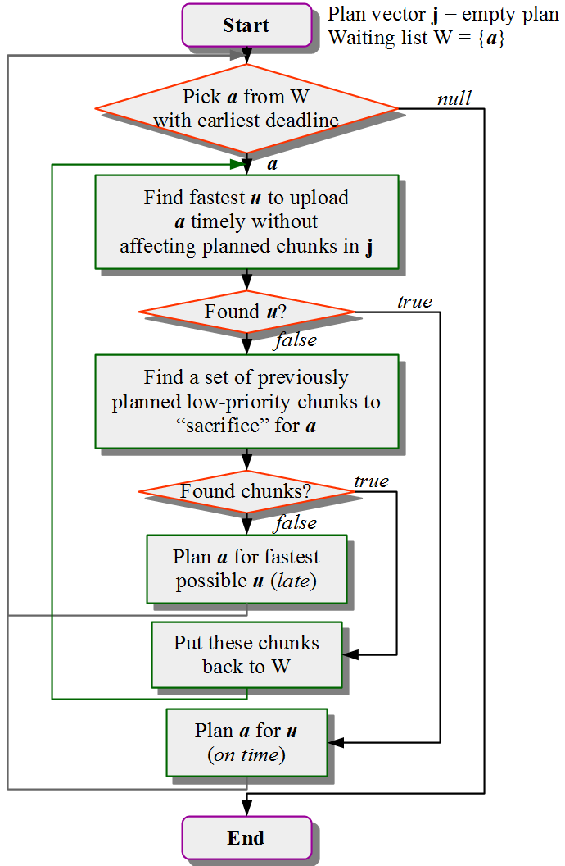
Balanced DOP
Start with an empty plan $j$ and a waiting list W with all data chunks.
Data chunks are picked from W in an EDF manner.
The total utility lost of all sacrificed chunks must not exceed the utility gain of having $a$ uploaded on time.
If cannot find such a set of chunks to sacrifice, a will be planned for late upload. Otherwise, re-plan the sacrificed chunks.

Slide 14
Dynamic adaptation
During plan execution, change the plan to adapt to dynamics.
Done on MDC during task execution, with knowledge $r\left(u\right)$ at the current upload opportunity.
Policies
Strict static plan: Always finish all data chunks told by the static plan (static planning only)
Strict timeline: Always try to catch up the timeline calculated from the static plan
Lyapunov control strategy

Slide 15
Lyapunov control strategy
State of our system $φ(t)$ at time slot $t$: A vector of two queues: $φ\left(t\right)=\left[Q\left(t\right),T\left(t\right)\right]$
Quadratic Lyapunov function: $L\left(φ\left(t\right)\right)=1/2Q^{2}\left(t\right)+1/2{\left(T\left(t\right)−β\right)}^{2}$
Lyapunov drift: $Δ\left(t\right)=E\left[L\left(φ\left(t+1\right)\right)−L\left(φ\left(t\right)\right) | φ\left(t\right)\right]$
Minimize: $Δ\left(t\right)−V⋅R\left(t\right)$
This is equivalent to maximizing
Queue backlog at the MDC
Time elapsed since the MDC started its operation
Time that is supposed to have elapsed according to the static plan
Reward (total utility gain by having all selected data chunks uploaded)
$$\sum_{a}{σ\left(a\right)⋅s\left(a\right)\left(Q\left(t\right)−{\left(T\left(t\right)−β\right)}/{r\left(t\right)}\right)+V⋅p\left(a\right)⋅f\left(T\left(t\right)+{s\left(a\right)}/{r\left(t\right)}−d\left(a\right)\right)}$$

Slide 16
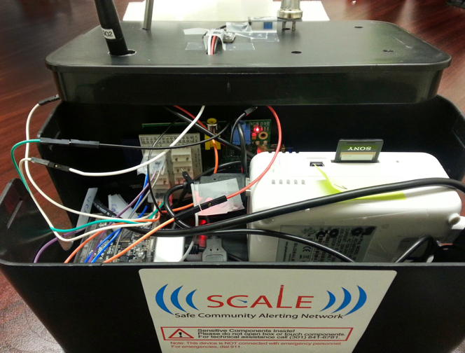
SCALECycle platform
SCALE multi-sensor boxes on bikes or in backpack
Current prototype
Raspberry Pi Model B
USB battery pack
Bluetooth GPS
Wi-Fi adaptor
Air quality (TGS 2600)
Can be extended to support multiple types of sensors and networks

Slide 17
SCALECycle architecture
Virtual sensors generate events based on physical sensor readings and policies
Wi-Fi RSSI virtual sensor
Air pollution virtual sensor
Network manager monitors the state of connections.
Event reporter decides which publisher to use, i.e. where to send data to – the cloud broker via MQTT, or the local MySQL database.

Slide 18
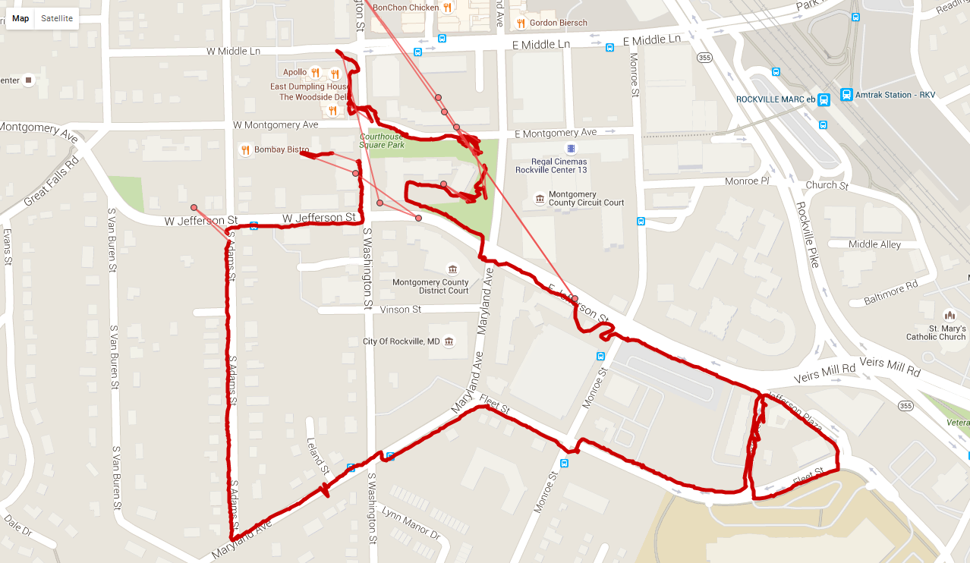
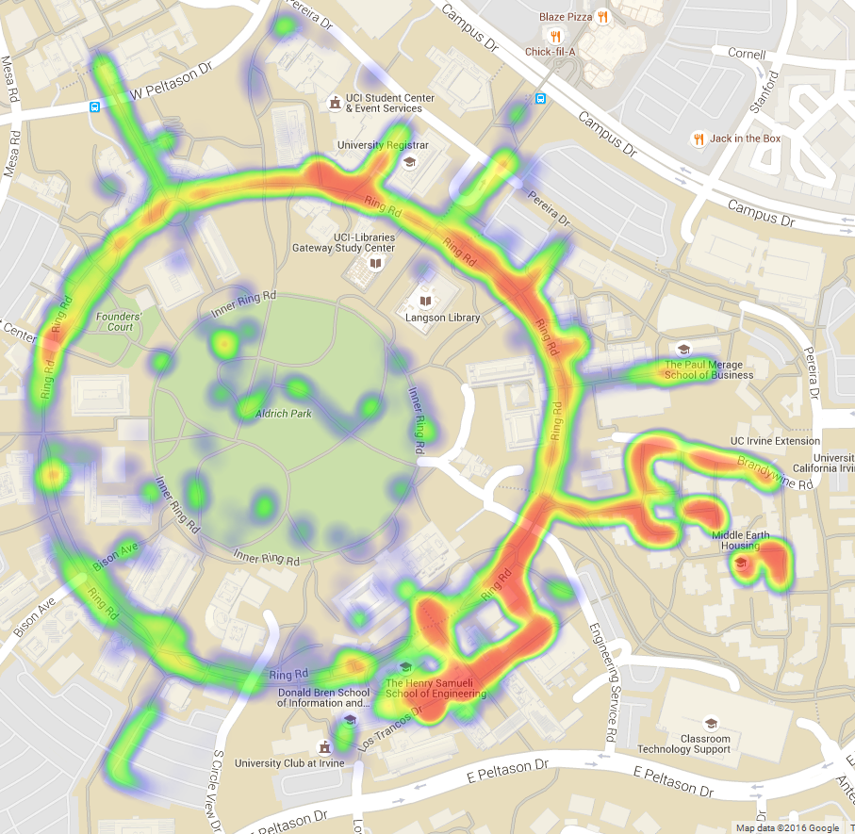
RSSI measurements
University of California, Irvine
“UCInet Mobile Access”
Montgomery County, MD
“MCGUEST”
Thingstitute Lab
(Red Brick Courthouse)
Department of Computer Science
(Donald Bren Hall)
Victory Court Senior Apartments
Good
Poor
Notes:
We collected data with our prototype platform on our two testbeds – UCI campus of Montgomery County, MD.
First picture shows the GPS trajectory in one measurement experiment.
With the data we collected, we were able to generate these Wi-Fi RSSI heat-maps.
Quick setup and measurements – It takes only a few hours to assemble/configure the boxes. If you are familiar with it or have the right instructions, it takes less. The measurements can be collected as you walk/ride. We once heat-mapped the area around several buildings in George Washington University in one hour.

Slide 19
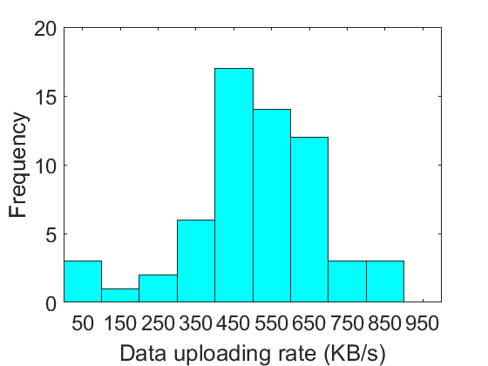
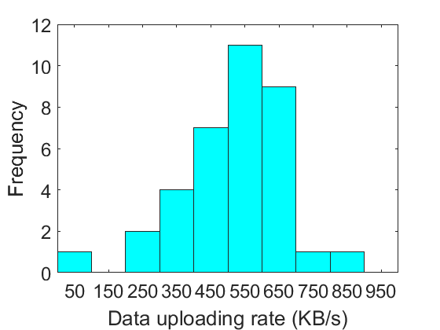
Uploading measurements
Montgomery County, MD testbed: The mean rate was 500 KB/s, and the standard deviation was 212 KB/s.
UCI campus testbed: The mean rate was 513 KB/s, and the standard deviation was 160 KB/s.
Notes:
These are histograms of data uploading rates measured on the two testbeds.

Slide 20
Performance evaluation
Scenario Characteristics |  | Small | Medium | Large
MDC | Speed $V/{ms^{−1}}$ | 5
 | Est. Conn. Time ${T_{c}}/s$ | 12
Path | Length Exp. ${E\left[L\right]}/m$ | 12,000 | 24,000 | 200,000
Data Sites and Chunks | Bandwidth ${R_{a}}/{Mbps}$ | 12
 | Total Number $N$ | 120 | 120 | 1000
 | Distance ${Δx\left(a\right)}/m$ | $$N\left({90,20}^{2}\right)$$ | $$N\left({180,60}^{2}\right)$$
 | Size $s/{MB}$ | $U\left(2,8\right)$ ª
 | Importance Level $p$ | $\left\{0.3,0.6,1.0\right\}$ ^{b}
 | Deadline Inc. ${Δd}/s$ | $$U\left(−40,200\right)$$
Upload Opportunities | Total Number $M$ | 6~30 ª | 4~40 ª | 10~200 ª
 | Distance ${Δx\left(u\right)}/m$ | $U\left(0,{2E\left[L\right]}/M\right)$ ª
 | Bandwidth ${r_{e}}/{Mbps}$ | $N\left({4,2}^{2}\right)$ ^{c}

Slide 21
Performance evaluation
Simulation environment
Intel Core 2 2.67 GHz
4.00 GB DDR2 SDRAM
Ubuntu 14.04 64-bit
QualNet EDU 7.3
MATLAB R2015b
Metrics
Weighted overall utility
Fraction of important data chunks uploaded in time
Total time to complete all data collection
Approaches compared
Naïve (first opportunity, purely opportunistic operation)
Static planning only (planned operation)
GA
BDOP
Two-phase approach
GA-Lyapunov
BDOP-Lyapunov

Slide 22
Results: Basic comparisons
Compared with the naïve approach, the two-phase approach using GA-Lyapunov and BDOP-Lyapunov improved the WOU by 14~24%

Slide 23
Results: Basic comparisons
The naïve approach cannot make full use of faster opportunities

Slide 24
Results: Basic comparisons
Lyapunov control performed better than “strict static plan”
Strict timeline was the worst

Slide 25
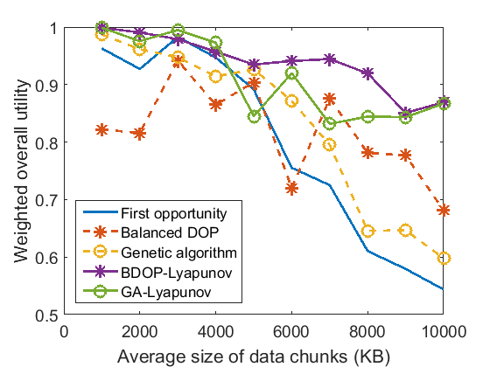
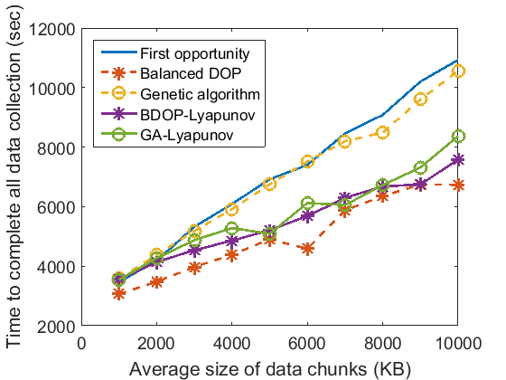
Results: Data heterogeneity
Compared with the naïve approach
The improvement in WOU was 36-60% for larger chunks.
The reduction in total data collection time was up to 30%.

Slide 26
Results: Data heterogeneity
With larger test sets (about 1000 data chunks), we found it took more than 20 minutes to generate a plan for one scenario using GA, but took less than a minute using BDOP
For a small test case with 120 data chunks of average size 5 MB, it took 30-40 seconds to generate a static plan using GA

Slide 27
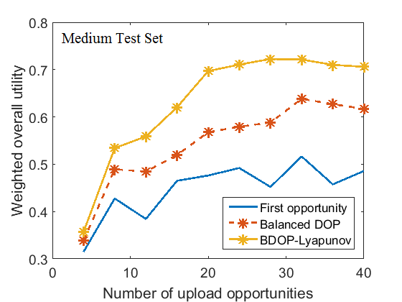
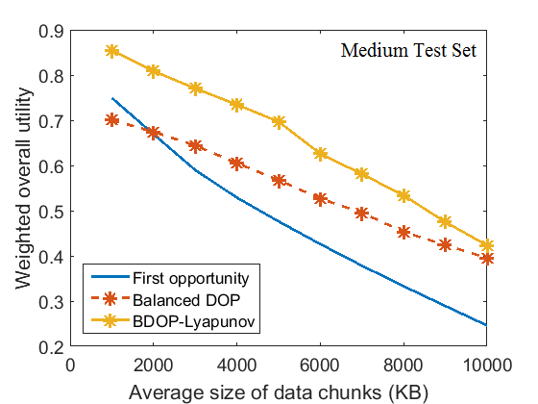
Results: Scalability
On medium test sets, The WOU was improved by 38-46% by our two-phase approach, compared with the naïve approach (purely opportunistic operation).

Slide 28
Results: Scalability
On the large test set, BDOP was well performing and stable when the system scaled up

Slide 29
Conclusion
The two-phase approach using a Balanced Delay-Opportunity-Priority planning algorithm and the Lyapunov-inspired adaptation can result in a 30-60% improvement in overall utility of collected data, along with an up-to 30% reduction in total collection time.
Contributions
Motivated and formulated the upload planning problem in smart community IoT settings.
Proposed a two-phase approach to solve the optimization in community settings.
Designed SCALECycle, a prototype system, to help conduct measurements in our real community testbeds.
Conducted simulation experiments using data collected with SCALECycle.
Simulation results showed that our two-phase approach using BDOP-Lyapunov worked significantly better and performed more stable than both the naïve approach and the planned approach, in complex community settings of different scales.
Future works
Incorporating a multi-network upload setting
Integrating upload planning with path planning/tasking

Slide 30
Upload Planning for Mobile Data Collection in Smart Community IoT Deployments
Thank you!
Questions?

