Slide 1
Exploiting Mobile Plus In-Situ Deployments in Community IoT Systems
Qiuxi Zhu
Committee (sorted by last name)
Nikil Dutt
Marco Levorato
Sharad Mehrotra
Nalini Venkatasubramanian (Chair)

Slide 2
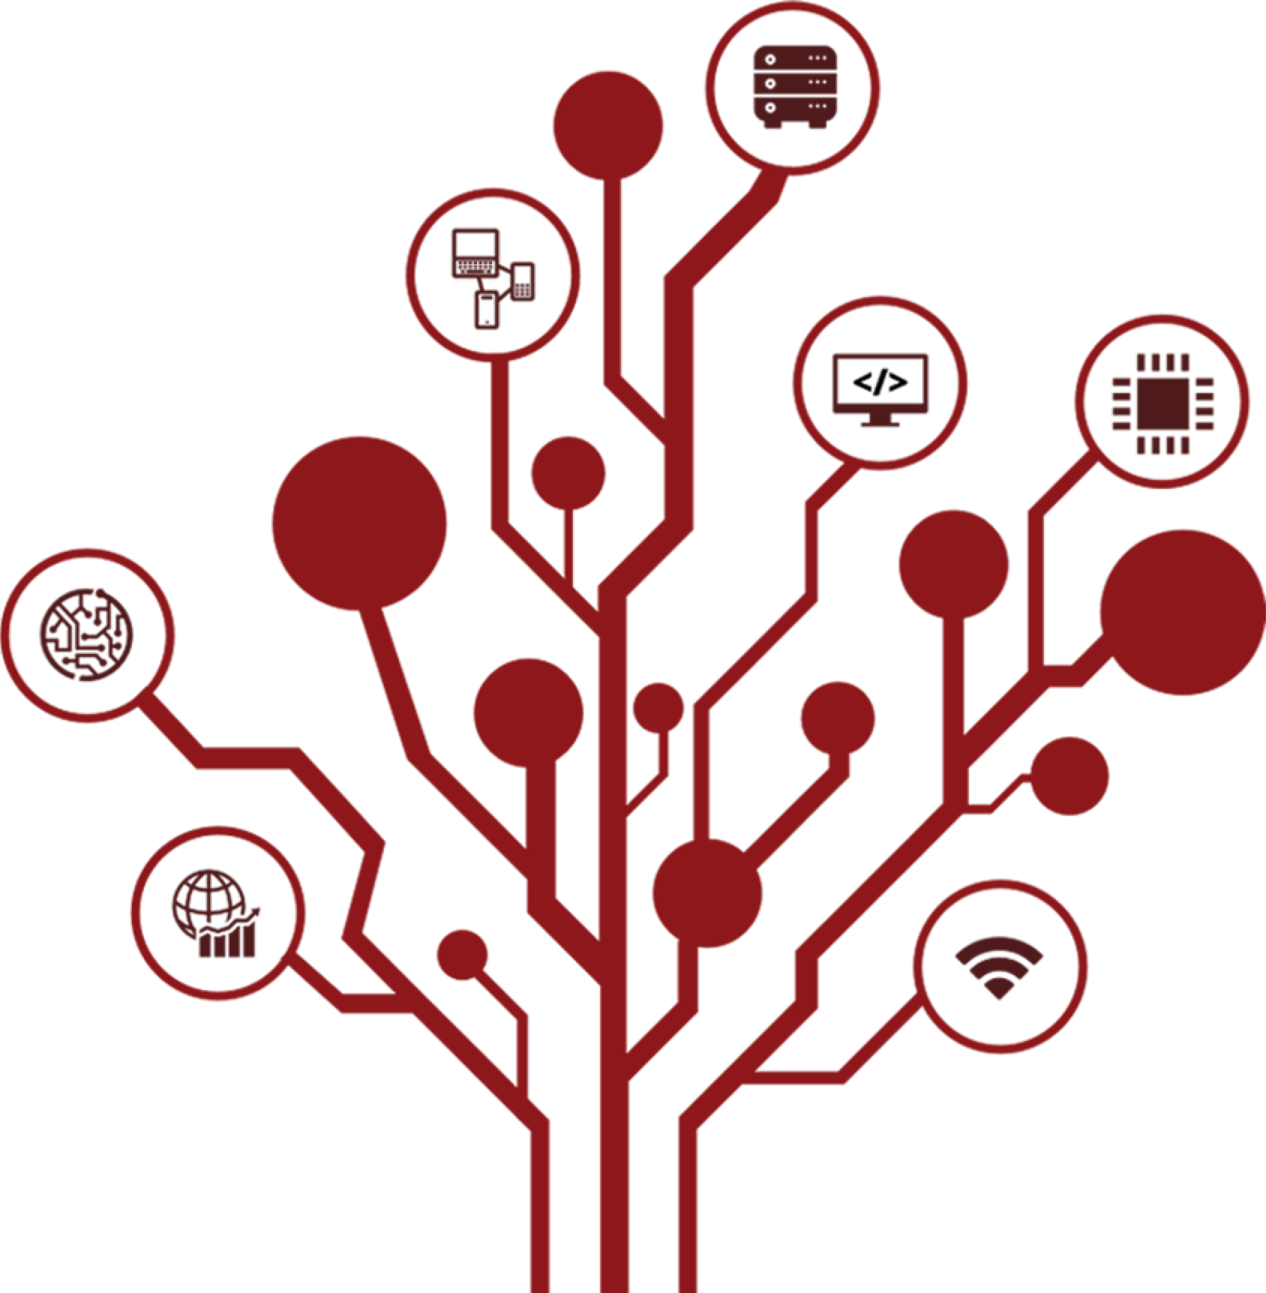
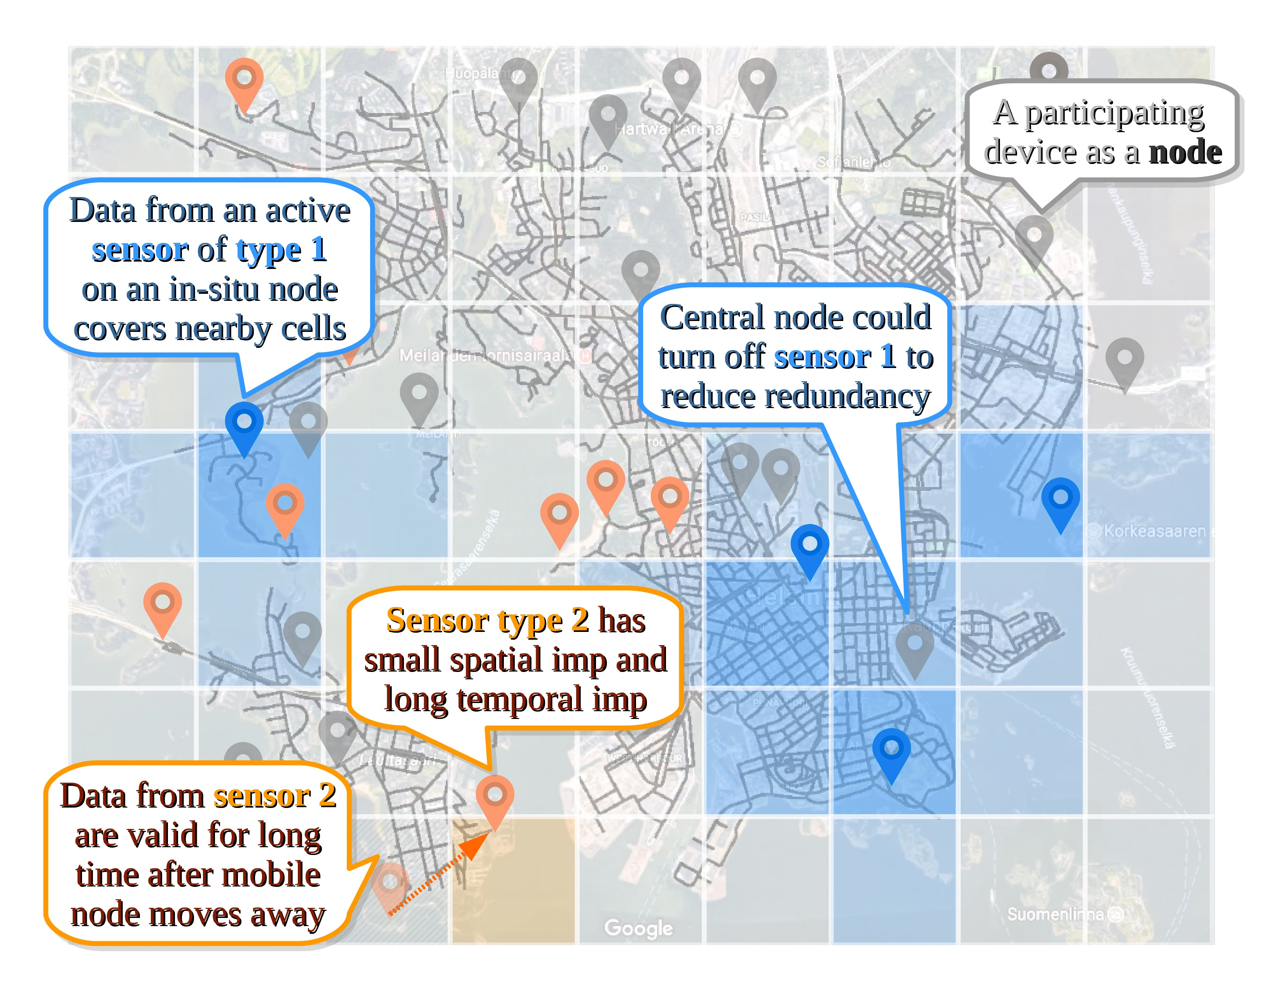
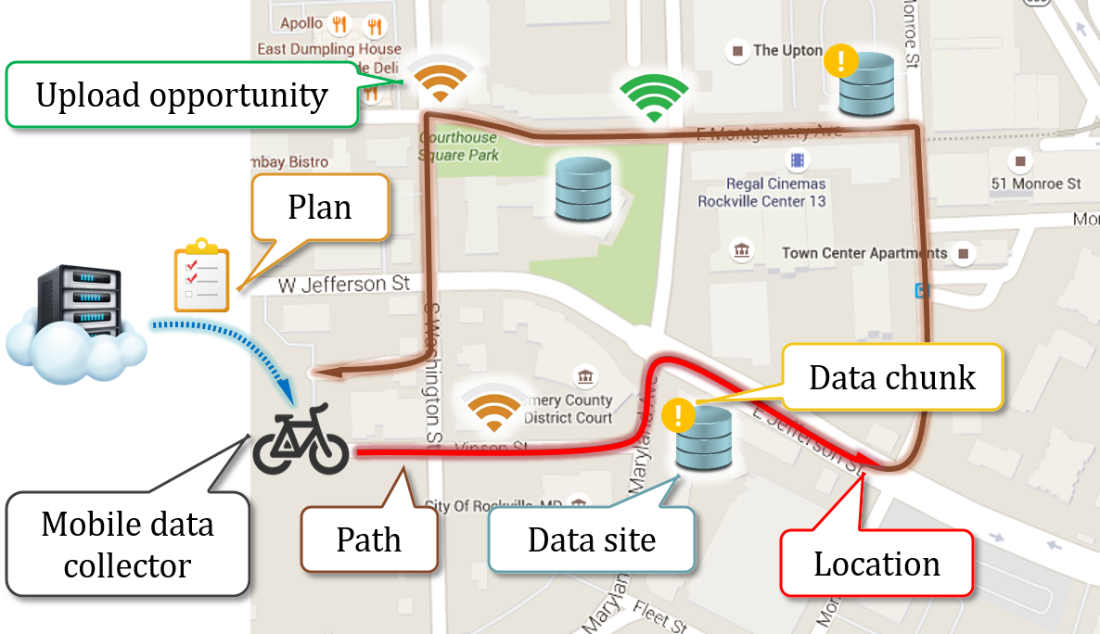
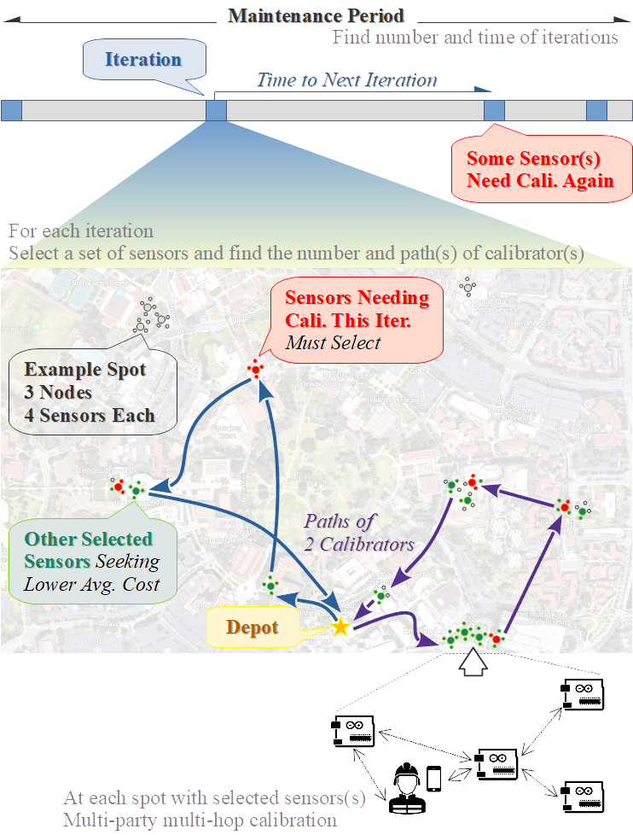
Outline
Background and motivation
Community IoT applications and systems
Mobile sensing and computing
Our experience: SCALE and SCALECycle
Data collection challenges in urban environmental sensing
Research problems
Data generation
planning
Data upload
planning
Sensor calibration
planning
Notes:
Our work is primarily based on two related fields of study – “IoT systems and applications” and “mobile sensing and computing”.
We will also present our IoT projects -- SCALE and SCALECycle.
Based on the experience we learned from the related work and our SCALE experience, we identify key data collection challenges in the community settings and derive our work using an urban environmental sensing scenario.
We propose to exploit the mobile plus in-situ IoT deployments in communities, with intelligent planning of the device and activities, and this will be detailed in three research projects…

Slide 3
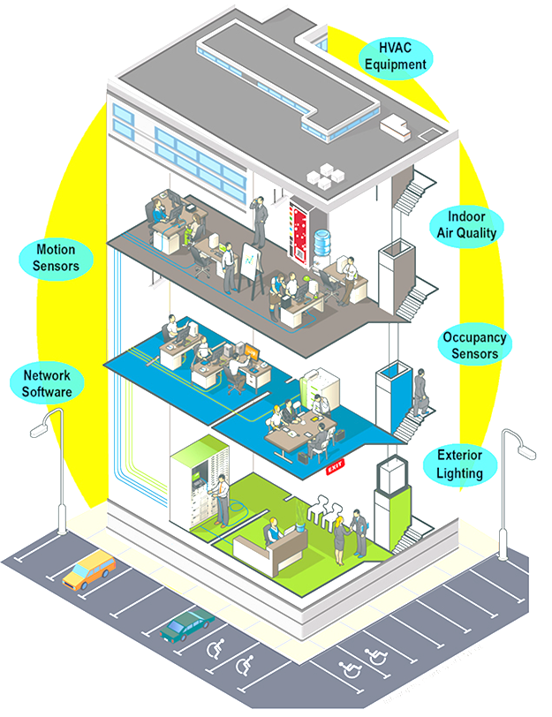
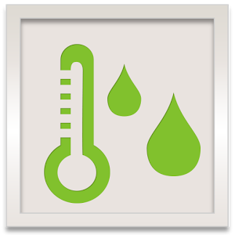
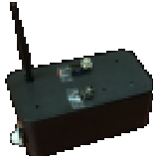
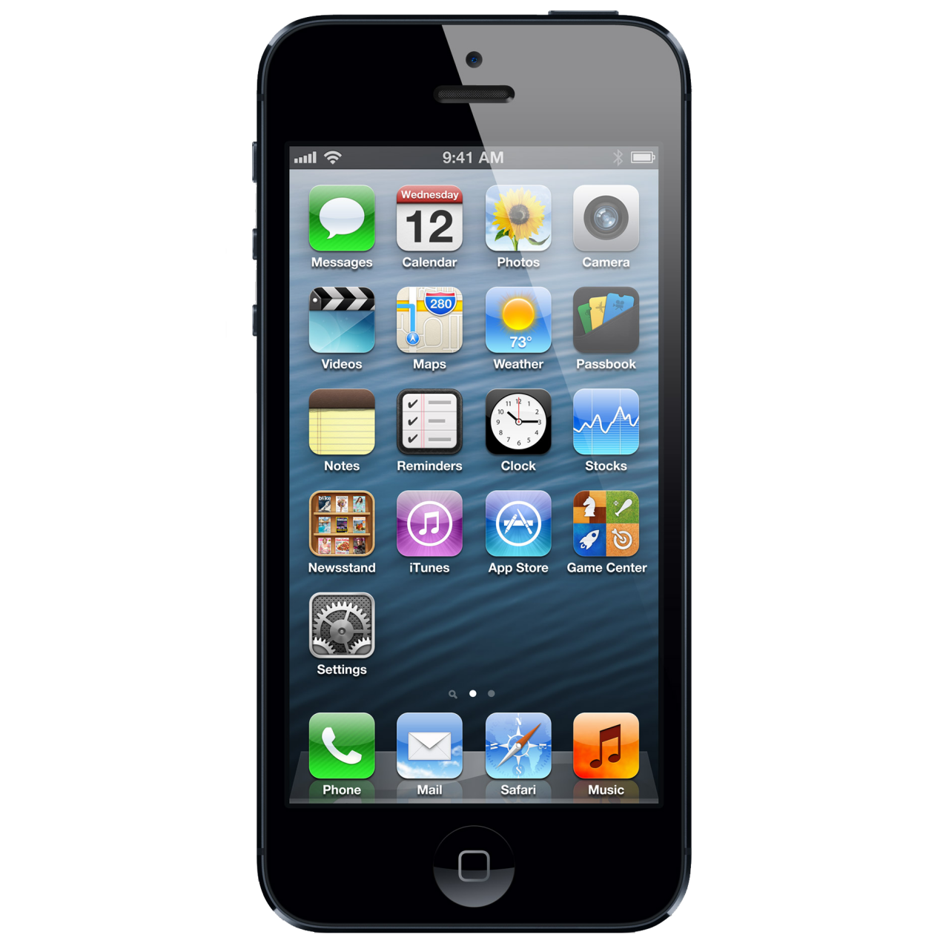
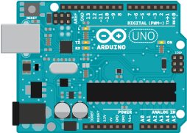
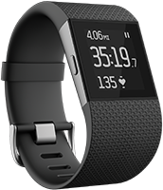
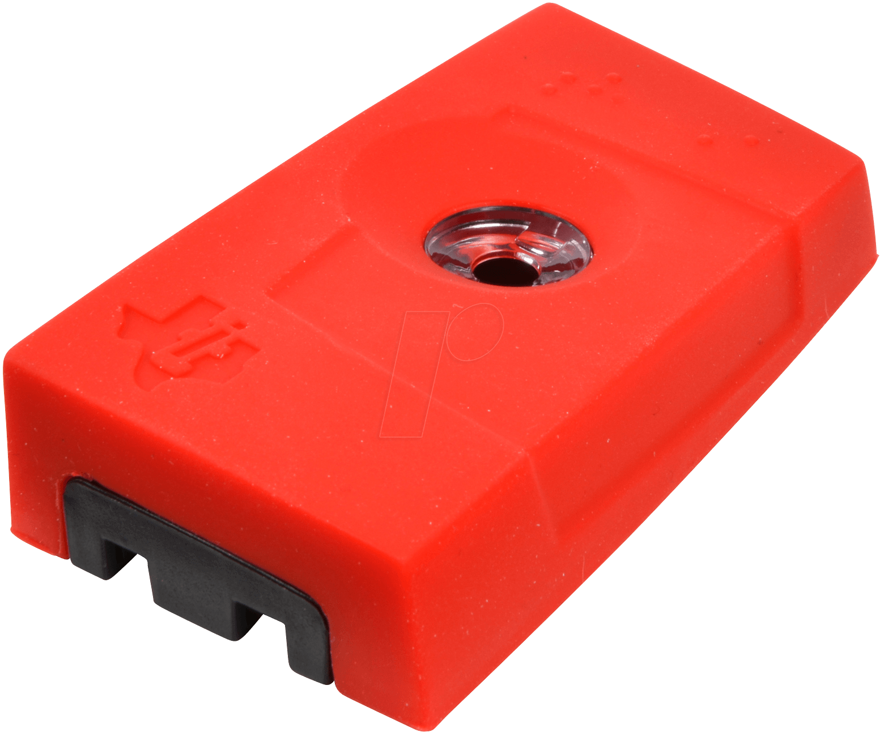
Internet of Things
Notes:
The Internet of Things, or IoT, refers to the system that connects everyday objects using the Internet.
This allows the devices to communicate with each other, or report/acquire data to/from cloud-based services.
The cloud is important for IoT, because this is how IoT achieves its low cost and complexity while dealing with the huge amount of devices.
IoT systems range in scale, from personal wearables, smart homes, smart buildings, to (large) community- and city-scale systems.

Slide 4
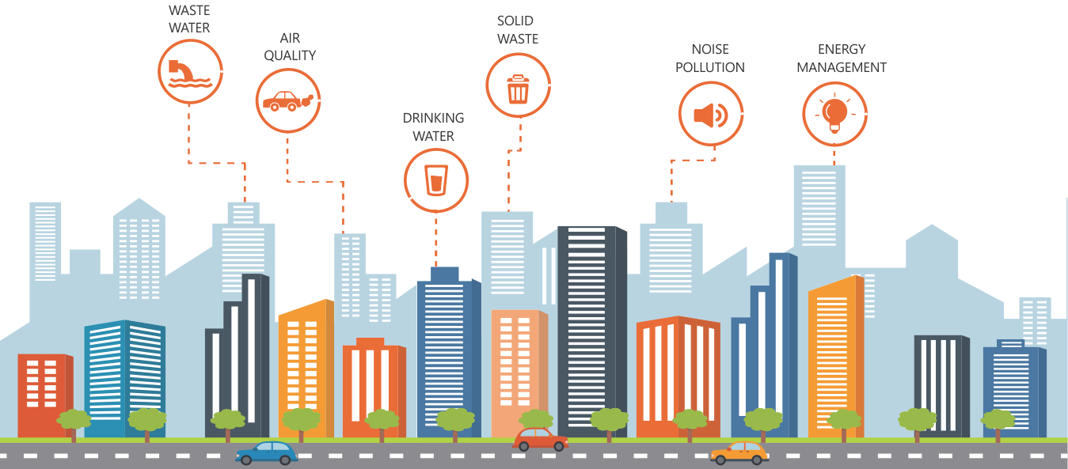
Community IoT
Indoor/outdoor deployments
Situation awareness in community scale
Notes:
When we talk about a community- or city-scale IoT system, we are expecting it to support applications that provide services in this scale, like environmental monitoring or emergency alerting.
Depending on the application, the IoT end devices could be indoor or outdoor.
Wherever they are deployed, we need to be able to collect data from all the devices and analyze them all together.
In other words, the community IoT system should operate as a whole, instead of its individual pieces.

Slide 5
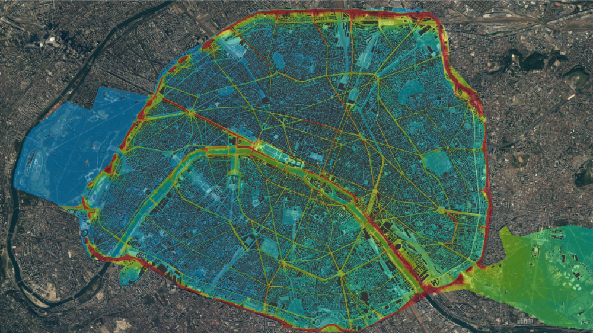
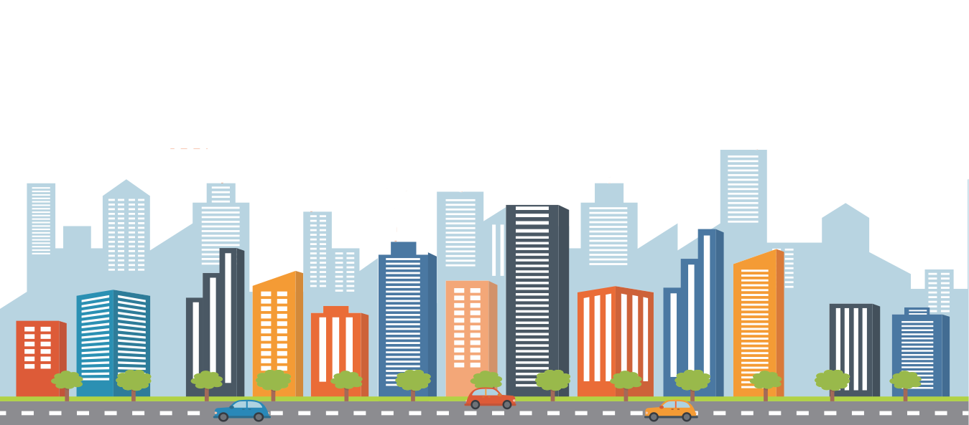
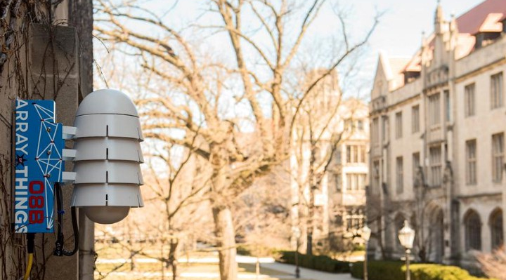
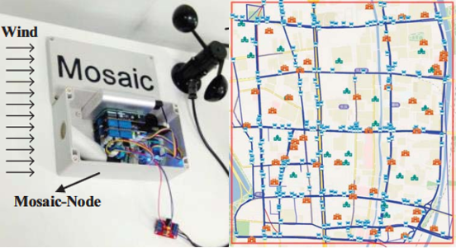
Community IoT (cont.)
Pasadena, California
Paris, France
Chicago, Illinois
Hangzhou, China
Notes:
Here are several examples of community- or city-scale IoT systems.
CSN from Caltech gets data from accelerometers deployed at residents’ homes and use them to detect seismic events (earthquakes).
There could be disturbance like people walking and cars passing by, thus a single pick reported by one device does not mean an earthquake.
The system must analyze data from many devices for reliable reports.
Other examples include:
Ambiciti is crowd-sensing project for noise and air quality.
Array of Things is for multiple environmental metrics.
Mosaic is mobile sensing on buses, primarily for particulate matters (PM).
As we can see here, some of these systems are built on in-situ devices that stay somewhere forever, while some others depend on mobile devices.

Slide 6
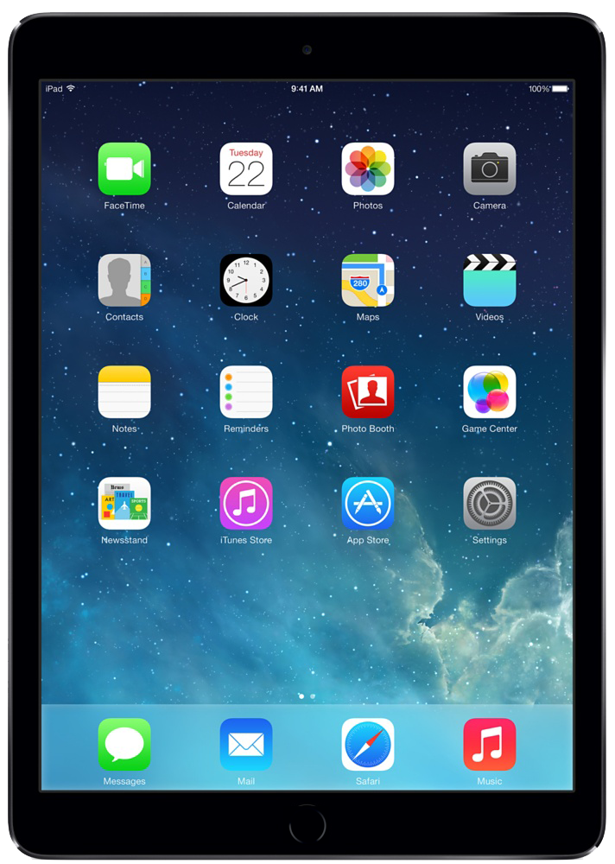
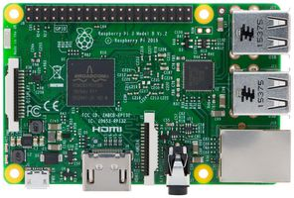
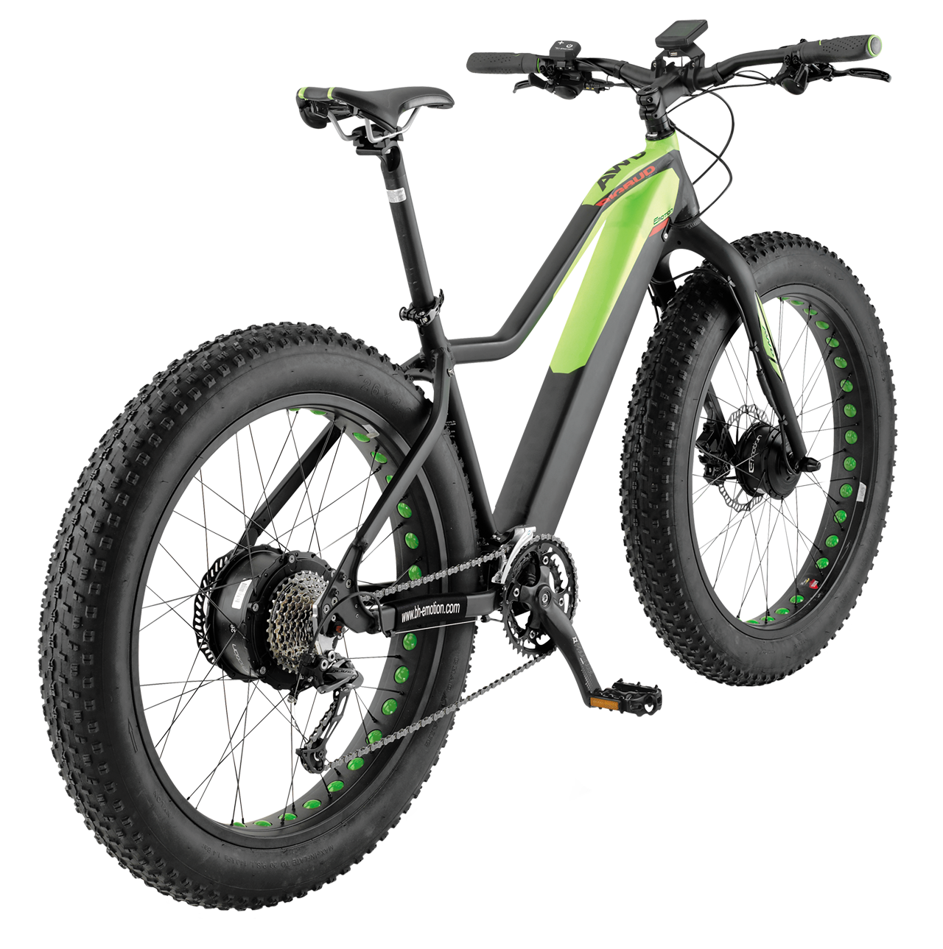
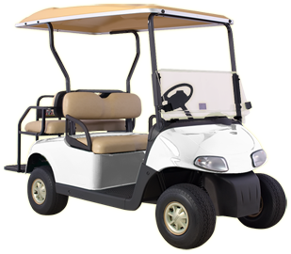
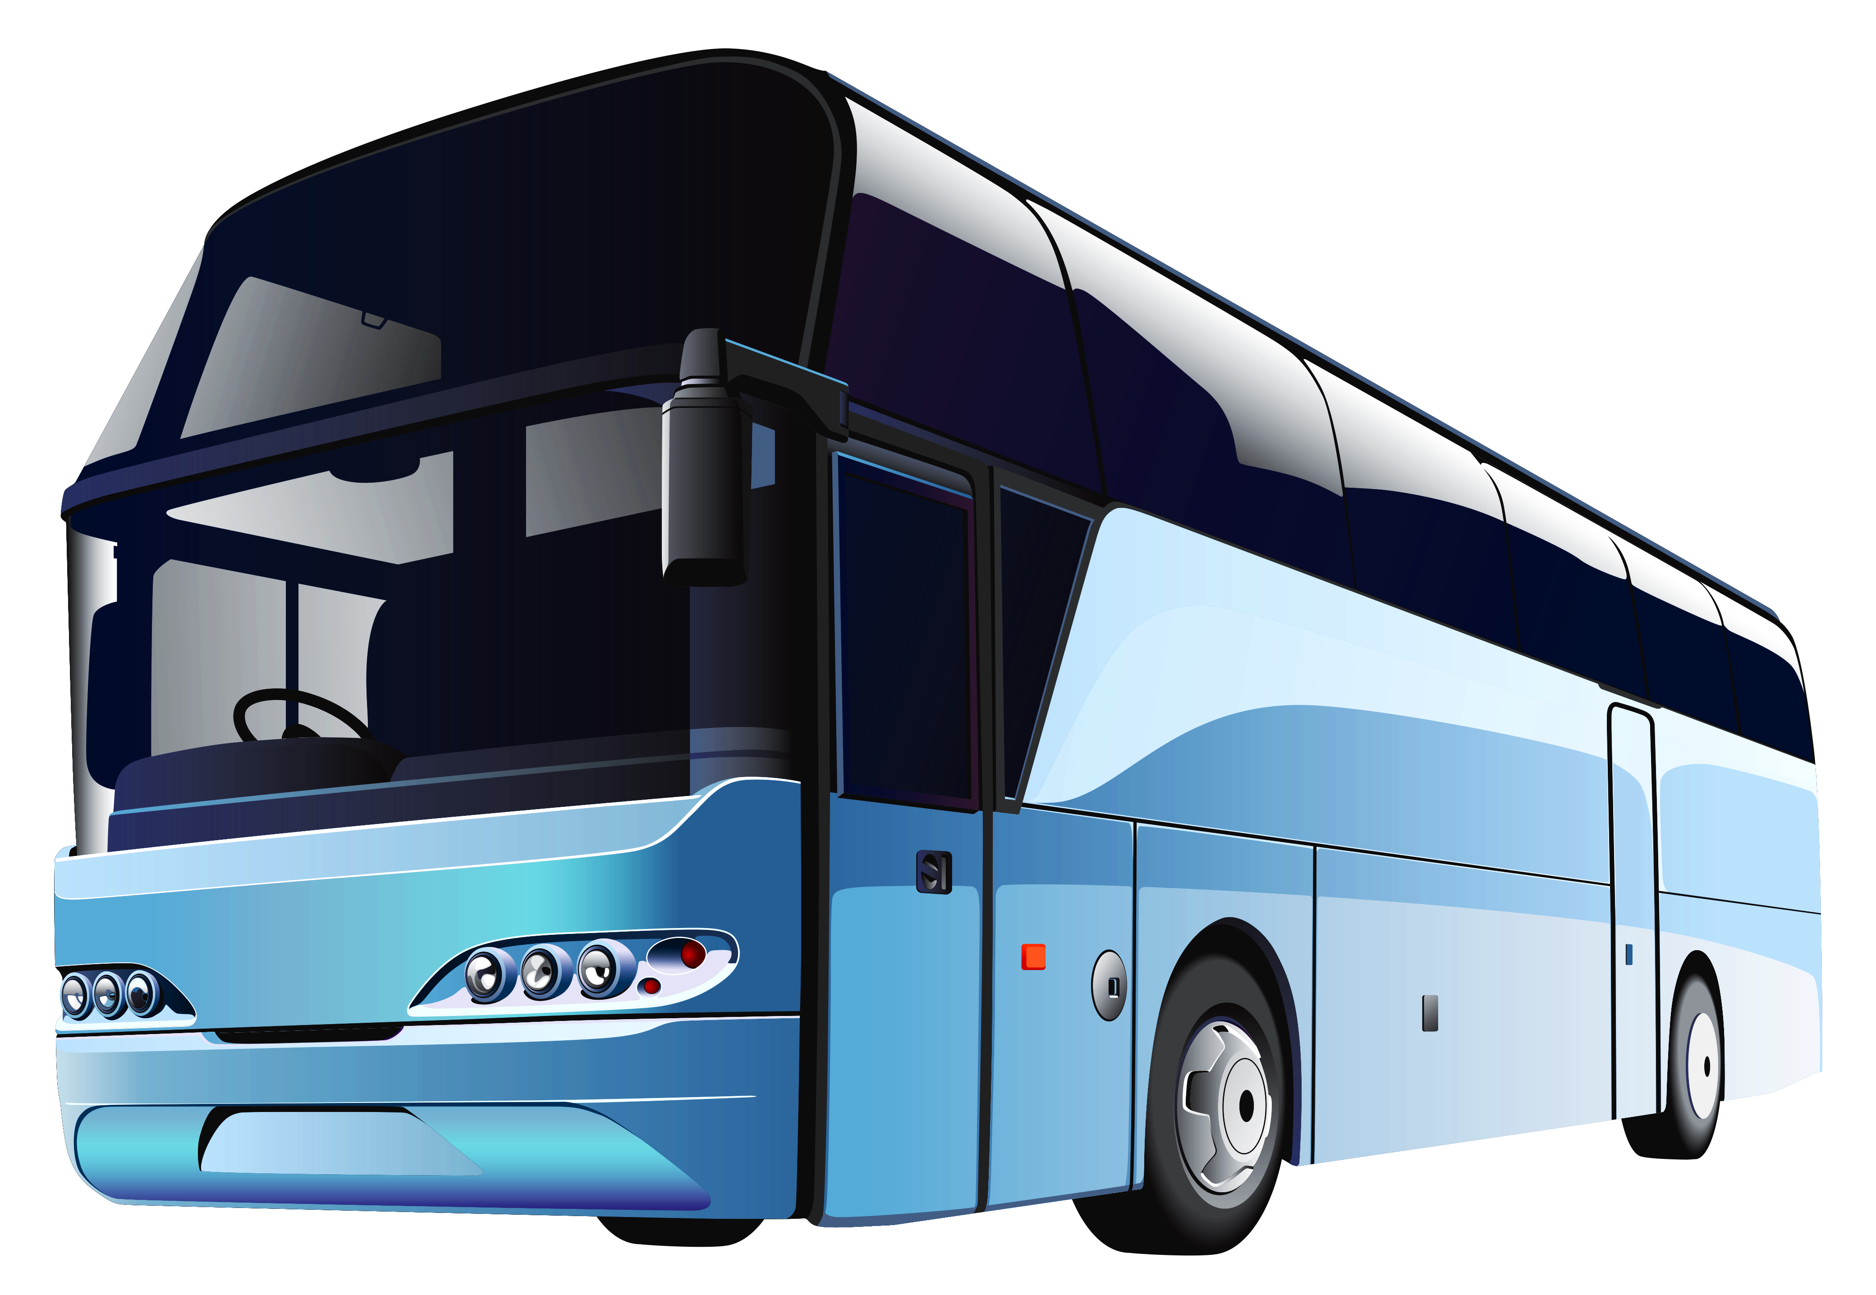
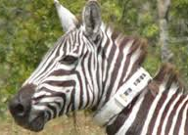
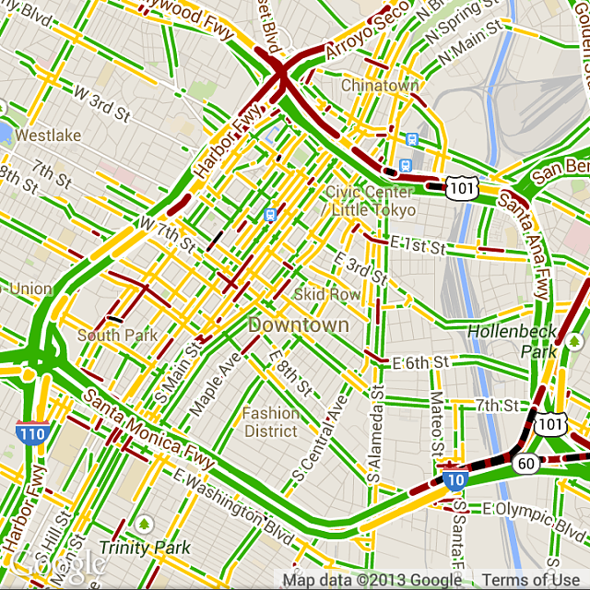
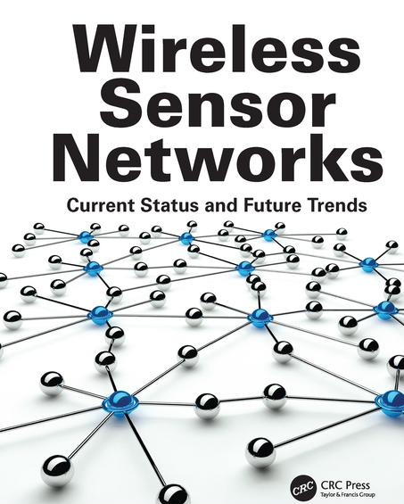
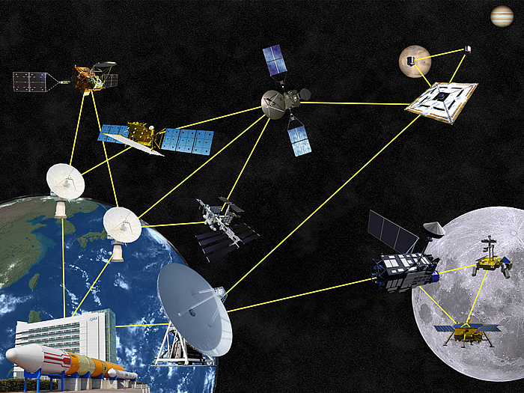
Mobility and sensing
Increasing sensing, computing, and networking capabilities
Large number of mobile entities in communities
Network coverage
Mobile Sensing
Crowdsensing
Delay-Tolerant Networks
Lack of runtime coordination for mobile/in-situ devices or for multiple applications & heterogeneous data.
Focus on placement, path planning, and energy, etc. – not on the timely data upload to the cloud.
Notes:
Talking about mobile devices --
In the last decade, smart mobile devices have become very popular. You can actually build your customized devices easily with these platforms.
The increasing coverage of multi-network also helps to make this happen.
There are a lot of mobile objects in communities, which we can leverage for mobile sensing and mobile computing; therefore, it is natural to include them in community IoT systems.
Work in related fields has been there for 10~20 years. They have their limitations but some of their methods inspired us to exploit the combination of mobile and in-situ devices in communities through intelligent planning.

Slide 7
Combining in-situ and mobile
In-situ IoT deployments
Mobile devices
Large number of low-cost devices
Relatively stable and controllable environment
Continuous operation and real-time situation awareness
Lower dependency on infrastructure -- extends sensing coverage
Existing moving objects in communities
Flexibility -- enables on-demand deployment in emergencies
Leverage advantages of both w/ intelligent planning of device activities!
Notes:
Briefly, we work on a community IoT system that has both in-situ and mobile devices.
Why do we want both?
Because each of them has its own advantages. For example, in-situ devices are suitable for large low-cost deployments, while mobile devices depend less on the infrastructure.
There will be challenges when we try to bring them together, which we will discuss next.
My work is to leverage their advantages and address the challenges that emerge from the combination.

Slide 8
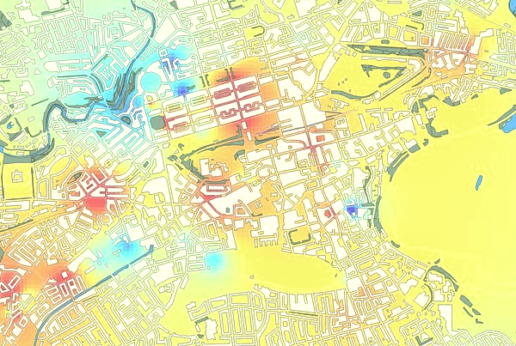
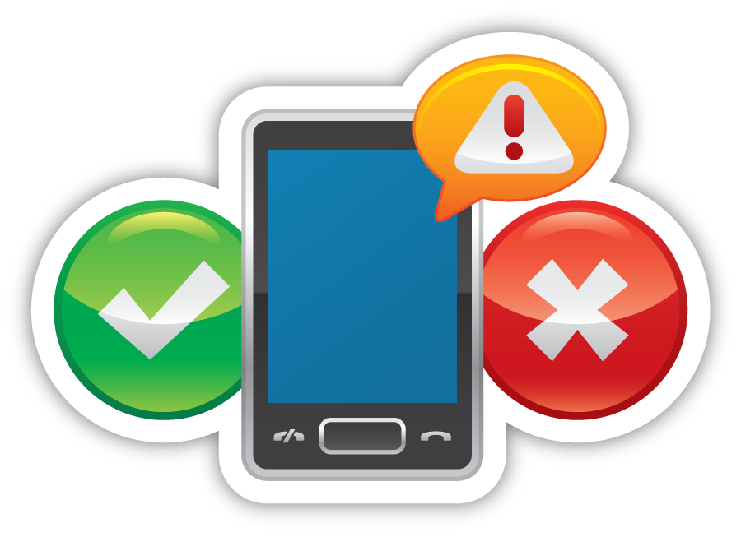
Scenario: Urban env. sensing
In-situ nodes on street lamps, traffic signals, buildings, etc.
Data and events sent through Wi-Fi, cellular, UNB, etc.
Particulate matter
Noise
Carbon monoxide
Wi-Fi coverage
Mobile nodes on buses, golf carts, bikes, pedestrian, etc.
High-resolution
spatiotemporal heatmap of sensor readings
Notes:
We base our work on the urban environmental sensing/monitoring scenario.
There are in-situ devices and mobile devices reporting data to the cloud.
Combining the data we could make high-resolution spatiotemporal heat-maps for sensor readings, one for each phenomena.
Residents can learn from these maps to avoid polluted areas, and decision makers can use the data for better urban planning.
Of course, the system can also be used to provide alerting at the same time using the same data.

Slide 9
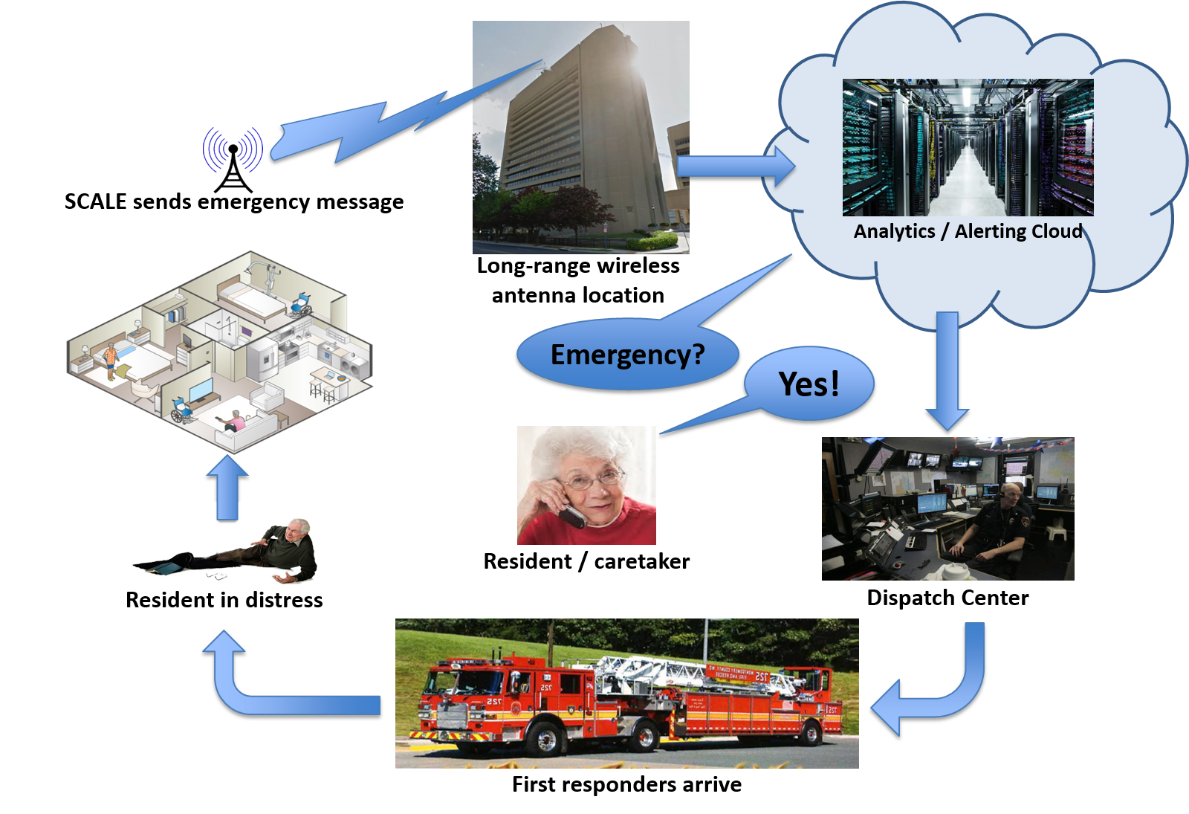
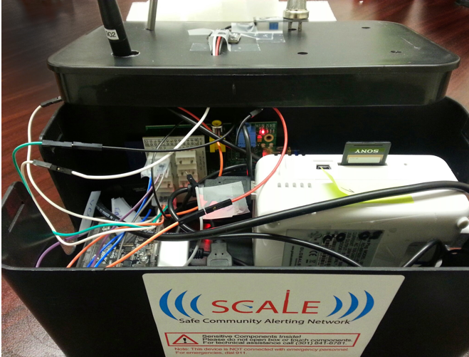
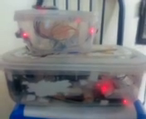
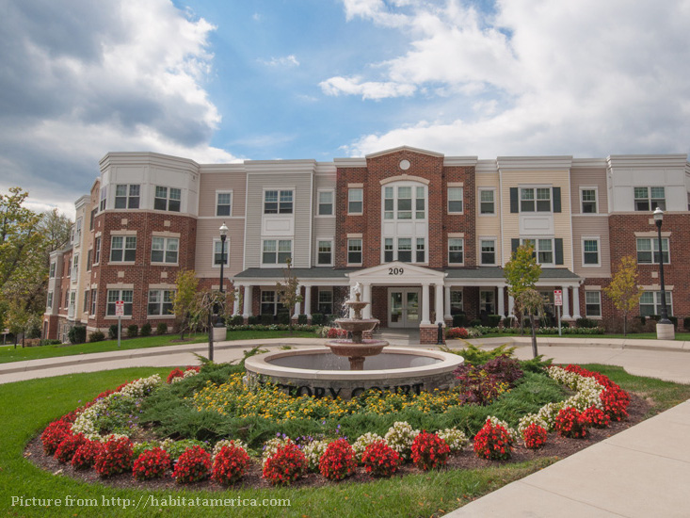
Our IoT testbed
“Democratizing safety by bringing the Internet of Things (IoT) to everyone”
Notes:
Next, we introduce the SCALE project from our group here. SCALE stands for “Safe Community Awareness and Alerting Network”.
It started in Dec 2013 as our response to the SmartAmerica Challenge. The challenge is to bring together academia, government, and industry to create innovative socially beneficial project.
SCALE started as a low-cost home safety and personal safety solution.
The photo at bottom is Victory Court Senior Apartments in Montgomery County, Maryland.
(Describe the figures and photos…)

Slide 10
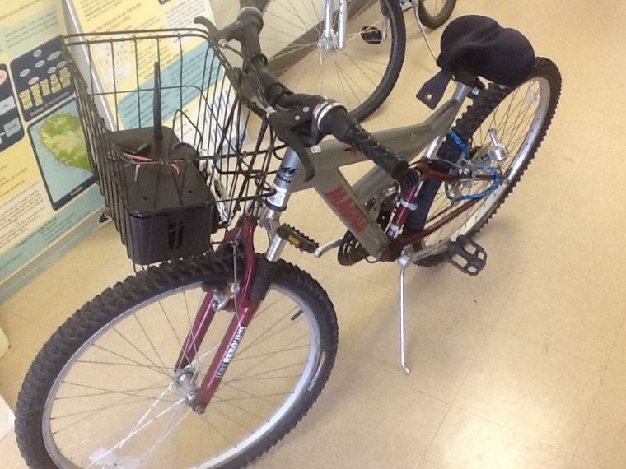
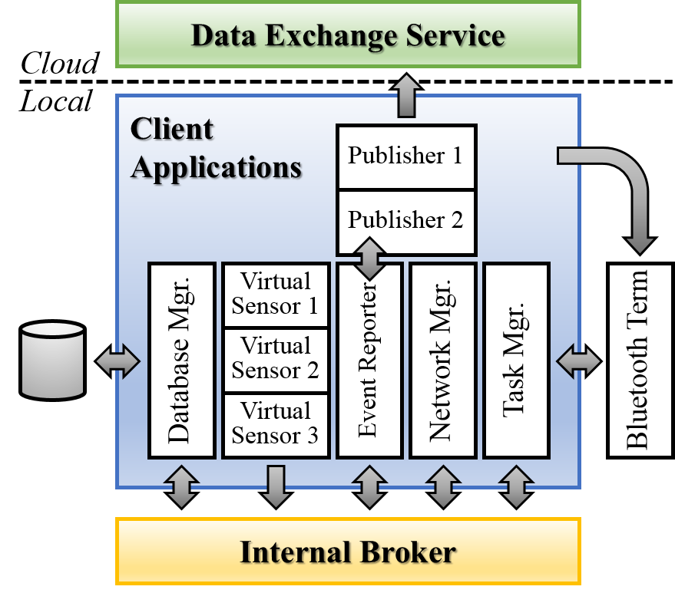
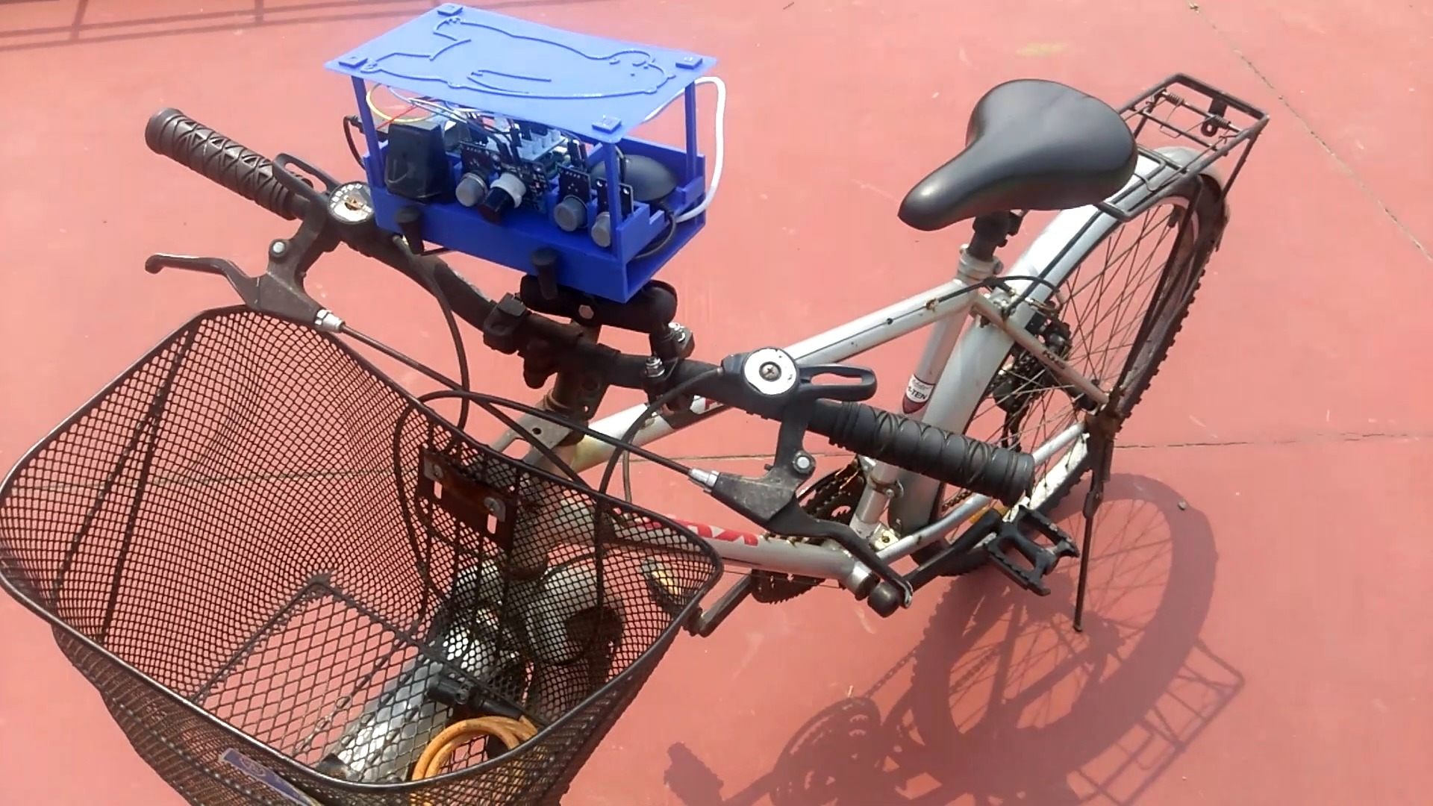
SCALECycle
University of California, Irvine
National Tsing-Hua University, Taiwan
Notes:
SCALE was successful and got into its second phase, namely, SCALE2.
In this phase, we leverage SCALE as a community IoT platform, extended it in different way, and worked on many resilience-related research problems with it.
SCALECycle is the mobile sensing platform I built on top of SCALE.
The SCALE system architecture is open and flexible, so most of the changes are made at the device level.
Added hardware pieces include battery, GPS, Wi-Fi, and air quality sensors.
We also extended the client software, adding a network manager, a task manager, and a local database for caching unsent messages.
Pictures here show two different versions of SCALECycle boxes, assembled at UCI and NTHU respectively.

Slide 11
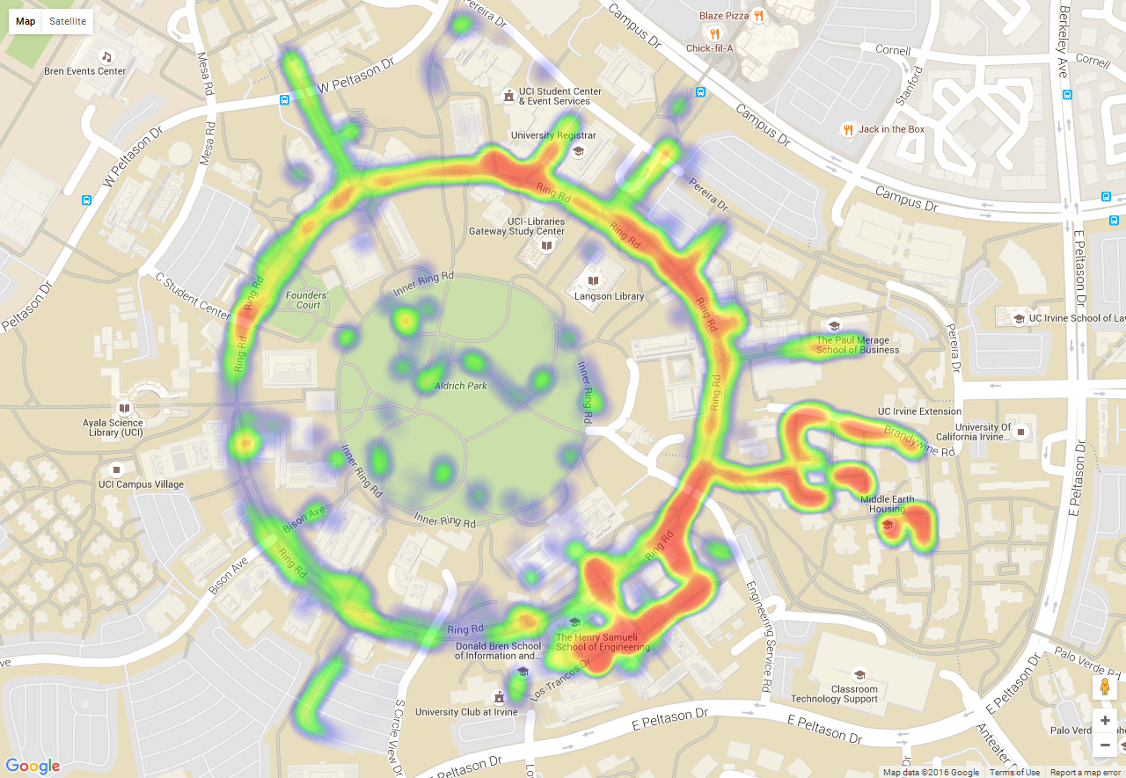
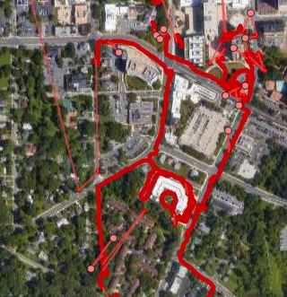
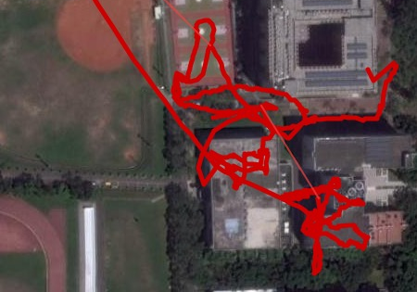
SCALECycle measurements
University of California, Irvine
“UCInet Mobile Access”
Montgomery County, MD
“MCGUEST”
Montgomery County, MD
Thingstitute Lab
(Red Brick Courthouse)
Department of Computer Science
(Donald Bren Hall)
Victory Court Senior Apartments
Good
Poor
National Tsing-Hua University
Sensor type | Format | Sampling pattern | Sample size
Analog sensors | JSON text | 1 message every 5 sec | 200 B
Microphone | WAV | 1 clip of 8 sec every minute | 800 KB
Camera | JPG | 1 picture every 20 sec | 180 KB
Wi-Fi iwlist | JSON text | 1 list of 20 items every 4 sec | 3600 B
Notes:
We collected data with our prototype devices from three testbeds. The data include mobility, Wi-Fi coverage, air quality, etc.
We also built a visualization tool to create these maps.
Quick setup – It can be done within a few hours if you have the pieces ready. The measurements can be collected as you walk/ride.
We once heat-mapped the area around several buildings in George Washington University in one hour before a demo session.

Slide 12
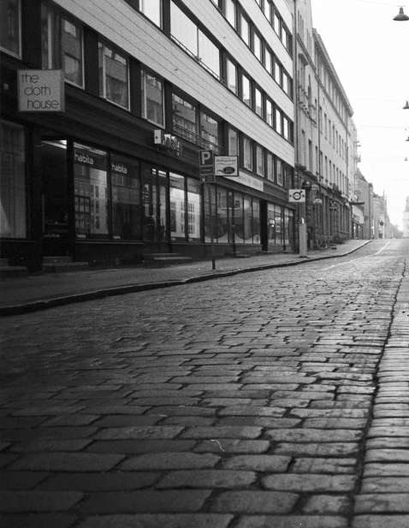
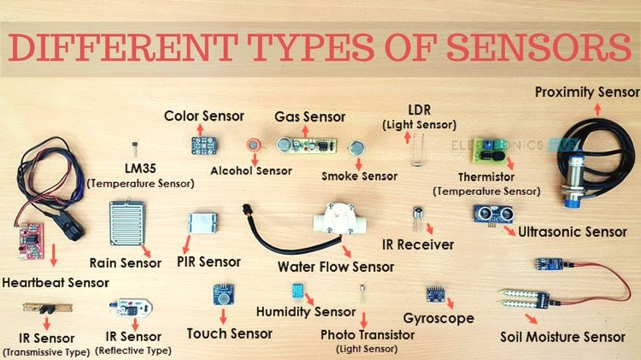
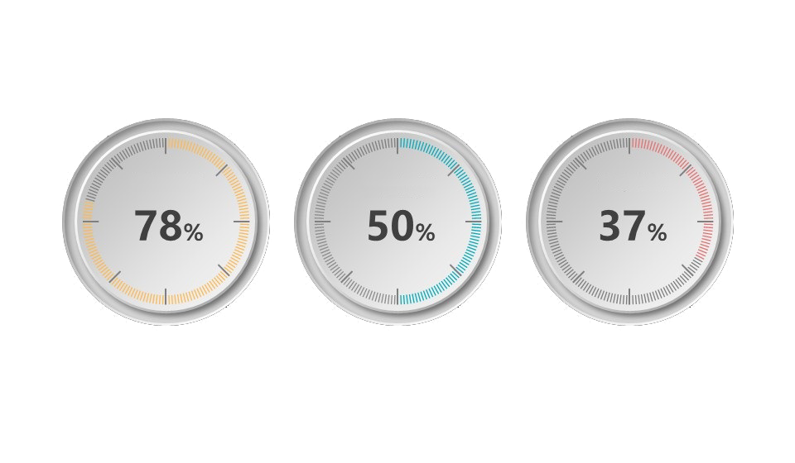
Data collection challenges
Non-uniform network coverage
Large-scale unbalanced deployment
Inaccuracy of low-cost sensors
Notes:
Combining “what we learned from the related work” and “our experience gained in the years we play with SCALE and SCALECycle”, we identify these major challenges in a community IoT system with both in-situ and mobile deployments.
First, network coverage is not uniformly good everywhere in the community. (UCI campus example…) Plus, Wi-Fi handover is still not seamless, and cellular is costly.
Second, in many cases mobility is not controllable or predictable, especially in big events or emergencies – but these are also when we want to ensure timely data delivery.
Third, there are so many types of sensors; the mobile and in-situ devices could have different combinations of them, too.
Last, low-cost sensors degrade. The data are not useful if they are not accurate and spatiotemporally consistent.
If we simply dump the mobile and in-situ devices and various applications together and let them run opportunistically, we could waste time on poor network connectivity, generate redundant data and congest the network, or spend a lot of time maintaining the low-cost devices.
We do not want these to happen, so planning is the key.

Slide 13
Planning is key
Deployment planning – Registration – Compression – Path planning – Analysis
Data generation
planning
Sensor calibration
planning
– Load balancing – Crowd incentive –
– Muling – Protocol – Mobile cloud –
Data upload
planning
Probabilistic broadcasting – Clustering – Caching – Routing – Swarm planning
Notes:
Therefore, planning is the key.
We propose to intelligently plan the activities of devices to make the system operate as a whole.
There are many aspect and stages that could be planned.
In this thesis, we consider three major phases: data generation, data upload, and sensor calibration (or maintenance).

Slide 14
Communication
Data heterogeneity
Data generation planning
Perfect / Irrelevant
Priority, Generation rate, Spatiotemporal imp.
Data upload planning
Campus and large community
Sensor calibration planning
Perfect / Ad-hoc
Calibration period and time (of sensors)
Role of mobile dev.
Mobility pattern
Proposed approaches
Scale of deployment
Large community to city district
Spatiotemporal scheduling
Data source
Arbitrary
Static planning and dynamic adaptation
Sporadic
Chunk size, Priority, Delay tolerance
Predictable
Building to large community
Sensor selection and multipath planning
Calibrator
Planned
Data collector
Notes:
The three projects are derived in similar scenarios at community-scale, but each focuses on certain aspects that we believe to be most challenging.

Slide 15
Publications
Q. Zhu, et al. "Spatio-temporal Scheduling of In-situ and Mobile Internet-of-Things Devices for Urban Environment Sensing". (WIP)
Q. Zhu, et al. "Spatiotemporal Scheduling for Crowd Augmented Urban Sensing". in IEEE INFOCOM 2018. (Best-in-session presentation award)
Sensor calibration
Q. Zhu, et al. "Multi-Sensor Calibration Planning in IoT-Enabled Smart Spaces". in IEEE ICDCS 2019. (Camera-ready)
Generation
Q. Zhu, et al. "Data Collection and Upload under Dynamicity in Smart Community Internet-of-Things Deployments". PMC (2017).
Q. Zhu, et al. "Upload Planning for Mobile Data Collection in Smart Community Internet-of-Things Deployments". in IEEE SMARTCOMP 2016. (Best paper nomination)
Upload
M. Y. S. Uddin, A. Nelson, K. Benson, G. Wang, Q. Zhu, Q. Han, N. Alhassoun, P. Chakravarthi, J. Stamatakis, et al. "The SCALE2 Multi-network Architecture for IoT-based Resilient Communities". in IEEE SMARTCOMP 2016.
K. Benson, C. Fracchia, G. Wang, Q. Zhu, S. Almomen, J. Cohn, L. D’Arcy, D. Hoffman, M. Makai, et al. "SCALE: Safe Community Awareness and Alerting Leveraging the Internet of Things". IEEE Communications (2015).
SCALE
Notes:
Therefore, planning is the key.
We propose to intelligently plan the activities of devices to make the system operate as a whole.
There are many aspect and stages that could be planned.
In this thesis, we consider three major phases: data generation, data upload, and sensor calibration (or maintenance).

Slide 16
Publications
■ SCALE system ■ Data generation pl.
■ Data upload pl. ■ Sensor calibration pl.
Q. Zhu, M. Y. S. Uddin, N. Venkatasubramanian, C. Chen, and C. Hsu. "Spatio-temporal Scheduling of In-situ and Mobile Internet-of-Things Devices for Urban Environment Sensing". (Work in progress)
Q. Zhu, F. Sailhan, M. Y. S. Uddin, V. Issarny, and N. Venkatasubramanian. "Multi-Sensor Calibration Planning in IoT-Enabled Smart Spaces". in IEEE ICDCS 2019. (Camera-ready)
Q. Zhu, M. Y. S. Uddin, N. Venkatasubramanian, C. Hsu, and H. Hong. "Poster Abstract: Enhancing Reliability of Community Internet-of-Things Deployments with Mobility". in IEEE INFOCOM WKSHPS 2018.
Q. Zhu, M. Y. S. Uddin, N. Venkatasubramanian, and C. Hsu. "Spatiotemporal Scheduling for Crowd Augmented Urban Sensing". in IEEE INFOCOM 2018. (Best-in-session presentation award)
Q. Zhu, M. Y. S. Uddin, Z. Qin, and N. Venkatasubramanian. "Data Collection and Upload under Dynamicity in Smart Community Internet-of-Things Deployments". Pervasive and Mobile Computing (2017).
M. Y. S. Uddin, A. Nelson, K. Benson, G. Wang, Q. Zhu, Q. Han, N. Alhassoun, P. Chakravarthi, J. Stamatakis, D. Hoffman, S. Almomen, L. DArcy, and N. Venkatasubramanian. "The SCALE2 Multi-network Architecture for IoT-based Resilient Communities". in IEEE SMARTCOMP 2016.
Q. Zhu, M. Y. S. Uddin, Z. Qin, and N. Venkatasubramanian. "Upload Planning for Mobile Data Collection in Smart Community Internet-of-Things Deployments". in IEEE SMARTCOMP 2016. (Best paper nomination)
K. Benson, C. Fracchia, G. Wang, Q. Zhu, S. Almomen, J. Cohn, L. D’Arcy, D. Hoffman, M. Makai, J. Stamatakis, and N. Venkatasubramanian. "SCALE: Safe Community Awareness and Alerting Leveraging the Internet of Things". IEEE Communications (2015).

Slide 17
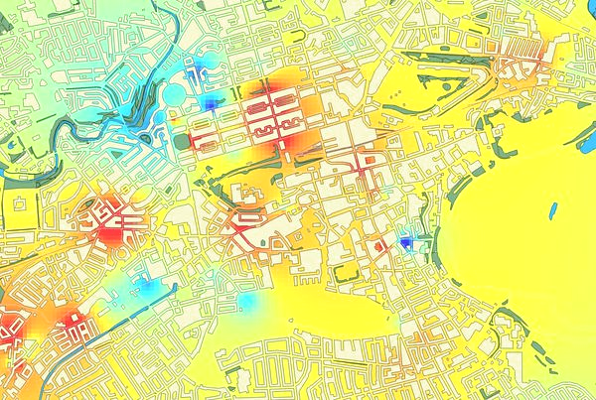
Data generation planning
Covered in topic defense
We anticipate that a large number of devices will participate in such activities in communities in the coming future.
Make plans for in-situ and mobile devices to regulate their sensing activities (i.e. activate/deactivate their sensors) for
Good sensing coverage
Lower data redundancy
Challenges
Device heterogeneity
Data heterogeneity
Unpredictable mobility
Scalability

Slide 18
Online scheduling approach
Devices report on-board sensing capability info to server.
Server collects or estimates the location of participating devices.
Server creates the plan which specifies what sensors should be active on which devices now.
Devices activate or deactivate sensors.
This is a device

Slide 19
Multi-objective optimization
Given the presence of sensors on nodes, $B_{N×K}$, the location of nodes, $G_{N×M}\left[n\right],n∈N$, and the characteristics of data types;
Find the plan for each time frame $W_{N×K}\left[n\right],n∈N$, to maximize the overall performance (coverage $X$ + utility $U$ – cost $Y$);
Subject to presence constraint $W_{j,k}\left[n\right]≤B_{j,k},∀j,k,n$ and data constraint $D≤D_{quota}$.
Algorithm: Highest-score-first (HSF) and Lyapunov control
Notes:
Time complexity of both algorithms: $O\left(KM^{2}N+KMN^{2}+K^{2}N^{2}\right)$.

Slide 20
Highest score first
Get higher overall performance using assigned data budget
Score of a sensor (i.e. a node-type pair) is defined as the performance gain divided by data consumption, i.e.
$$\frac{γ_{1}⋅Δx\left[n\right]+γ_{2}⋅Δu\left[n\right]−γ_{3}⋅Δy\left[n\right]}{Δd\left[n\right]}$$
Select the node-sensor pair with the highest score, add it to the plan, and loop until: (1) All sensors are active, (2) Data quota is used up, or (3) Highest score is non-positive.
Any selection could affect scores of unselected sensors.
Unused data budget rolls over to the next time frame.
Notes:
Recall that the overall performance includes three terms: Utility, coverage, and node activation.
Time complexity: O(K * M ^ 2 * N + K * M * N ^ 2 + K ^ 2 * N ^ 2)

Slide 21
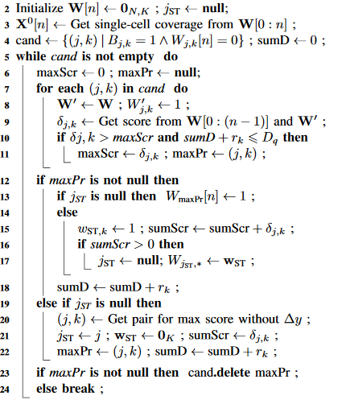
Highest score first
Start with an empty $W\left[n\right]$
For every node-sensor pair $\left(j,k\right)$ that is not marked as active and does not violate data quota constraint in $W\left[n\right]$, compute its score
Mark the $\left(j,k\right)$ pair with highest positive score as active, and loop until…
Slow termination: When highest score is negative
Unit-data performance gain, i.e.
$$\frac{γ_{1}⋅Δx\left[n\right]+γ_{2}⋅Δu\left[n\right]−γ_{3}⋅Δy\left[n\right]}{Δd\left[n\right]}$$
Notes:
There are 3 (three) ways this algorithm terminates:
All sensors are active
Data quota runs out
Highest score is non-positive

Slide 22
Lyapunov control
Match used data (actually generated) with data quota
State of the system $φ\left[n\right]$ is represented by a “queue”, the size of the queue is the total amount of data generated up to the current time frame, i.e. $φ\left[n\right]=Q\left[n\right]=n⋅d\left[0:\left(n−1\right)\right]$.
Lyapunov function $L\left(φ\left[n\right]\right)$
$$=\frac{1}{2}{\left(Q\left[n\right]−n⋅D_{quota}\right)}^{2}$$
Lyapunov drift $ΔL\left(φ\left[n\right]\right)≈\left(Q\left[n\right]−n⋅D_{quota}\right)⋅d\left[n\right]$
Minimizing “drift minus reward” is equivalent to maximizing
$$γ_{1}⋅x\left[0:n\right]+γ_{2}⋅u\left[0:n\right]−γ_{3}⋅y\left[0:n\right]−γ_{L}⋅ΔL\left(φ\left[n\right]\right)$$
Notes:
Lyapunov control allows us to over-draft data budget from future time frames when there is a good opportunity in the current one.
This is actually another way to define the “score” to use in HSF.

Slide 23
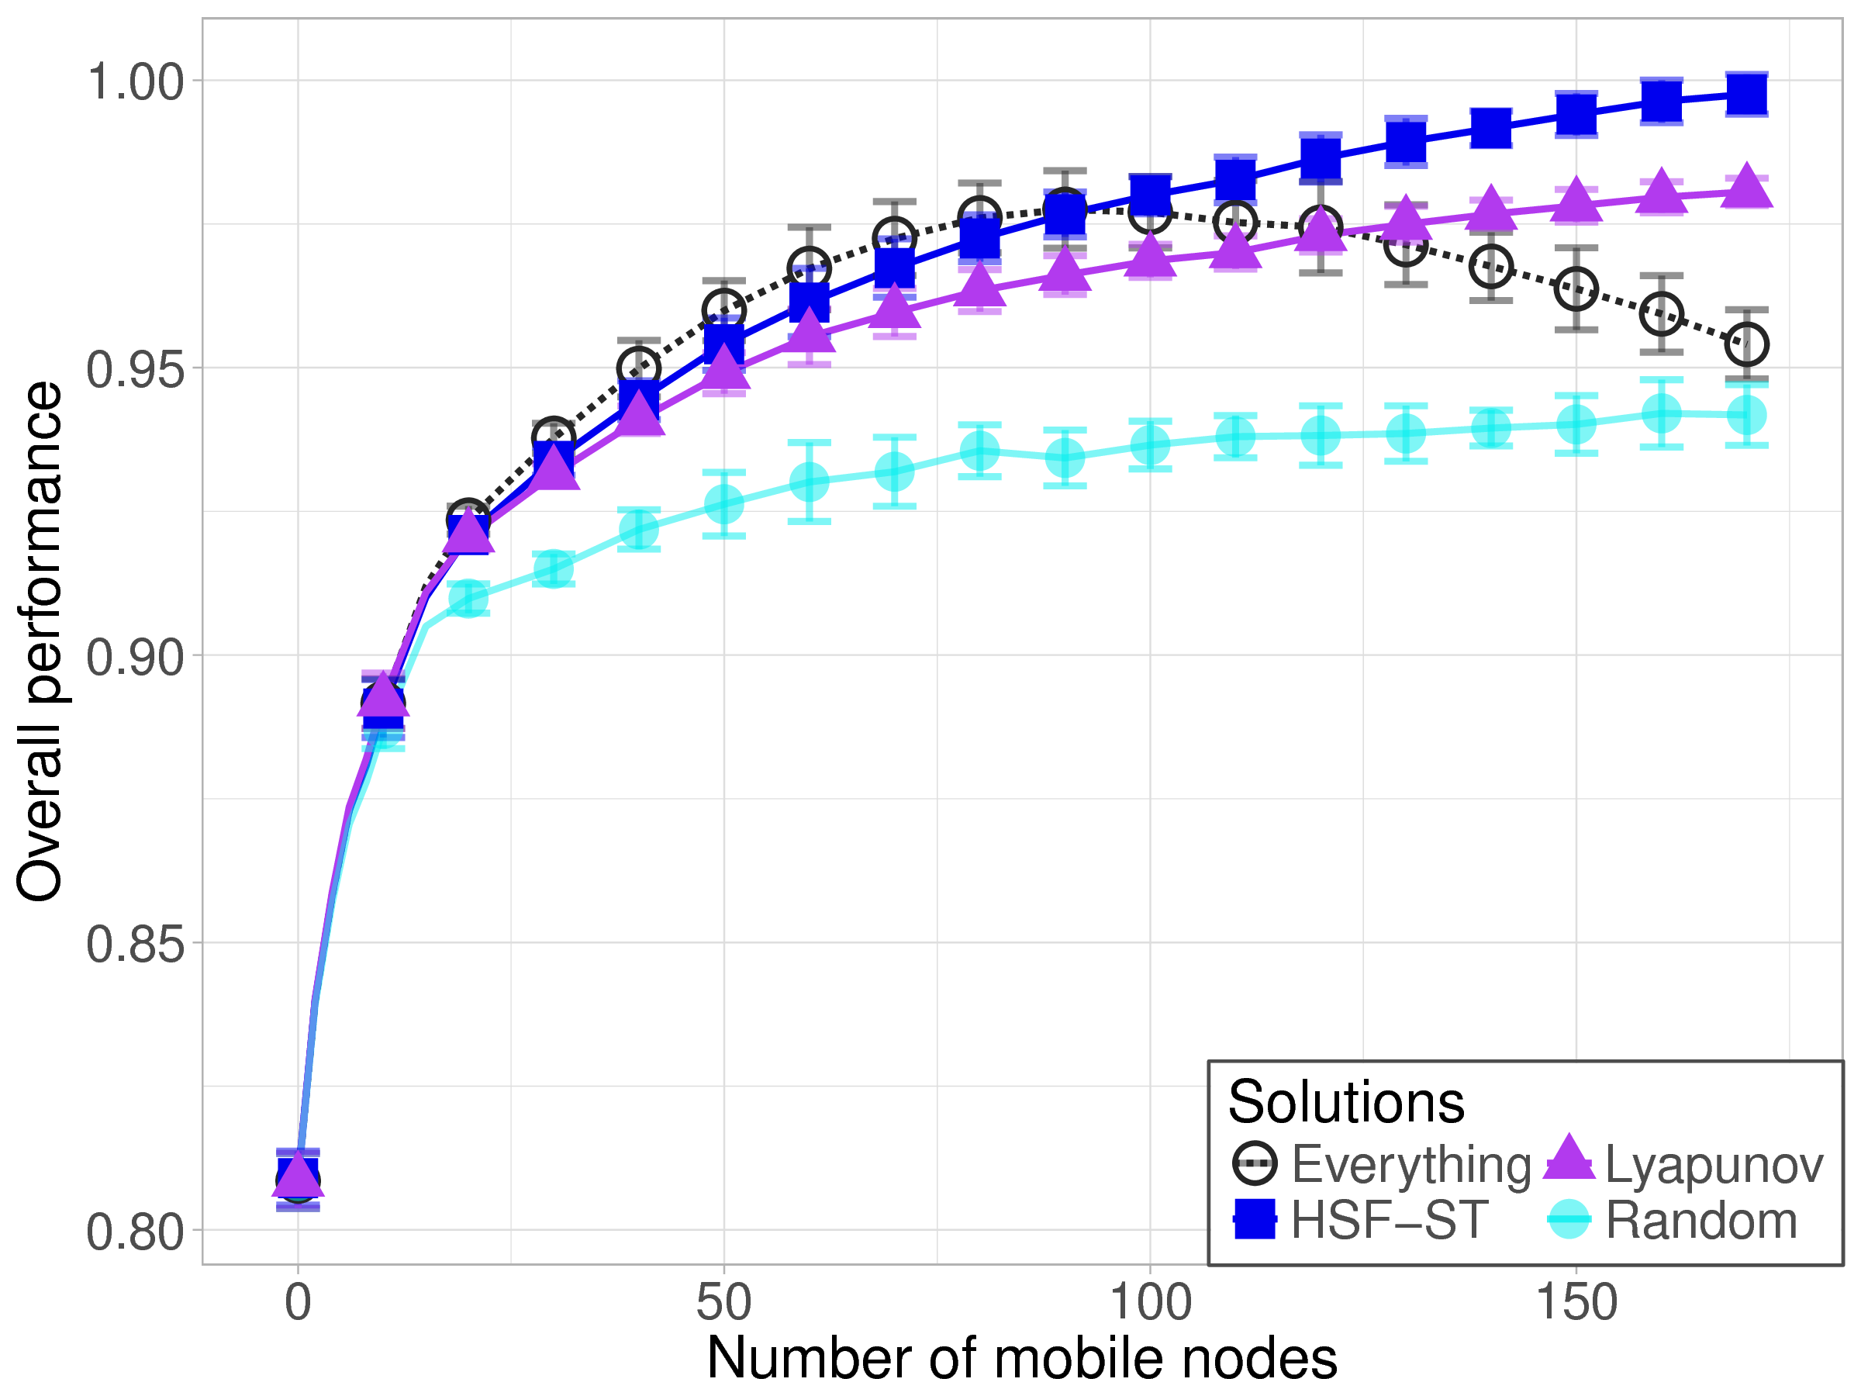
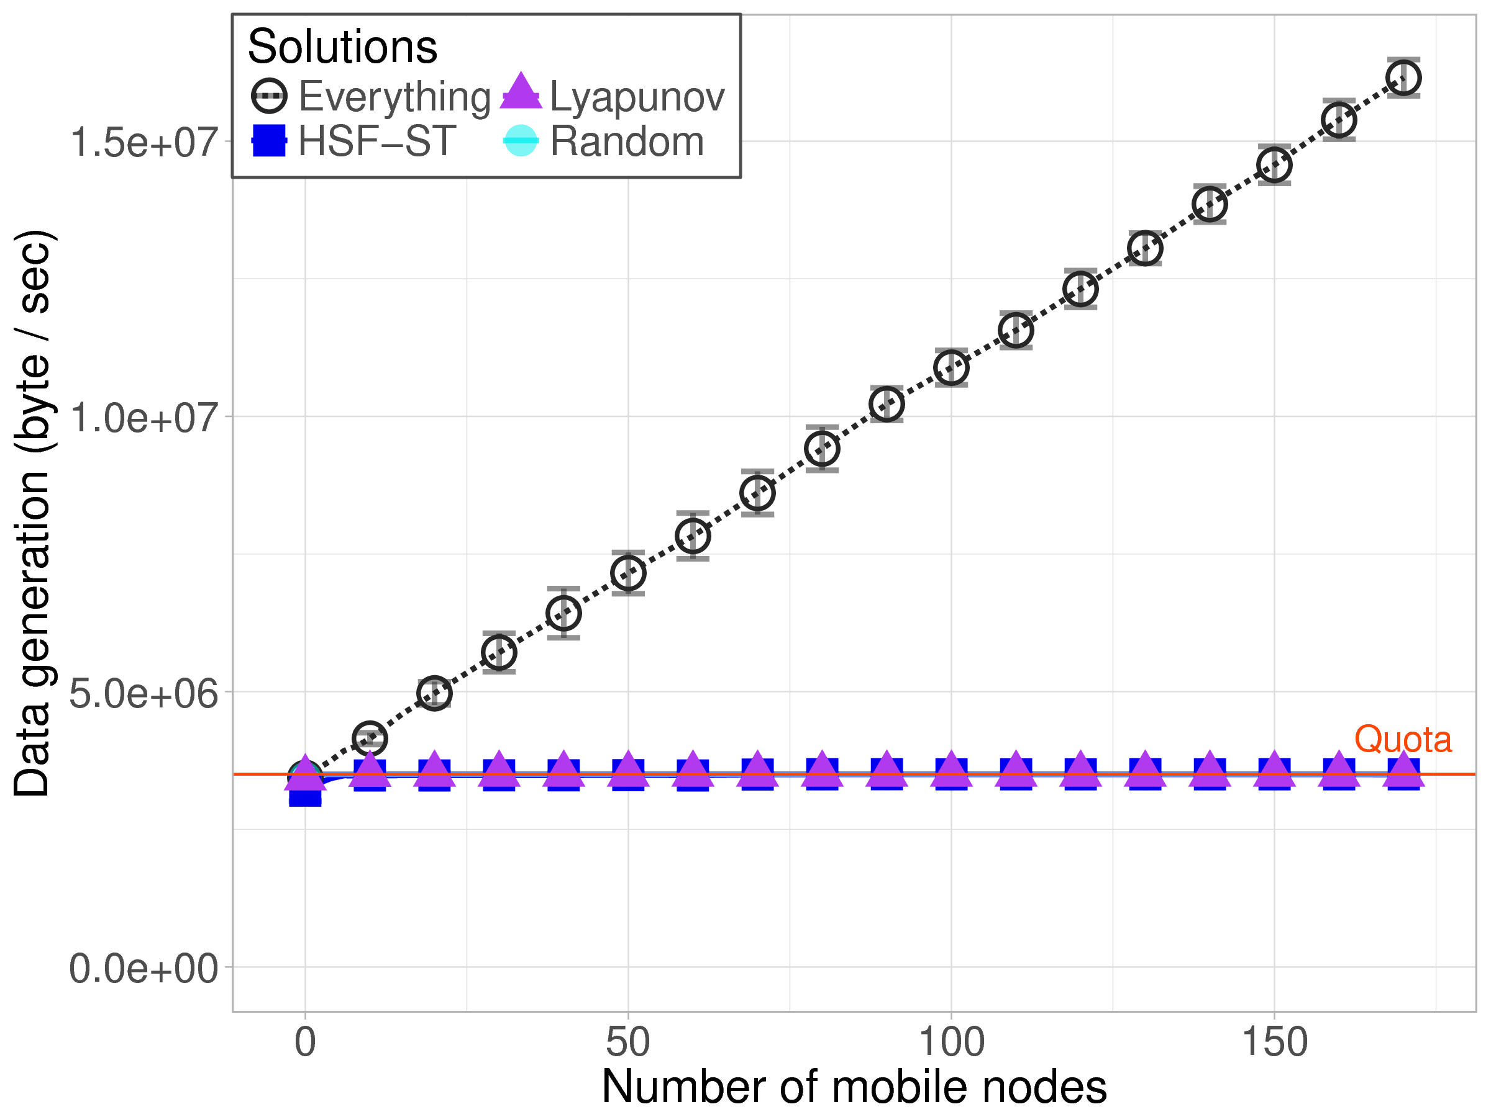
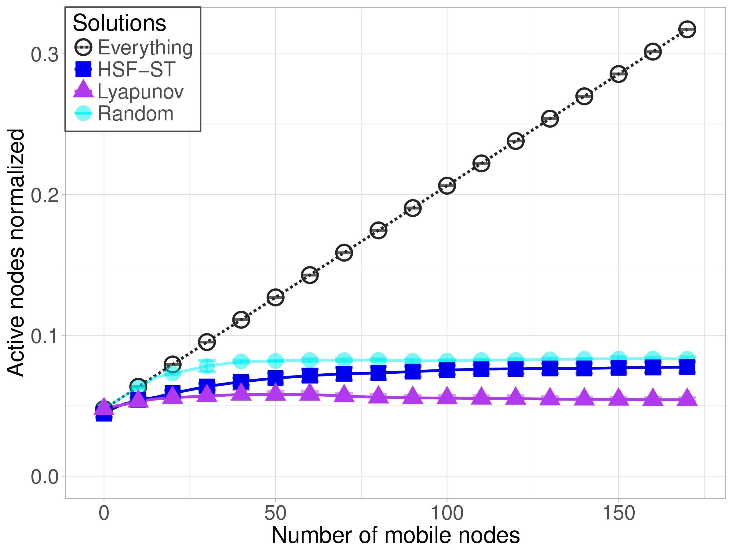
Results
~30% fewer active nodes
Node mobility
# In-situ: 30
# mobile: 0~170
Activating everything results in the maximum coverage, but it violates the data budget constraint and uses more nodes.
Results on more tests show that our algorithms perform well as the system scales up, or with higher heterogeneity.
Q. Zhu, et al. "Spatio-temporal Scheduling of In-situ and Mobile Internet-of-Things Devices for Urban Environment Sensing". (Work in progress)
Q. Zhu, et al. "Spatiotemporal Scheduling for Crowd Augmented Urban Sensing". in IEEE INFOCOM 2018.

Slide 24
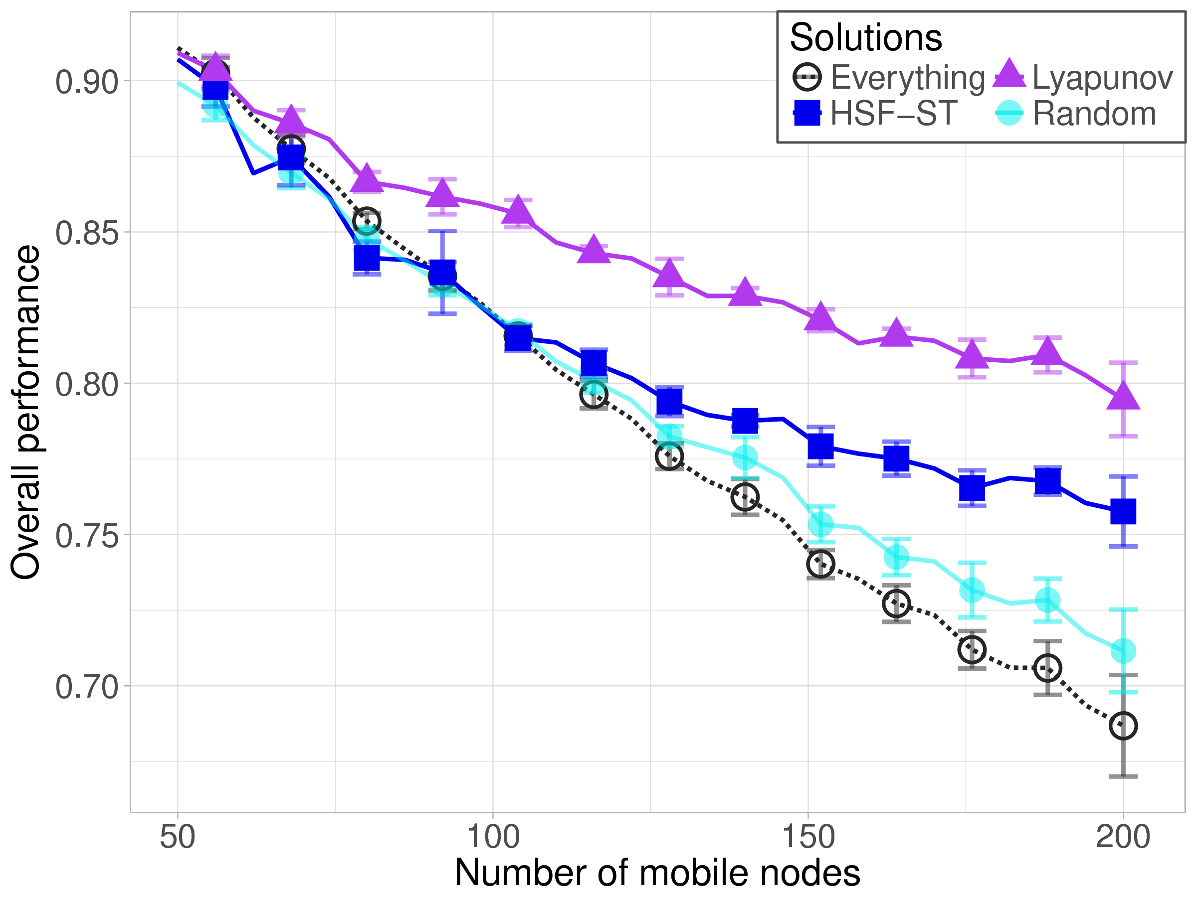
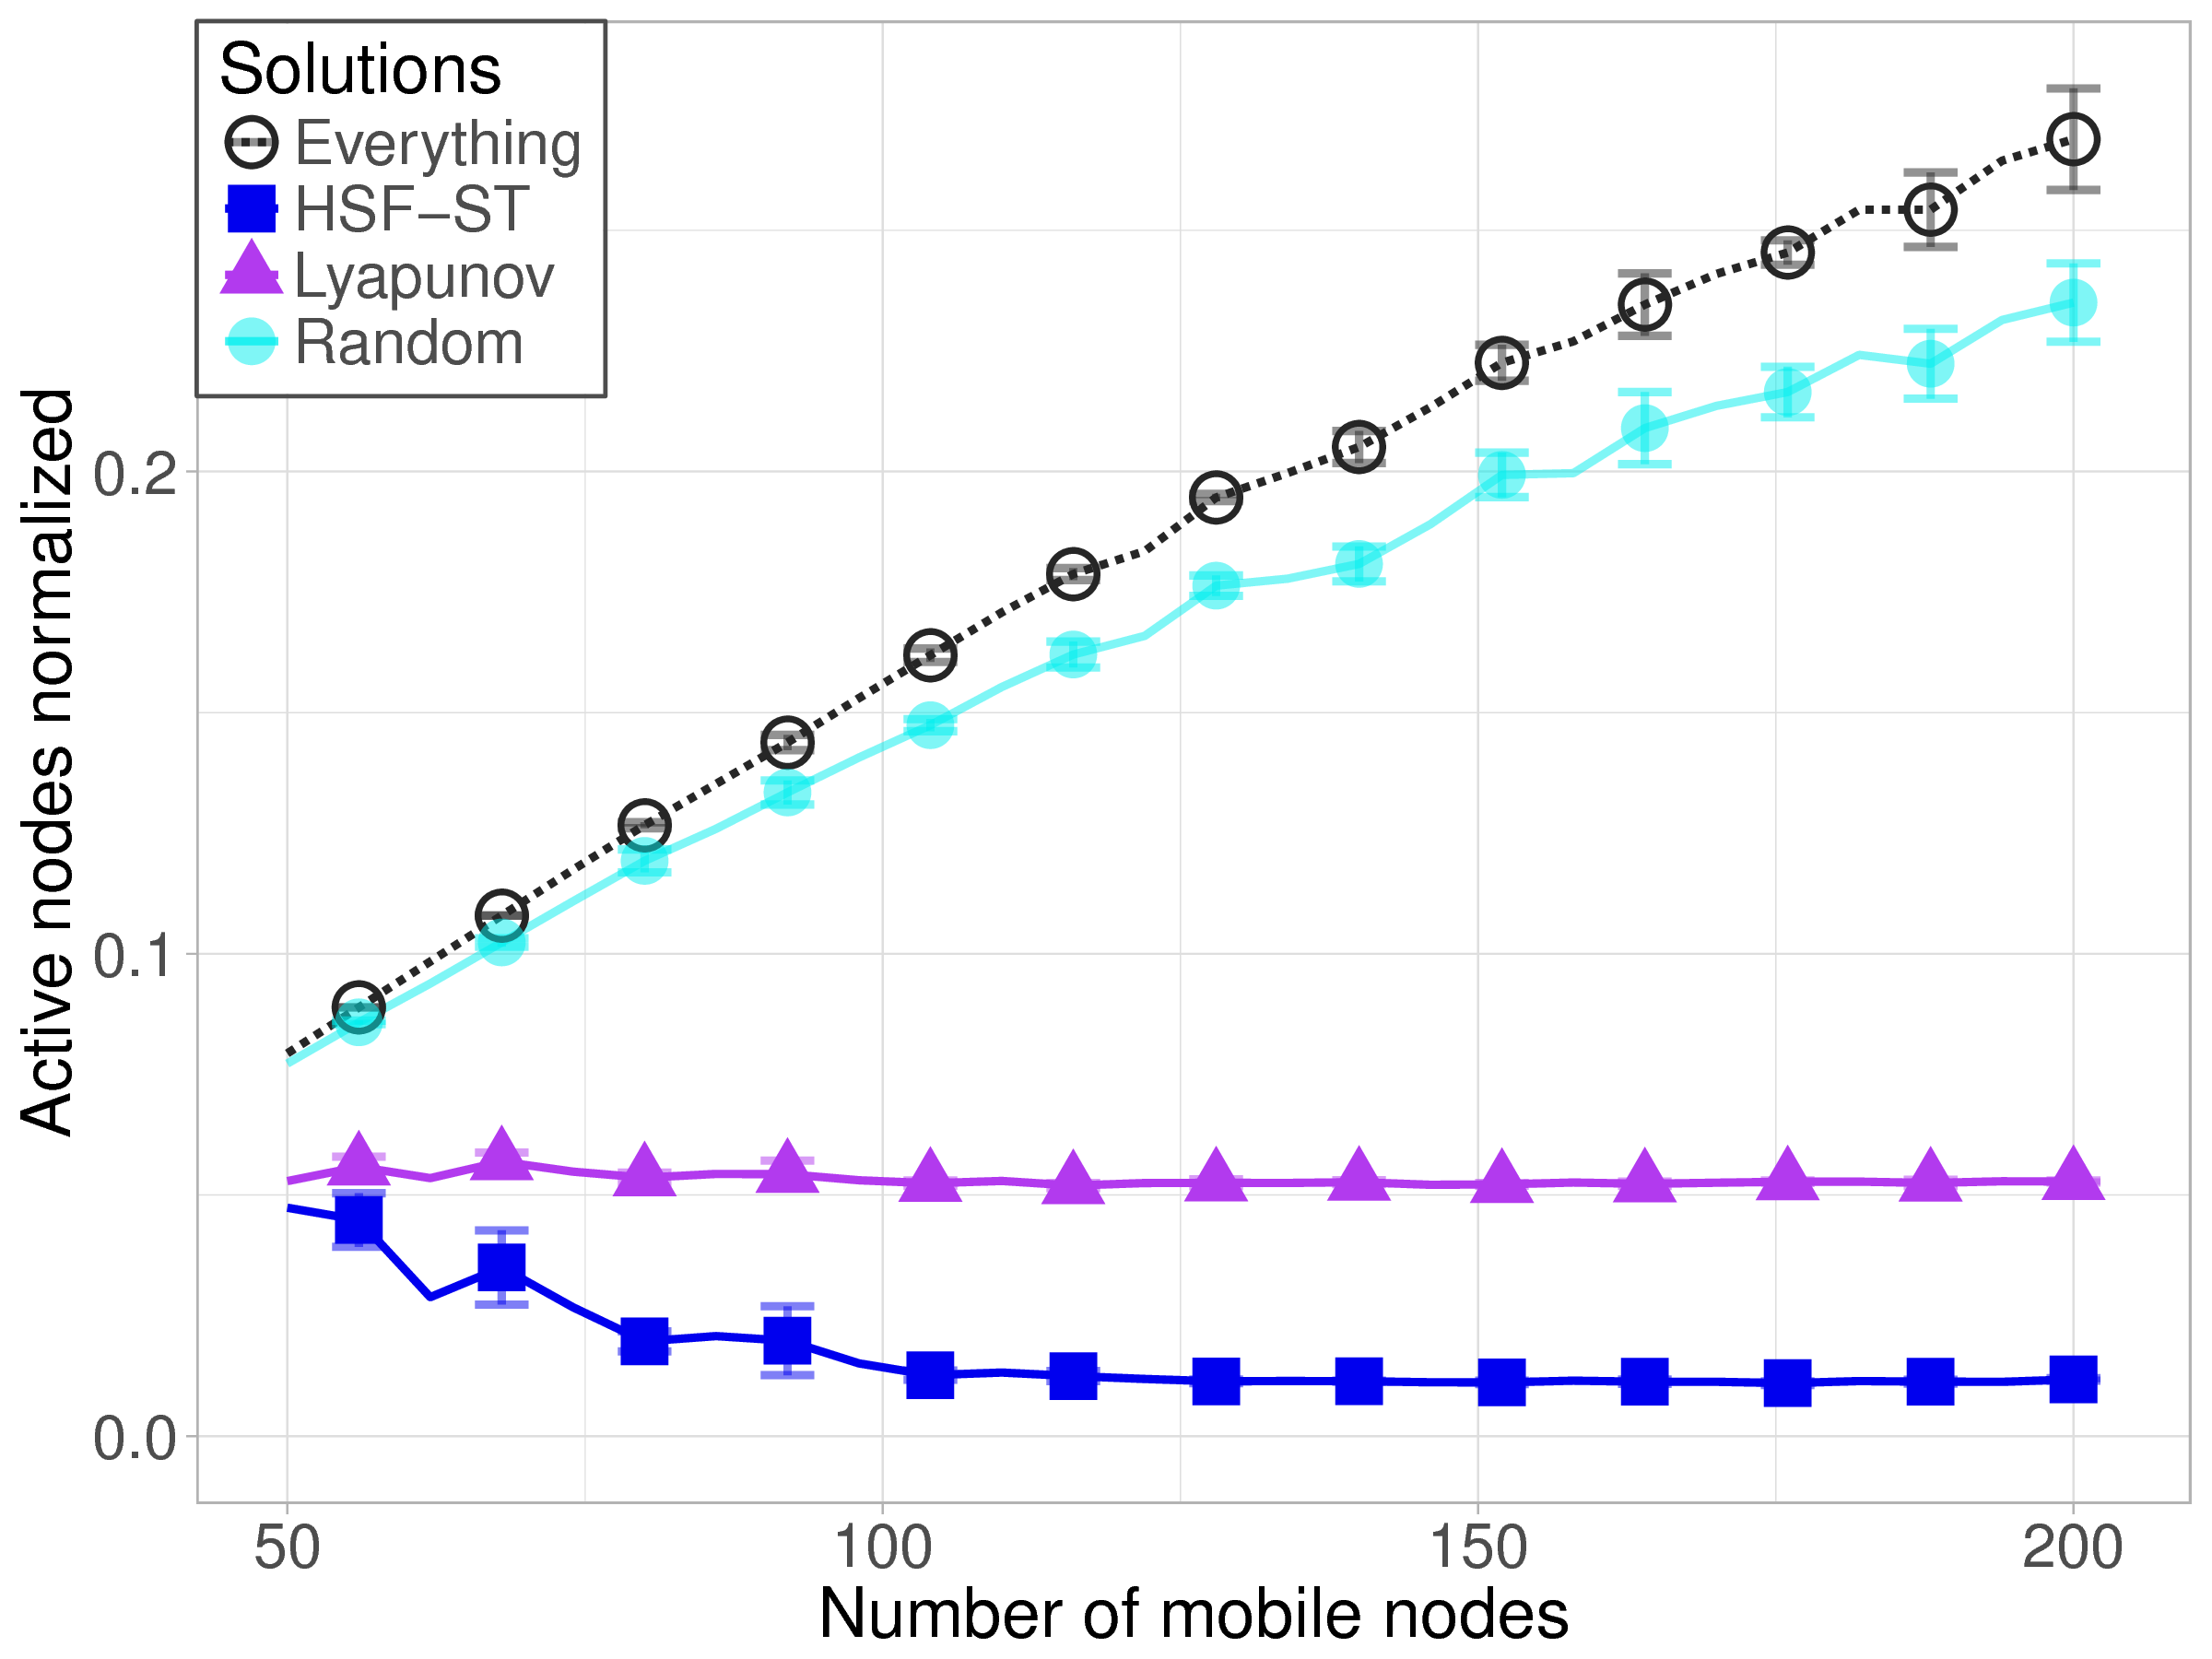
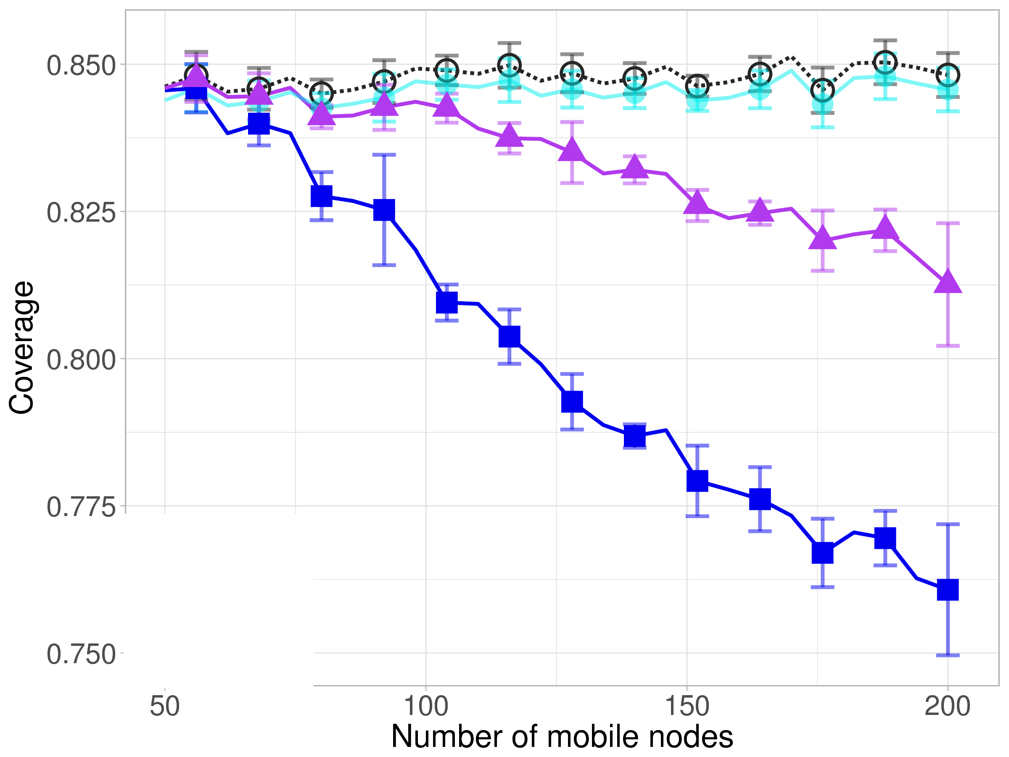
Results: heterogeneity
Sensors are dist. more sparsely (+x)
Device heterogeneity
Fixed total # sensors
All nodes are mobile
# nodes: 50~200
Performance of all algorithms decrease, because there are more nodes to activate (i.e. higher cost).
Our algorithms sacrifice coverage for lower cost and achieve relatively better overall performance as heterogeneity increases.

Slide 25
Data upload planning
Covered in candidacy exam
A mobile sensor/data collector (MDC) is given a path, where there are several sites to fetch data from in-situ sensors, and several access points to upload data.
Plan for data fetched from data sites, which opportunities to use to upload them
Challenges
Network availability
Data heterogeneity
Size/type and priority
Timing requirements
Movement uncertainty
(Community Wi-Fi AP)
(In-situ node)
Notes:
There are several difficulties in solving such a planning problem.
Connectivity: UCI campus is intended to provide students with ubiquitous Internet access, but the reality is not perfect. Wi-Fi coverage is not uniform, resulting in relatively poor coverage is some areas. Avoid poor connectivity.
What is the naïve approach? Upload at the next opportunity.

Slide 26
Two-phase approach
Reconfigure
Developing an optimal and comprehensive plan requires thorough knowledge about the state of the entire system, which is computationally complex and difficult to achieve in real-time.
Static planning phase
Make a comprehensive plan using prior knowledge
Greedy heuristic: Balanced Delay-Opportunity-Priority
Done on the backend server before departure of the MDC
Dynamic adaptation phase
Adjust plan for dynamics in environment and network
Simple policies on the MDC: Lyapunov control strategy

Slide 27
Formulation and solution
Given a list of data chunks (including their size, importance level, deadline, and location), and a list of upload opportunities (including their upload rate and location);
Find a plan, i.e. for each data chunk, which opportunity we should use to upload it, to maximize the weighted overall utility (WOU).
Static planning: Balanced Delay-Opportunity-Priority (BDOP)
Dynamic adaptation: Lyapunov control strategy
Notes:
Time complexity of BDOP: $O\left(MN^{3}\right)$.

Slide 28
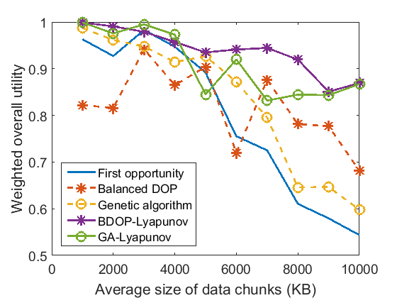
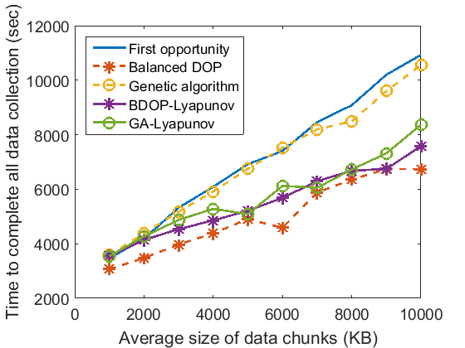
Results
Comparing with the naïve approach
The improvement in WOU was 36-60% for larger chunks.
The reduction in total data collection time was up to 30%.
Q. Zhu, et al. "Data Collection and Upload under Dynamicity in Smart Community Internet-of-Things Deployments". Pervasive and Mobile Computing (2017).
Q. Zhu, et al. "Upload Planning for Mobile Data Collection in Smart Community Internet-of-Things Deployments". in IEEE SMARTCOMP 2016.

Slide 29
Outline
Background and motivation
Community IoT applications and systems
Mobile sensing and computing
Our experience: SCALE and SCALECycle
Data collection challenges in urban environmental sensing
Research problems
Data generation
planning
Data upload
planning
Sensor calibration
planning

Slide 30
Motivation of calibration
Sensors from different vendors have different response to the same phenomenon.
Sensors degrade and drift.
In event detection systems, environmental changes affect accuracy of detection.
Data are not useful if the sensors are inaccurate or inconsistent. Calibration is crucial for sensing and event detection systems.

Slide 31
Our experience
Ambiciti: Crowd participants calibrate microphones are their smartphones at stations.
SCALE: Sensor degrading.
4 pairs of analog sensors
Light – CO (MQ-9)
Explosive gas (MQ-2)
Air contaminant (TGS 2600)
Compare the difference between the sensor readings from each pair in long term.
Notes:
We have learned the need for calibration from both related work and our experience.

Slide 32
Application scenario
Normal operation (e.g. TIPPERS)
Noise (microphones), photos and video streams (cameras), occupancy, energy consumption, etc.
Carbon dioxide, temperature, etc. (SCALE boxes)
Emergency and post-emergency operation (e.g. fire)
Poisonous gas, smoke, temperature, occupancy, etc.
Mobile calibrators carry reference sensors to calibrate low-cost in-situ sensors.
Different types of sensors need to be calibrated differently often (i.e. at different calibration period).
How do we plan the activities of mobile calibrators to achieve acceptable data accuracy and reduce the operational cost?

Slide 33
Calibration procedure
Calibration involves an accurate reference sensor and at least one other uncalibrated sensor that measures the same variable or detects the same phenomenon.
In normal cases, readings $Y$ of the uncalibrated sensor can be corrected using a linear function: $\hat{Y}=kY+c$.
During calibration, we expose the reference sensor and the uncalibrated sensor(s) to the same environment or stimuli, take samples, and solve for coefficients.
Francoise Sailhan, et al. "Opportunistic Multiparty Calibration for Robust Participatory Sensing." In IEEE MASS 2017.
Kaibo Fu, et al. "Multihop calibration for mobile sensing: K-hop Calibratability and reference sensor deployment." IEEE INFOCOM 2017.
Yuzhi Wang, et al. "A Deep Learning Approach for Blind Drift Calibration of Sensor Networks." IEEE Sensors Journal (2017).
Olga Saukh, et al. "Reducing multi-hop calibration errors in large-scale mobile sensor networks." In IPSN 2015.
Ronen Vaisenberg, et al. "Exploiting semantics for sensor re-calibration in event detection systems." In SPIE 2008.
Emiliano Miluzzo, et al. "CaliBree: A self-calibration system for mobile sensor networks." IEEE DCOSS 2008.
Multi-party calibration
Multi-hop calibration

Slide 34
Sensor calibration planning
Sensor calibration is carried out in iterations (i.e. batches).
Given a long maintenance period (e.g. a few years) and the calibration requirements of the sensors, find the plan: the number of iterations and the time at which each iteration takes place; for each iteration, the sensors that will be calibrated and the number and path(s) of mobile calibrators.
Maintenance Period
Find number and time of iterations
Iteration
Time to Next Iteration
Some Sensor(s) Need Cali. Again
For each iteration
Select a set of sensors and find the number and path(s) of calibrator(s)

Slide 35
Sensors Needing Cali. This Iter.
Must Select
Paths of 2 Calibrators
Other Selected Sensors Seeking Lower Avg. Cost
Depot
Example Spot
3 Nodes
4 Sensors Each
At each spot with selected sensors(s)
Multi-party multi-hop calibration

Slide 36
Terms and notations
Maintenance Period $T$
Find number $Ω$ and time $t_{ω}$ of iterations
Iteration $ω=2$
$ω=1$ $ω=2$ $…$ $ω=Ω$
$$C_{it}$$
$$C_{it}$$
$$C_{it}$$
$$C_{it}$$
Given a long maintenance period $T$, we plan the number of iterations $Ω$, and the time that each iteration $ω=1,2,…,Ω$ takes place.
We assume that each iteration is associated with:
A fixed cost, called the iteration overhead $C_{it}$;
The cost that depends on the amount of work.

Slide 37
Sensor types and presence
Node $n_{j}$,
$$j=1,…,N$$
Sensor type $s_{k}$, $k=1,…,K$
s₁
s₂
s₃
s₄
s₅
s₆
s₇
s₈
n₁
1 | 1 | 1 | 1 | 1 | 0 | 0 | 0
1 | 1 | 1 | 1 | 1 | 1 | 1 | 1
0 | 1 | 0 | 1 | 0 | 1 | 1 | 0
1 | 1 | 1 | 1 | 0 | 1 | 0 | 1
0 | 0 | 1 | 1 | 1 | 0 | 0 | 1
n₂
n₃
n₄
n₅
Sensor presence matrix $Q_{N×K}$, $Q_{j,k}=1$ if $n_{j}$ has $s_{k}$

Slide 38
Calibration time and period
Each sensor of type $s_{k}$ is associated with a calibration time $τ_{k}$, i.e. how long does it take to calibrate a sensor of this type; and a calibration period $T_{k}$, i.e. how often a sensor of this type needs to be calibrated. For example –
Each individual sensor $\left(j,k\right)$ is associated with a time to next calibration (TTNC) $F_{j,k}$ at any time instant. If the TTNC of $\left(j,k\right)$ drops to 0, an iteration must be carried out to ensure its acceptable accuracy. After calibration, the TTNC changes back to the calibration period $T_{k}$ of sensor type $s_{k}$.
 | $$s_{1}$$ | $$s_{2}$$ | $$s_{3}$$ | $$s_{4}$$ | $$s_{5}$$ | $$s_{6}$$ | $$s_{7}$$ | $$s_{8}$$
$τ_{k}$ / min | 20 | 20 | 30 | 1 | 5 | 20 | 15 | 20
$T_{k}$ / day | 60 | 28 | 16 | 90 | 7 | 45 | 45 | 10

Slide 39
TTNC and TTNI
Next iteration $ω$ must take place in $\min{F\left[{\left(ω−1\right)}_{+}\right]}$ days, which
is the time to next iteration (TTNI)
Assume this $$F\left[{\left(ω−1\right)}_{+}\right]$$
s₁
s₂
s₃
s₄
s₅
s₆
s₇
s₈
n₁
10 | 14 | 6 | 6 | 5 | +∞ | +∞ | +∞
60 | 28 | 15 | 90 | 7 | 45 | 45 | 10
+∞ | 11 | +∞ | 45 | +∞ | 5 | 5 | +∞
18 | 14 | 8 | 48 | +∞ | 8 | +∞ | 8
+∞ | +∞ | 16 | 76 | 5 | +∞ | +∞ | 8
n₂
n₃
n₄
n₅
TTNC matrix $F_{N×K}$, $F_{j,k}\left[ω_{±}\right]$ is the TTNC of $\left(j,k\right)$ before/after $ω$

Slide 40
TTNC and TTNI (cont.)
This is $$F\left[ω_{−}\right]$$
$$F\left[ω_{−}\right]=F\left[{\left(ω−1\right)}_{+}\right]−\min{F\left[{\left(ω−1\right)}_{+}\right]}$$
s₁
s₂
s₃
s₄
s₅
s₆
s₇
s₈
n₁
5 | 9 | 1 | 1 | 0 | +∞ | +∞ | +∞
55 | 23 | 10 | 85 | 2 | 40 | 40 | 5
+∞ | 6 | +∞ | 40 | +∞ | 0 | 0 | +∞
13 | 9 | 3 | 43 | +∞ | 3 | +∞ | 3
+∞ | +∞ | 11 | 71 | 0 | +∞ | +∞ | 3
n₂
n₃
n₄
n₅

Slide 41
Sensor selection
$F_{j,k}\left[ω_{−}\right]$
$Γ_{j,k}\left[ω\right]$
s₁
s₂
s₃
s₄
s₅
s₆
s₇
s₈
n₁
5 1 | 9 1 | 1 1 | 1 1 | 0 1 | +∞ 0 | +∞ 0 | +∞ 0
55 0 | 23 0 | 10 0 | 85 0 | 2 0 | 40 0 | 40 0 | 5 0
+∞ 0 | 6 1 | +∞ 0 | 40 1 | +∞ 0 | 0 1 | 0 1 | +∞ 0
13 0 | 9 0 | 3 1 | 43 1 | +∞ 0 | 3 0 | +∞ 0 | 3 1
+∞ 0 | +∞ 0 | 11 1 | 71 1 | 0 1 | +∞ 0 | +∞ 0 | 3 1
n₂
n₃
n₄
n₅
Sensor selection matrix $Γ_{N×K}$, $Γ_{j,k}\left[ω\right]=1$ if $\left(j,k\right)$ is selected

Slide 42
Community/building map
Location matrix $D_{N×L}$
$D_{j,l}=1$ if in-situ node $n_{j}$ is deployed at spot $ν_{l}$
Spot $ν_{l}$, $l=1,…,L$
Each node can only be deployed at one spot, but it is okay to have multiple nodes deployed at the same spot.
Movement time is the same for all mobile calibrators.
Matrix $G_{L×L}$
$G_{l_{1},l_{2}}$ is the shortest movement time from $ν_{l_{1}}$ to $ν_{l_{2}}$

Slide 43
Paths of mobile calibrators
Paths are represented in 3-dimensional matrix $W_{L×L×M}$, where $M$ is the number of mobile calibrators.
$W_{l_{1},l_{2},i}\left[ω\right]=1$ if calibrator $m_{i}$ visits spot $ν_{l_{2}}$ immediately after visiting spot $ν_{l_{1}}$.
No mobile calibrator should work for longer than $\hat{c}$ time, this includes movement time and calibration time.
We have enough mobile calibrators.
Each “selected spot” is visited exactly once by only one mobile calibrator.
No node is deployed at the depot.
Depot $ν_{1}$, where all mobile calibrators start

Slide 44
Definition of cost
Three major types of cost
Iteration overhead $C_{it}$
Movement cost $C_{w}\left(W\right)$
Calibration cost $C_{c}\left(Γ,W\right)$
The iteration overhead $C_{it}$ is a constant that is the same for every iteration.
The movement cost is derived from the total movement time of the paths of mobile calibrators.
$C_{w,i}\left[ω\right]=\sum_{l_{1}=1}^{L}{\sum_{l_{2}=1}^{L}{\left(W_{l_{1},l_{2},i}\left[ω\right]⋅G_{l_{1},l_{2}}\right)}}$,
$C_{w}\left[ω\right]=\sum_{i=1}^{M}{C_{w,i}\left[ω\right]}$.
The total cost $C$ is the weighted sum of them, i.e.
$C\left(Γ,W\right)=$ $μ_{0}⋅C_{it}+μ_{w}⋅C_{w}+μ_{c}⋅C_{c}$ .

Slide 45
Calibration cost
Multi-party multi-hop calibration helps to save time when calibrating sensors at the same spot.
n₄
n₅
$n_{4}$ and $n_{5}$ are both deployed at spot $ν_{l}$
Calibration time $Υ_{l}$ at $v_{l}$

Slide 46
Calibration cost (cont.)
Calibration cost of an individual mobile calibrator $m_{i}$
$$C_{c,i}\left[ω\right]=\sum_{l=1}^{L}{\left(\max_{j,k}\left(D_{j,l}⋅Γ_{j,k}\left[ω\right]⋅τ_{k}\right)⋅\sum_{l^{′}=1}^{L}{W_{l,l^{′},i}\left[ω\right]}\right)}$$
Total calibration cost of all mobile calibrators
$$C_{c,i}\left[ω\right]=\sum_{l=1}^{L}{\max_{j,k}\left(D_{j,l}⋅Γ_{j,k}\left[ω\right]⋅τ_{k}\right)}$$

Slide 47
Formulation
Given the maintenance period $T$, map $G$, deployment location matrix $D$, sensor presence matrix $Q$, calibration time $τ_{k}$, calibration period $T_{k}$ (for each sensor type $s_{k}$), and initial TTNC $F\left[1_{−}\right]$;
Find the number of iterations $Ω$, the time $t_{ω}$ that they take place, the sensors selection plan $Γ\left[ω\right]$ and paths of mobile calibrators $W[ω]$ for each iteration $ω$.
$$\min{\frac{1}{T}⋅\sum_{ω=1}^{Ω}{C\left(Γ\left[ω\right],W\left[ω\right]\right)}}$$
Subject to constraints: Only select present sensors, non-negative TTNC, all spots with selected sensors are visited, maximum workload, etc.

Slide 48
Total cost depends on
sensor selection and calibrator paths
Given –
$T$, $G$, $D$, $Q$,
$τ_{k}$, $T_{k}$, $F\left[1_{−}\right]$
Find –
$Ω$, $t_{ω}$,
$Γ\left[ω\right]$, $W\left[ω\right]$
Do not select an absent sensor
TTNC transition
TTNI definition
Maintenance period fully covered
Selected spots
All selected spots are visited
Individual workload limit

Slide 49
Two-phase iterative approach
$$ω=1$$
$$ω=2$$
Overhead $C_{it}$
Int. min F[1₊]
Interval 2
$$F\left[1_{−}\right]$$
$$F\left[1_{+}\right]$$
$$F\left[2_{−}\right]$$
Selection planning
Selection $Γ\left[1\right]$
Calibration $C_{c}\left[1\right]$
Multi-path planning
Paths $W\left[1\right]$
$$\frac{C_{it}+C_{c}\left[ω\right]+C_{w}\left[ω\right]}{\min{F\left[1_{+}\right]}}$$
Movement $C_{w}\left[1\right]$

Slide 50
TTNI-driven sensor selection
We are here
Different selections $Γ$
Minimize the movement and calibration cost for each TTNI
Select all sensors that must be calibrated to meet it;
Select all sensors that can be calibrated without extra cost (i.e. sensors at the same spots with the already selected ones).
The more we select, the longer we can wait before the next iteration.
Notes:
Time complexity: $O\left(N^{2}K^{2}+N^{2}KL\right)$.
There are $O\left(NK\right)$ worst-case possible values of TTNI. For each of them, computing selection takes $O\left(NK+NL\right)$.
Time to evaluation the movement cost is excluded.

Slide 51
TTNI-driven sensor selection (cont.)

Slide 52
Multi-path planning phase
Given –
$G$, $D$, $Γ\left[ω\right]$,
$τ_{k}$, $T_{k}$
Total movement time
Do not loop locally
Find –
$W\left[ω\right]$
Every calibrator starts at depot
In = out
Visit selected spots
Sub-tour elimination constraints

Slide 53
Nearest-neighbor-based MPP
Modified from the corresponding greedy algorithm for TSP.
Start with a set of empty paths (i.e. all the calibrators stay at the depot) and the set of all selected spots $H$.
At each step, for every unvisited spot, compute the extra travel and calibration time yield by adding it to the end of the path of each mobile calibrator as long as the calibrator is not overloaded. Pick the spot-calibrator pair that induces the least additional movement time. Note that the spot could be added to an old calibrator or a new calibrator.
Loop until all the spots are visited.

Slide 54
Improved GA for MPP
Chromosome: An integer vector that is made of two parts: a permutation of all the selected spots (1st half) and an assignment mapping the spots to calibrators (2nd half).
$$\left[\underline{2, 4},\underline{5, 6, 3},2, 3, 0, 0, 0\right]$$
Fitness: The negative of the total movement time of all the mobile calibrators. Selection: Standard scaled-fitness proportional selection.
Initial population: Uniformly random permutation and uniformly random subtraction assignment.
Crossover: Standard order crossover on the permutation half.
Mutation: (a) two-point swap; (b) segment reversal; (c) 3-opt local optimization (for directed graph); (d) merge of 2 paths.
Auxiliary functions: (a) compress; (b) split; (c) merge.

Slide 55
Evaluation setup
Indoor map data set
DBH floorplan
Outdoor map data set
A city district in Paris

Slide 56
Evaluation setup (cont.)
Input data |  |  | Indoor |  | Outdoor
 |  |  | Normal | Emergency
Map | $$L$$ | Number of spots | 60 |  | 63
 | $$G$$ | Pairwise traveling time | ≤ 53 sec |  | ≤ 73 min
Sensors | $$K$$ | Number of types | 10 |  | 8
 | $$τ_{k}$$ | Calibration time | 1~30 min |  | 0.25~1 min
 | $$T_{k}$$ | Calibration period | 14~91 days | 7~91 days | 28~123 days
Nodes | $$N$$ | Number of nodes | 100 (varies if used as independent variable)
 | $$Q$$ | Sensor presence | 50 (varies if used as independent variable)
User req. | $$\hat{c}$$ | Workload limit | 2 hours |  | 4 hours
 | $$μ$$ | Coefficients | $C_{it}=10000$, $μ_{0}=1$, $μ_{w}=5$, $μ_{c}=1$
 | $$T$$ | Maintenance period | 360 days

Slide 57
Compared algorithms
Sensor selectors
All/Minimal: Naïve
Local: Minimal, adding all sensors at selected spots
Local bounded: Similar to “local” but only adding sensors with shorter calibration time
TTNI-driven (proposed)
Metrics: Average cost, running time, average TTNI.
Multi-path planners
Each: Each selected spot gets a distinct calibrator
GLPK/Gurobi: MIP solver
Nearest-neighbor greedy
Improved GA (proposed)
Metrics: Traveling time, running time, # calibrators.

Slide 58
Results (indoor)
Average cost:
$\min{\frac{1}{T}⋅\sum_{ω=1}^{Ω}{C\left(Γ\left[ω\right],W\left[ω\right]\right)}}$.
Indoor setup
Impact of number of nodes $N$
${\sum{Q}}/{\left(N⋅K\right) }=0.5$
GA is used for multi-path planning in all tests.
Lower average cost
Sometimes do more work for better TTNI
Slower for more nodes

Slide 59
Results (outdoor)
Outdoor setup
Longer dist. between spots
Impact of number of nodes $N$
Impact of number of sensors
$N=100$
Higher movement cost
Local-bounded performs worse because it considers movement cost (space) but not TTNC (time)

Slide 60
Results (impact of # sensors)
Indoor setup
Impact of number of sensors, $N=100$
Comparing with an emergency (after fire) scenario, where some types of sensors need to be calibrated more often.
Our approach perform well and stable in both sets.
Normal
After fire

Slide 61
Results (path planning)
Synthetic setup
Impact of number of spots $L$
Acceptable performance (close to optimal for smaller problems) and shorter running time.

Slide 62
Towards a usable system

Slide 63
Future work
A systematical study on the degradation of common sensor types.
Comparison with real-world accurate sensors (collaboration with AirUCI, potentially a course project)
Long-term studies with an end-to-end system.
Planner as a service
Smartphone navigation app (work in progress)
A model that includes system/device dynamicity and the design of a new set of solutions and simulations.
Q. Zhu, et al. "Multi-Sensor Calibration Planning in IoT-Enabled Smart Spaces". in IEEE ICDCS 2019. (Camera-ready)

Slide 64
Contributions of this thesis
Deployment planning – Registration – Compression – Path planning – Analysis
Data generation
planning
Sensor calibration
planning
– Load balancing – Crowd incentive –
– Muling – Protocol – Mobile cloud –
Data upload
planning
Probabilistic broadcasting – Clustering – Caching – Routing – Swarm planning
Notes:
Therefore, planning is the key.
We propose to intelligently plan the activities of devices to make the system operate as a whole.
There are many aspect and stages that could be planned.
In this thesis, we consider three major phases: data generation, data upload, and sensor calibration (or maintenance).

Slide 65
Contributions of this thesis
The scheme that combines in-situ deployments and mobile devices and leverages the mobility to enhance the community IoT systems using intelligent planning.
SCALECycle mobile sensing platform and measurement study.
Approaches and algorithms that achieve
Spatiotemporal sensing coverage in community with bounded data traffic
Timely delivery of high-priority data using mobile data collectors and community wireless networks
Cost-efficient joint calibration of low-cost in-situ sensors
Performance evaluation driven by real-world measurements.

Slide 66
Future work
Data generation planning
A scheduling hierarchy that allows us to offload work to edge servers and devices.
A study on the impact of network connectivity uncertainties.
A model that allows prioritization of cells and time frames, useful in emergencies.
Data upload planning
The joint data upload planning of multiple MDCs.
A detour planning model and framework.
A comprehensive multi-network model for the management of heterogeneous networks.

Slide 67
Future work (cont.)
Systems that could be potentially integrated
Smart traffic systems;
Vehicular networks and vehicle-to-infrastructure communication;
Smart systems on city infrastructure;
Autonomous vehicles and drones.
Work in progress at DSM
Leveraging public transportation systems in data collection;
Leveraging drones for extended sensing coverage and space modeling.

Slide 68
Questions?

Slide 69
Acknowledgement
Advisor: Nalini Venkatasubramanian
Fellowship/grants: Donald Bren School of ICS, NSF, NIST
Co-authors: Md Yusuf Sarwar Uddin, Zhijing Qin, Cheng-Hsin Hsu, Chao-Wen Chen, Valerie Issarny, Francoise Sailhan
SCALE team: Kyle Benson, Guoxi Wang, Daniel Hoffman
Committee: Nikil Dutt, Marco Levorato, Sharad Mehrotra
DSM group: Qing Han, Fangqi Liu, Hang Nguyen, Praveen Venkateswaran, Nailah Alhassoun
Information Systems Group
My friends and family

Slide 70
Exploiting Mobile Plus In-Situ Deployments in Community IoT Systems
Thank you!
Committee (sorted by last name)
Nikil Dutt
Marco Levorato
Sharad Mehrotra
Nalini Venkatasubramanian (Chair)

